Slide 1


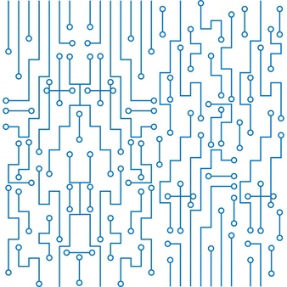

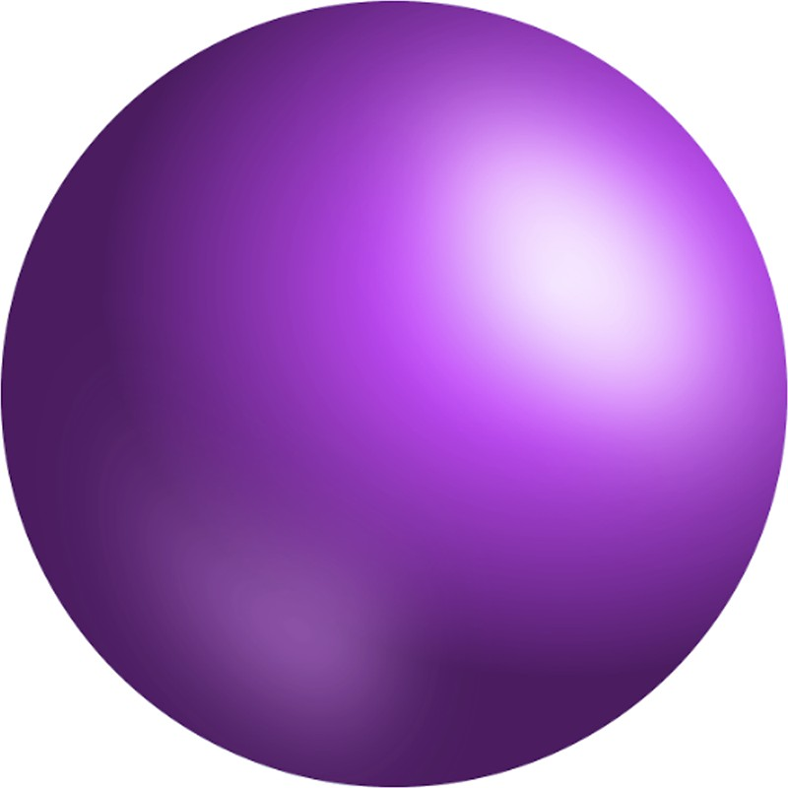

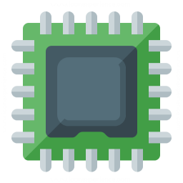


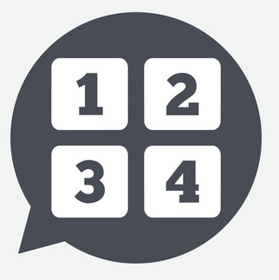

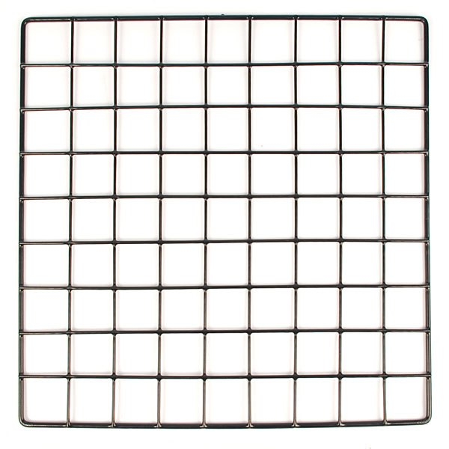




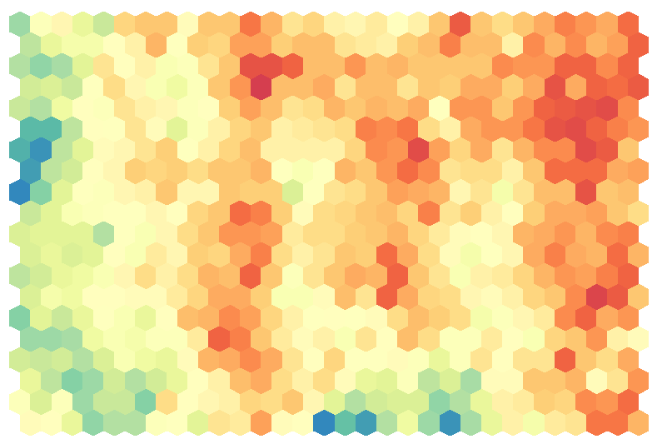


Digit Recognizer (Kaggle Data)
MNIST ("Modified National Institute of Standards and Technology") is the de facto “hello world” dataset of computer vision. Since its release in 1999, this classic dataset of handwritten images has served as the basis for benchmarking classification algorithms. As new machine learning techniques emerge, MNIST remains a reliable resource for researchers and learners alike. In this competition, the goal is to correctly identify digits from a dataset of tens of thousands of handwritten images.
CNN Architecture (Built Using keras - Tensorforflow backend)
MNIST Image
(N X 28 X 28 X 1)
Convolution Layer
32 filters|RELU|Filter Size (5,5)|
Output: (N X 28 X 28 X 32)
Max Pooling
Pool Size (2,2)|
Output: (N X 14 X 14 X 32)
Convolution Layer
64 filters|RELU|Filter Size (3,3)|
Output: (N X 28 X 28 X 64)
Max Pooling
Pool Size (2,2)|
Output: (N X 7 X 7 X 64)
Flatten
(3136N X 1)
Hidden Layer
(128 units | RELU)
Output Layer
(10 units | Softmax)
Data AUGMENTATION
Model Performance
Data augmentation is essential as it helps “generate” data when you have limited data to begin with. It helps reduce overfitting and tries to teach the model that images can be rotated, zoomed and translated. This generalizes the model and improves its performance in real world.
Model Accuracy
Model Loss
It can be noted that there is slight overfitting as the validation accuracy is slightly lower than the training accuracy.
The final accuracy obtained on unseen data(Kaggle) is:
99.01%
How Do Convolutional neural networks work?
IMAGE INPUT
MNIST images are 2D data with pixels as rows and columns.
CONVOLUTION FILTERS
Filters are used to detect patterns in the image. This helps find the feature anywhere in the image. Optimum filters are created by the algorithm.
FEATURE MAPS
Filters create feature maps which can be used to identify where the feature appeared in the image. For every filter, there will be a feature map.
MAX POOLING
Pooling is done to approximate the position of the feature. The benefits include reduced inputs, regularization against overfitting and noise filtering.
FLATTENED INPUT TO ANN
Flatten the pixels from the maps and send the inputs to a fully connected ANN. Every extracted feature gets to vote towards the final probability of the digit.

