Slide 1


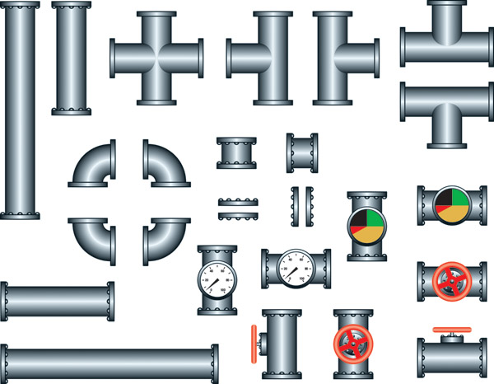

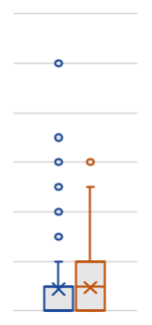
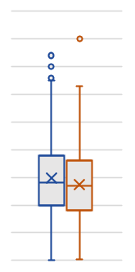

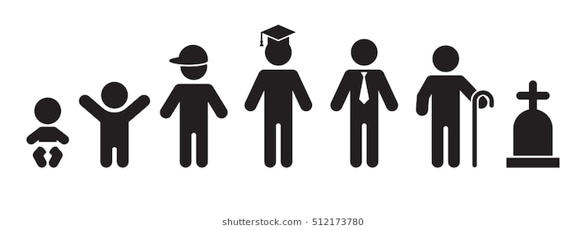
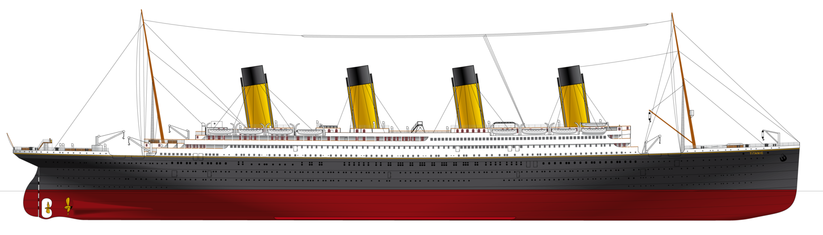


Titanic – Machine Learning from Disaster
Using machine learning techniques, we are predicting which passengers were more likely to survive the tragedy. Although there was some element of luck involved in surviving the sinking, some groups of people were more likely to survive than others, such as women, children, and the upper-class.
The sinking of the RMS Titanic is one of the most infamous shipwrecks in history. On April 15, 1912, during her maiden voyage, the Titanic sank after colliding with an iceberg, killing 1502 out of 2224 passengers and crew. This sensational tragedy shocked the international community and led to better safety regulations for ships.
Did Survival Depend On Passenger Gender?
Machine Learning Pipeline
Did Survival Depend On Passenger Class?
Data Ingestion
Kaggle Dataset
Missing Value Treatment
Treated missing values of Age using Predictive Mean Matching method in the MICE package
68% Survivors comprised of females while 85% Non-Survivors comprised of males
Exploratory Data Analysis
Check the relationship of the dependent variable to the features
40% Survivors comprised of upper class while 67% Non-Survivors comprised of lower class
Feature Selection
Selected Pclass, Gender, Age and Family based on Stepwise Regression
Did Survival Depend On Passenger Age?
Did Survival Depend On Family Size?
Model Building
Built an ensemble model taking inputs from 5 classification models namely –Random Forest, KNN, SVM, Logistic Regression and LDA
0
0
Model Evaluation
Used 10-fold cross validation to evaluate model performance
1
1
0
20
40
60
80
0
2
4
6
8
10
Average age of Survivors was 27 as compared to the average age of 30 of Non-Survivors
Median family size of Survivors was 1 compared to the median family size of 0 of Non-Survivors
Model Performance
77.5%
Created by Santosh Selvaraj

