Slide 1
Electronic Systems Design Methodology
Santosh S Malagi - v01

Slide 2

Electronic Systems Design Methodology © 2024 by Santosh S Malagi is licensed under CC BY-SA 4.0. To view a copy of this license, visit http://creativecommons.org/licenses/by-sa/4.0/

Slide 3
Contents
Motivation
Electronic Systems – an Overview
Electronic Systems Design
Standard Cell-Based ASIC Design
FPGA based Design
Analog VLSI Design
Mixed-Signal VLSI Design
Executing Design Methodologies using EDA tools
Summary
References and More Resources

Slide 4
motivation
Who? What? and Why?

Slide 5
What?
Economics of Electronic Systems Design (ESD)
Understand various market players - EDA/IP, fabless, fablite, foundry etc.
Introduction to basics of Electronics Systems Design Methodology
VLSI design methodologies – Digital, Analog and Mixed-Signal
Various EDA tools involved in the design process
‘Hardware-Software Co-design’ using ‘Platform SoCs’ or ‘MpSoC’s’
What is NOT covered?
Transistors, semiconductor physics etc. deliberately left out to focus on higher levels of abstraction
Memory design will be included in future revisions
Analog design (the presenter is a ‘Software Engineer’ who writes C++ but knows a bit of DFT/ATPG) ☺
Advanced topics in Physical Design and Implementation – beyond author’s level of expertise

Slide 6
Why?
‘Software Engineers’ interested to learn more about VLSI and chip design flow
Many want to learn about different EDA tools and how they fit in the overall design flow
Stuff you don’t learn in EE/ECE/CE curriculum but are expected to pick up on your own
Clarify basic terminology and three-four letter acronyms - VLSI, ASIC, ASSP, SoC etc.
Provide pointers and useful references for those looking for more
Collection of ‘Personal Notes’ and ‘Illustrations’ attempts to cover the following topics:
Electronic Systems Design Methodology
EDA Software
VLSI Test Engineering
The depth of material is akin to a ‘motivational’ or ‘101’ lecture given in relevant EE/CE courses
Limited to my knowledge and experience gained in the past 4.5 years

Slide 7
Electronics Systems – an overview
Integrated Circuits (IC), economic impact and the design ecosystem

Slide 8
Preliminaries
Integrated Circuit (IC) – electronic circuit fabricated on a single piece of semiconductor material
Wafer – extremely thin circular disk of semiconductor material used to fabricate multiple ICs
Die – individual IC ‘sliced’ from a wafer, ‘naked die’ before packaging
Chip (aka microchip) – an IC which is hermitically sealed/packaged
Printed Circuit Board (PCB) – polysilicon material used to interconnect and hold together several chips to form an ‘Electronic System’

Slide 9
Electronic Systems Evolution
Platform SoC
Software
Clock
Chip 1
RAM
PLL
Function Specific Logic
Memory
Interface
DSP
Chip 2
DSP
ROM
GPU
Bus architecture
µP
Memory
ASIC
µP
µP
RF Modem
Core
DAC
ADC
ASIC
DAC
ADC
System on Chip (SoC)
Printed Circuit Board with multiple ICs

Slide 10
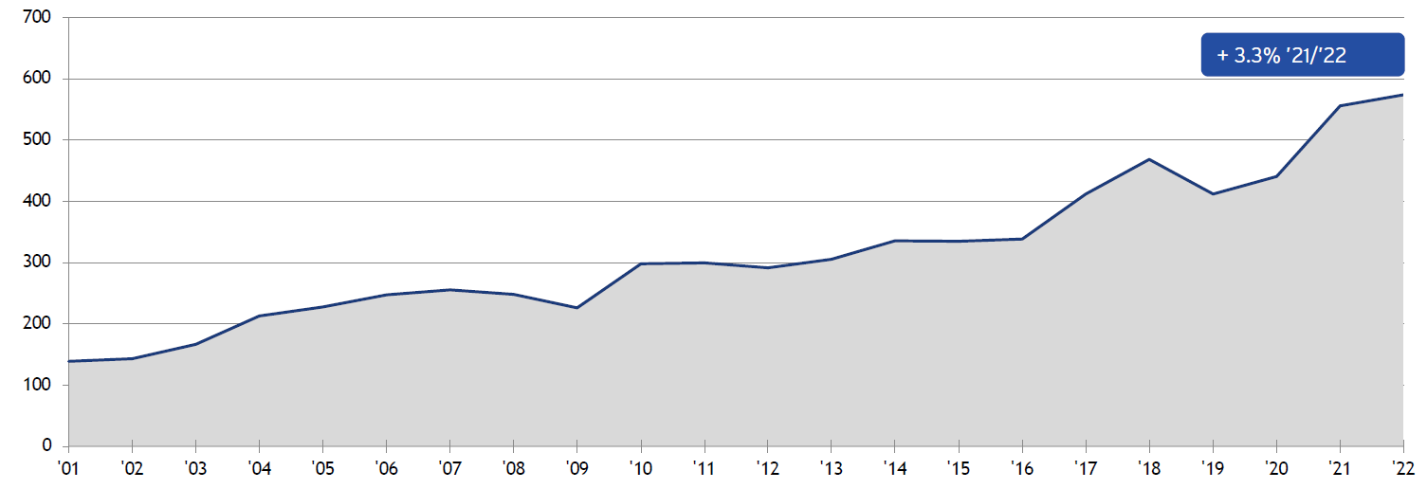
Global Electronic Systems Market – by Numbers
Global Electronics Sales in billion USD
Electronics is a major contributor to the world GDP, enabler of the modern ‘digital economy’
Annual growth rate of 6.67%, sales increased from $139.0 billion in 2001 to $574.0 billion in 2022
Significant R&D investment, requires skilled labor and value creation through ‘product differentiation’
Reference – Semiconductor Industry Association (SIA) Factbook 2023

Slide 11
End Markets for Electronic Systems
Electronic Systems – Application Areas:
Computing
Cloud and distributed systems, PC, office equipment, tablet PCs etc.
Communications
Wired/Wireless devices, routers, switches, networking, telecommunication infrastructure etc.
Automotive
ECU, infotainment, power train, safety, ADAS etc.
Consumer
All kinds of consumer appliances – smart TVs, digital cameras, smartphones, medical devices etc.
Industrial
Industrial automation and robotics, manufacturing, monitoring, surveillance, etc.
Government
Defense, aerospace etc.
Reference – 2022 State of the US Semiconductor Industry Report - SIA

Slide 12
Who are the Market Players?
Electronic Design Automation/IP Vendors - software tools, virtual components, IP blocks etc.
Fabless companies - design chips, outsource manufacturing/packaging/test to foundry/OSATs
Integrated Device Manufacturer (IDM) – design and fabricate chips in house
Fablite companies - outsource standard wafer processing, retain specialized manufacturing
Foundry - wafer processing, chip fabrication, heterogenous integration etc.
Equipment – design and manufacture technology for chip fabrication, packaging, test etc.
Outsourced Semiconductor Assembly and Test (OSAT) and Contract Manufacturers
Materials Providers – semiconductor materials, chemicals for chip fabrication, packaging etc.
More….

Slide 13
Integrated Circuits – Digital, Analog, and Mixed-Signal
Digital
Mixed-Signal
Analog
Logic
General purpose
Microprocessor (CPU)
Graphics Processing Unit (GPU)
Microcontroller (MCU)
Field Programmable Logic (FPL)
Memory
Volatile – SRAM and DRAM
Non-volatile – ROM, Flash etc.
Analog to Digital Converters (ADC)
Digital to Analog Converters (DAC)
Digital Signal Processors (DSP)
Delta-Sigma Modulators
Error Detection/Correction ICs
Single-stage Amplifiers
Differential Amplifiers
Operational Amplifiers (OpAmps)
Power Amplifiers
Comparators
Radio Frequency Integrated Circuits (RFIC)
Phase Locked Loops (PLLs)
Others
Micro-Electro Mechanical Systems (MEMS)
Sensors
Actuators
Photonic/Optoelectronic ICs
Emerging Technologies
Digital ICs - operate on discrete logic high ‘1’ or logic low ‘0’ signal levels
Analog ICs – operate on continuous time varying signals between two levels
Mixed Signal ICs – operate on both digital and analog signals, often convert between the two (DAC, ADC)

Slide 14
Integrated Circuits – Market’s Perspective
General Purpose IC
Generic functionality, IC sold in huge quantities e.g., 74xx, 555, RAM, ROM etc.
Application Specific Integrated Circuit (ASIC)
IC designed for a specific purpose/application area
Application Specific Standard Product (ASSP)
IC designed and optimized for a specific purpose, sold to numerous customers
E.g., Qualcomm sells Snapdragon processors to Samsung, MediaTek, Lenovo etc.
User Specific Integrated Circuit (USIC)
IC designed and optimized by a company for its specific use case, product differentiation
E.g., Apple designs ‘Apple Silicon’ for use ONLY in Apple products
What is a System on Chip (SoC)?
A SoC is an ASIC which integrates a complete computing system on a single chip (SiP – System on Package). Most often an SoC includes a Central Processing Unit (CPU), Graphics Processing Unit (GPU), embedded memory (SRAM), RF modem, sensors, I/O interfaces along side specialized hardware e.g., hardware accelerators on a single substrate or microchip.
*All SoCs are ASICs, but all ASICs need not be SoC’s!

Slide 15
System on Chip (SoC)
Platform SoC
A SoC combines multiple stand-alone circuits on a single silicon substrate – thereby creating a complete ‘System on Chip’
‘Platform SoC’ = ‘Software Stack’ + SoC
MpSoC = Multiprocessor System on Chip, SoC with multiple processors
Benefits to the SoC approach:
accommodate “increased functionality for the same price”
reduce the number of discrete components – hence the points of failure
faster, powerful systems at reduced price
What enabled the SoC revolution?
Continued progress in IC fabrication technology
EDA tools, IP ecosystem and design methodologies
Market drivers – demand for more functionality
Software
PLL
Function Specific Logic
Memory
Interface
DSP
GPU
Bus architecture
µP
Memory
µP
RF Modem
Core
DAC
ADC
Smaller
Faster
Cheaper
Reliable
Powerful
System on Chip (SoC)

Slide 16
Microprocessors (µP), Microcontrollers (µC), vs System on Chip (SoC)
RAM
ROM
RAM
ROM
ALU
GPIO
GPIO
CODECS
µP
µP
µP
CPU
ADC
ADC
µP
µP
More…
Timers
Registers
GPU
Timers
DAC
Counters
DAC
RF
Counters
Microprocessor:
General purpose computing
I/O devices and memory are interfaced externally
Microcontroller:
Embedded computing
µP + memory + I/O devices + other basic peripherals
usually, single µP core
System on Chip (SoC):
Complex applications
multiple µP + memory + I/O devices + RF + GPU + ….
Sophisticated computing system on a chip

Slide 17


EDA/VLSI in the OSI Model
End User
Content
Network
Hardware
Compilers
Applications
Services
Systems Programming
Electronic Design Automation
Hardware-Software Co-design/verification
Chip-design

Slide 18
Electronic Systems DESIGN
How to design Electronic Systems?

Slide 19
Electronic System Design – Traditional Design Methodology
Requirements and Specification
User inputs
Architecture Design Space Exploration (DSE)
Drawbacks of Traditional Electronic System Design Flow:
Hardware Architecture (Analog/Digital Partitioning)
Hardware architecture is designed and implemented first
Software development can only start after prototype hardware is available
Longer TTM – hardware-software design loop
Analog VLSI Design
Digital VLSI Design
Mixed-mode System Verification
Software Architecture
Design loop
Post-Silicon Validation and Debug
Software Design
Software Testing
Maintenance/Field Debug

Slide 20
Electronic Systems Design – Hardware/Software Co-design Methodology
User inputs
Requirements and Specification
Architecture Design Space Exploration (DSE)
Hardware/Software Partitioning
Hardware Architecture (Analog/Digital Partitioning)
Hardware-Software Co-verification
Software Architecture
Software Design
Analog VLSI Design
Digital VLSI Design
Rapid Prototyping
Software Testing
Hardware Software Integration and Simulation/Emulation
Mixed-mode System Verification
Software Build/Application
IC Fabrication and Packaging
Post-Silicon Validation and Debug
Deployment
Maintenance/Field Debug

Slide 21

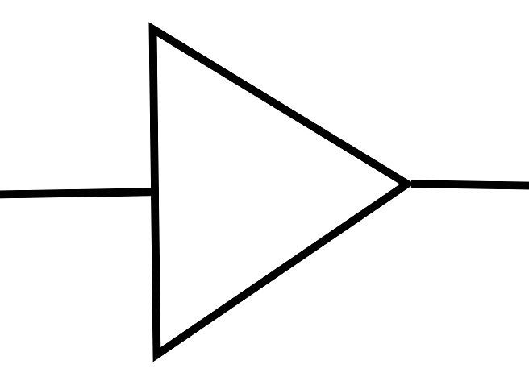
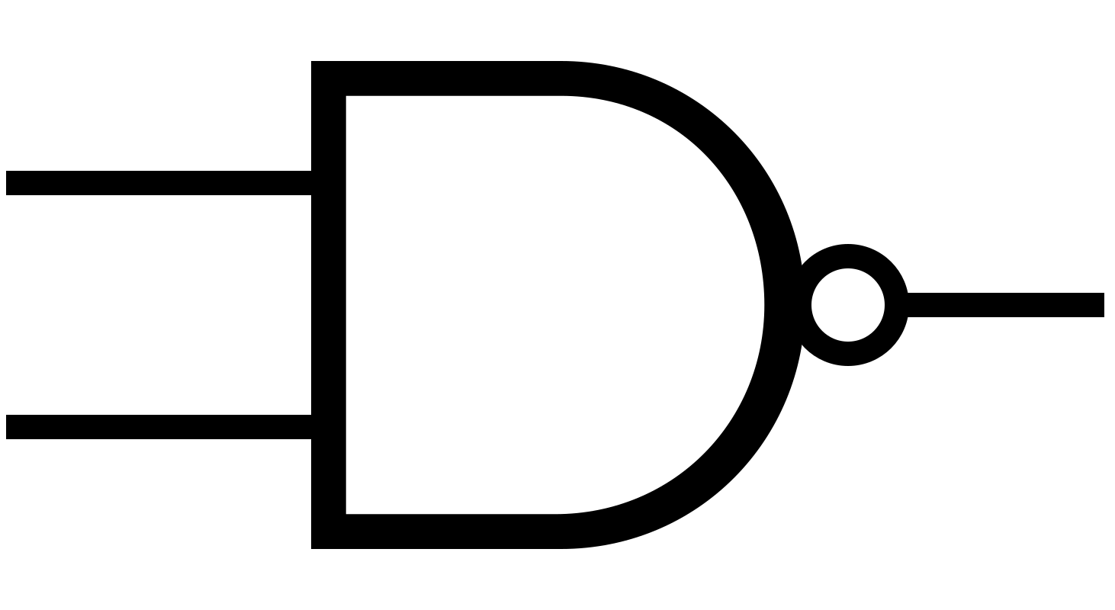
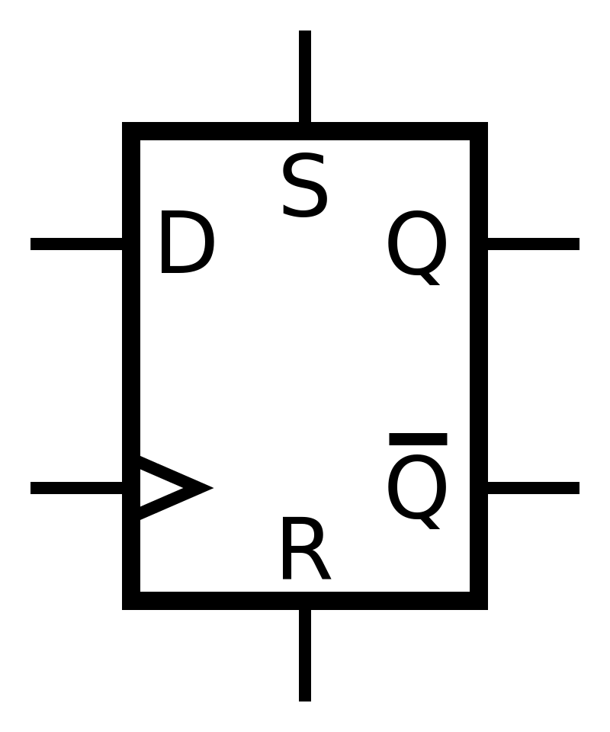
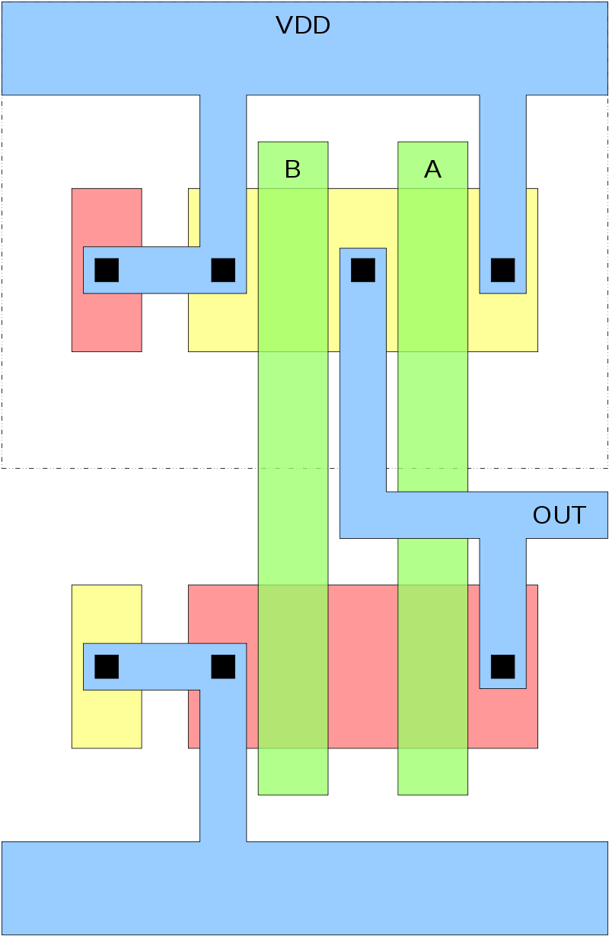
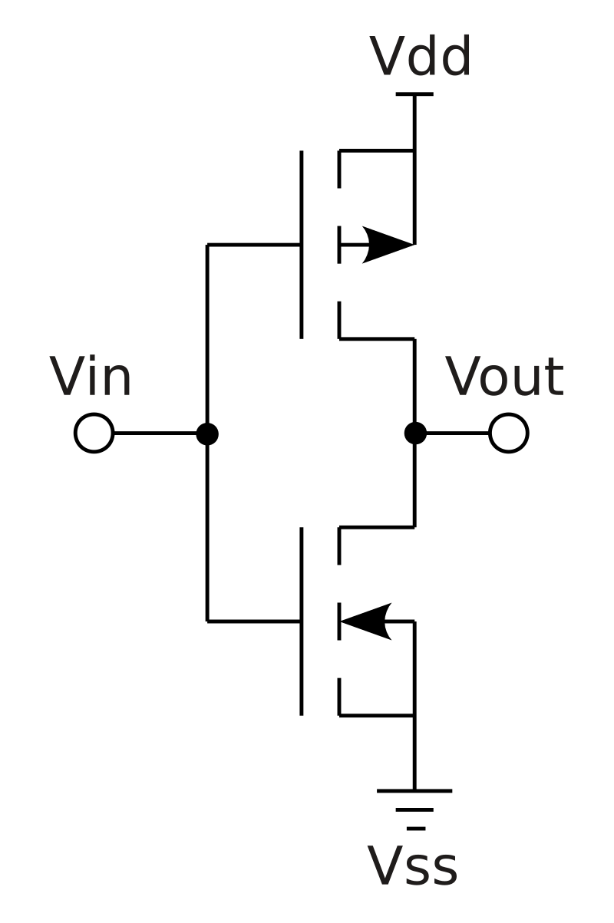
RTL to GDSII flow = Front End + Back End Design Flow
System Level Specifications
Block-level RTL Simulation
RTL power/timing verification
Gate Level Simulation (GLS)
Define Overall Architecture
Behavioral Modelling
Block-level Functional Specification
IP
Verification
Formal Verification
Front End Design
Block-level RTL design
Emulation
Logic Synthesis
Test Structure Insertion (DFT)
ATPG
Test Vectors
Partitioning Floorplanning Power and Ground Routing Placement Clock Tree Synthesis Global Routing Detailed Routing Sign-off STA
Standard Cell-Based ASIC Design
Logical Equivalence Check (LEC)
Physical Design
Standard-cell Library
Physical Verification
Back End Design
Design Rule Check (DRC) Layout vs Schematic (LVS)
Antenna Effects Electrical Rule Check (ERC) Parasitic Extraction Signal and Power Integrity
Sub-block Integration
PDK
Layout Post Processing, ECO
PDK – Process Design Kit
GDSII
Mask Generation
Fabrication

Slide 22
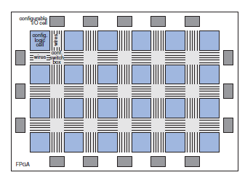
FPGA based Design
Field Programmable Gate Array (FPGA)
pre-defined ‘Look Up Tables’ (LUTs), hardware resources which can be programmed using a ‘bit stream’
FPGAs vs ASICs
Design Methodology
ASIC design methodology = RTL to GDSII flow (Front End + Back End Design)
FPGA design methodology = digital design → generate bit-stream → program FPGA device → deploy
‘Reprogrammable’
ASIC is ‘cast’ in Silicon → cannot be modified unless there is a ‘respin’ or new design, system level changes only possible through software programming if ASIC embeds a CPU/GPU/DSP etc.
FPGA is ‘Field Programmable’ i.e., a new digital design can be remapped to hardware and redeployed on the fly. Modern FPGAs embedded with a CPU are called ‘Embedded FPGA Processors’ or ‘SoC FPGAs’ or ‘FPGA SoCs’
Others
FPGA based systems often have high production cost (this is changing overtime), mostly suited for low volume
ASIC performance is generally better than FPGAs
FPGAs are a very good prototyping vehicle or for products requiring constant ‘reconfigurability’.
Design Entry or HDL Design
Logic Synthesis
Device Mapping Place and Route
Static Timing Analysis (STA)
Requirements
Functional (RTL) Simulation
Bitstream Generation
Design suite provided by FPGA/EDA vendor
FPGA programming

Slide 23
Analog VLSI Design
Analog IC Design:
Circuit Specifications
Analog IP
Analog circuits interface and manipulate continuous time arbitrary electrical signals
Analog circuit design is considered a ‘Black Art’
Analog design automation still today mostly remains an ‘elusive research topic’
Analog circuits WILL always remain relevant and can play a significant role in the AI chip revolution
Architecture Design and Partition into Blocks
Device Library
Technology Data
Rule Files Simulation Models
Circuit Design
Circuit Simulation
Circuit Calibration
Custom Layout Design
PDK
Layout Verification
“Analog Circuit designers are scarce, VERY WELL
compensated, gain lots of respect, and often regarded as Artists” - a well known adage in the VLSI industry!
Parasitic Extraction
PDK – Process Design Kit
GDSII for Fabrication

Slide 24
System Specification
Hardware Architecture (Analog/Digital Partitioning)
Analog VLSI Design Flow
Digital VLSI Design Flow
IP
Architecture Design and Partition into Blocks
Block-level RTL design
Analog IP
Verification
Circuit Design
Logic Synthesis
Circuit Simulation
DFT and ATPG
Device Library
Technology Data
Rule Files Simulation Models
Mixed-Signal Design
Top-level mixed mode simulation
Floorplanning
Custom Layout Design
Physical Design
Standard-cell Library
Layout Verification
Physical Verification
PDK
Top-level Routing
PDK
DRC and LVS
Post Layout Simulation
Layout Post Processing
Mask Generation

Slide 25
Executing Design Methodologies using EDA tools
EDA Methodology in Practice
© Santosh S Malagi 2023

Slide 26
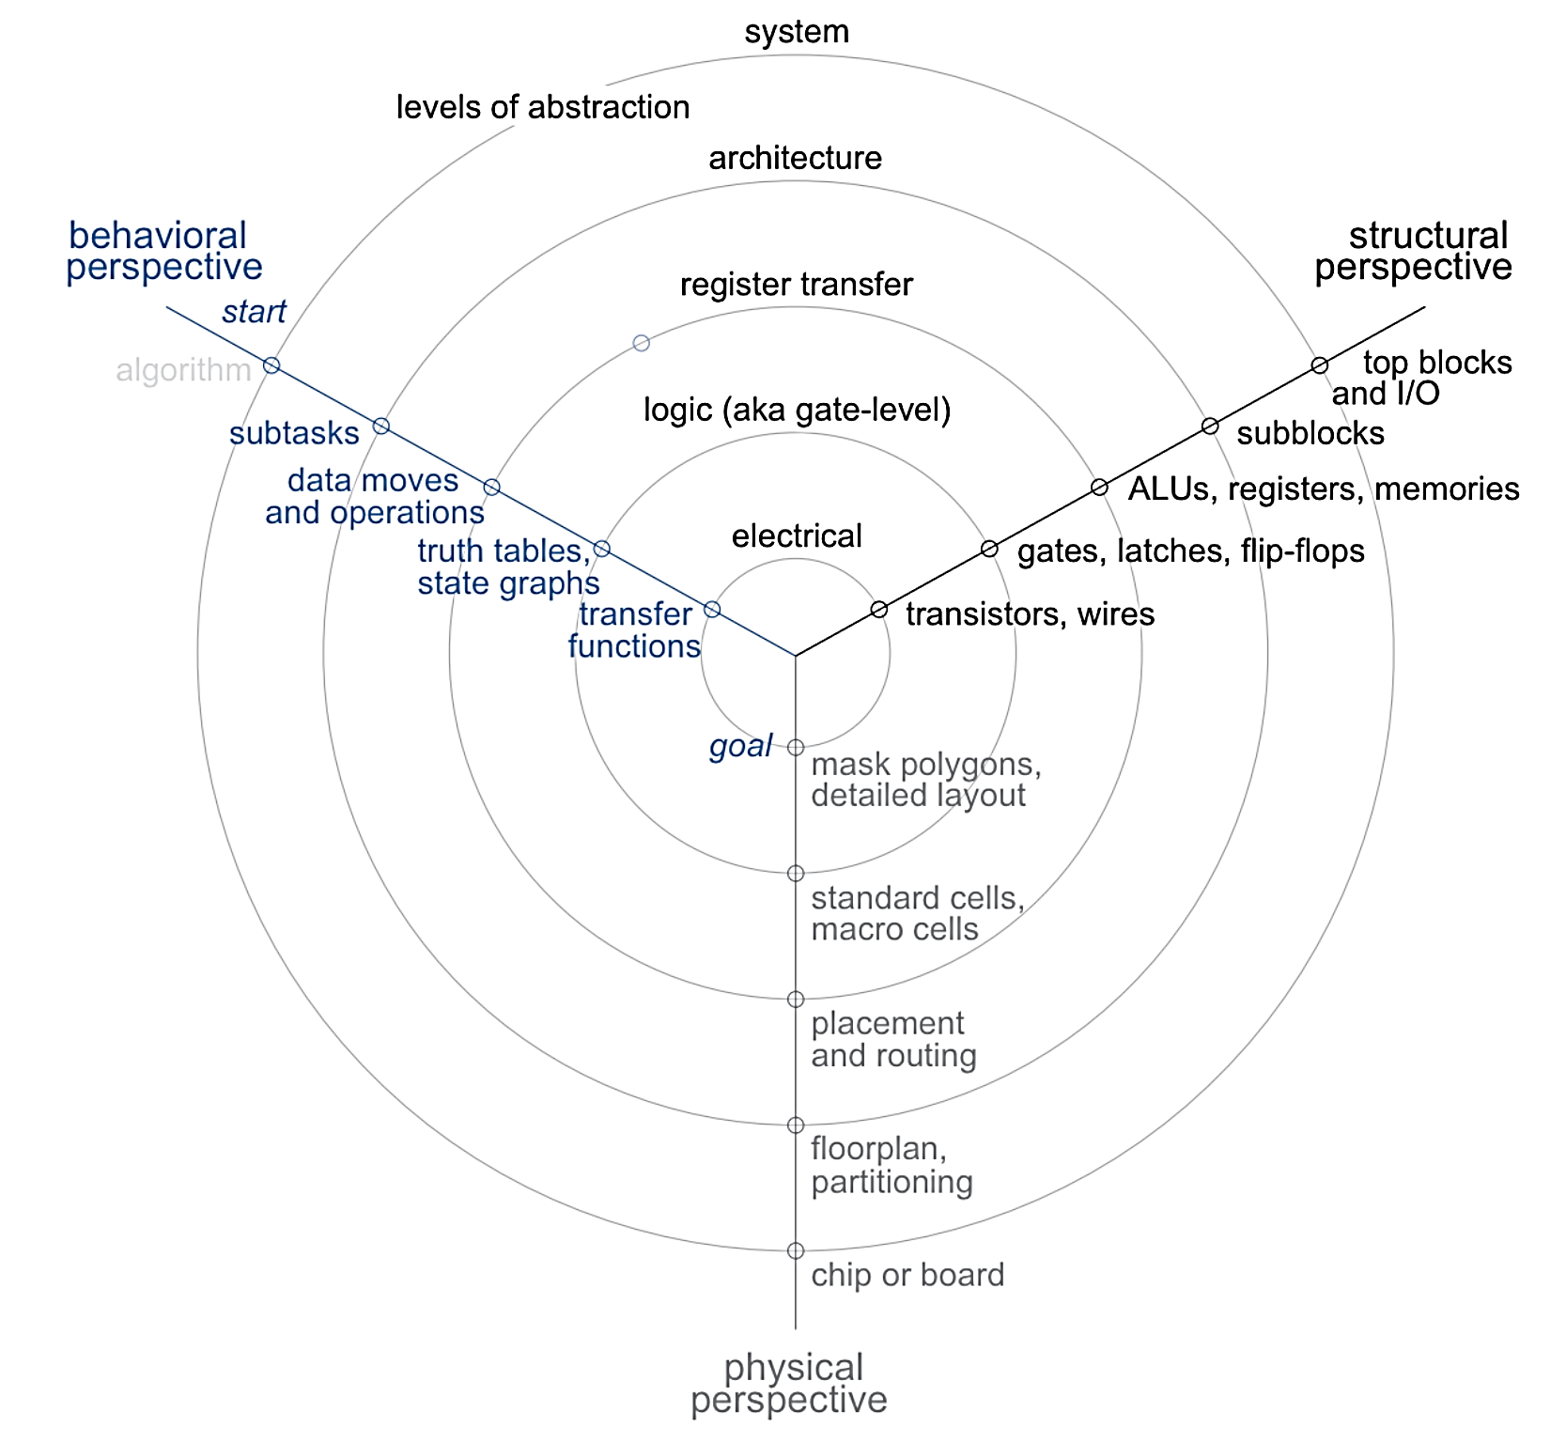
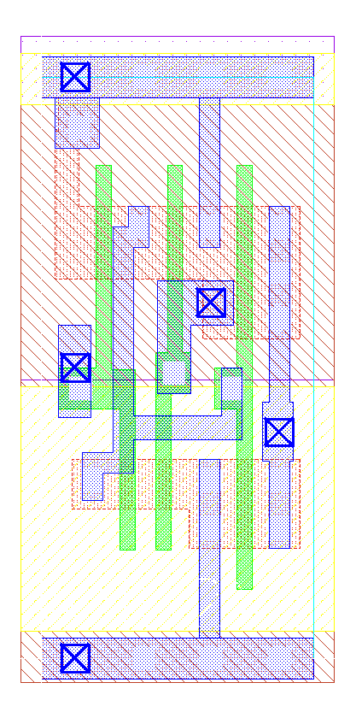
Design Methodologies – ‘Top-Down Approach’
module dff (CK,Q,D);
input CK,D;
output Q;
reg Q;
always @ (posedge CK)
Q <= D;
endmodule
module And_DFF_Or(in1,in2,in3,CK,out1);
input in1,in2,in3,CK;
output out1;
wire w1,w2;
and AND1(w1,in1,in2);
dff DFF1(CK,w2,w1);
or OR1(out1,w2,in3);
endmodule
Front-end design
module And_DFF_Or(in1, in2, in3, CK, out1, SCAN_EN, SCAN_IN, SCAN_OUT);
input in1, in2, in3, CK, SCAN_EN, SCAN_IN;
output out1, SCAN_OUT;
wire in1, in2, in3, CK, SCAN_EN, SCAN_IN;
wire out1, SCAN_OUT;
wire n_0;
OR2X1 g11__2398(.A (in3), .B (SCAN_OUT), .Y (out1));
SDFFQX1 DFF1_Q_reg(.CK (CK), .D (n_0), .SI (SCAN_IN), .SE (SCAN_EN),
.Q (SCAN_OUT));
AND2X1 g13__5107(.A (in1), .B (in2), .Y (n_0));
endmodule
Back-end design
Daniel-Gajski Y Chart
Reference – Top-Down VLSI Design, Figure 1.10

Slide 27
‘Design Methodology’ and ‘Tool Flow’ Example
ATPG Tool Flow
Overall Design Goals:
Achieve high (99%) stuck-at and 85% transition fault coverage.
Test Methodology:
DC pin test parametric test
Test logic verification
DC logic stuck-at
At-speed logic delay
Memory testing
Iddq testing
Specialty testing
Analog
Burn-in testing
Setup tool environment
Read design netlist
Read standard-cell Verilog
Build ATPG design model
Setup constraints
Build chip testmodes
DRC checks
Enumerate list of faults
Generate scan-chain tests
Generate stuck-at ATPG patterns, simulate to calculate FC
Generate two-cycle transition ATPG patterns, simulate to calculate FC
Compact and write out Vector set in required format
Block-level RTL design
Verification
Logic Synthesis
Test Structure Insertion (DFT)
DFT methodology influences the ATPG methodology or the other way round. It also impacts the Physical Design flow.
ATPG
Logical Equivalence Check (LEC)
Physical Design
Physical Verification
Sub-block Integration
‘Tool Flow’ helps execute a ‘Test Methodology’ to achieve the overall ‘Design Goal’.
Layout Post Processing, ECO
Mask Generation

Slide 28
Summary

Slide 29
Future Developments in ‘Design Methodologies’
Design methodologies will continue to address the following challenges:
Hardware-software co-design and verification
SoC’s increasingly involve multiple IPs (often from multiple vendors) connected by a bus architecture
Verification complexity increases proportionately with design complexity
Design for Testability
dealing with newer defect mechanisms in advanced nodes, low pin count testing and cost of testing
Design Integrity
cross talk, IR drop, timing closure, Electromigration (EM), Electrostatic Discharge (ESD)
3DIC Integration and Packaging
Integrating heterogenous cores (digital, analog, memory etc.) and 3D IC integration
Power, Thermal and Timing
Timing closure – ensuring design meets the timing checks and requirements
Higher power = hotter chips!

Slide 30
Summary
Electronic systems form the backbone of the modern digital economy
Multiple players – EDA/IP, fabless, foundry, IDM’s etc. make up the semiconductor value chain and ecosystem
A System on Chip (SoC) - integrates a complete computing system on a single chip
Today’s electronic systems are mostly developed using ‘Hardware-Software Co-design Methodology’
Design methodology - sequence of steps needed to convert a ‘concept’ into ‘working silicon’
Successful design methodology development is a multi-disciplinary endeavor
Hardware architecture and systems engineering
Circuit Design (digital and analog)
Verification technologies
Test Engineering
Fabrication, physical layout design and semiconductor physics
Expertise in use of advanced EDA tools, tool scripting etc.
Optimum use of compute resources
Design Data Management
“There is no single right way to design a chip, but sure there are many wrong ways.”
-Anonymous

Slide 31
References
Kaeslin, Hubert. Top-down digital VLSI design: from architectures to gate-level circuits and FPGAs. Morgan Kaufmann, 2014.
Dillinger, Thomas. VLSI Design Methodology Development. Prentice Hall, 2019.

