Slide 1

Data Warehousing Final Presentation Group# 10 – Section 602
Fathima Benazir Ghouse Mohideen
Thenmozhi Singaravel
Santosh Kumar Sriram

Slide 2
Business Questions
Business Question 1 - Which of the following coupons are effectively redeemed in each DFF store - Meat or Grocery or Fish Coupons?
Business Question 2 - How does age of the customers and demography affect the pharmacy sales?
Business Question 3 - Which type of frozen food that is in high demand in the whole of DFF?
Business Question 4 - How are beer sales and profit in regions where single living population are high?
Business Question 5 - Which among Wine or Spirits is sold more during holiday season? Which is better gifted during Halloween, Thanksgiving or Christmas – Wine or Spirits?

Slide 3
Schema used and ETL Strategies
Schema Details
STAR Schema
ETL Strategies
Pre-Staging tables
Data Cleansing methodologies
Pre-Staging → Staging Environment
Staging → Data Warehouse
FULL refresh implementation
Data Mart | Time | Store | Product
Coupon Redemption | X | X
Sales | X | X
Movement | X |  | X

Slide 4
List of Reports
Business Question | Type of Report | Report Link
Business Question 1 | SSRS on SSAS | Group10_Section602_BQ1_Report >Coupon Sales
Business Question 2 | SSRS | Group10_Section602_BQ2 > BQ2
Business Question 3 | SSRS on SSAS | Group10_Section602_BQ3_Report > Frozen Food Sales
Business Question 4 | Report Builder | --NA--
Business Question 5 | SSAS | Next Slide

Slide 5
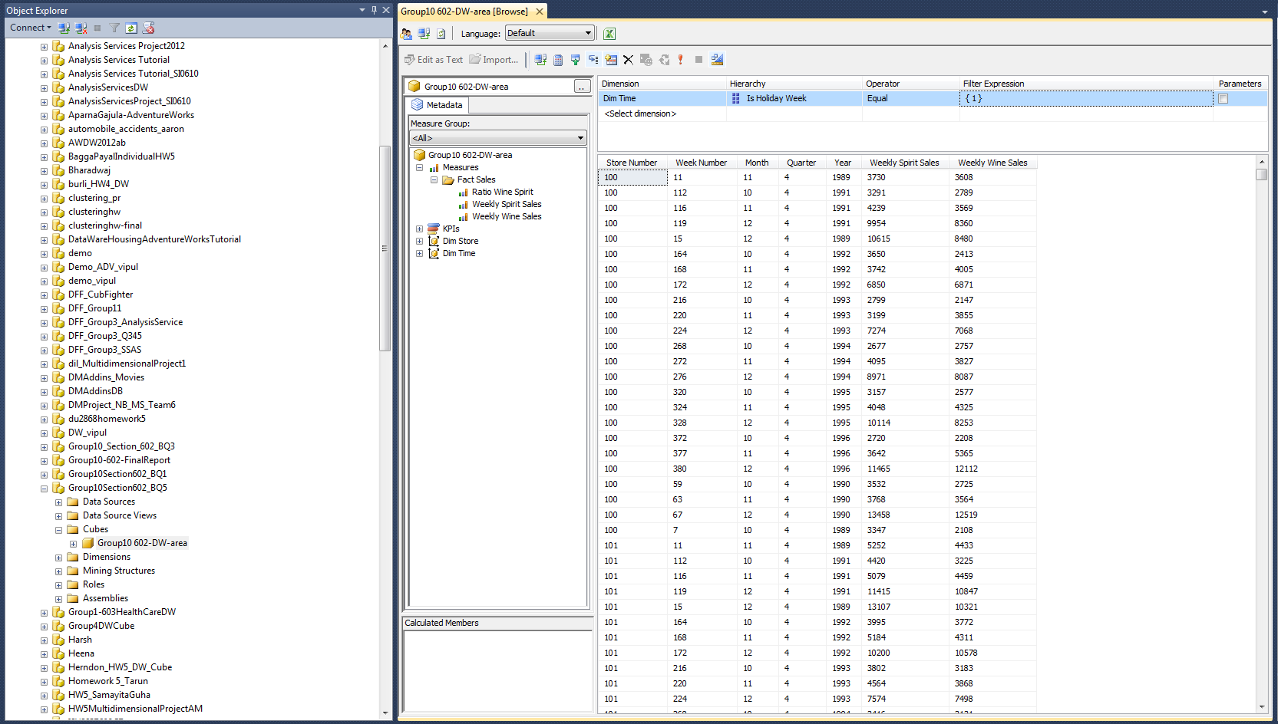
An SSAS report only

Slide 6
Niche work
Our Approach to this project and understanding the domain
Analysis on what DFF missed
Identified key issues using data
Framed our business questions
Executed the report supporting the business questions
Justifying our report and business question
Document our analysis

Slide 7


Thank You to Dr. Sen and everyone!

