Slide 1
Engineering Documents (ED) - Search
EDMS AMO Team

Slide 2
Table Of Contents
- User Guide(ED)
Search Overview
Full Text Search
Attribute Search
How to view document

Slide 3

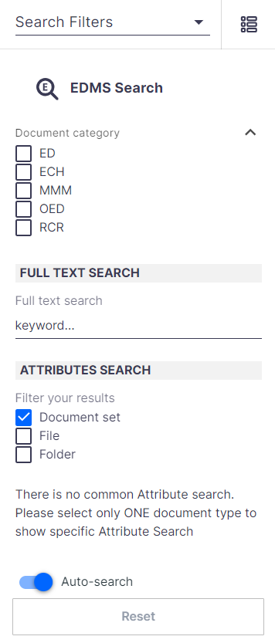
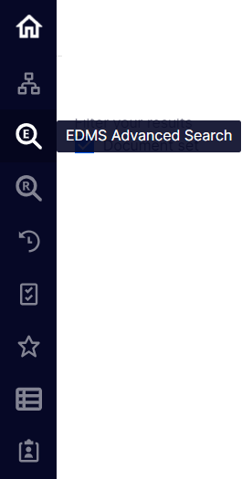
1.Search Overview
To use Search function, please click button from navigation bar in left side.
EDMS search screen will appear as below.
Once you select EDMS Advanced Search button, search filter will display on the right side as below.
There are two types of search in this system
①Full Text Search
②Attribute Search

Slide 4
6-1.Search Overview
At first, specify document type you want to search by check ON the checkbox.
You also can specify multiple document types.
※This manual explains for ED document type. Please select ED.
You can filter search result by 3 types: Document set, File, Folder
（By default, Document set is selected. It is basically recommended to search by Document set)

Slide 5
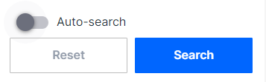
6-1.Search Overview
In default state “Auto-search” is ON.
✔When “Auto-search” is ON:
The search is performed automatically when each filter is selected.
✔When “Auto-search” is OFF:
Below “Search” button will display
In this case, after you select search filter, you have to manually press “Search” button to perform search.
✔Press “Reset” button to reset all filters you specified.

Slide 6
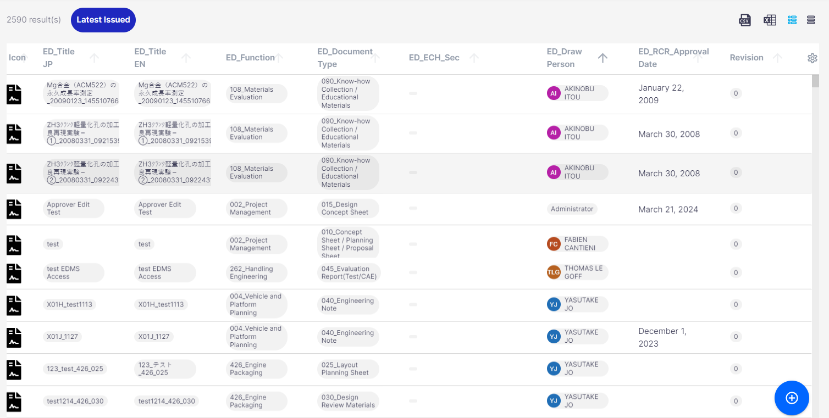
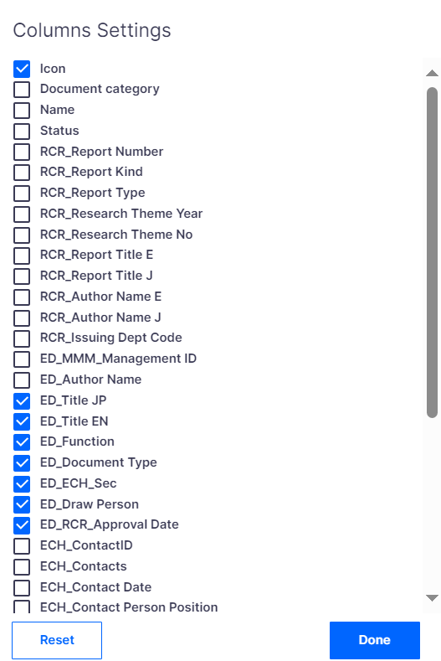
6-1.Search Overview
When you perform a search, search result appears in the field on the right side of screen as below image( Below sample is case of filtering result with “Document set”)
If there are many search results, you can further filter by attribute values, etc)
Search count
Turn “Latest Issued” ON to filter only latest issued document
Able to sort in descending/Ascending order by clicking arrow next to each attribute
Able to export search result to Excel
Press the setting button in the upper right of the screen. Column settings window appears.
You can select to show/hide each column with this checkbox.
The settings is inherited in next time you log in.
Click on document you want to view, detail screen will open

Slide 7
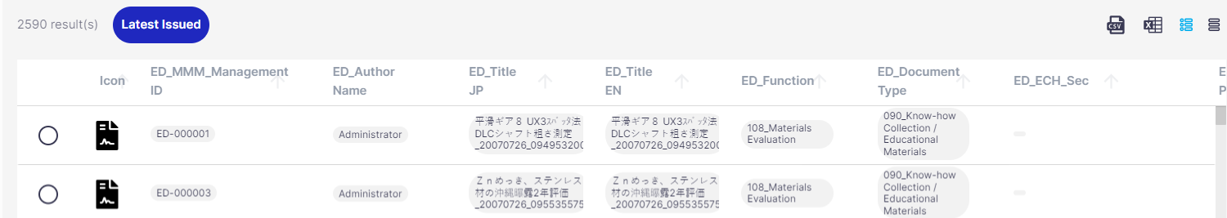
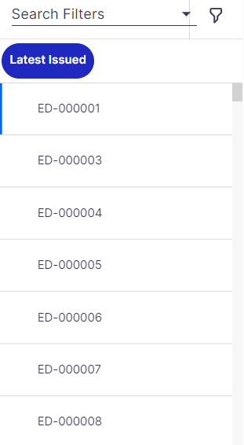
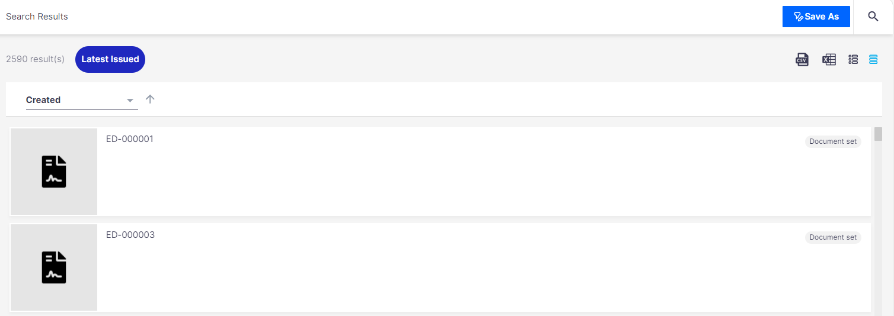
6-1.Search Overview
The advance search screen provides multiple views.
Click the button in red frame to switch the display.
Table View
Filter View
（Specify Search Conditions Screen）
Queue View
（List of search result)
List View

Slide 8
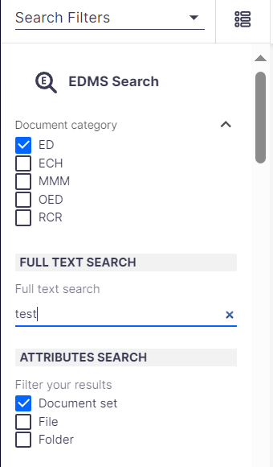
6-2.Full Text Search
When you enter a keyword you want to search in the text entry field of “FULL TEXT SEARCH”, you can
perform a full-text search on all documents registered in the system for the specified document type.
※ Refer to below link for full text search in detail.
https://jp.nissan.biz/EDMS_RL/ui/#!/doc/180a36df-4281-4c3d-94b6-a25c98bc55bb
A keyword full text search is a search that includes the keywords you enter.
It is partial match search.

Slide 9
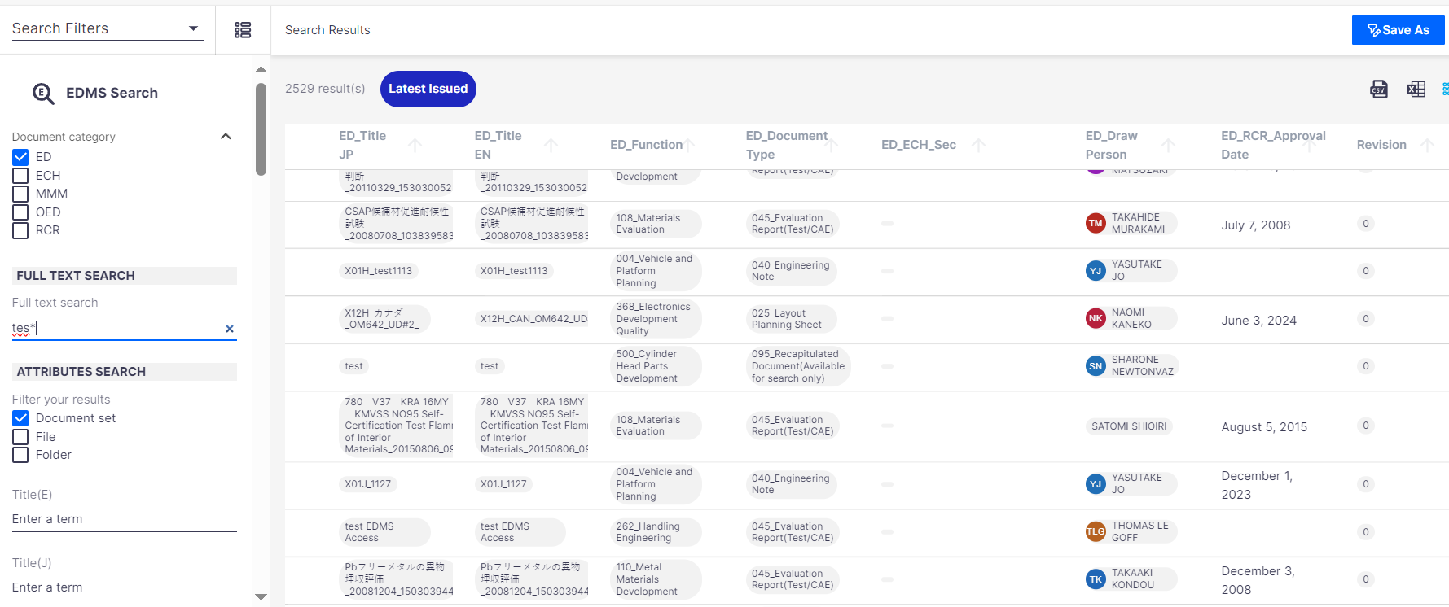
6-2.Full Text Search
1) "Starts with" search
If user want to partial(starting with) search, user can add wildcard * at the end of the term
If any attribute starts with the term
then the document will be filtered into search results

Slide 10
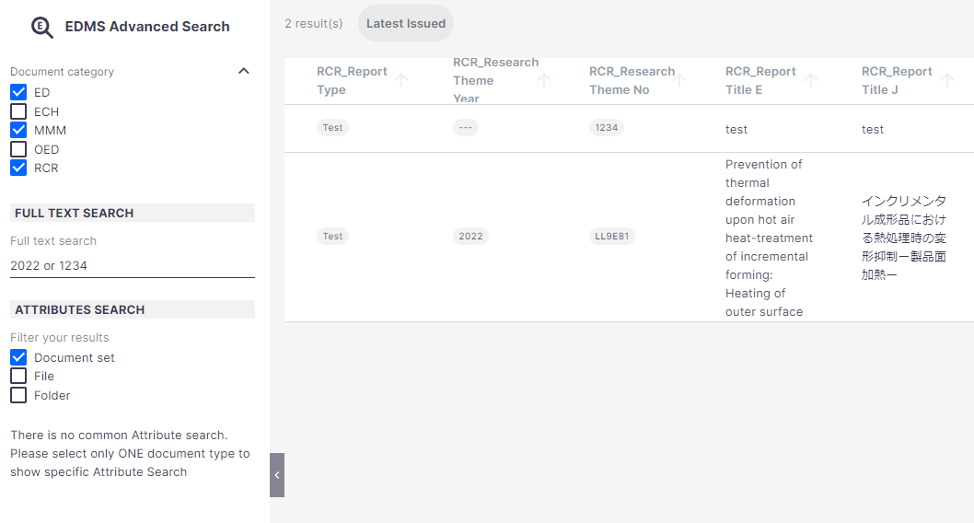
6-2.Full Text Search
2) OR search
If user want to search by multiple terms and need all those in which at least one term can be found, user can add "OR" between two terms
If in a document at least one term can be found some attribute,
then the document will be filtered into search results

Slide 11
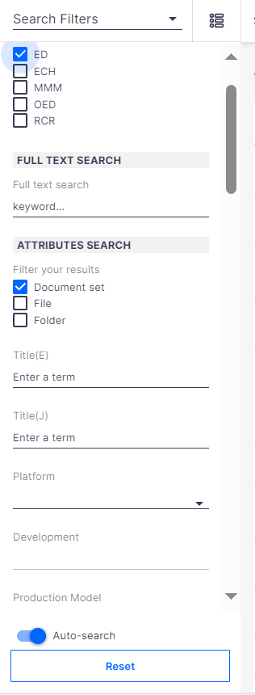
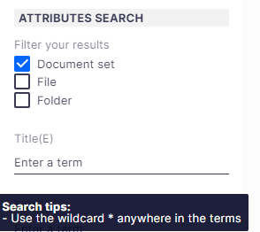
6-3.Attribute Search
You can filter by Attributes, not just by keyword
（Supporting searching for keywords only, attribute values only, keyword＋attribute values）
Scroll bar
※Refer to below link for Attribute Search in detail.
https://jp.nissan.biz/EDMS_RL/ui/#!/doc/10a5767e-efd4-447e-a8c9-d329fea65e23
Attributes
✔ When hover the mouse over some attributes filter, Search tips will show.

Slide 12
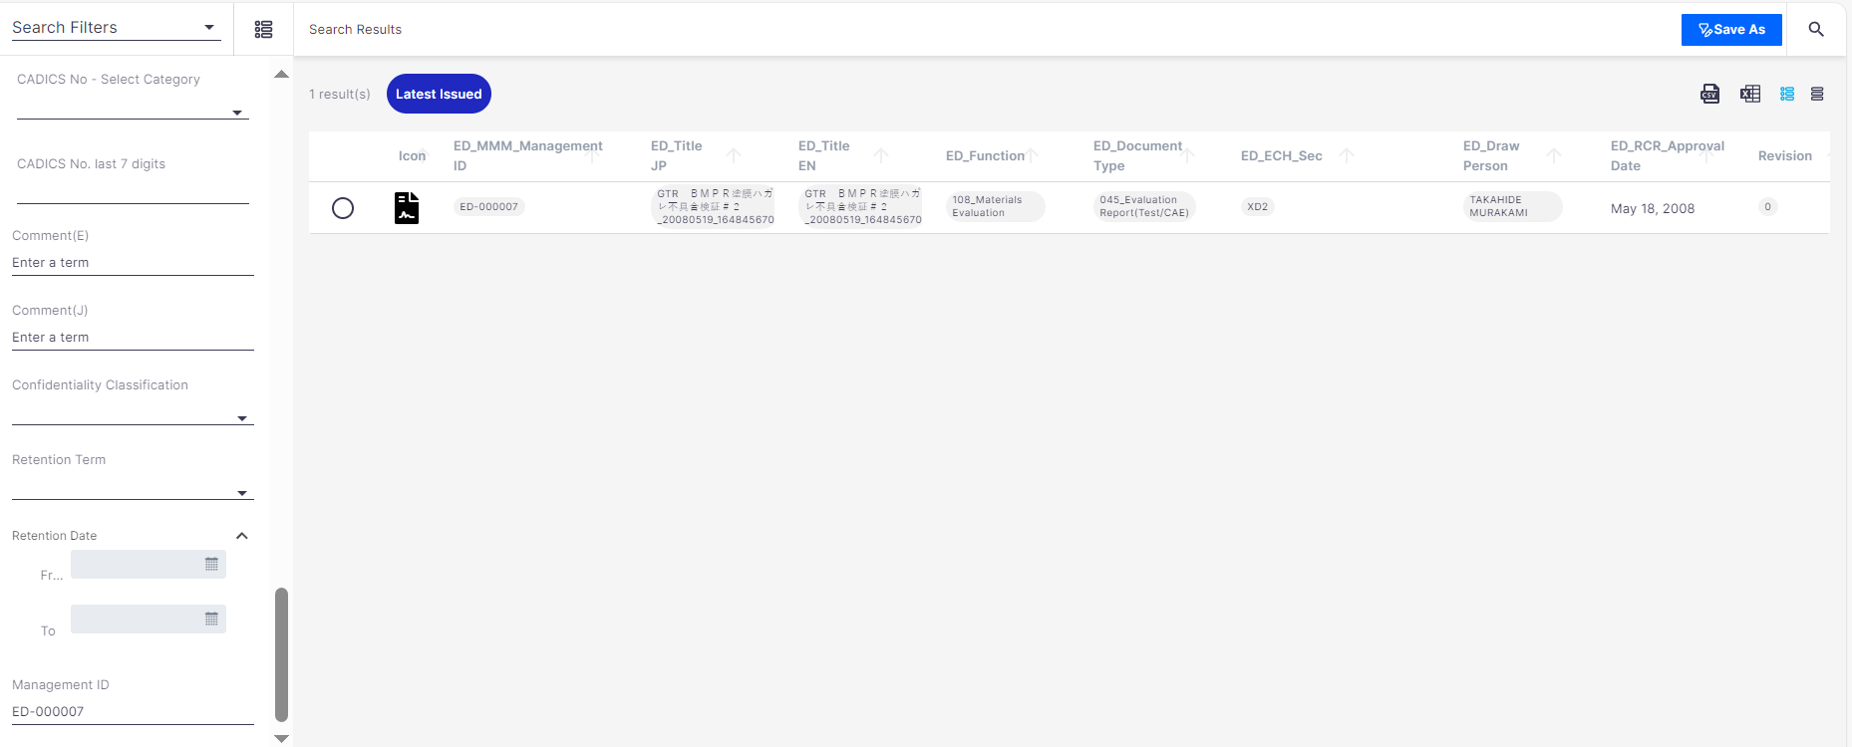
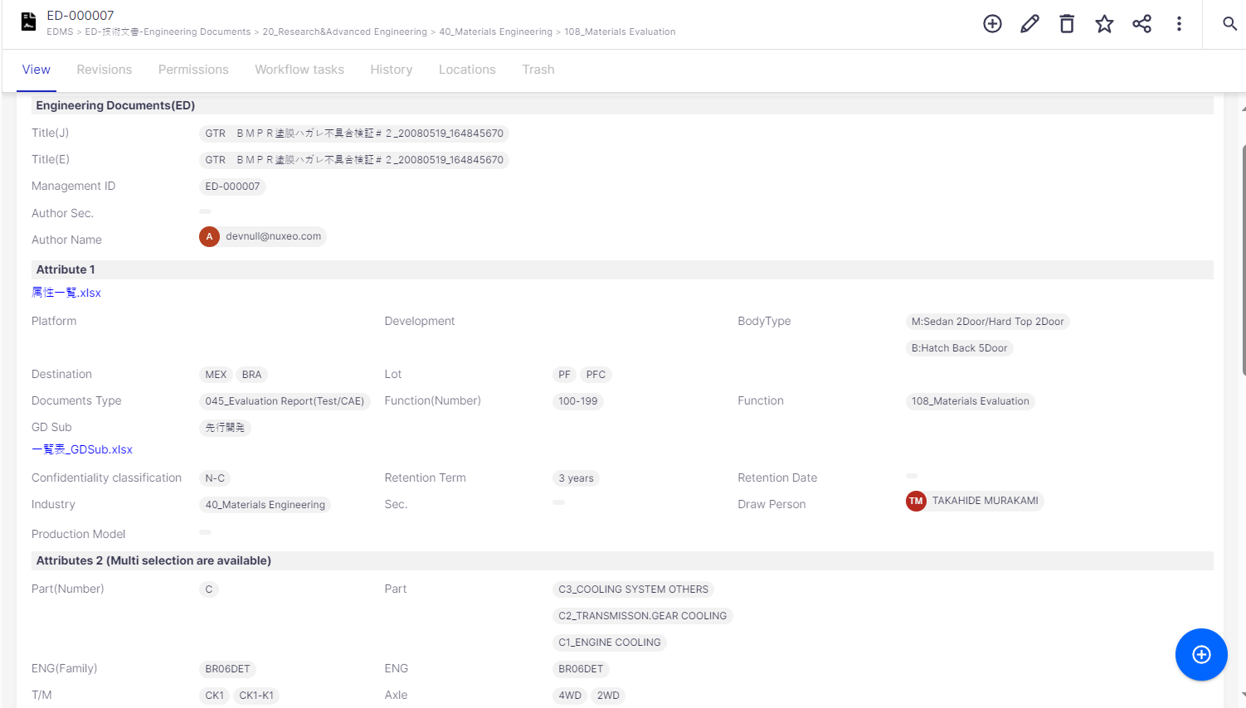
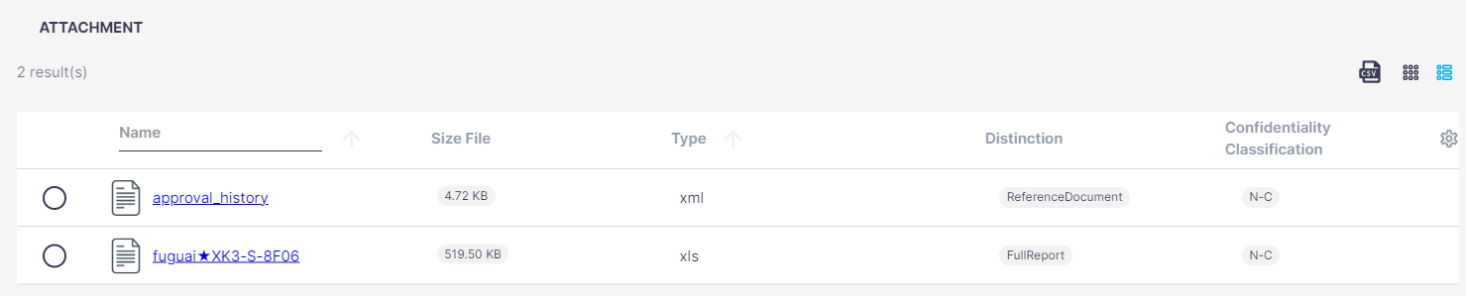
6-4.How to view document
Search document via search function -> click on target document in search result -> Detail screen will open.
②
②Click on target document in search result
③Detail screen is opened.
Top: Attribute value.
Defined attribute information is displayed
①
①Search target document
Bottom: Attachment list
A set of attached file displays.
You can click on target file to check content.

Slide 13
Thank you

