Slide 1
TRIBHUVAN UNIVERSITY · IOE PULCHOWK CAMPUS · BIG DATA TECHNOLOGY
Real-Time and Historical Analytics of the Nepal Stock Exchange
A big data stack with Apache Kafka, Apache Spark and Hadoop HDFS
Santosh Tiwari (082MSDSA024)
Arbind Sah (082MSDSA006)
Submitted to Basanta Joshi
11 October 2026
Notes:
Introduce the project: one pipeline for live and historical NEPSE data using Kafka, Spark and HDFS.

Slide 2
The problem: no single view of NEPSE
Live monitoring
Unusual activity
Live prices, turnover and biggest movers for the whole market in one place
Automatic alerts for volume spikes, big moves and the ±10 % circuit limit
Historical context
Trustworthy data
Compare today with years of data: moving averages, RSI, 52-week range
Raw history has bad rows and bonus-share price drops that look like crashes
Existing portals show current prices only — they cannot do any of these four things together.
Notes:
Retail investors must combine several websites by hand.

Slide 3
Why it is a big data problem
514,018
15,142
5 s
daily price records, 372 companies, 1995–2026
intraday ticks for 327 symbols in a single replayed day
polling interval for ~350 live symbols
Variety
Veracity
JSON (NEPSE API), HTML tables (ShareSansar), CSV (GitHub), chart JSON (MeroLagani), JSONL recordings
40,552 rows (8 %) with inconsistent high/low, 20 invalid rows and 731 artificial bonus/right-share price drops
Notes:
Volume, velocity, variety, veracity, value.

Slide 4
Data sources: all public
Source | Data | Mode
nepalstock.com API | Live price, volume, turnover | Real-time JSON
ShareSansar | Live prices (fallback) | HTML table
GitHub nepse-data | Daily OHLCV, 1995 → today | Batch CSV
MeroLagani | NEPSE index since 2000 | Batch JSON
Company master | 649 securities with sectors | Reference
Recorded sessions | Own live ticks for replay | JSONL
One message format
Live and replay producers publish identical JSON to Kafka, keyed by symbol, so Spark never needs to know the mode.
Offline sample: 42 stocks, 4 MB, in the repo.
Notes:
Common JSON message keyed by symbol, same for live and replay.

Slide 5
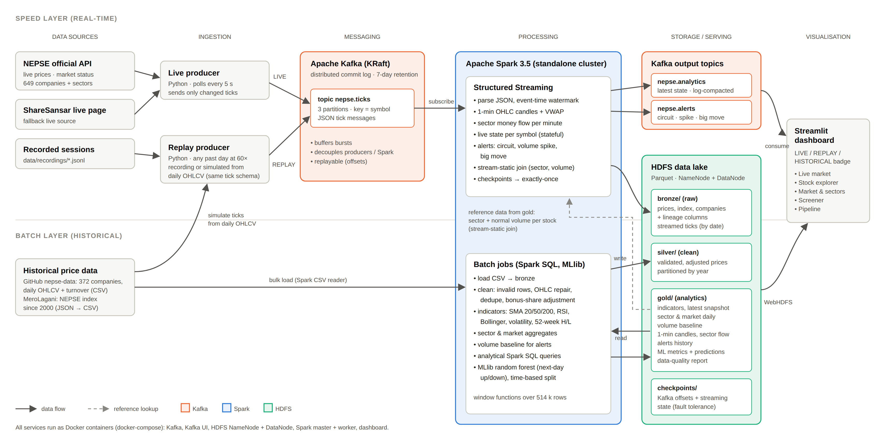
Architecture: Lambda-style pipeline
Kafka ingests live or replayed ticks
Spark streams candles, snapshot, sector flow, alerts
Spark batch cleans 31 years of history
HDFS Parquet holds every layer
Streamlit dashboard on top
Notes:
Speed layer above, batch layer below, joined by stream-static join.

Slide 6
Component choices and why
Need | Chosen | Why not alternatives
Ingestion | Kafka | Flume cannot replay; RabbitMQ deletes consumed messages
Stream | Spark Structured Streaming | One API for stream, batch, SQL, ML (Flink is lower-latency but separate)
Batch | Spark SQL | In-memory window functions, far faster than MapReduce
Storage | HDFS + Parquet | Columnar scans suit analytics better than key-value stores
Latest state | Compacted Kafka topic | Avoids Redis/Cassandra
Notes:
Kafka and Spark are the two main tools; HDFS is shared storage.

Slide 7
HDFS data lake: bronze, silver, gold
Bronze · raw
Silver · clean
Gold · analytics
CSV and ticks as received, plus lineage columns
Validated, de-duplicated, OHLC-repaired, bonus-adjusted
Indicators, screener, sector stats, candles, alerts, ML results
11.9 MB
23.1 MB
51.7 MB+
2.8×
Yearly partitions
Replication 1
Avoids ~3,500 tiny daily directories (small-files problem)
Single DataNode; raise to 3 on a real cluster
smaller: 33 MB CSV → 11.7 MB Parquet
Notes:
Medallion layout; every layer can be rebuilt from the one below.

Slide 8
Batch layer: cleaning 31 years of data
20
0
40,552
731
invalid rows dropped
duplicates found
OHLC rows repaired
bonus/right-share adjustments
Corporate-action detection
Example: NABIL, 2017-09-12
NEPSE circuit is ±10 %, so an opening gap below −10.5 % is a bonus/right share. Earlier prices are back-adjusted.
Closed 1,630, opened 1,254: ratio 0.769 = 30 % bonus share. Without adjustment, moving averages treat it as a crash.
Notes:
Spark SQL with window functions; corporate action detection is the key idea.

Slide 9
Speed layer: five Spark streaming queries
ticks
Exactly-once Parquet sink to bronze
5 s
candles_1m
1-min event-time windows, OHLC + VWAP
snapshot and alert refresh
sector_flow
Stream-static join, windowed by sector
10–20 s
live_snapshot
Latest state per symbol → Kafka
candle written after its minute closes
alerts
Circuit, 3× volume spike, ≥5 % move
Ticks are enriched with batch results (sector, 20-day volume baseline): this joins the two layers.
Notes:
One Spark app, each query with its own HDFS checkpoint.

Slide 10
Three modes, one pipeline
LIVE
REPLAY
HISTORICAL
Market open
Market closed
Always
NEPSE API → live producer → Kafka → Spark
Recorded or historical day replayed at e.g. 60× with fresh timestamps
History CSV → Spark batch → HDFS gold
A 15,142-tick day replays in about 4 minutes. Each loop is its own session, so results never mix.
Notes:
Demo never depends on market hours.

Slide 11
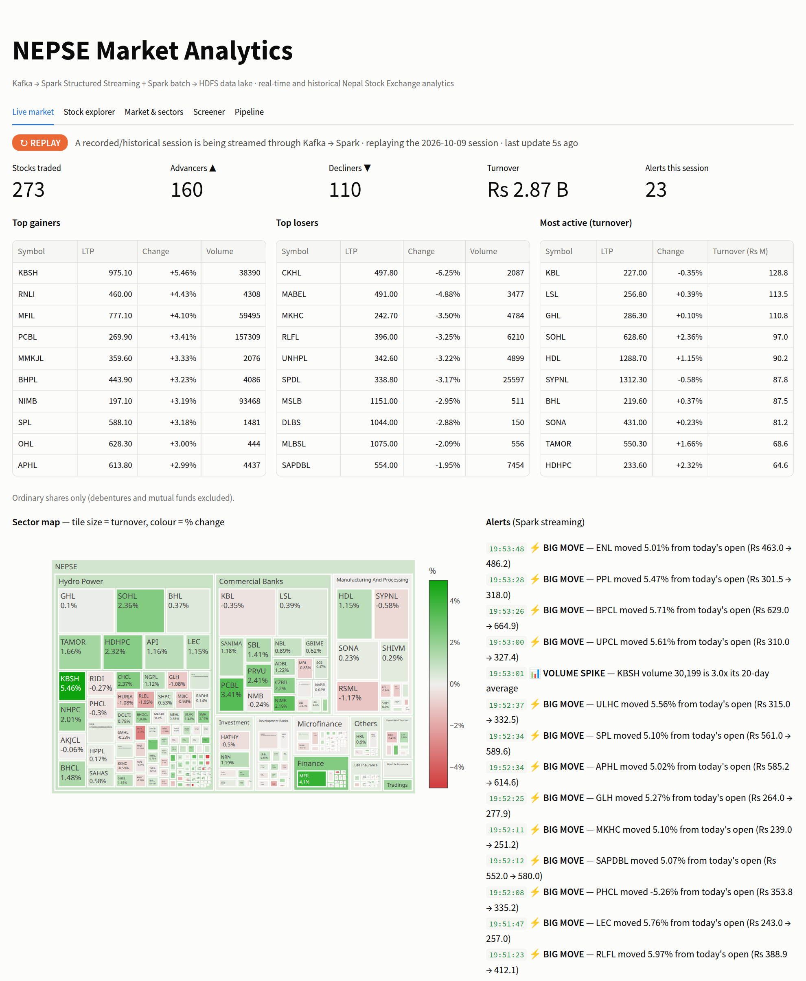
Dashboard: live market tab
Mode badge shows LIVE, REPLAY or HISTORICAL
Market KPIs, gainers and losers
Sector money-flow map
Spark alerts arrive via Kafka
Refreshes every 3 seconds
Notes:
Mode badge, KPIs, movers, sector map, Spark alerts.

Slide 12
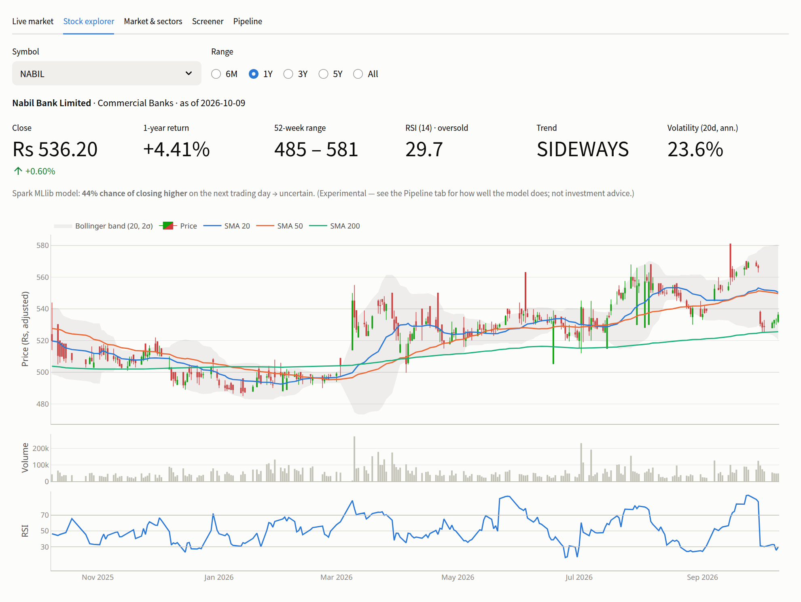
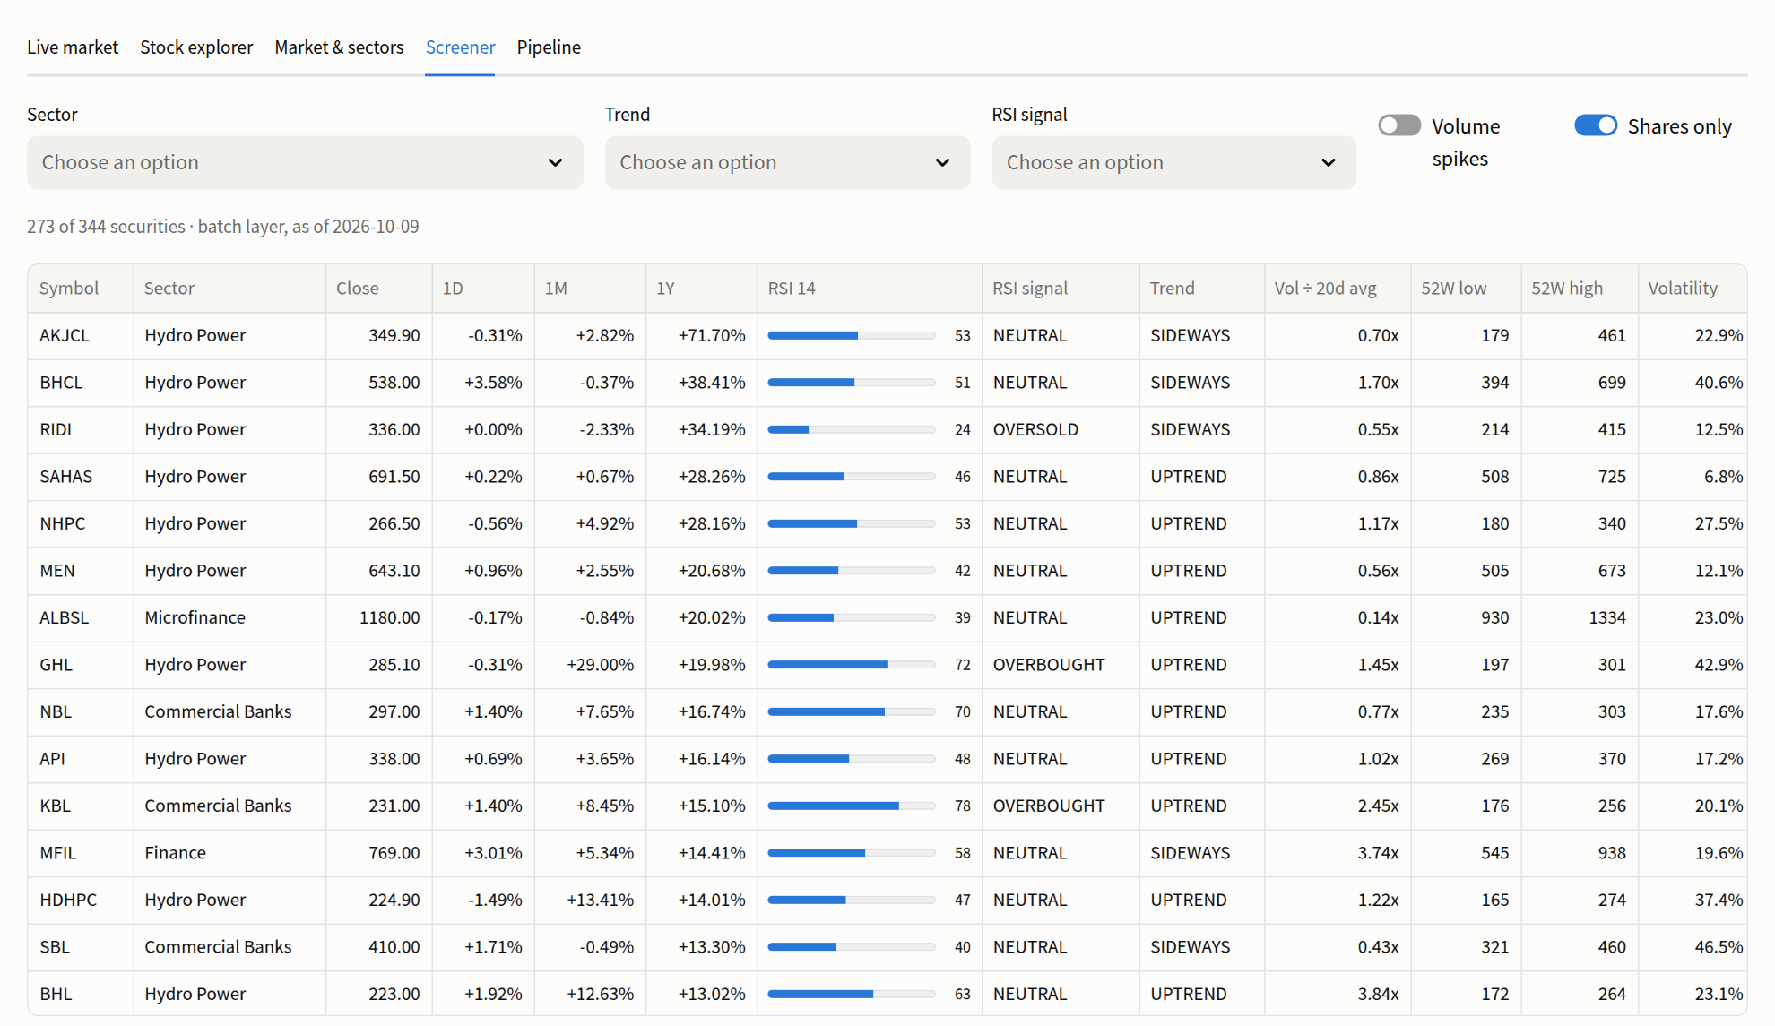
Dashboard: historical analytics
Screener: filter by sector, trend, RSI signal, volume spike
Stock explorer: adjusted candles, SMA 20/50/200, Bollinger band, RSI
Notes:
Candlesticks use bonus-adjusted prices.

Slide 13
Results: data, streaming, performance
~5.5 min
whole batch layer on an 8-core laptop
1.7 GB
memory, whole stack idle
Hydropower led the last 30 days: NPR 43.4 bn, then banks 15.4 bn.
Notes:
Numbers from sections 7.1–7.5.

Slide 14
Fault tolerance: kill Spark mid-session
15,142 / 15,142
ticks stored exactly once: nothing lost, nothing duplicated
1
Streaming job stopped about 1 min into a full-day replay
2
Ticks keep arriving in Kafka for 50 s
3
Job restarts; resumes from checkpointed offsets
Notes:
Offsets in checkpoint plus exactly-once file sink. Alerts are at-least-once.

Slide 15
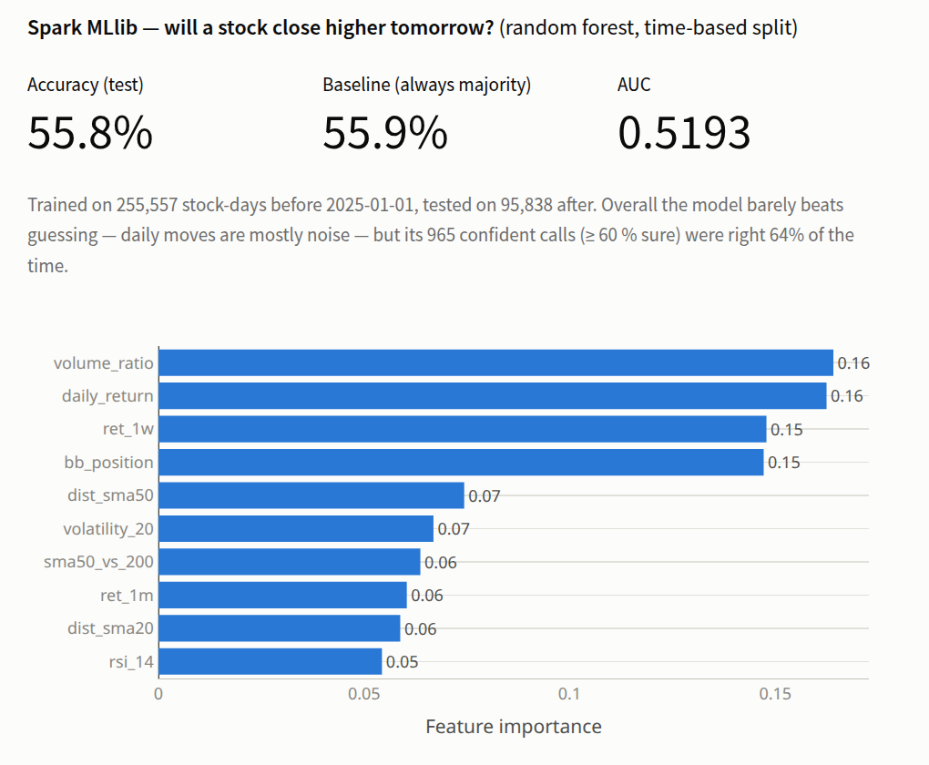
Bonus: Spark MLlib, an honest result
55.8 %
55.9 %
test accuracy
always-'down' baseline
0.519
64 %
AUC, barely above 0.5
accuracy on 965 confident calls
Daily moves are close to random. The value is a leakage-free, time-split distributed ML pipeline.
Notes:
Random forest, 60 trees, depth 7; trained 2015–2024, tested 2025 onward.

Slide 16
Limitations and future work
Limitations
Future work
Single machine: one broker, one DataNode, one worker
Bonus shares under ~10 % not adjusted
Simulated ticks do not follow real intraday order
Unofficial NEPSE client may break
ML has no practical predictive power
Multi-node cluster: 3 brokers, replication 3
Official corporate-action records
News and sentiment as another stream
Compaction and Hive metastore
Watchlists and push alerts

Slide 17
Conclusion
Kafka ingests live or replayed ticks; Spark processes them as a stream and as a 31-year batch; HDFS stores bronze, silver and gold Parquet
514,018 rows cleaned, a full day analysed in minutes, exactly-once recovery proven
Replay mode lets the system be demonstrated at any time
Thank you · Questions?

