Slide 1


Samarth Group of Institutions College of Engineering , Belhe
Department of Computer Science and Engineering
Project Topic Proposal
By-
Bhor Pooja
Date Pratik
Waghmare Santosh
Project Guide:
Prof. Shiv Shinde

Slide 2
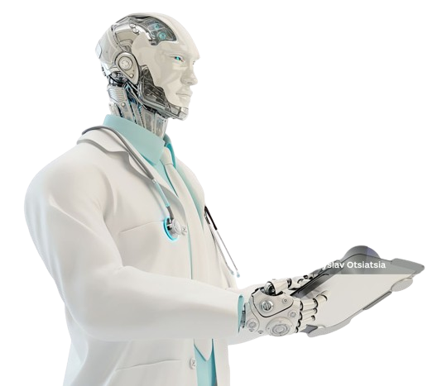
Chatbot For Multiple Disease Prediction Using Machine Learning and Deep Learning

Slide 3
Existing System Overview
Multiple Models for Disease Prediction:
The current system uses separate machine learning (ML) and deep learning (DL) models to predict different diseases based on medical data and images.
Each model is specialized for a specific type of disease, providing targeted predictions.
Lack of Unified Interaction:
There is no dedicated chatbot interface to interact with users.
Users must manually input data into different models without a cohesive interaction platform.
Data Input:
Users provide medical information (e.g., hemoglobin levels, st_slope) and images through separate interfaces.
Data input is not streamlined, making it less user-friendly.
User Experience:
The absence of a centralized system or chatbot reduces user engagement and accessibility.
Users may find it challenging to navigate and use multiple models for comprehensive disease prediction.

Slide 4
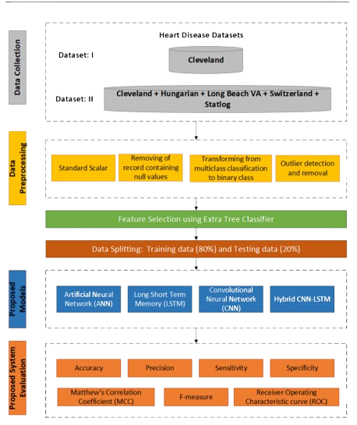
Flow-Chart of Existing System

Slide 5
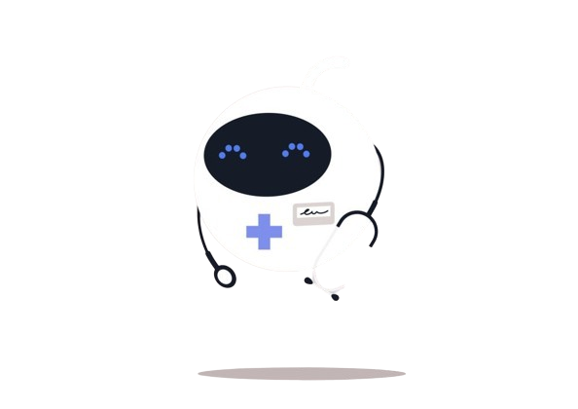
Project Brief: Rule-Based Chatbot for Disease Prediction
1.Overview:
Objective: Develop a rule-based chatbot that predicts multiple diseases using machine learning (ML) and deep learning (DL) techniques.
Inputs: The chatbot takes medical information (e.g., hemoglobin levels, st_slope) and images to predict diseases.
Methodology: Utilizes ML and DL models for disease prediction based on user-provided data.

Slide 6
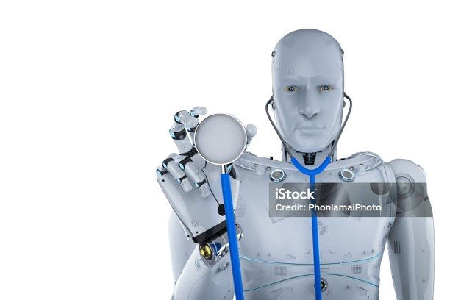
1.Key Features:
User Interaction:
Chatbot interface for users to input medical data and images.
User-friendly prompts guiding users to provide necessary information.
Medical Information Processing:
Collects various medical parameters (e.g., hemoglobin levels, st_slope).
Processes input data to standardize and prepare for model prediction.
Image Processing:
Accepts and processes medical images.
Uses DL techniques (e.g., convolutional neural networks) to analyze images.
Disease Prediction:
Implements rule-based logic for initial assessment.
Utilizes ML models trained on medical data to predict possible diseases.
Applies DL models for image-based diagnosis.
Output:
Provides users with predicted diseases based on input data.
Offers suggestions for further medical consultation or tests if needed.

Slide 7
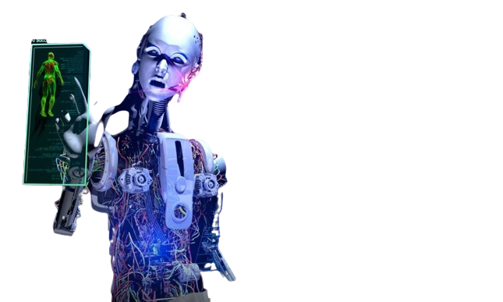
Technical Details:
Machine Learning:
Models trained on structured medical data (e.g., decision trees, random forests).
Feature extraction from user inputs for accurate prediction.
Deep Learning:
Convolutional Neural Networks (CNNs) for image analysis.
Training on large datasets of medical images to recognize disease patterns.
Rule-Based System:
Initial rules set for quick assessment based on common symptoms and medical values.
Enhances prediction accuracy by combining rules with ML/DL models.

Slide 8
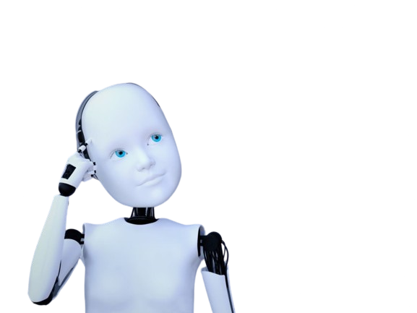
Future Enhancements:
Expand Dataset:
Continuously update and expand datasets for improved accuracy.
Model Improvement:
Regularly update ML/DL models with new data.
User Feedback:
Incorporate user feedback for better interaction and prediction accuracy.

Slide 9
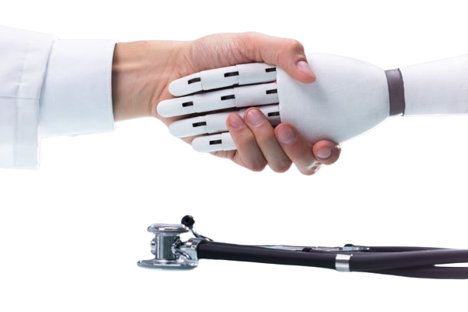
THANK YOU

