Slide 1
AI-Based Vibration Detection System
Using ESP32 and MPU6050
B. Sandeep - 2520030523
Sai Teja - 2520030241
Santosh - 2520030474
Ayush - 2520030496
Koneru Lakshmaiah Education Foundation
Bachupally, Hyderabad
2026

Slide 2
Overview
1
Objectives
7
AI Model Architecture
2
Problem Statement
8
Results
3
System Architecture
9
Applications
4
Hardware Components
10
Limitations and Future Scope
5
Complete Hardware Connection
11
Conclusion
6
Hardware Connections / Pin Details
2 / 17

Slide 3
Objectives
1
Detect real-time vibration
Use the MPU6050 sensor to sense movement and shaking as it happens.
2
Read accelerometer and gyroscope data
The accelerometer gives movement on the X, Y and Z axes; the gyroscope gives rotation.
3
Process data on the ESP32
The ESP32 receives the sensor readings over I2C and handles them on the spot.
4
Extract useful features
Convert raw readings into inputs the model can use to tell the two conditions apart.
5
Classify NORMAL or VIBRATION
The machine-learning model decides which condition the readings show.
6
Run the model on the ESP32
Inference happens on the chip itself, so no cloud or internet is needed.
7
Use TensorFlow Lite Micro
A library built to run small AI models on microcontrollers with limited memory.
8
Trigger a physical output
The LED lights up and the motor/output responds when vibration is detected.
9
Build a low-cost prototype
Show that edge-AI vibration monitoring is possible with inexpensive parts.
3 / 17

Slide 4
Problem Statement
The Problem
Fixed thresholds fall short: simple limit-based systems cannot tell normal movement from a meaningful vibration pattern.
Faults show up early as vibration: abnormal vibration can appear before a machine visibly fails.
Monitoring must be continuous: only constant watching gives early detection.
Small chip, limited resources: embedded devices have little memory and computing power.
What We Are Doing
Sense: the MPU6050 reads accelerometer and gyroscope data and sends it to the ESP32 over I2C.
Learn: features from the readings train a machine-learning model to tell NORMAL from VIBRATION.
Run on the chip: the model is converted to TensorFlow Lite Micro and runs on the ESP32, with no cloud.
Respond in real time: the LED and motor output react as soon as vibration is detected.
Our goal: a compact, low-cost embedded AI system that detects vibration patterns in real time, right on the microcontroller.
4 / 17

Slide 5
System Architecture
1
MPU6050 Senses Vibration
Component:
MPU6050 (Sensor)
• Reads accelerometer and gyroscope data
• Communicates with ESP32 via I2C
2
ESP32 Receives Data
Component:
ESP32 (Microcontroller)
• Gets sensor readings over I2C
• Collects data continuously
3
Data Processing & Feature Extraction
Component:
ESP32 (On-device)
• Cleans and processes the raw data
• Extracts useful features for the model
Continuous sensor reading and inference loop
4
AI Model Performs Inference
Model:
TensorFlow Lite Micro (On-device)
• TensorFlow Lite Micro runs on ESP32
• Classifies the condition
5
Classification Result
Output:
NORMAL / VIBRATION (On ESP32)
• NORMAL or VIBRATION
• Decision made in real time
6
Trigger Output Control
Components:
LED, L298N Motor Driver + DC Motor
• LED shows the detected condition
• L298N drives the motor (vibration source)
Repeat Continuously
(Real-time monitoring)
5 / 17

Slide 6
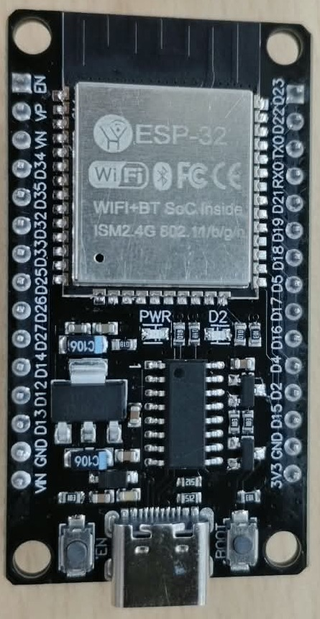
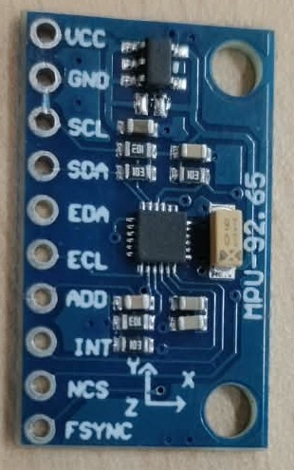
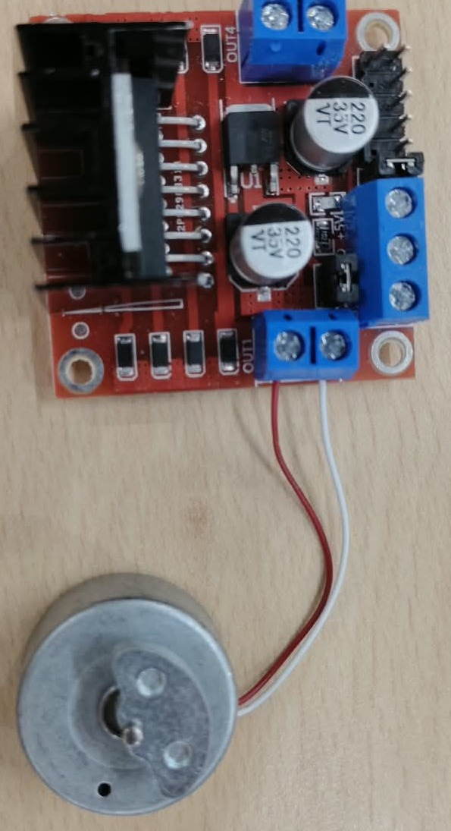
Hardware Components
ESP32 Development Board
MPU6050 Sensor
L298N Driver + DC Motor
Main microcontroller: reads the sensor, runs the AI model and controls outputs.
Accelerometer + gyroscope: measures motion and vibration, talks to ESP32 over I2C.
Driver switches the motor; the motor is the vibration source used for testing.
Also used
LED with current-limiting resistor | Jumper wires and breadboard | Power supply
6 / 17

Slide 7
Component 1: ESP32 Development Board
What is it?
A low-cost microcontroller board with the ESP-32 module, USB Type-C port, EN / BOOT buttons and pin headers on both sides.
1
Why is it used?
It is small and cheap, strong enough to run a TinyML model, and has many GPIO pins for the sensor, driver and LED.
2
How does it work?
It runs the firmware we upload over USB. The firmware reads the sensor, prepares data, runs the AI model and sets GPIO pins HIGH or LOW.
3
In our project
Reads the MPU6050 over I2C, runs the TensorFlow Lite Micro model, and drives the L298N (GPIO 27, 26) and the LED.
4
Output
A decision, NORMAL or VIBRATION, turned into LED and motor signals on its GPIO pins.
ESP32 Development Board
5
Photo: ESP-32 module (Wi-Fi + Bluetooth), USB Type-C, EN and BOOT buttons
7 / 17

Slide 8
Component 2: MPU6050 Sensor
What is it?
A small module with a 3-axis accelerometer and a 3-axis gyroscope. The X, Y and Z directions are printed on the board.
1
Why is it used?
Vibration is fast shaking. The accelerometer feels the shaking and the gyroscope feels rotation, so together they describe the motion.
2
How does it work?
It measures motion on every axis and sends the numbers to the ESP32 over the I2C bus (two wires: SDA for data, SCL for clock).
3
In our project
Placed near the vibration source. VCC goes to 3.3V, GND to GND, SDA and SCL to the ESP32 I2C pins. It gives the live data for the AI.
4
Output
Continuous raw accelerometer and gyroscope readings sent to the ESP32.
MPU6050 Motion Sensor Module
5
Photo: VCC, GND, SCL, SDA pins; X, Y, Z axes marked on the board
8 / 17

Slide 9
Component 3: L298N Motor Driver and DC Motor
What is it?
An L298N motor driver board (heat sink and blue screw terminals) connected to a small DC motor by red and white wires.
1
Why is it used?
ESP32 pins give only a tiny current, but a motor needs more. The driver works as a switch the ESP32 can control safely.
2
How does it work?
IN1 and IN2 receive logic signals from the ESP32. The board then switches the motor supply to the OUT terminals to run the motor.
3
In our project
GPIO 27 goes to IN1, GPIO 26 to IN2, and OUT goes to the DC motor. The running motor is the vibration source that MPU6050 senses.
4
Output
Motor movement, which creates the physical vibration used to test NORMAL and VIBRATION conditions.
L298N Driver + DC Motor
5
Photo: heat sink, blue screw terminals, motor with red and white wires
9 / 17

Slide 10
Complete Hardware Connection
FULL HARDWARE CONNECTION PHOTO WILL BE ADDED HERE
10 / 17

Slide 11
Hardware Connections / Pin Details
Component | Pin | Connects to | Purpose
MPU6050 | VCC | ESP32 3.3V | Power
MPU6050 | GND | ESP32 GND | Ground
MPU6050 | SDA | ESP32 I2C SDA pin | I2C data
MPU6050 | SCL | ESP32 I2C SCL pin | I2C clock
L298N | IN1 | ESP32 GPIO 27 | Motor control
L298N | IN2 | ESP32 GPIO 26 | Motor control
L298N | OUT | DC motor | Drives motor
LED | Anode | ESP32 GPIO via resistor | Indication
Why I2C for MPU6050?
Only two wires (SDA, SCL) carry all sensor data to the ESP32.
Why L298N?
GPIO pins cannot supply motor current; the driver switches it.
Why direct LED?
An LED needs little current, so the GPIO with a resistor is enough.
SDA/SCL pins and the LED GPIO follow the firmware configuration.
11 / 17

Slide 12
AI Model Architecture
Sensor data collection
MPU6050 readings come in
Preprocessing
Clean the readings
Feature extraction
Prepare useful inputs
Model input
Features fed to model
ML classification
Model checks the pattern
1
2
3
4
5
Execution on ESP32
Live on-device inference
TFLite Micro deployment
Added to ESP32 firmware
TensorFlow Lite conversion
Ready for microcontroller
Output
NORMAL / VIBRATION
9
8
7
6
Why TensorFlow Lite Micro?
Lightweight and built for microcontrollers with little memory.
Runs the model on the ESP32 itself, without cloud.
The trained model is converted to TensorFlow Lite format.
The converted model is placed inside the ESP32 firmware.
12 / 17

Slide 13
Results / Functional Testing
13 / 17

Slide 14
Applications
Application | How vibration detection helps
Industrial machine health monitoring | Changes in vibration can show a machine is wearing or loose.
Motor vibration monitoring | Abnormal shaking may point to imbalance or a motor problem.
Predictive maintenance | Repairs can be planned before a machine fails.
Equipment fault detection | Unusual vibration can flag a fault early.
Structural vibration monitoring | Bridges or frames can be watched for unusual movement.
Smart IoT monitoring systems | Low-cost nodes can watch many machines and report status.
Robotics | Vibration can show a joint or motor is not running smoothly.
Industrial automation | Automated lines can alert or stop when vibration appears.
14 / 17

Slide 15
Limitations and Future Scope
Current Limitations
Future Scope
Small prototype dataset
Sensor noise
Mounting and environment effects
Limited ESP32 memory and computing resources
Performance depends on data quality
Limited industrial testing
Only NORMAL vs VIBRATION classification
Larger and more diverse datasets
More vibration classes
Specific fault-type classification
Wi-Fi / IoT dashboard
Mobile notifications
More advanced TinyML models
Predictive maintenance
Battery-powered industrial deployment
15 / 17

Slide 16
Conclusion
ESP32 and MPU6050 form the sensing and processing platform.
1
Final outcome
A compact embedded AI prototype that detects vibration in real time and responds physically, showing that low-cost edge AI is practical for machine and structure monitoring.
Machine learning is used to tell NORMAL from VIBRATION.
2
TensorFlow Lite Micro allows AI inference on the microcontroller.
3
Decisions are made locally on the ESP32, with no cloud needed.
4
LED and motor/output give immediate physical feedback.
5
The project shows how edge AI can do low-cost vibration monitoring.
6
16 / 17

Slide 17
Thank You
Questions & Discussion
Project
AI-Based Vibration Detection System
Using ESP32 and MPU6050
17 / 17

