Slide 1
Intent, Specifications, Realizations, and the Judgments That Connect Them
Agentic Software Engineering — ASE Principles Module, Lecture 01

Slide 2
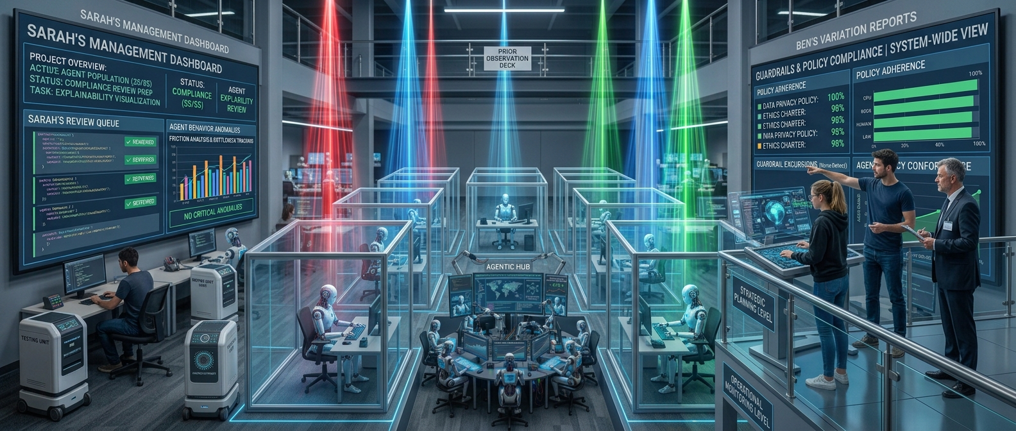
Motivation
As we move into the future..
The question this lecture begins to answer:
What are the basic principles can guide us in engineering the development and assurance context?
Human effort will shift
…from engineering the code
…to engineering the development and assurance context
…to engineering layered, composable abstractions
…that provide direction but also explainability
Notes:
We believe in abstractions: hierarchical, composable, designed for formal reasoning. How to develop agentic software engineering so that the abstractions are the heart of what they produce, how they plan (i.e., how they decompose work temporily and structurally)
Assurance – externalize confidence in the system – how do we achieve views that are appropriate for humans (avoid mental overhead) and agents (avoiding time and token burn). Cautionary story about Haskell build system. Achieve visibility into the development process – governance, process improvement measurement. Key point: independence – diversity in reasoning and problem solving.
High assurance, properties that are specified and assessed at multiple levels of abstraction
Usability for agents – I’ve got this powerful new employee and teammate. They are much smarter and faster than me at meany things. But they are not as good as me at other things.
Shift from engineering the code to engineering the development and assurance context
Managed technology base – layered composable abstractions that not only provide direction but provide explainability

Slide 3

ASE – Key Concepts
Much of the development process can be managed by understanding and applying the following concepts…
Part 1: Basic Development Items and Relationships (Judgements)
Stakeholders /
Human Intent
Specs
Quality
Rules
Validation
Verification
Realization
Quality
Rules

Slide 4
System purpose/scope
Glossary
User stories
Requirements
Architecture descriptions
Data description
Sequence charts, etc., etc.
Captures human intent
(should conform to intent)
Directs development
Summarizes (for understanding) the system
Abstractions of the realization
Stakeholders /
Human Intent
Specs
Quality
Rules
Unambiguous
Consistency
Completeness
Formatted for traceability
Elicitation / Interviews
Examples and counter-examples
Illustrations / simulations
Validation
Verification
Realization
Quality
Rules

Slide 5
Stakeholders /
Human Intent
Specs
Quality
Rules
Validation
Verification
Linting
Complexity measures
Appropriate code-level abstractions
Technical debt reduced
Realization
Quality
Rules

Slide 6
Does the realization conform to the specification?
Strategies
  Mechanical (deterministic)
    Testing (coverage!)
    Formal verification
  Audit (Agent)
  Audit (Human)
Stakeholders /
Human Intent
Specs
Quality
Rules
Traceability!!
Coverage / Completeness
Trustworthiness of the strategy
Validation
Verification
Realization
Quality
Rules

