Slide 1
Goals of this Paper
System Testing: Integrated Model- and Code-based framework for…
Contract-based (symbolic execution) verification of components (HILT 2022)
Property-based automated testing of components (FMICS 2023)
System testing based on
Guided exploration of static system schedules
Run-time monitoring of contracts of component pre-states and post-states
Framework of value injection and event observation
Distributed execution of system tests
Sophisticated reporting/coverage framework

Slide 2

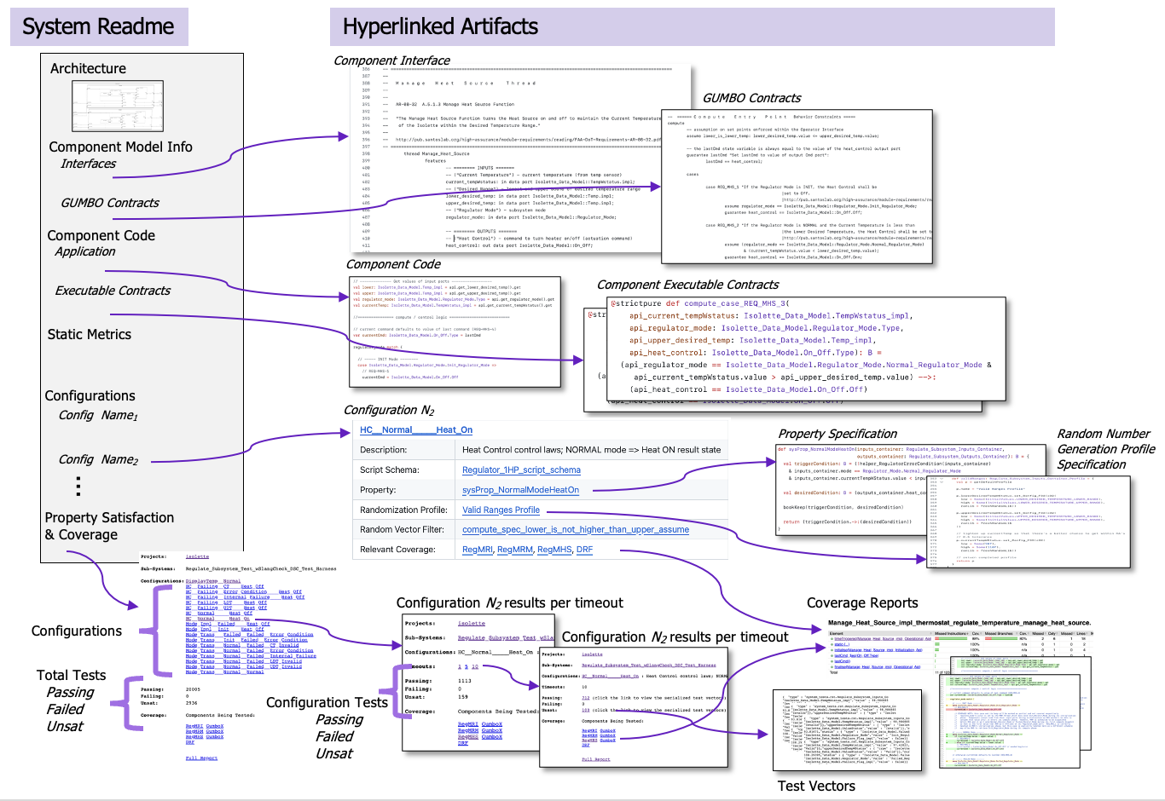
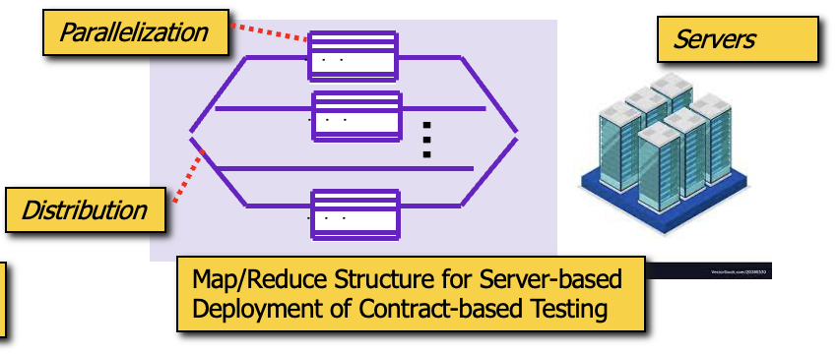
HAMR System Testing Concepts
Randomizing
Service
Property( , ... , )
value vectors
<u₁,u₂, ..., u_{l}>
<v₁,v₂, ..., v_{n}>
<w₁,w₂, ..., w_{k}>
Integrated contract
checking
inject
observe
observe
...
scriptable execution progression
Initialization
Phase
Compute
Phase
Finalization
Phase
Auto-generated Distribution of Tests on Servers
Auto-generated Hyper-linked Test Reports and Assurance Evidence

Slide 3
HAMR System Testing Concepts
Randomizing
Service
Property( , ... , )
value vectors
<u₁,u₂, ..., u_{l}>
<v₁,v₂, ..., v_{n}>
<w₁,w₂, ..., w_{k}>
Integrated contract
checking
inject
observe
observe
...
scriptable execution progression
Initialization
Phase
Compute
Phase
Finalization
Phase
Auto-generated Distribution of Tests on Servers
Auto-generated Hyper-linked Test Reports and Assurance Evidence

Slide 4
Example System Property
Typical embedded system properties require not only identifying state constraints but placing these in time
Observe system state at component ports
If
[When ..subsystem has received all inputs]
There are no failure conditions on inputs
Acquire observations of system state at specific points in schedule
The Regulate Subsystem is in NORMAL mode
The current temp is greater than high set point
Bound latencies (not directly treated in paper)
[When ..subsystem completes its scheduling]
Then
The heat control command shall be set to OFF
Challenges
…observations are for different parts of the system state (different ports)
…observations occur at different points in time (different points in schedule)

Slide 5
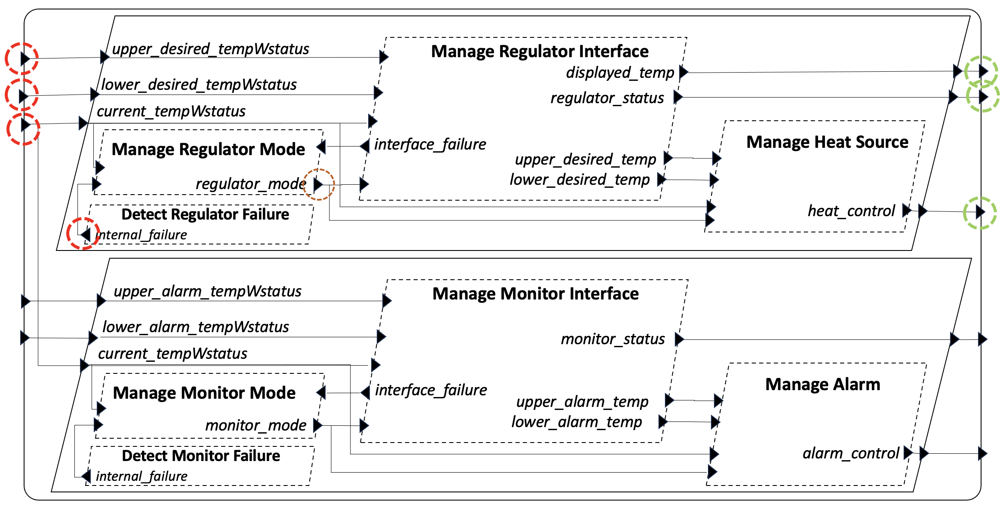
Injections / Observations at Ports
This property relates to the Regulate subsystem. So identify the Regulate ports for injections and observations
(for this property, triggering conditions and response conditions)
Desired temperature
Current
temperature
Failures
Mode
Heat Control

Slide 6
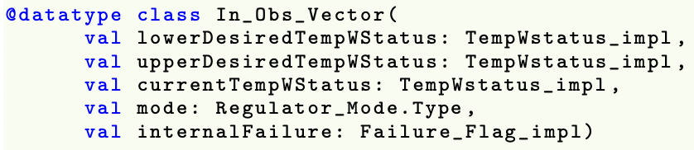
Observation Vectors
HAMR provides support for constructing vectors of port values
Desired temperature
Current
temperature
Failures
Mode
Heat Control

Slide 7
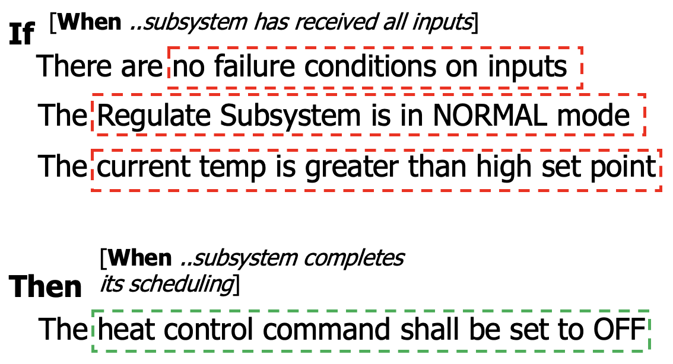
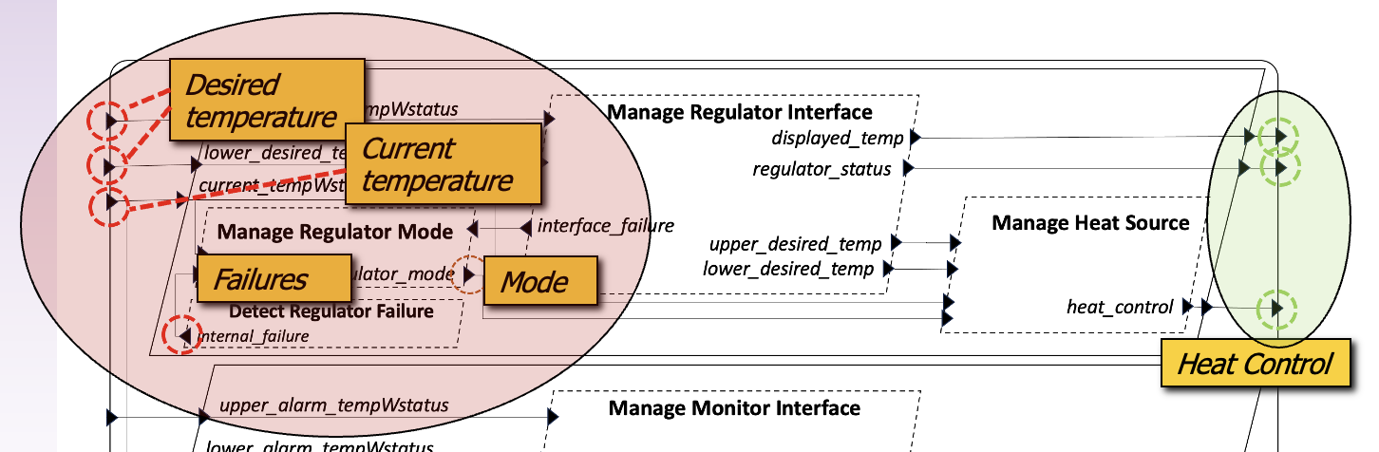
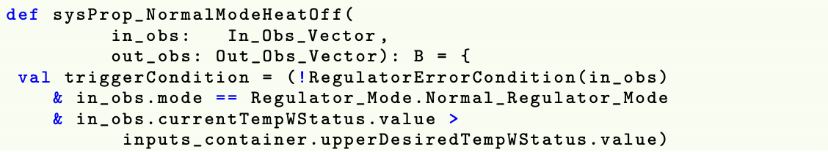
Property Specification
System property (state constraints) are specified as Slang Boolean functions on injections/observations

Slide 8
Static Schedule (Intuition)
Intuitive representation of static cyclic schedule
Subsytem Inputs
0
Operator Interface
Manage Interface
Manage Heat Source
3
10
Manage Mode
4
5
Heat
Controller
Internal Failure Detection
2
8
1
9
7
Temp
Sensor
6

Slide 9
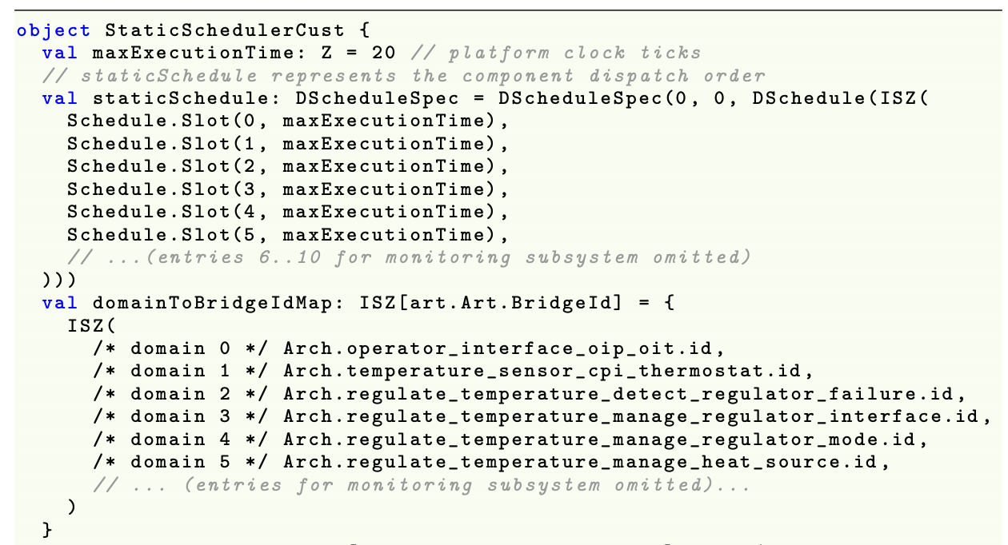
Static Schedule Declaration
Using a scheduling approach that aligns with seL4 domain scheduler and Collins Aerospace strategies – static cyclic scheduling
0
..
3
4
5
..
Scheduling slots that include a thread identifier and the absolute execution time associated with that thread…
Excerpts
Manage Heat Source allocated to slot # 5

Slide 10
Concept of Execution Schema for This Property
Check property on In and Out vectors
SysPropNormalModeHeatOff( , )
Randomizing
Service
<u₁,u₂, ..., u_{l}>
<w₁,w₂, ..., w_{k}>
inject
observe
...
...
Initialization
Phase
Step past input tasks
Compute
Phase
Finalization
Phase
Step to end of hyperperiod
Run until system has cycled a few times
Inject random port values for In vector satisfying range/filter constraints
Hyperperiod
Boundary
Hyperperiod
Boundary
Observer port values for Out vector

Slide 11
Testing/Debugging API for Schedule Control
HAMR provides APIs that allow debugging and testing tools to directly advance the scheduling at different increments…
Sstep(numSteps)
Advance numSteps slots in schedule (wrap if necessary)
relative
Hstep(numHyperPeriods)
Advance numHyperPeriods slots in schedule, stopping at hyperperiod boundary
RunToSlot(slotNum)
Advance to slot number slotNum
absolute
RunToThread(threadID)
Advance to slot associated with threadID
RunToHP(HPNum)
Advance to hyperperiod number HPNum

Slide 12
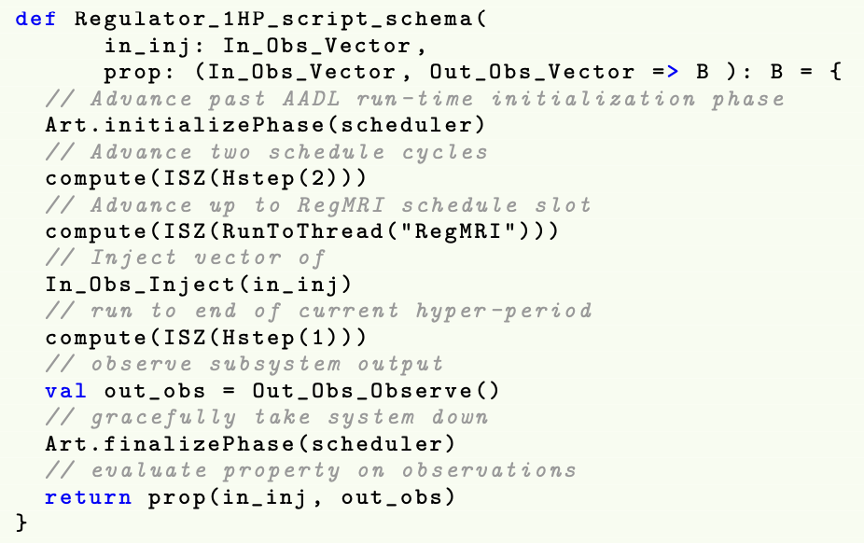
System Testing Scripts
Developers create testing scripts that advance the schedule, inject randomized values, acquire observations of system state, and evaluate properties
Run initialization phase of system
Run several cycles to allow system to stablize
Run past point where inputs have been acquired
Inject randomize values into ports (satisfying constraints)
Run to end of hyperiod and observe output values
Check property – desired relationship between observed state and different temporal points

Slide 13
Randomization Framework for Injection Vectors
Scripts can be parameterized on injection vectors, which enables us to use a randomizing framework to generate these vectors
Accepts an input of randomized port values
Test configurations can be defined to specify the
number of runs for the tests,
constraints on random value vector generation
specific property to be checked within the test script

Slide 14
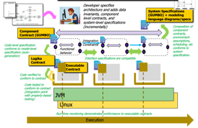

Scaling Up – Server-Based Deployment
HAMR generates a server-based deployment to run the framework in a distributed/parallel fashion...
Parallelization
Servers
...
...
...
Distribution
...
Continous Integration / Delivery of Formal Methods
Map/Reduce Structure for Server-based Deployment of Contract-based Testing
Random generators and configured system tests are farmed out to a configurable family of servers
Test vectors and results are serialized for flexible deployment, reporting, and replay of the tests
Currently hosted using our Jenkins setup, but easy for HAMR to automatically generate deployment scripts, e.g., for AWS, in the future

Slide 15

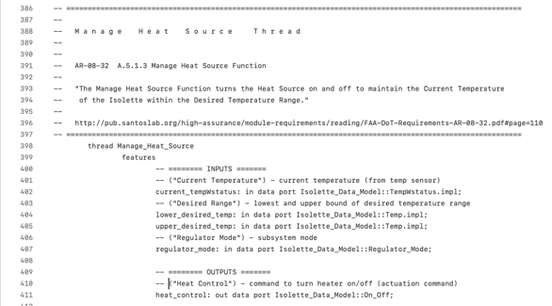
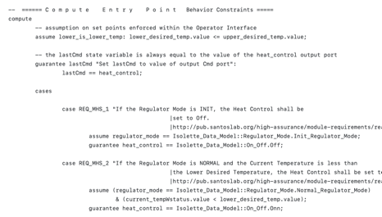
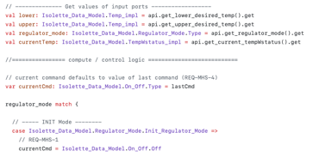
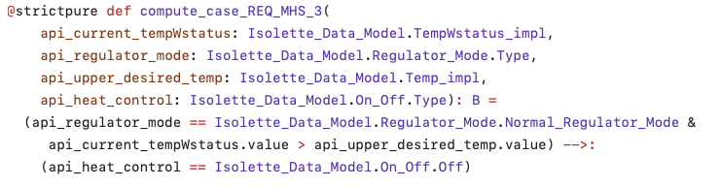
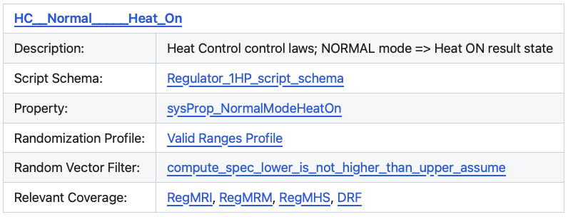
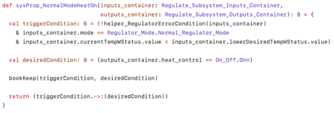
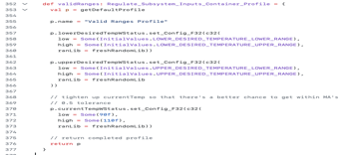
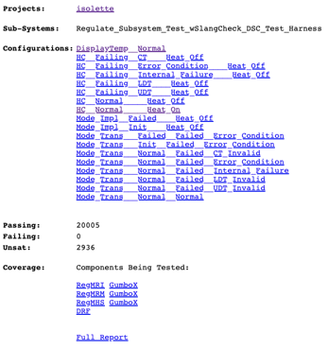
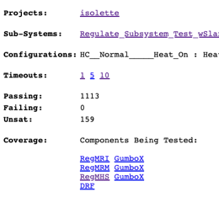
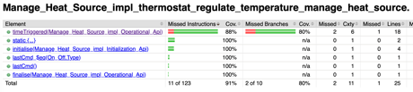
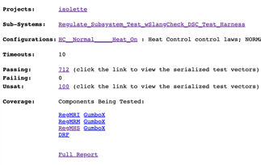
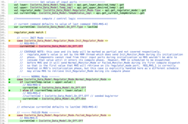

Auto-Generated Assurance Information
System Readme
Hyperlinked Artifacts
Architecture
Component Interface
GUMBO Contracts
Component Model Info
Interfaces
GUMBO Contracts
Component Code
Application
Component Code
Executable Contracts
Component Executable Contracts
Static Metrics
Configurations
Configuration N₂
Config Name₁
Property Specification
Random Number Generation Profile
Specification
Config Name₂
…
Property Satisfaction
& Coverage
Configuration N₂ results per timeout
Coverage Reports
Configurations
Configuration N₂ results per timeout
Total Tests
Passing
Failed
Unsat
Configuration Tests
Passing
Failed
Unsat
Test Vectors

