Slide 1
Slang & Logika: Loops and Invariants
STRESS 2024 – October 24, 2024
Kansas State University
Aarhus University
Robby
John Hatcliff
Jason Belt
Stefan Hallerstede
This material is based on research sponsored in part by DARPA
DISCLAIMER: The views and conclusions contained in this presentation are those of the author and should not be interpreted as representing the official policies, either express or implied, of any agency or department of the U.S. Government, Kansas State University or Aarhus University
Notes:
I'm John Hatcliff, a professor from Kansas State University. This is a second talk on semantics for a modeling language, and here we aim to make deeper connections with the underlying application and infrastructure code via contracts. This talk pulls together several different lines of work that were carried out in collaboration with different teams, including teams from SEI and Galois primarily, but always folks from Collins Aerospace and people working on seL4.

Slide 2
While Loops
Hoare-style reasoning about while loops
// Assume pre-condition
Loop statement
// Deduce post-condition (proof obligation)
Notes:
The framework that we will be using for this work is HAMR -- a model-driven development tool chain for high assurance embedded systems that emphasizes three layers of development:
Modeling, analysis and verification in the AADL modeling language, leveraging many tools in the AADL ecosystem
Development of component application logic in multiple languages include C and Slang (a safety-critical system of Scala with a contract verification framework, which can be translated to C)
Deployments on multiple platforms including seL4 verified microkernel.

Slide 3
While Loops
Syntax of the while loop
// Assume pre-condition
before loop
while (condition) {
loop body
}
after loop
// Deduce post-condition (proof obligation)
Notes:
The framework that we will be using for this work is HAMR -- a model-driven development tool chain for high assurance embedded systems that emphasizes three layers of development:
Modeling, analysis and verification in the AADL modeling language, leveraging many tools in the AADL ecosystem
Development of component application logic in multiple languages include C and Slang (a safety-critical system of Scala with a contract verification framework, which can be translated to C)
Deployments on multiple platforms including seL4 verified microkernel.

Slide 4
While Loops
Facts about the while loop that can be observed immediately
// Assume pre-condition
before loop // Deduce facts known before the loop is entered
while (condition) { // Deduce the condition (at this program location)
loop body
} // Deduce the negation of the condition (at this program location)
after loop
// Deduce post-condition (proof obligation)
Notes:
The framework that we will be using for this work is HAMR -- a model-driven development tool chain for high assurance embedded systems that emphasizes three layers of development:
Modeling, analysis and verification in the AADL modeling language, leveraging many tools in the AADL ecosystem
Development of component application logic in multiple languages include C and Slang (a safety-critical system of Scala with a contract verification framework, which can be translated to C)
Deployments on multiple platforms including seL4 verified microkernel.

Slide 5
While Loops
Deducing a new fact by means of an inductive invariant
// Assume pre-condition
before loop // Deduce facts known before the loop is entered
// Deduce the invariant (loop proof obligation) while (condition) { // Deduce the condition (at this program location)
// Assume the invariant loop body // Deduce the invariant (loop proof obligation)
} // Deduce the negation of the condition (at this program location)
// Deduce the invariant after loop
// Deduce post-condition (proof obligation)
Notes:
The framework that we will be using for this work is HAMR -- a model-driven development tool chain for high assurance embedded systems that emphasizes three layers of development:
Modeling, analysis and verification in the AADL modeling language, leveraging many tools in the AADL ecosystem
Development of component application logic in multiple languages include C and Slang (a safety-critical system of Scala with a contract verification framework, which can be translated to C)
Deployments on multiple platforms including seL4 verified microkernel.

Slide 6
While Loops
Deducing a new fact by means of an inductive invariant
// Assume pre-condition
before loop // Deduce facts known before the loop is entered
// Deduce the invariant (loop proof obligation – base case) while (condition) { // Deduce the condition (at this program location)
// Assume the invariant loop body // Deduce the invariant (loop proof obligation – inductive step)
} // Deduce the negation of the condition (at this program location)
// Deduce the invariant after loop
// Deduce post-condition (proof obligation)
Notes:
The framework that we will be using for this work is HAMR -- a model-driven development tool chain for high assurance embedded systems that emphasizes three layers of development:
Modeling, analysis and verification in the AADL modeling language, leveraging many tools in the AADL ecosystem
Development of component application logic in multiple languages include C and Slang (a safety-critical system of Scala with a contract verification framework, which can be translated to C)
Deployments on multiple platforms including seL4 verified microkernel.

Slide 7
While Loops
Syntax of while loops and loop invariants
// Assume pre-condition
before loop // Deduce facts known before the loop is entered
// Deduce the invariant (loop proof obligation) while (condition) { // Deduce the condition (at this program location)
// Assume the invariant loop body // Deduce the invariant (loop proof obligation)
} // Deduce the negation of the condition (at this program location)
// Deduce the invariant after loop
// Deduce post-condition (proof obligation)
// … using the invariant and the negation of the condition
Notes:
The framework that we will be using for this work is HAMR -- a model-driven development tool chain for high assurance embedded systems that emphasizes three layers of development:
Modeling, analysis and verification in the AADL modeling language, leveraging many tools in the AADL ecosystem
Development of component application logic in multiple languages include C and Slang (a safety-critical system of Scala with a contract verification framework, which can be translated to C)
Deployments on multiple platforms including seL4 verified microkernel.

Slide 8
While Loops
Syntax of loop invariants and Logika deductions
// Assume pre-condition
…
Deduce(⊢ …)
Deduce(⊢ I) while (C) {
Invariant(
Modifies(list of variables),
I
)
…
} Deduce(⊢ I ∧ ¬C)
…
// Deduce post-condition (proof obligation)
Notes:
The framework that we will be using for this work is HAMR -- a model-driven development tool chain for high assurance embedded systems that emphasizes three layers of development:
Modeling, analysis and verification in the AADL modeling language, leveraging many tools in the AADL ecosystem
Development of component application logic in multiple languages include C and Slang (a safety-critical system of Scala with a contract verification framework, which can be translated to C)
Deployments on multiple platforms including seL4 verified microkernel.

Slide 9
Specification (The maths)
Example: Factorial function
@strictpure def fac_spec(n: Z): Z = n match { case 0 => 1 case m => m * fac_spec(m - 1) }
Recursive specification of the factorial function
Notes:
The framework that we will be using for this work is HAMR -- a model-driven development tool chain for high assurance embedded systems that emphasizes three layers of development:
Modeling, analysis and verification in the AADL modeling language, leveraging many tools in the AADL ecosystem
Development of component application logic in multiple languages include C and Slang (a safety-critical system of Scala with a contract verification framework, which can be translated to C)
Deployments on multiple platforms including seL4 verified microkernel.

Slide 10
Implementation using a While Loop
Example: Factorial function
@pure def fac_it(n: Z): Z = { Contract( Requires(n >= 0), Ensures(Res == fac_spec(n)) ) var x: Z = 1 var m: Z = 0; while (m < n) { Invariant( Modifies(x, m), (m >= 0), (m <= n), (x == fac_spec(m)) ) Deduce(|- (x * (m + 1) == fac_spec(m + 1))) m = m + 1 Deduce(|- (x * m == fac_spec(m))) x = x * m Deduce(|- (x == fac_spec(m))) } Deduce(|- (m == n)) return x }
Variables x and m are modified by the loop body
Inductive property (that is continually true)
Property that can be inferred on loop termination
Notes:
The framework that we will be using for this work is HAMR -- a model-driven development tool chain for high assurance embedded systems that emphasizes three layers of development:
Modeling, analysis and verification in the AADL modeling language, leveraging many tools in the AADL ecosystem
Development of component application logic in multiple languages include C and Slang (a safety-critical system of Scala with a contract verification framework, which can be translated to C)
Deployments on multiple platforms including seL4 verified microkernel.

Slide 11
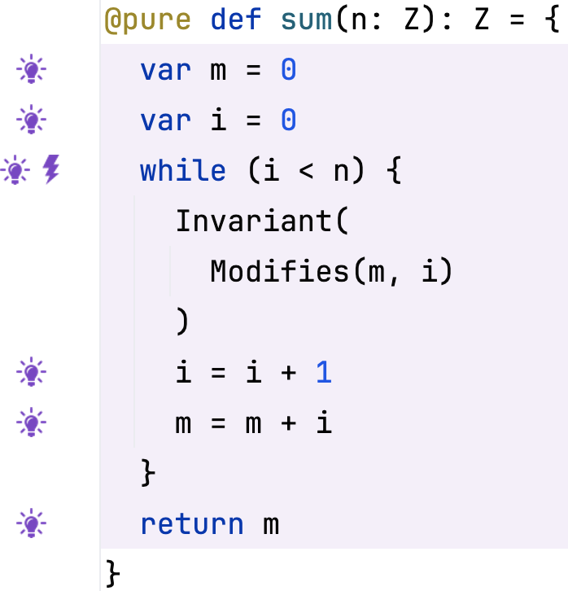
Exercise
Function computing n * (n + 1) / 2
(A) State a contract that ensures that the returned result is n * (n + 1) / 2
(B) Prove it
File: M02_01_Sum_Up.sc
Notes:
The framework that we will be using for this work is HAMR -- a model-driven development tool chain for high assurance embedded systems that emphasizes three layers of development:
Modeling, analysis and verification in the AADL modeling language, leveraging many tools in the AADL ecosystem
Development of component application logic in multiple languages include C and Slang (a safety-critical system of Scala with a contract verification framework, which can be translated to C)
Deployments on multiple platforms including seL4 verified microkernel.

