Slide 1
Slang & Logika: Sequences and Quantification
STRESS 2024 – October 24, 2024
Kansas State University
Aarhus University
Robby
John Hatcliff
Jason Belt
Stefan Hallerstede
This material is based on research sponsored in part by DARPA
DISCLAIMER: The views and conclusions contained in this presentation are those of the author and should not be interpreted as representing the official policies, either express or implied, of any agency or department of the U.S. Government, Kansas State University or Aarhus University
Notes:
I'm John Hatcliff, a professor from Kansas State University. This is a second talk on semantics for a modeling language, and here we aim to make deeper connections with the underlying application and infrastructure code via contracts. This talk pulls together several different lines of work that were carried out in collaboration with different teams, including teams from SEI and Galois primarily, but always folks from Collins Aerospace and people working on seL4.

Slide 2
Sequences (Overview)
Sequence type and operations
Slang | Explanation | Deduced Property
val empty: ISZ[Z] = ISZ() | Empty sequence | empty.isEmpty
val s1: ISZ[Z] = ISZ(1) | Sequence const. | s1(0) == 1
val s2: ISZ[Z] = ISZ(2) | Sequence const. | ¬s2.isEmpty
val s3: ISZ[Z] = ISZ(1, 2) | Sequence const. | s3.size == 2
val s4: ISZ[Z] = ISZ(2, 1) | Sequence const. | s3(0) == s4(1)
val s5: ISZ[Z] = s1 :+ 2 | Push (right) | s3 == s5
val s6: ISZ[Z] = 1 +: s2 | Push (left) | s3 == s5
val s7: ISZ[Z] = s1 ++ s2 | Concatenate | s3 == s7
val s8: ISZ[Z] = s3(0 ⤳ s3(1), 1 ⤳ s3(0)) | Overwrite (here swap) | s4 == s8
val v9: ZRange[Z] = s8.indices | Index range | v9 == 0 until 2
The type ISZ[T] denotes sequences with elements of type T
Notes:
The framework that we will be using for this work is HAMR -- a model-driven development tool chain for high assurance embedded systems that emphasizes three layers of development:
Modeling, analysis and verification in the AADL modeling language, leveraging many tools in the AADL ecosystem
Development of component application logic in multiple languages include C and Slang (a safety-critical system of Scala with a contract verification framework, which can be translated to C)
Deployments on multiple platforms including seL4 verified microkernel.

Slide 3
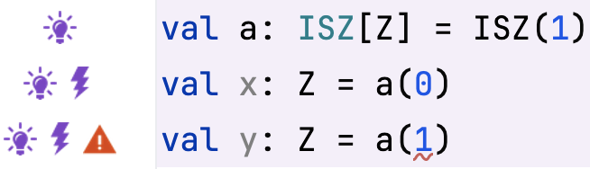

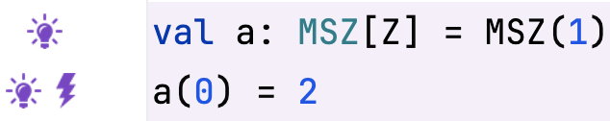
Sequences
Access to elements of a sequence
There are two types of sequences in Slang: immutable and mutable
Could not deduce that the sequence indexing is in bound
ISZ[T] sequences are immutable
Mutable sequences are provided by the type MSZ[T]
Notes:
The framework that we will be using for this work is HAMR -- a model-driven development tool chain for high assurance embedded systems that emphasizes three layers of development:
Modeling, analysis and verification in the AADL modeling language, leveraging many tools in the AADL ecosystem
Development of component application logic in multiple languages include C and Slang (a safety-critical system of Scala with a contract verification framework, which can be translated to C)
Deployments on multiple platforms including seL4 verified microkernel.

Slide 4
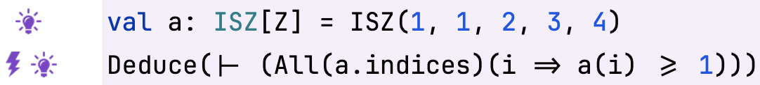
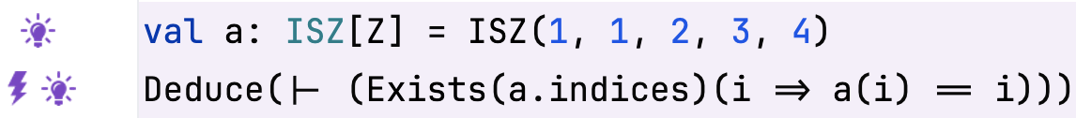
Sequences
Quantification (Range Restricted)
Universal quantification
All(range)(variable => expression)
Range of the quantifier
Existential quantification
Exists(range)(variable => expression)
Range of the quantifier
Notes:
The framework that we will be using for this work is HAMR -- a model-driven development tool chain for high assurance embedded systems that emphasizes three layers of development:
Modeling, analysis and verification in the AADL modeling language, leveraging many tools in the AADL ecosystem
Development of component application logic in multiple languages include C and Slang (a safety-critical system of Scala with a contract verification framework, which can be translated to C)
Deployments on multiple platforms including seL4 verified microkernel.

Slide 5
Sequences
Quantification (when the range is the type itself)
Universal quantification
All{variable: type => expression}
Existential quantification
This is just a closure
Exists{variable: type => expression}
Notes:
The framework that we will be using for this work is HAMR -- a model-driven development tool chain for high assurance embedded systems that emphasizes three layers of development:
Modeling, analysis and verification in the AADL modeling language, leveraging many tools in the AADL ecosystem
Development of component application logic in multiple languages include C and Slang (a safety-critical system of Scala with a contract verification framework, which can be translated to C)
Deployments on multiple platforms including seL4 verified microkernel.

Slide 6
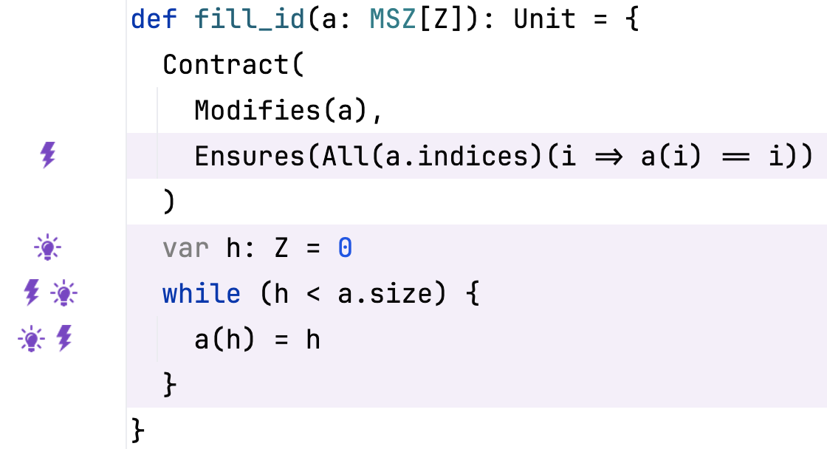
Sequences
Sequence and Quantification Example
Function filling a mutable sequence with the identity
All indices of the sequence
Notes:
The framework that we will be using for this work is HAMR -- a model-driven development tool chain for high assurance embedded systems that emphasizes three layers of development:
Modeling, analysis and verification in the AADL modeling language, leveraging many tools in the AADL ecosystem
Development of component application logic in multiple languages include C and Slang (a safety-critical system of Scala with a contract verification framework, which can be translated to C)
Deployments on multiple platforms including seL4 verified microkernel.

Slide 7
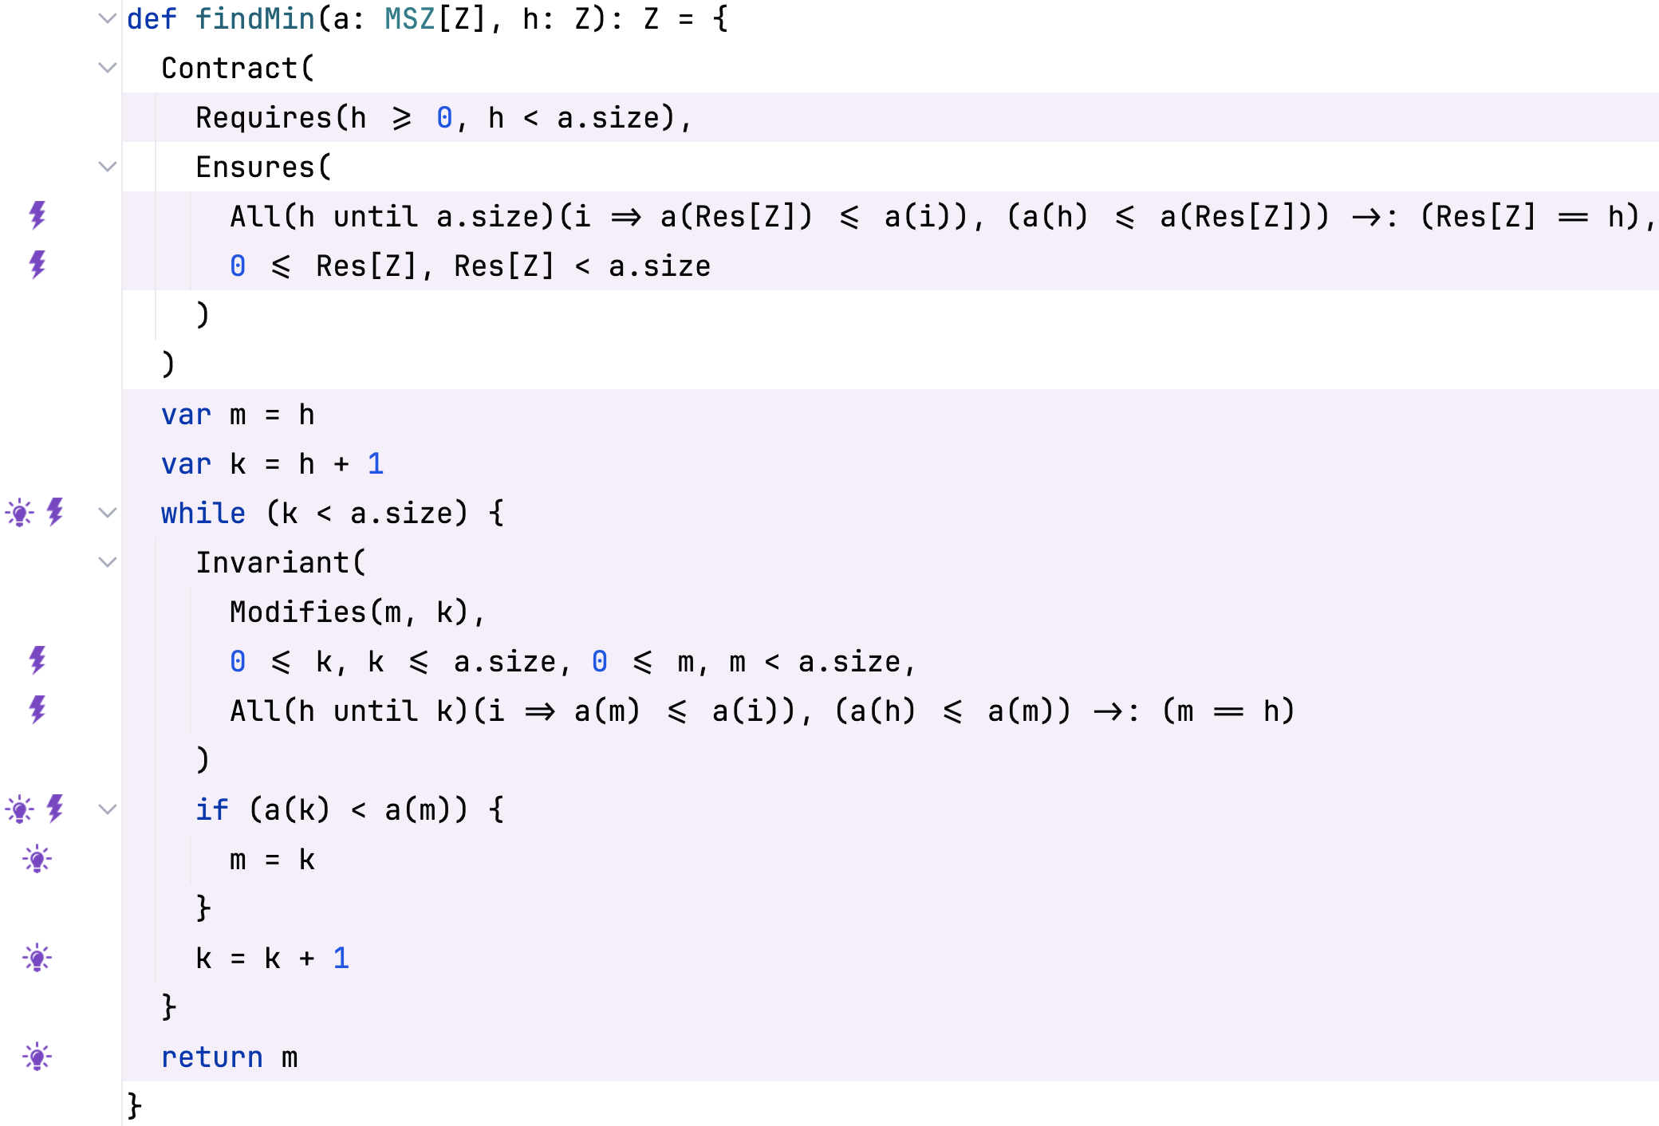
Sequences
Find (stable) minimum in sequence of numbers
The range of numbers from h to k-1
File: M02_03_2_Refactor_Proof.sc
Notes:
The framework that we will be using for this work is HAMR -- a model-driven development tool chain for high assurance embedded systems that emphasizes three layers of development:
Modeling, analysis and verification in the AADL modeling language, leveraging many tools in the AADL ecosystem
Development of component application logic in multiple languages include C and Slang (a safety-critical system of Scala with a contract verification framework, which can be translated to C)
Deployments on multiple platforms including seL4 verified microkernel.

