Slide 1
Logika: Recursion and Induction
STRESS 2024 – October 24, 2024
Kansas State University
Aarhus University
Robby
John Hatcliff
Jason Belt
Stefan Hallerstede
This material is based on research sponsored in part by DARPA
DISCLAIMER: The views and conclusions contained in this presentation are those of the author and should not be interpreted as representing the official policies, either express or implied, of any agency or department of the U.S. Government, Kansas State University or Aarhus University
Notes:
I'm John Hatcliff, a professor from Kansas State University. This is a second talk on semantics for a modeling language, and here we aim to make deeper connections with the underlying application and infrastructure code via contracts. This talk pulls together several different lines of work that were carried out in collaboration with different teams, including teams from SEI and Galois primarily, but always folks from Collins Aerospace and people working on seL4.

Slide 2
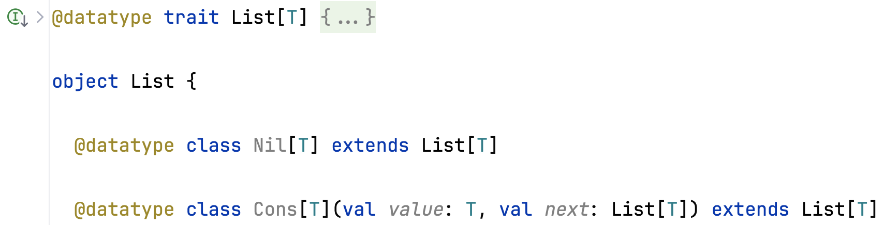
Inductive List datatype
Declaration of a List datatype in Slang
A List is either empty (Nil) or constructed (Cons) from a value and another list next. value is the head of the list, and next its tail.
Inductive datatypes are used with recursive function implementations.
Facts about these functions are proved by induction (@induct)
Notes:
The framework that we will be using for this work is HAMR -- a model-driven development tool chain for high assurance embedded systems that emphasizes three layers of development:
Modeling, analysis and verification in the AADL modeling language, leveraging many tools in the AADL ecosystem
Development of component application logic in multiple languages include C and Slang (a safety-critical system of Scala with a contract verification framework, which can be translated to C)
Deployments on multiple platforms including seL4 verified microkernel.

Slide 3
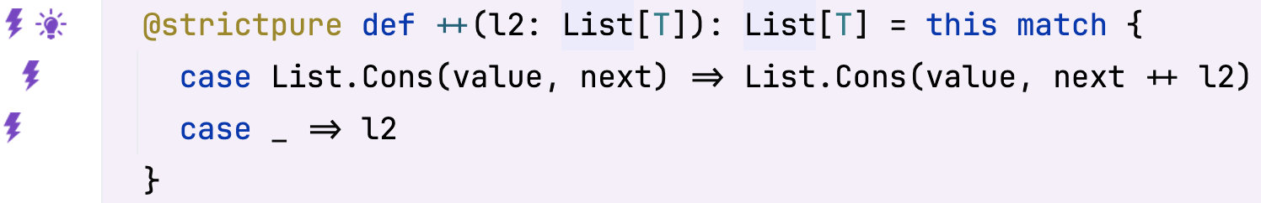
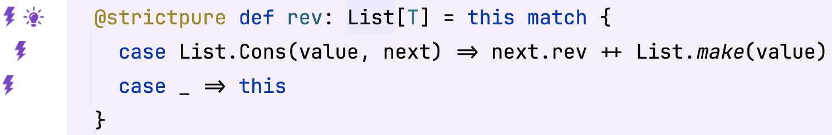
Recursive functions
Appending two lists (++) and reversing a list (rev)
Object-oriented notation
Function rev uses ++ to avoid introducing an accumulator.
Suppose we want to prove x.rev.rev == x for any list x
Notes:
The framework that we will be using for this work is HAMR -- a model-driven development tool chain for high assurance embedded systems that emphasizes three layers of development:
Modeling, analysis and verification in the AADL modeling language, leveraging many tools in the AADL ecosystem
Development of component application logic in multiple languages include C and Slang (a safety-critical system of Scala with a contract verification framework, which can be translated to C)
Deployments on multiple platforms including seL4 verified microkernel.

Slide 4
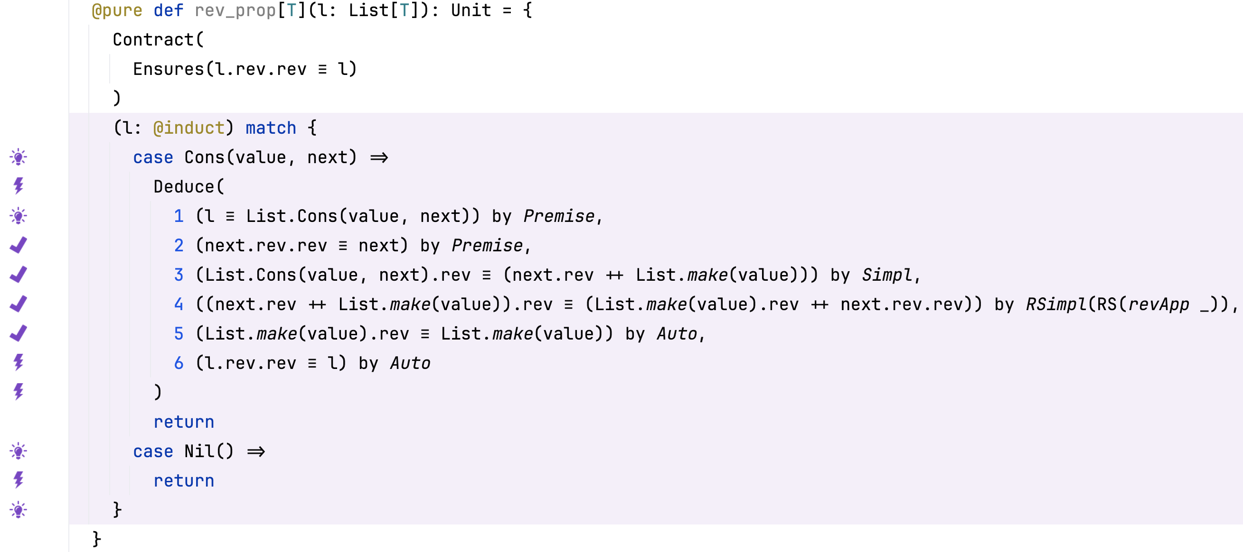
Induction
Use of @induct/match for inductive proofs
Algebraic property (can be used for rewriting)
Algebraic lemma used for rewriting
File: List_induct.sc
Notes:
The framework that we will be using for this work is HAMR -- a model-driven development tool chain for high assurance embedded systems that emphasizes three layers of development:
Modeling, analysis and verification in the AADL modeling language, leveraging many tools in the AADL ecosystem
Development of component application logic in multiple languages include C and Slang (a safety-critical system of Scala with a contract verification framework, which can be translated to C)
Deployments on multiple platforms including seL4 verified microkernel.

Slide 5
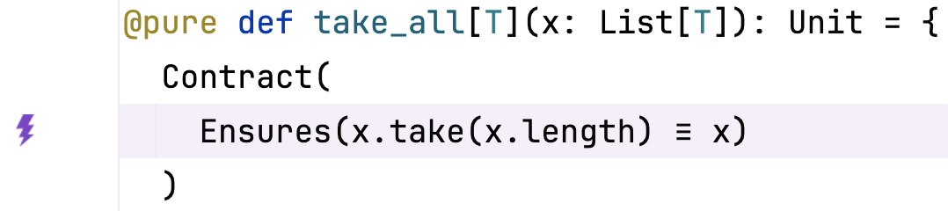
Exercise
(A) Prove the following statement by induction
(B) Spell out the proof for the Cons case using a series of deductions, starting with the premises of the case
File: A01_03_List_Exercise.sc
Notes:
The framework that we will be using for this work is HAMR -- a model-driven development tool chain for high assurance embedded systems that emphasizes three layers of development:
Modeling, analysis and verification in the AADL modeling language, leveraging many tools in the AADL ecosystem
Development of component application logic in multiple languages include C and Slang (a safety-critical system of Scala with a contract verification framework, which can be translated to C)
Deployments on multiple platforms including seL4 verified microkernel.

