Slide 1
Logika: Proof and Rewriting
STRESS 2024 – October 24, 2024
Kansas State University
Aarhus University
Robby
John Hatcliff
Jason Belt
Stefan Hallerstede
This material is based on research sponsored in part by DARPA
DISCLAIMER: The views and conclusions contained in this presentation are those of the author and should not be interpreted as representing the official policies, either express or implied, of any agency or department of the U.S. Government, Kansas State University or Aarhus University
Notes:
I'm John Hatcliff, a professor from Kansas State University. This is a second talk on semantics for a modeling language, and here we aim to make deeper connections with the underlying application and infrastructure code via contracts. This talk pulls together several different lines of work that were carried out in collaboration with different teams, including teams from SEI and Galois primarily, but always folks from Collins Aerospace and people working on seL4.

Slide 2
Expression Rewriting
Systematic application of equalities
Many facts have the shape of equalities, e.g.,
Properties of numbers like x + 0 = x
Function definitions like f(x) = if (x > 0) then x else 0
Properties derived from the above
These can be exploited in proofs, e.g.,
f(1) + 0
f(1) using x + 0 = x
if (1 > 0) then 1 else 0 using f(x) = if (x > 0) then x else 0
1 using semantics of if-statement
Logika has built in some rewriting rules
based on semantics (and expression evaluation)
Other rewriting rules can be added and used in proofs
Notes:
The framework that we will be using for this work is HAMR -- a model-driven development tool chain for high assurance embedded systems that emphasizes three layers of development:
Modeling, analysis and verification in the AADL modeling language, leveraging many tools in the AADL ecosystem
Development of component application logic in multiple languages include C and Slang (a safety-critical system of Scala with a contract verification framework, which can be translated to C)
Deployments on multiple platforms including seL4 verified microkernel.

Slide 3
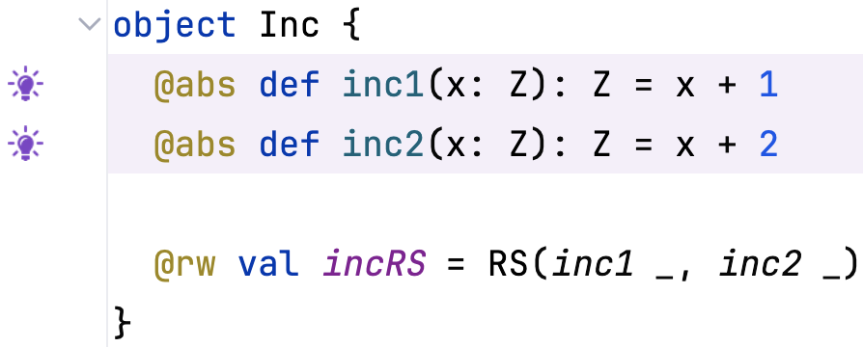
Expression Rewriting
Abstract function definitions
Two functions that can be used directly for rewriting (@abs)
Definition of a rewrite set called incRS
File: Proof_rewrite.sc
Notes:
The framework that we will be using for this work is HAMR -- a model-driven development tool chain for high assurance embedded systems that emphasizes three layers of development:
Modeling, analysis and verification in the AADL modeling language, leveraging many tools in the AADL ecosystem
Development of component application logic in multiple languages include C and Slang (a safety-critical system of Scala with a contract verification framework, which can be translated to C)
Deployments on multiple platforms including seL4 verified microkernel.

Slide 4
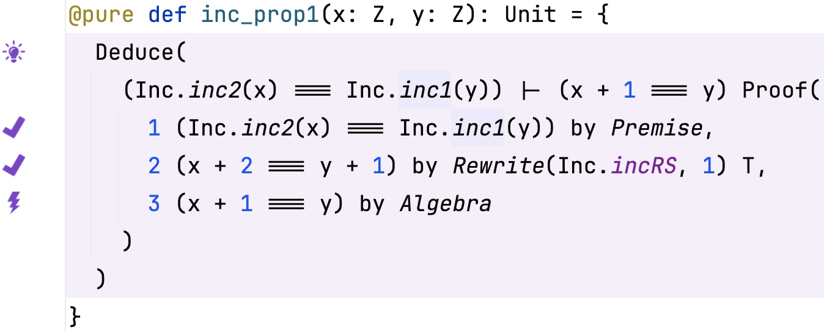
Expression Rewriting
The Rewrite tactic
This is a forward rewriting step that rewrites a previous fact (1)
Rewrite 1 using the equations in incRS
where incRS is
inc1(x) == x + 1
inc2(x) == x + 2
File: Proof_rewrite.sc
Notes:
The framework that we will be using for this work is HAMR -- a model-driven development tool chain for high assurance embedded systems that emphasizes three layers of development:
Modeling, analysis and verification in the AADL modeling language, leveraging many tools in the AADL ecosystem
Development of component application logic in multiple languages include C and Slang (a safety-critical system of Scala with a contract verification framework, which can be translated to C)
Deployments on multiple platforms including seL4 verified microkernel.

Slide 5
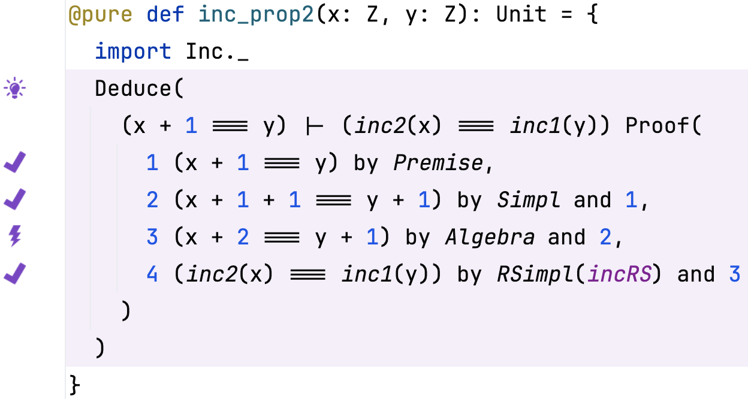
Expression Rewriting
The RSimpl tactic
Rewrite 4 using the equations in incRS and 3
This is a backward rewriting step that rewrites the current goal (4)
File: Proof_rewrite.sc
Notes:
The framework that we will be using for this work is HAMR -- a model-driven development tool chain for high assurance embedded systems that emphasizes three layers of development:
Modeling, analysis and verification in the AADL modeling language, leveraging many tools in the AADL ecosystem
Development of component application logic in multiple languages include C and Slang (a safety-critical system of Scala with a contract verification framework, which can be translated to C)
Deployments on multiple platforms including seL4 verified microkernel.

Slide 6
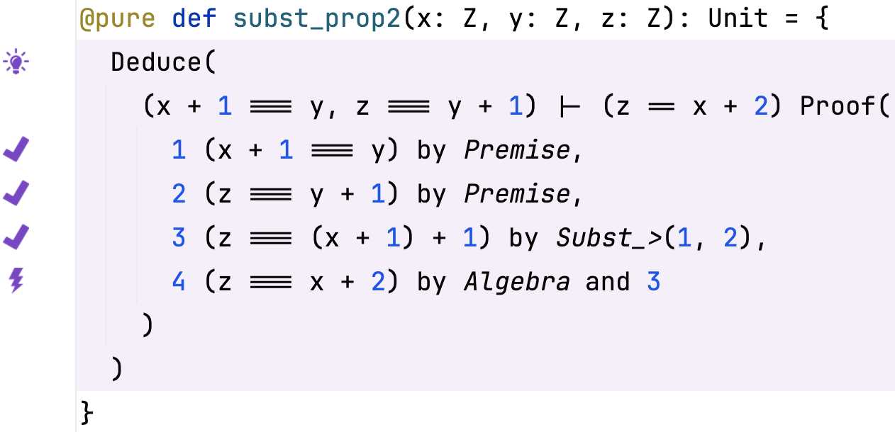
Expression Rewriting
Forward substitution
Read equation left-to-right (>)
Substitute 1 in 3 to obtain 2
File: Proof_rewrite.sc
Notes:
The framework that we will be using for this work is HAMR -- a model-driven development tool chain for high assurance embedded systems that emphasizes three layers of development:
Modeling, analysis and verification in the AADL modeling language, leveraging many tools in the AADL ecosystem
Development of component application logic in multiple languages include C and Slang (a safety-critical system of Scala with a contract verification framework, which can be translated to C)
Deployments on multiple platforms including seL4 verified microkernel.

Slide 7
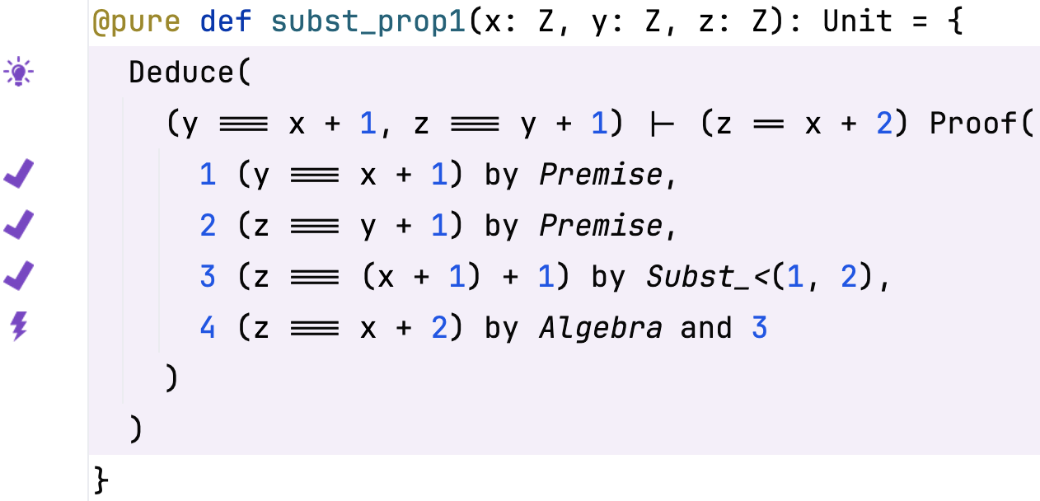
Expression Rewriting
Backward substitution
Read equation right-to-left (<)
Substitute 1 in 3 to obtain 2
File: Proof_rewrite.sc
Notes:
The framework that we will be using for this work is HAMR -- a model-driven development tool chain for high assurance embedded systems that emphasizes three layers of development:
Modeling, analysis and verification in the AADL modeling language, leveraging many tools in the AADL ecosystem
Development of component application logic in multiple languages include C and Slang (a safety-critical system of Scala with a contract verification framework, which can be translated to C)
Deployments on multiple platforms including seL4 verified microkernel.

Slide 8
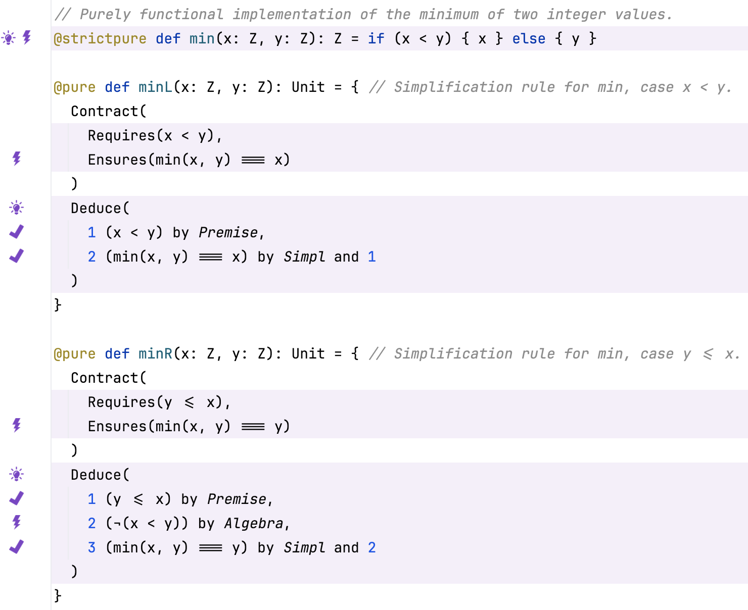
Proving Dedicated Rewriting Rules
Backward substitution
Definition of function
Rewrite rule lemmas
File: Proof_simpl.sc
Notes:
The framework that we will be using for this work is HAMR -- a model-driven development tool chain for high assurance embedded systems that emphasizes three layers of development:
Modeling, analysis and verification in the AADL modeling language, leveraging many tools in the AADL ecosystem
Development of component application logic in multiple languages include C and Slang (a safety-critical system of Scala with a contract verification framework, which can be translated to C)
Deployments on multiple platforms including seL4 verified microkernel.

Slide 9
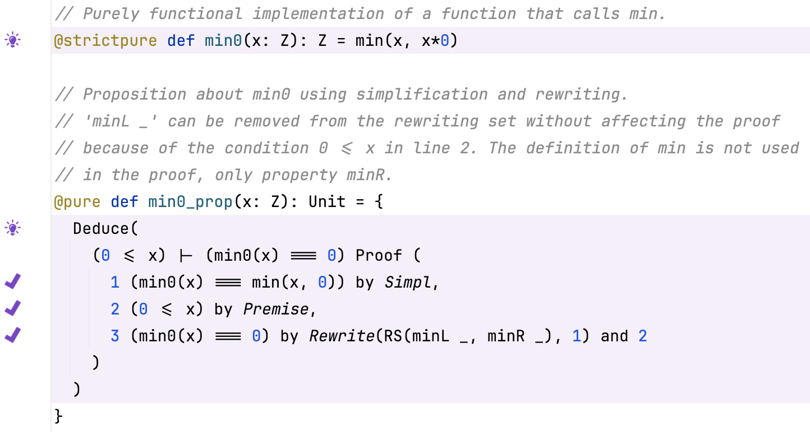
Proving Dedicated Rewriting Rules
Backward substitution
Definition of function that uses min
Use of the rewrite rule lemmas by Rewrite
File: Proof_simpl.sc
Notes:
The framework that we will be using for this work is HAMR -- a model-driven development tool chain for high assurance embedded systems that emphasizes three layers of development:
Modeling, analysis and verification in the AADL modeling language, leveraging many tools in the AADL ecosystem
Development of component application logic in multiple languages include C and Slang (a safety-critical system of Scala with a contract verification framework, which can be translated to C)
Deployments on multiple platforms including seL4 verified microkernel.

