Slide 1
Logika: Proof and Structure
STRESS 2024 – October 24, 2024
Kansas State University
Aarhus University
Robby
John Hatcliff
Jason Belt
Stefan Hallerstede
This material is based on research sponsored in part by DARPA
DISCLAIMER: The views and conclusions contained in this presentation are those of the author and should not be interpreted as representing the official policies, either express or implied, of any agency or department of the U.S. Government, Kansas State University or Aarhus University
Notes:
I'm John Hatcliff, a professor from Kansas State University. This is a second talk on semantics for a modeling language, and here we aim to make deeper connections with the underlying application and infrastructure code via contracts. This talk pulls together several different lines of work that were carried out in collaboration with different teams, including teams from SEI and Galois primarily, but always folks from Collins Aerospace and people working on seL4.

Slide 2
Logika Proof-Style
Natural Deduction Proofs
Logika accepts proofs in natural deduction style
Proofs are linear and tree-shaped sequences of facts
Subproofs may begin with
an assumption (Assume) that must be discharged (implication proofs)
a new variable (Let) that must be discharged (universal quantification proofs)
Subproofs can be provided for assertions (Assert) (local lemmas, cut rule)
In practice, such proofs look similar to structured programs
There is a close analogy between natural deduction and functional programming (Curry-Howard Isomorphism)
Notes:
The framework that we will be using for this work is HAMR -- a model-driven development tool chain for high assurance embedded systems that emphasizes three layers of development:
Modeling, analysis and verification in the AADL modeling language, leveraging many tools in the AADL ecosystem
Development of component application logic in multiple languages include C and Slang (a safety-critical system of Scala with a contract verification framework, which can be translated to C)
Deployments on multiple platforms including seL4 verified microkernel.

Slide 3
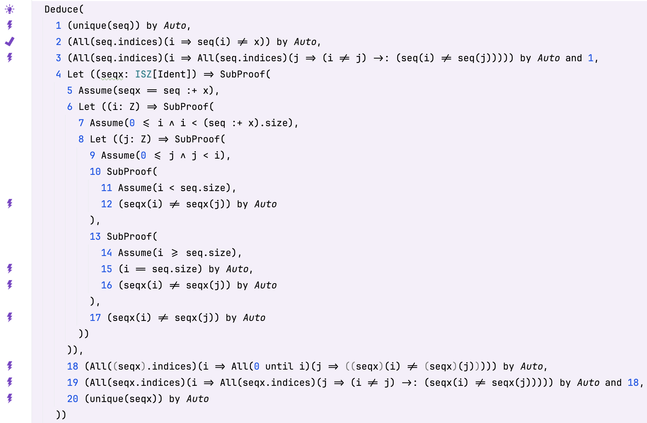
Structured Proof in Logika
Quantifier proofs with Assume and Let
The first Let/Assume pair (4/5) introduces the abbreviation seqx
The second Let/Assume pair (6/7) is discharged by the outer quantifier in 18
The third Let/Assume pair (8/9) is discharged by the inner quantifier in 18
Structured proof often helps the SMT solver by providing additional constraints reducing the proof search
The shown proof is only natural deduction style – it relies entirely on the SMT solver for the facts (Auto)
File: Symbol_Table_Proofs.sc
Notes:
The framework that we will be using for this work is HAMR -- a model-driven development tool chain for high assurance embedded systems that emphasizes three layers of development:
Modeling, analysis and verification in the AADL modeling language, leveraging many tools in the AADL ecosystem
Development of component application logic in multiple languages include C and Slang (a safety-critical system of Scala with a contract verification framework, which can be translated to C)
Deployments on multiple platforms including seL4 verified microkernel.

Slide 4
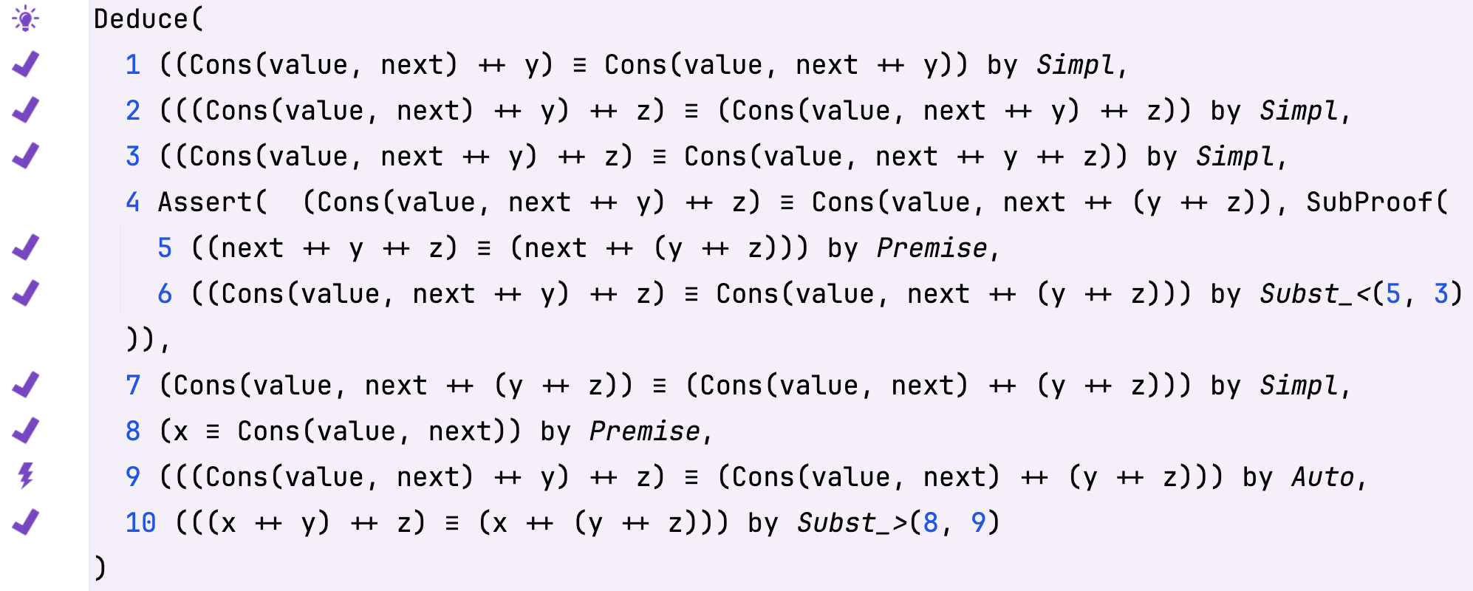
Structured Proof in Logika
Local lemmas with Assert
The subproof after the assert hides the facts in the subproof like a local block in a program.
File: List_induct.sc
Notes:
The framework that we will be using for this work is HAMR -- a model-driven development tool chain for high assurance embedded systems that emphasizes three layers of development:
Modeling, analysis and verification in the AADL modeling language, leveraging many tools in the AADL ecosystem
Development of component application logic in multiple languages include C and Slang (a safety-critical system of Scala with a contract verification framework, which can be translated to C)
Deployments on multiple platforms including seL4 verified microkernel.

Slide 5
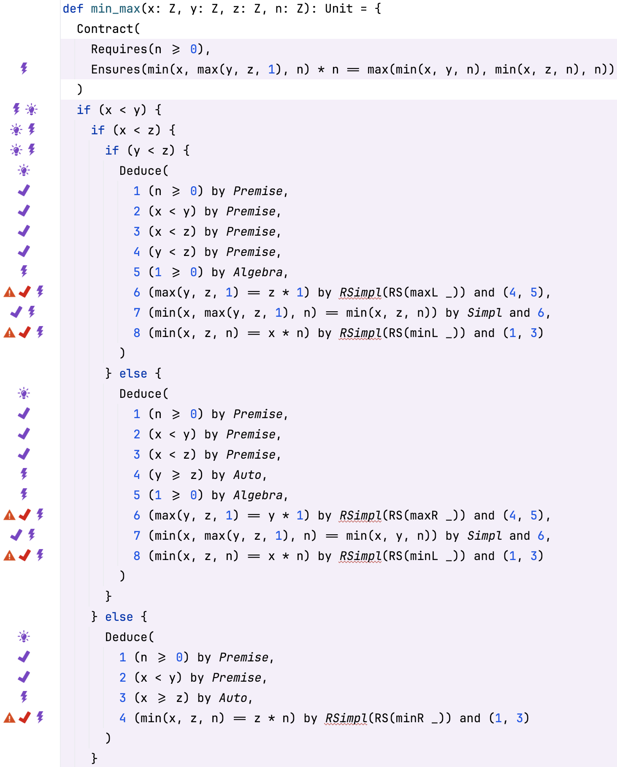
Proof Exercise
Devise simplification rewriting rules for use with RSimpl
(A) Devise the missing rules minL, minR, maxL, maxR
(B) Ensure the proof succeeds!
The red hooks will be replaced by violet hooks by Logika when the correct rewrite rules are specified
File: A01_01_Min_Max.sc
Notes:
The framework that we will be using for this work is HAMR -- a model-driven development tool chain for high assurance embedded systems that emphasizes three layers of development:
Modeling, analysis and verification in the AADL modeling language, leveraging many tools in the AADL ecosystem
Development of component application logic in multiple languages include C and Slang (a safety-critical system of Scala with a contract verification framework, which can be translated to C)
Deployments on multiple platforms including seL4 verified microkernel.

