Slide 1
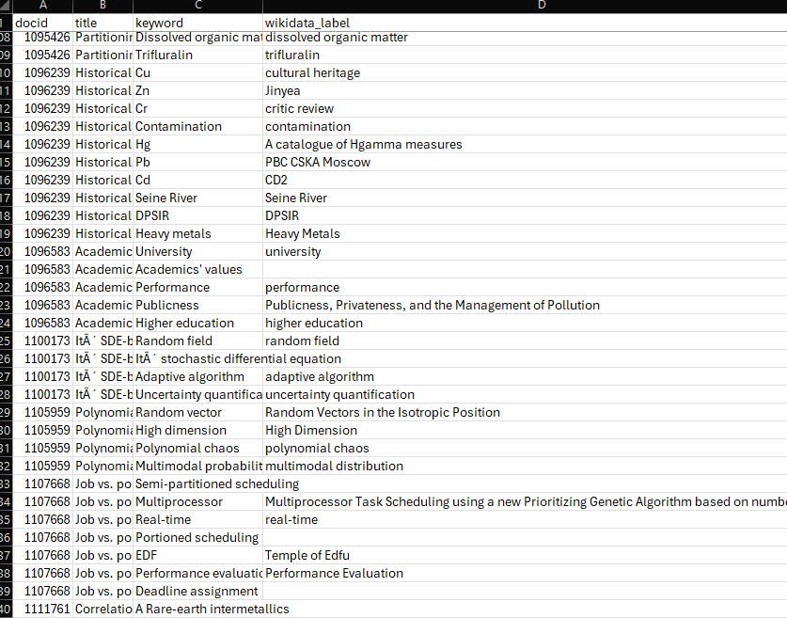
Mapping_v2.py
There is no good match

Slide 2
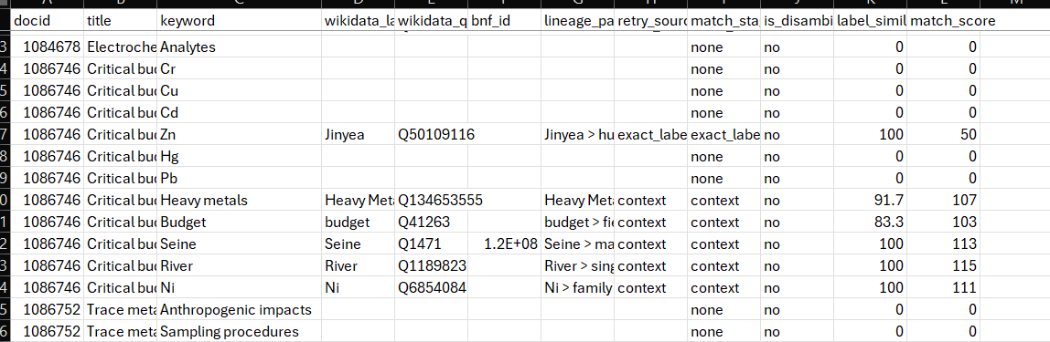
Mapping_v3.py
Including similarity and match score
Corrected
Wrong: element vs name

Slide 3
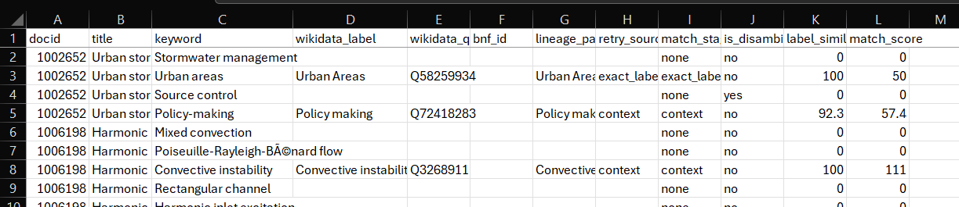
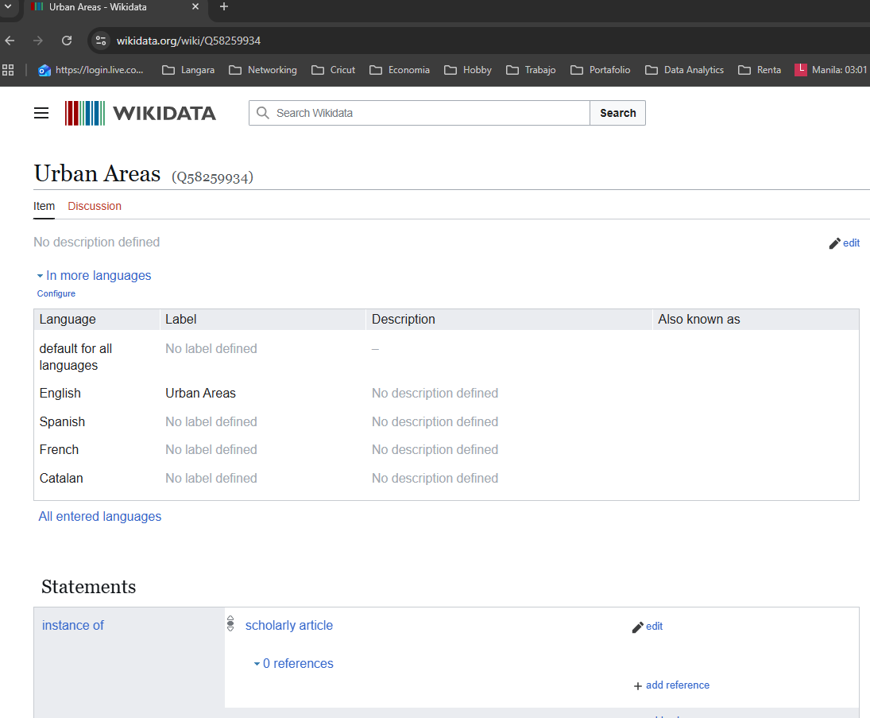
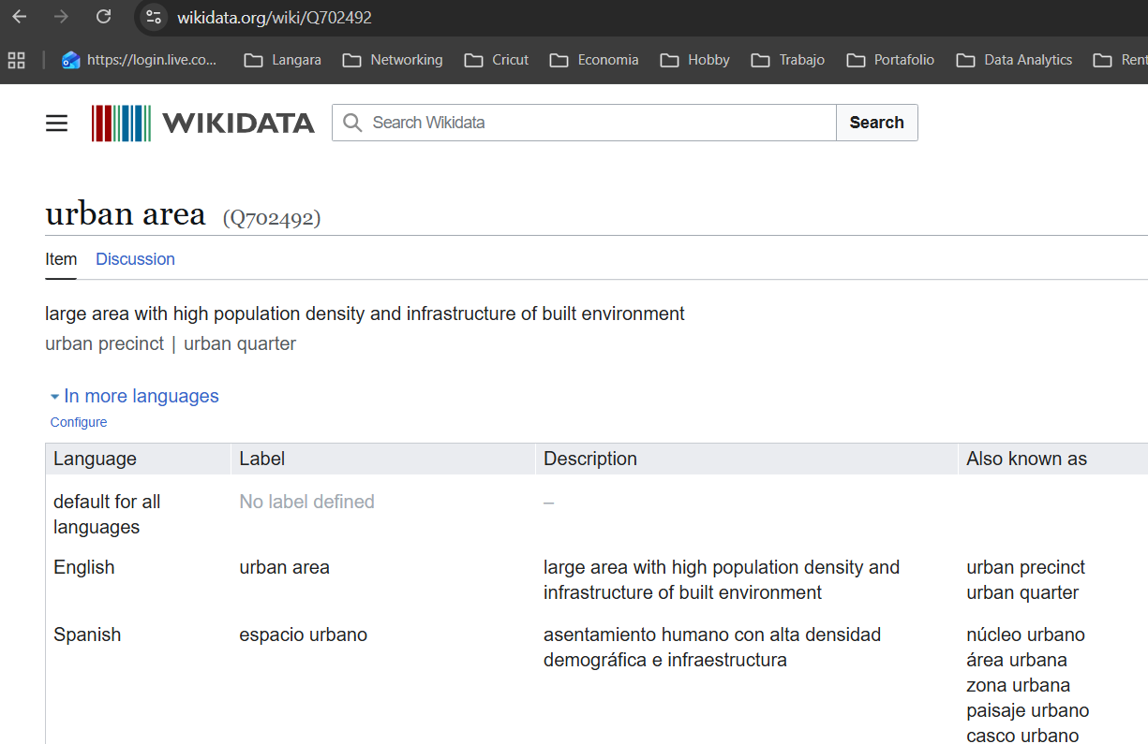
Mapping_v3.py
Including similarity and match score
Q58259934 (Urban Areas), which is a scholarly article (P31=scholarly article), not the concept “urban area” (Q702492)

Slide 4
Discards candidates whose P31 is “scholarly article (Q13442814)”, “book (Q571)”, “academic journal (Q737498)”, or other works.
Rewards candidates of type “human settlement (Q486972)”, “geographical object (Q618123)”, “geographic region (Q82794)”, “class (Q16889133)”, etc.
Keeps the accuracy bonus only if the type is not on the forbidden list.
Adds a simple plural→singular test for English keywords (e.g., “Urban areas” → “Urban area”) before scoring.

Slide 5
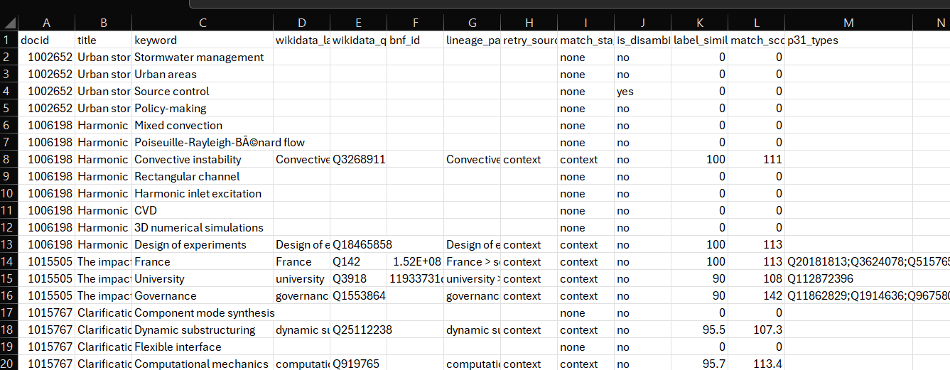
Mapping_v4.py
Including p31_types
Q58259934 (Urban Areas), which is a scholarly article (P31=scholarly article), not the concept “urban area” (Q702492)

Slide 6
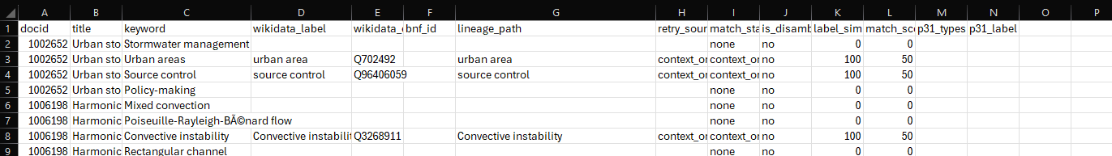
Mapping_v7.py
Solving Urban areas words, (also includes normalization and plural words)

Slide 7
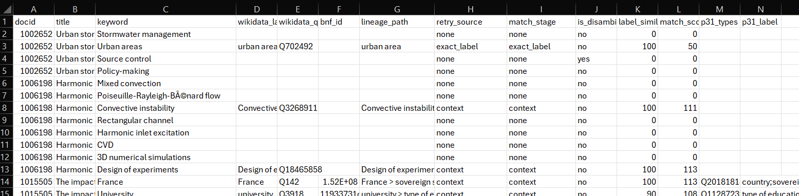
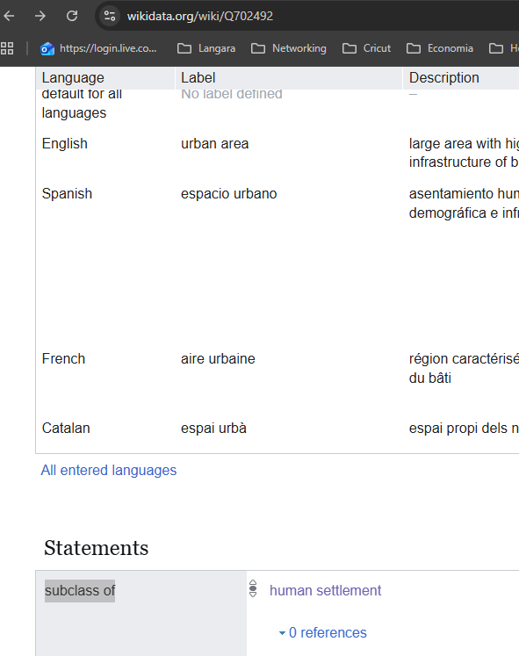
Mapping_v8.py
Correction (first context and then exact match)
Wrong lineage_path

Slide 8
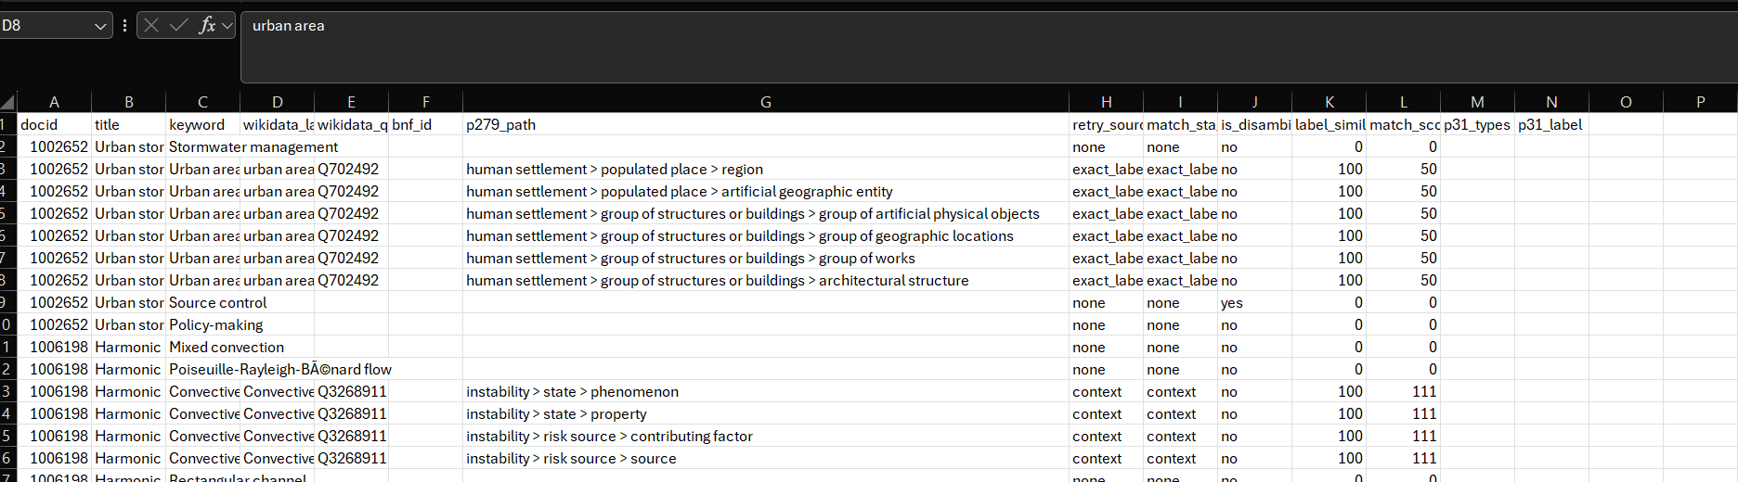
Mapping_v9.py
Correction (p279_path)
3 Levels

