Slide 1
PRODUCT REVIEW
NAME: SANTHOSH V
CLASS: I-ECE-E
REG NO: 922525106285
TOPIC: STUDY LAMP REVIEW

Slide 2
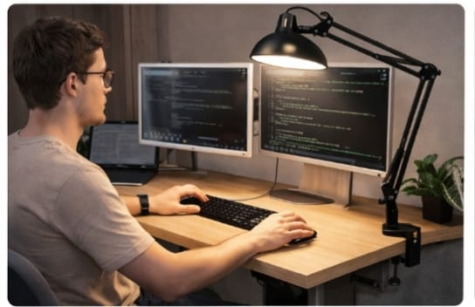
Features of a Study Lamp
• Adjustable Brightness (Dimming options)
• Adjustable Neck (Gooseneck or Swivel)
• Color Temperature Control (Warm to Cool white)
• Eye-care Technology (Flicker-free lighting)
• Power Source (USB rechargeable or AC powered)
• Timer functions and USB charging ports

Slide 3
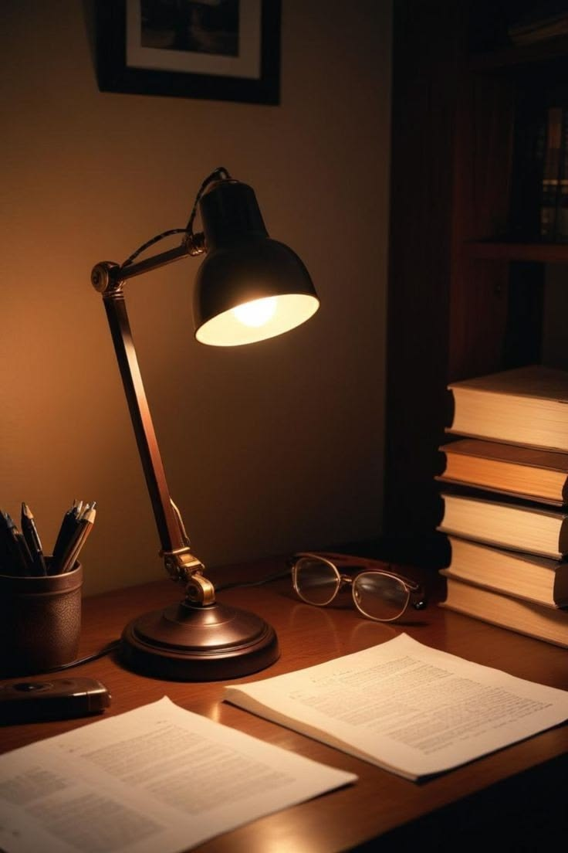
Positives (Pros)
• Reduces eye strain during late-night study sessions
• Portability (for wireless models)
• Energy Efficiency (LED bulbs consume less power)
• Space-saving designs for small desks
• Longevity (LEDs last for thousands of hours)

Slide 4
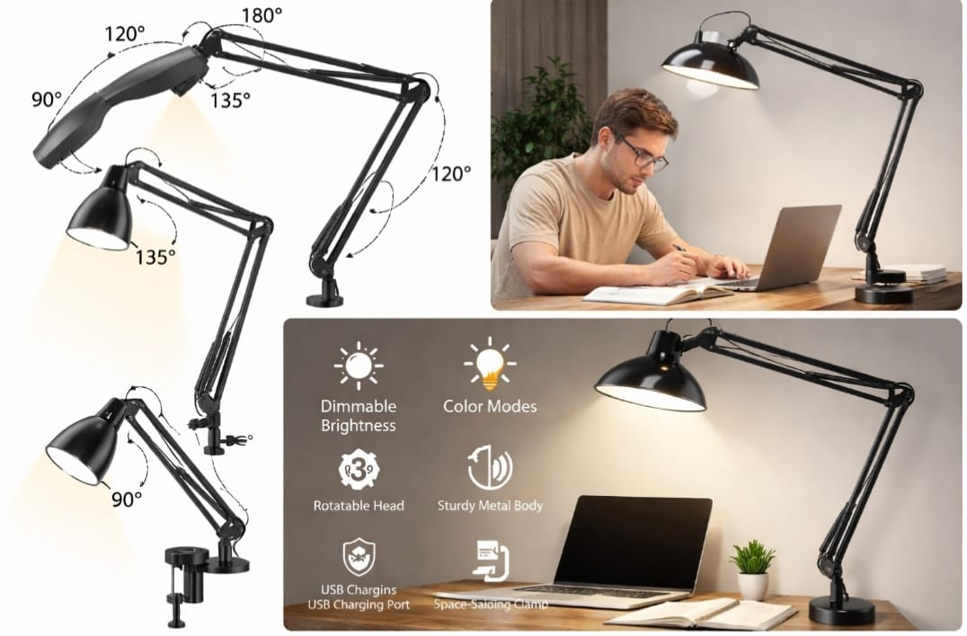
Negatives (Cons)
• Limited battery life in some portable models
• Non-replaceable bulbs in many LED designs
• Cost can be high for high-end smart features
• Stability issues in lightweight plastic designs
• Heat emission (in older halogen/incandescent models)

Slide 5
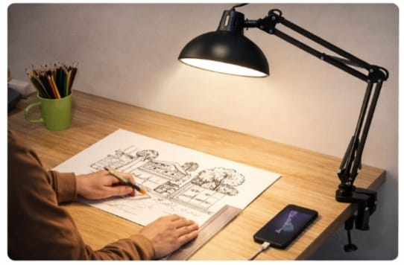
User Ergonomics
• Height adjustment prevents shadows on books
• Correct placement: Opposite side of your writing hand
• Anti-glare filters improve readability
• Touch-sensitive controls for ease of use

Slide 6
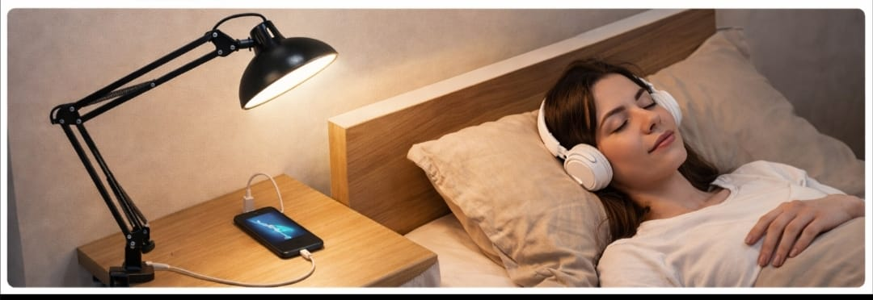
Final Verdict
• Essential tool for students and professionals
• Greatly improves concentration and focus
• Modern designs blend well with room decor
• Recommendation: Look for Eye-Care certified LEDs

