Slide 1
Implementing a Metasearch Framework with Content-directed
Result Merging
Santthosh Babu Selvadurai

Slide 2

Introduction
INTRODUCTION | FRAMEWORK | CONTENT-DIRECTION | RESULTS | CONCLUSION
Information Retrieval: wide spread problem of interest
Cost-effectively find information that is relevant and timely
Reduce the amount of information that needs to be consulted to make right decisions
Solution: Search Engines. Popular forms search the Internet
Several unsolved problems, opportunities for improvement
Focus of this research: improving the coverage of information search across several data sources and improving the relevance of retrieved results

Slide 3

Concepts
INTRODUCTION | FRAMEWORK | CONTENT-DIRECTION | RESULTS | CONCLUSION
Before we start …
Information retrieval
  is the science of searching for information in documents, searching documents themselves, searching metadata which describe documents, or searching within databases, whether relational stand-alone databases or hyper textually-networked databases such as the World Wide Web
Metasearch Engine
  a system that sends user requests to several other search engines and/or databases and returns the results from each one
Result Merging in Metasearch Engines
  the process of combining results from several search engines into a single ranked document

Slide 4

Contributions
INTRODUCTION | FRAMEWORK | CONTENT-DIRECTION | RESULTS | CONCLUSION
Contributions of this research is twofold
To stop reinventing the wheel..
  Develop a modular Metasearch framework, that helps users to build customized metasearch engines that queries several data sources without significant programming effort.
To improve the relevance of search results for queries
  By utilizing unstructured related information artifacts (referred as content-direction) provided by user beforehand.

Slide 5
Outline
Metasearch Framework
Content-Direction
Results
Conclusion
Prototype Demonstration

Slide 6
Metasearch Framework
INTRODUCTION | FRAMEWORK | CONTENT-DIRECTION | RESULTS | CONCLUSION
Need for metasearch engines
  Information explosion [185 Exabytes created in 2006, 161 Exabytes created by April’07 (IDC)]
  Gap between the speed of information generation and the speed of crawlers
  Information that is not publicly indexed, Deep Web
  Virtual Organizations
Challenges
  Heterogeneity of the component search engines
  Response times
  Non-standard API’s, variations in requests and responses
  Technology differences
  Development time

Slide 7
Requirements
INTRODUCTION | FRAMEWORK | CONTENT-DIRECTION | RESULTS | CONCLUSION
Modularity to handle eclectic information sources
Provisions for
  Database selection
  Query reformulation
  Scheduling
  Result Merging
Dynamic reconfiguration
Architectural support for user feedback like content direction
Extensibility to support multimedia content
Ease of implementation in parallel or clustered environment

Slide 8
Design
INTRODUCTION | FRAMEWORK | CONTENT-DIRECTION | RESULTS | CONCLUSION
Data Artifact
  Information entity; can be used as query, content-direction and so forth
Configuration
  Refers the static XML document or the instance of configuration object which can be modified at run time
Framework Class
  Entry point for metasearch, controls execution, needs configuration initialized
Components
  Segregator : Query preprocessor
  Scheduler : Schedules queries to providers and collects Search Result Records (SRR’s)
  Aggregator : Re-ranks queries, eliminates duplicates and merges results
  Search provider : An adapter to participating search engine

Slide 9
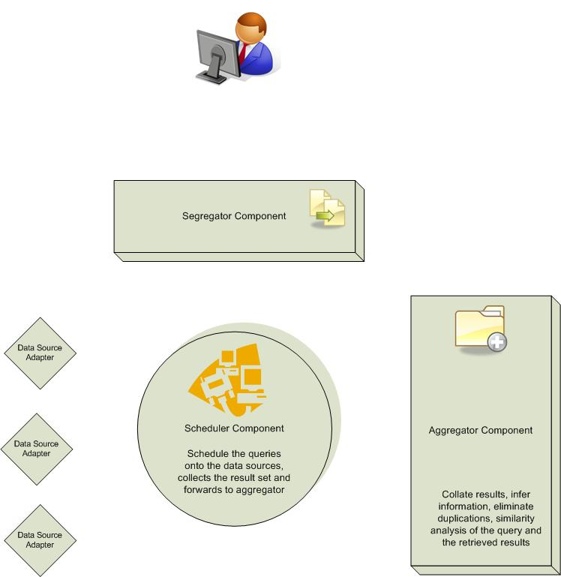
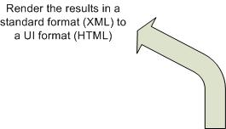
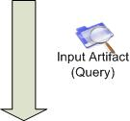
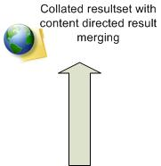
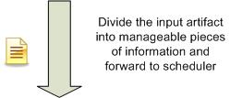

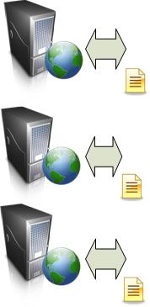

Framework - How it works?
INTRODUCTION | FRAMEWORK | CONTENT-DIRECTION | RESULTS | CONCLUSION

Slide 10
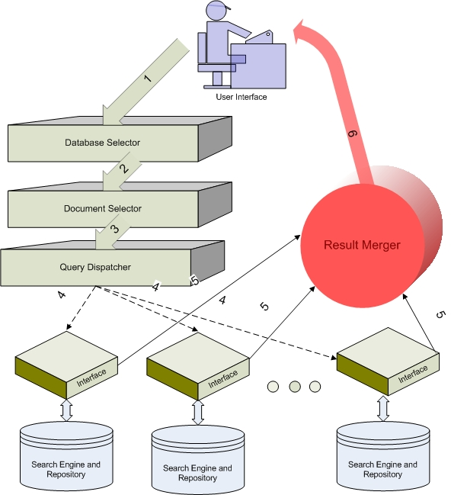
Mapping
INTRODUCTION | FRAMEWORK | CONTENT-DIRECTION | RESULTS | CONCLUSION
Our design differs from typical Metasearch component architecture. Why?
  Flexibility and Reusability of components
Database Selection and Document Selection is done by runtime configuration object or the static configuration XML document
Query dispatch is done by the Scheduler component
Result merging is done by the aggregator component
Segregator is a new component that facilitates the query preprocessing for effective retrieval, shares roles with the configuration object in document selection.

Slide 11
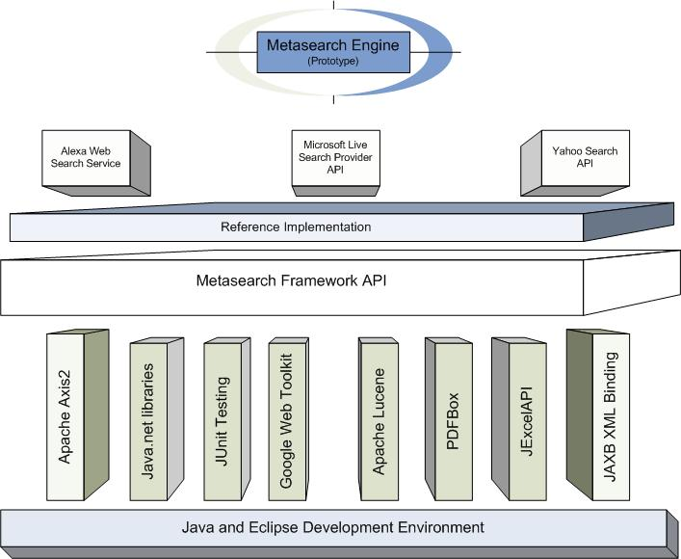
Reference Implementation
INTRODUCTION | FRAMEWORK | CONTENT-DIRECTION | RESULTS | CONCLUSION
Framework, Reference implementation, tools used, and prototype evolution

Slide 12
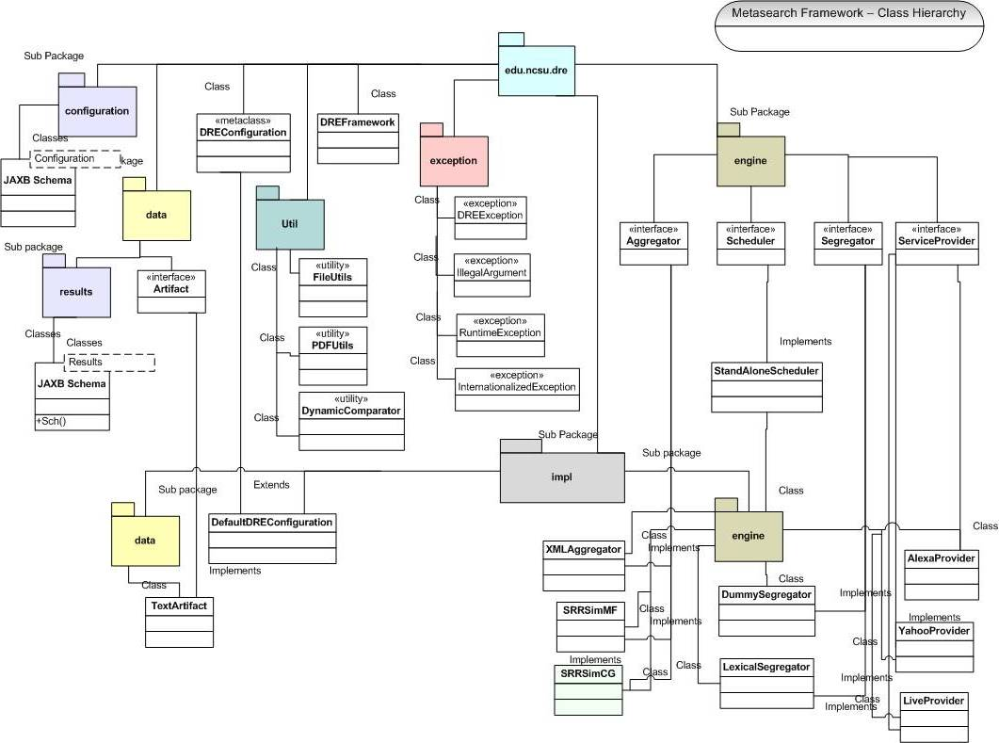
Class Hierarchy
INTRODUCTION | FRAMEWORK | CONTENT-DIRECTION | RESULTS | CONCLUSION

Slide 13
Result Merging
INTRODUCTION | FRAMEWORK | CONTENT-DIRECTION | RESULTS | CONCLUSION
Key stage in metasearch, directly impacts the effectiveness of the search
Search Result Records (SRR) from component search engines are merged into a single ranked list
Several techniques, Example: Borda count
To effectively merge results, the technique should use combination of evidences from
  Document title
  Description snippet
  Search engine usefulness
But such a technique is often expensive and time consuming

Slide 14
Existing Algorithms
INTRODUCTION | FRAMEWORK | CONTENT-DIRECTION | RESULTS | CONCLUSION
Top Document search engine score (TopD)
  Retrieves the top ranked document and computes search engine score. Assumes that the top ranked document is most relevant. Poor performance, time consuming
Top SRR based search engine score (TopSRR)
  Uses the top result of search engine to compute the search engine score. Still the top ranked document is trusted to be the most relevant. Improved response time but still poor performance
Simple similarity rank between SRR and query (SRRSim)
  Attempts to identify relevance between the query, title and snippet and rank the results. Fast and below average performance
Compound similarity rank between SRR and Query (SRRSimMF)
  Attempts to identify relevance between the query, title and snippet and rank the results. Considers the proximity and frequency of terms. Fast and average performance

Slide 15
Problem: Relevance
INTRODUCTION | FRAMEWORK | CONTENT-DIRECTION | RESULTS | CONCLUSION
Most search engines have limits on the query length, similarity functions fail to strike the correct relevance due to this
Most times there isn’t enough information to judge the relevance between the query and the retrieved results
Semantic analysis of the query and each of the retrieved results is expensive and time consuming
Query reformulation is very effective, but very time consuming, cannot be imposed on the users and has to be automated
Any relevance improvement approach should not adversely affect the response time

Slide 16
Motivations for Content-direction
INTRODUCTION | FRAMEWORK | CONTENT-DIRECTION | RESULTS | CONCLUSION
Often users have information that is relevant to the search queries they make in the form of documents, descriptions or even prior search results themselves
Retrieval model
  The success of Best match searching and relevance feedback model retrieving the most relevant results
  The model involves quantitative measure of similarity between the query and each of the items in a document, and the ranking is based on the similarities. Best results are produced when weighting schemes use term frequency and collection frequency.

Slide 17
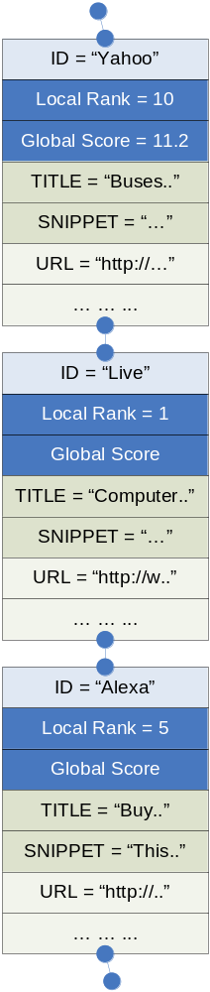
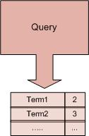
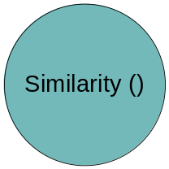
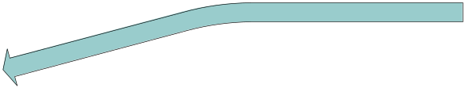
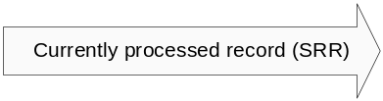

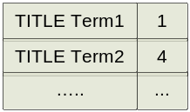
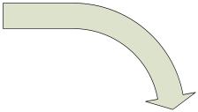
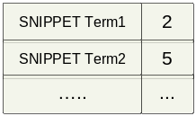
SRRSimMF (Existing) : How it works?
~= X + Y
Sim(Q,T) = X
Sim(Q,S) = Y

Slide 18
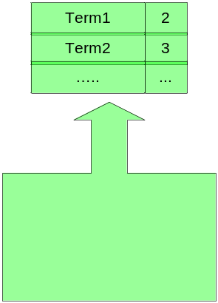
SRRSimCD (Proposed) : How it works?
~= (X1 + Y1) + (X2 + Y2)
Sim(Q,T) = X1
Sim(G,T) = X2
Sim(Q,S) = Y1
Sim(G,S) = Y2
Content Direction

Slide 19
Solution: Content-Direction
INTRODUCTION | FRAMEWORK | CONTENT-DIRECTION | RESULTS | CONCLUSION
The method is an extension to the SRRSimMF scheme
In this algorithm, a pre-specified document is used as guide document
Similarity function computes the similarity between the SRR’s from the component search engines and query also between the SRR’s and the guide document
Query and the content-guide artifacts are compared individually with the title and the snippet of each SRR to compute the similarity rank.
There is no upper limit on the size of the content-direction document, but performance impacted for really huge documents.
The component search engines may have limits on the query length

Slide 20
Similarity function
INTRODUCTION | FRAMEWORK | CONTENT-DIRECTION | RESULTS | CONCLUSION
 | Similarity = [TNDT * ( c₃ * Sim(T,Q) + (1-c₃) * Sim(S,Q)) / QLEN] + [TNDT_{Guide} * ( c₃ * Sim(G,T) + (1-c₃) * Sim(G,S) / (TITLEN + SLEN)]
Here,
TNDT_{Guide} is the total number of distinct query terms appeared in guide document
 | Sim(G,T) = S_{GTNDT} + (S_{GTNT} / TITLEN)
 | Sim(G,S) = S_{GSNDT} + (S_{GTNS} / SLEN)
 | S_{GTNDT} = No. of Distinct Title Terms (NDT) that match GUIDE / TITLEN
 | S_{GSNDT} = No. of Distinct Snippet Terms (NDT) that match GUIDE / SLEN
 | S_{GTNT} = Count of matching guide terms in title (TDT) / TITLEN
 | S_{GTNS} = Count of matching guide terms in snippet (TDS) / SLEN

Slide 21
Evaluation Standards
INTRODUCTION | FRAMEWORK | CONTENT-DIRECTION | RESULTS | CONCLUSION
TREC – Text REtrieval Conference organized by National Institute of Standards and Technology
  A set of workshops (TRACKS), each focused on a specific information retrieval problem
  Provides test collections, evaluation methodology supporting retrieval research
Web Track [2002, 2004] – Features search tasks on World Wide Web
  Contains 50 set of topics each containing a number, title (used as query), brief description, and a narration on what documents retrieved are considered relevant
Sample Web Track
<webtrack>
<topic>
<num> Number: 551 </num>
<title> intellectual property</title>
<desc> Description: Find documents related to laws or regulations that protect intellectual property </desc>
<narr> Narrative: Relevant documents describe legislation or federal regulations that protect authors or composers from copyright infringment , or from piracy of their creative work. These regulations may also be related to fair use or to encryption.</narr>
</topic>
</webtrack>

Slide 22

Strategy
INTRODUCTION | FRAMEWORK | CONTENT-DIRECTION | RESULTS | CONCLUSION
Web track is limited to a set of documents crawled in early 2000
Alternative metric: TSAP – TREC Style Average Precision
Since number of retrieved documents is not constant, hence we use
  TSAP@N – Where N is the cutoff,
  We use N=5 and N=10 in our experiments
  r_{i} = 1/i if i^{th} ranked result is relevant else r_{i} =0
TSAP@N considers number of relevant documents in N as well as the ranks of individual documents

Slide 23
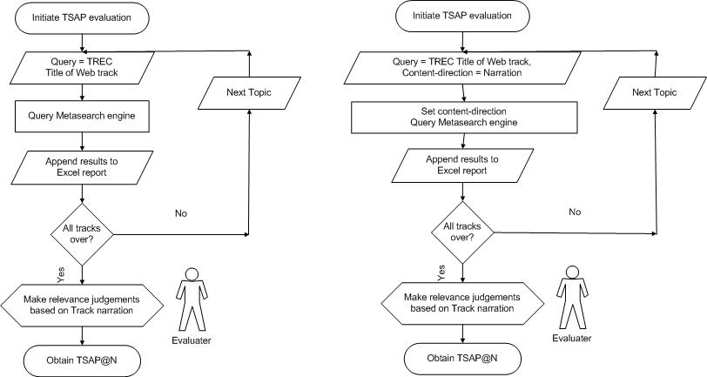
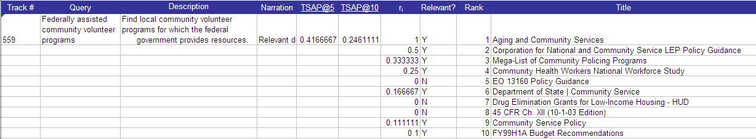
Evaluation process…
INTRODUCTION | FRAMEWORK | CONTENT-DIRECTION | RESULTS | CONCLUSION
TSAP@N Computation without content-direction
TSAP@N Computation with content-direction
Sample TSAP evaluation

Slide 24
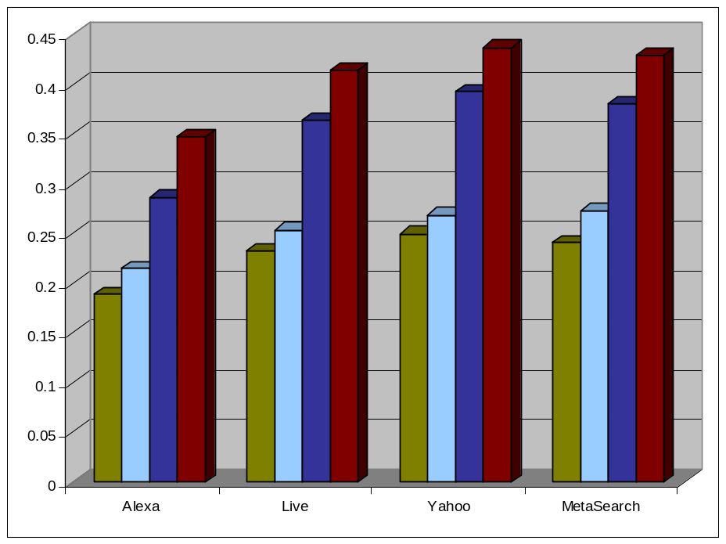
Results: Retrieval effectiveness
INTRODUCTION | FRAMEWORK | CONTENT-DIRECTION | RESULTS | CONCLUSION
Both individual search engines and the metasearch prototype benefits by content direction. For TSAP@10 and TSAP@5 respectively
  Alexa gains relevance by 14% and 21%
  LiveSearch gains by 14% and 9%
  Yahoo gains by 11% and 7.5%
  Metasearch engine gains by 13% for both
Benefit is significant for the worst performing search engine
The performance of the metasearch engine is comparable to the best search engine available (same results have been obtained in similar studies)
TSAP@10
TSAP@10 with CD
TSAP@5
TSAP@5 with CD

Slide 25
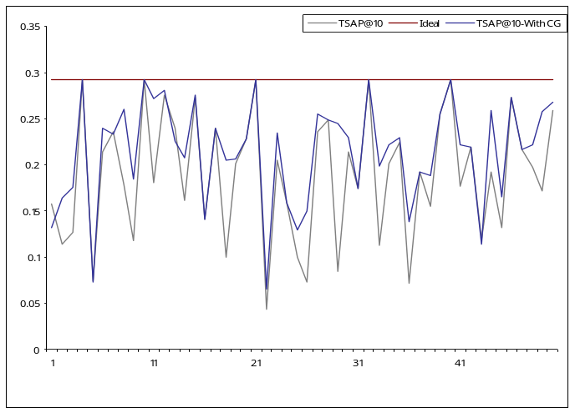
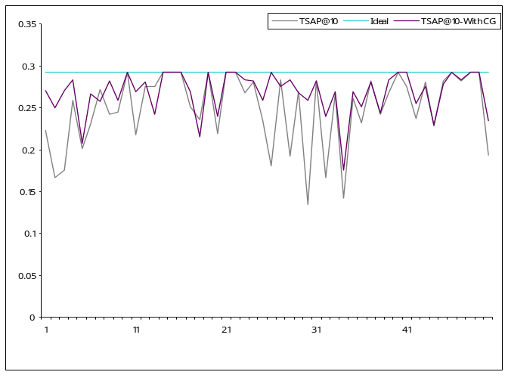
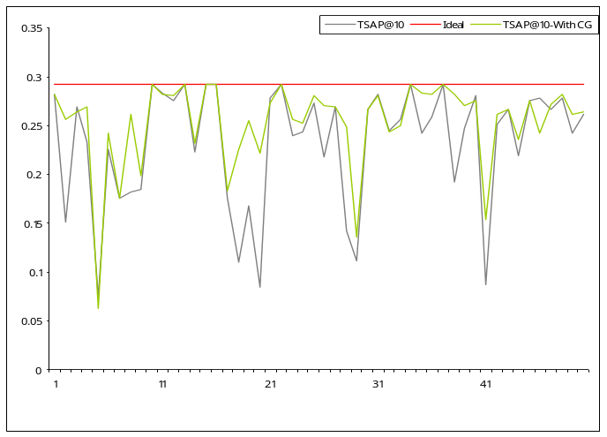
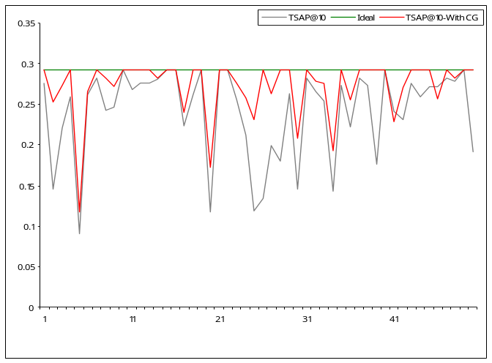
Results: Individual performance
INTRODUCTION | FRAMEWORK | CONTENT-DIRECTION | RESULTS | CONCLUSION
Alexa
Yahoo
TSAP@10 without CD
Live
Metasearch

Slide 26

Conclusion
INTRODUCTION | FRAMEWORK | CONTENT-DIRECTION | RESULTS | CONCLUSION
Emerging SOA and related technologies have removed the blockades to building highly modular metasearch mechanisms
Content-direction can be leveraged to provide highly relevant search results.
Effects of content-direction is NOT always positive
Content-direction provides additional feedback to IR systems enabling them to make informed decisions
Content-direction can also be used to filter irrelevant results quickly from a large set of Search Result Records (SRR)

Slide 27
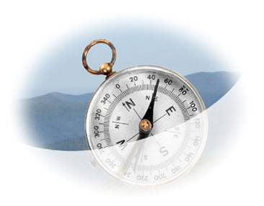
Future work
INTRODUCTION | FRAMEWORK | CONTENT-DIRECTION | RESULTS | CONCLUSION
New
  Segregation algorithms
  Scheduling strategies
  Aggregation algorithms
Evolve test platforms to compare search mechanisms
Managing negative impacts on content-direction
Evolve filtering techniques based on content-direction
Use of content-direction in parallel with implicit feedback mechanism to build highly personalized search engines

Slide 28
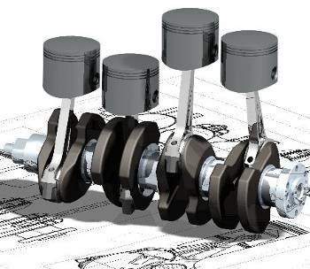
Prototype Demonstrations
Use case 1: query ‘bus’
  Simple metasearch
  Content-directed metasearch (memory bus research paper)
Use case 2: query ‘belt’
  Simple metasearch
  Content-directed metasearch (Six-sigma document)
Other Framework capabilities
  Database selection demo
  Dynamic re-configuration

Slide 29
Thank you!

