Slide 1
RESTful service
REST stands for Representational State Transfer.
REST is an architectural pattern for creating an API that uses HTTP as its underlying communication method.
The REST architectural pattern specifies a set of constraints that a system should adhere to
Notes:
What are IOTs The term IOTs stands for Internet Of Things. Internet Of Things are the objects or devices that have an IP address and can communicate over the internet with other internet enabled devices and objects. Examples for IoT include security systems, electronic appliances, thermostats, cars etc..., in addition to desktops, laptops, and smart phones.

Slide 2
RESTful service
Client Server constraint - This is the first constraint. Client sends a request and the server sends a response. This separation of concerns supports the independent evolution of the client-side logic and server-side logic. Stateless constraint - The next constraint is the stateless constraint. The communication between the client and the server must be stateless between requests. This means we should not be storing anything on the server related to the client. The request from the client should contain all the necessary information for the server to process that request. This ensures that each request can be treated independently by the server. Cacheable constraint - Some data provided by the server like list of products, or list of departments in a company does not change that often. This constraint says that let the client know how long this data is good for, so that the client does not have to come back to the server for that data over and over again.
Notes:
What are IOTs The term IOTs stands for Internet Of Things. Internet Of Things are the objects or devices that have an IP address and can communicate over the internet with other internet enabled devices and objects. Examples for IoT include security systems, electronic appliances, thermostats, cars etc..., in addition to desktops, laptops, and smart phones.

Slide 3
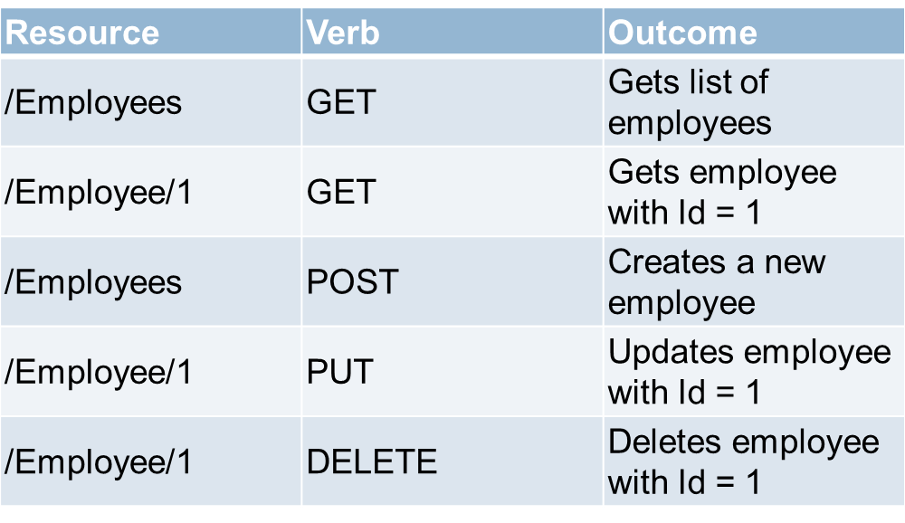
RESTful service
Uniform Interface - The uniform interface constraint defines the interface between the client and the server. To understand the uniform interface constraint, we need to understand what a resource is and the HTTP verbs - GET, PUT, POST & DELETE. In the context of a REST API, resources typically represent data entities. Product, Employee, Customer etc are all resources. The HTTP verb (GET, PUT, POST, DELETE) that is sent with each request tells the API what to do with the resource. Each resource is identified by a specific URI (Uniform Resource Identifier). The following table shows some typical requests that you see in an API
Notes:
What are IOTs The term IOTs stands for Internet Of Things. Internet Of Things are the objects or devices that have an IP address and can communicate over the internet with other internet enabled devices and objects. Examples for IoT include security systems, electronic appliances, thermostats, cars etc..., in addition to desktops, laptops, and smart phones.

Slide 4
Web API
API stands for Application Programming Interface which allows software applications to communicate with each other via API calls.
Web API is a framework that makes it easy to build or crate HTTP services
API services reach a broad range of clients, including browsers and mobile devices.
This is the new framework for building HTTP services with easy and simple way.
The ASP.NET Web API is an ideal platform for building REST Services on the .NET Core/Framework.
Web API services can be consumed by a broad range of clients like 1. Browsers 2. Mobile applications 3. Desktop applications 4. IOTs( Internet Of Things)
It can be hosted with in IIS/Tomcat or Windows Azure
It is very similar to ASP.NET MVC since it contains the MVC features such as routing, controllers, action results, filter, model binders etc.
Notes:
What are IOTs The term IOTs stands for Internet Of Things. Internet Of Things are the objects or devices that have an IP address and can communicate over the internet with other internet enabled devices and objects. Examples for IoT include security systems, electronic appliances, thermostats, cars etc..., in addition to desktops, laptops, and smart phones.

Slide 5
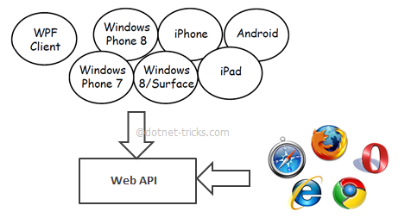
Web API
Why Asp.Net Web API (Web API) ?
Web API is the great framework for exposing your data and service to different-different devices. Moreover Web API is open source an ideal platform for building REST-full services over the .NET Core.
For example twitter,facebook and Google API for the web application and phone apps.

Slide 6
Service Types
Web Service
It is based on SOAP and return data in XML form.
It support only HTTP protocol.
It is not open source but can be consumed by any client that understands xml.
It can be hosted only on IIS.
WCF
It is also based on SOAP and return data in XML form.
It is the evolution of the web service(ASMX) and support various protocols like TCP, HTTP, HTTPS, Named Pipes, MSMQ.
The main issue with WCF is, its tedious and extensive configuration.
It is not open source but can be consumed by any client that understands xml.
It can be hosted with in the applicaion or on IIS or using window service.

Slide 7
Service Types
Web API
This is the new framework for building HTTP services with easy and simple way.
Web API is open source an ideal platform for building REST-full services over the .NET Core/Framework.
it use the full features of HTTP (like URIs, request/response headers, caching, versioning, various content formats)
It also supports the MVC features such as routing, controllers, action results, filter, model binders, IOC container or dependency injection, unit testing that makes it more simple and robust.
It can be hosted with in the application or on IIS/Azure/AWS.
It is light weight architecture and good for devices which have limited bandwidth like smart phones.
Responses are formatted by Web API’s MediaTypeFormatter into JSON, XML or whatever format you want to add as a MediaTypeFormatter.

Slide 8
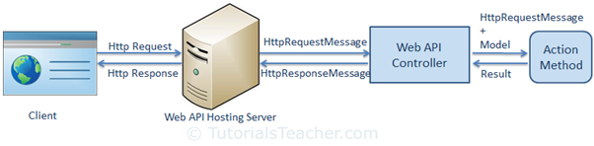
request/response pipeline

Slide 9
Web API Controller
Web API Controller is similar to ASP.NET MVC controller. It handles incoming HTTP requests and send response back to the caller.
The name of a controller class must end with "Controller" and it must be derived from System.Web.Http.ApiController class. All the public methods of the controller are called action methods.
Based on the incoming request URL and HTTP verb (GET/POST/PUT/PATCH/DELETE), Web API decides which Web API controller and action method to execute e.g. Get() method will handle HTTP GET request, Post() method will handle HTTP POST request, Put() mehtod will handle HTTP PUT request and Delete() method will handle HTTP DELETE request for the above Web API.
If you want to write methods that do not start with an HTTP verb then you can apply the appropriate http verb attribute on the method such as HttpGet, HttpPost, HttpPut etc.

Slide 10
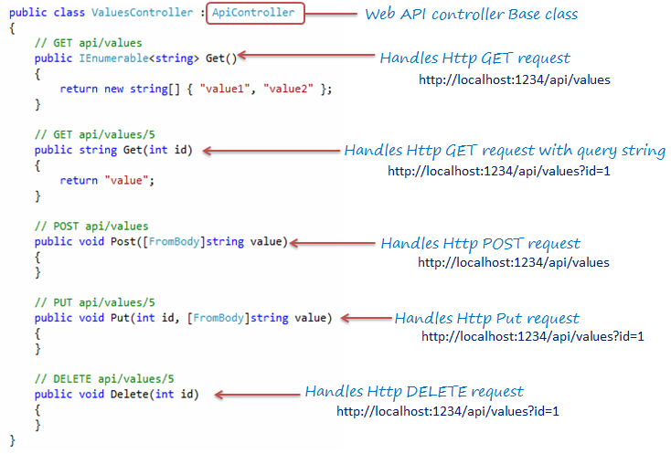
Web API Controller

Slide 11
Action Method Naming Conventions
HTTP Request Method | Possible Web API Action Method Name
GET | Get() get() GET() GetAllStudent() (*any name starting with Get *)
POST | Post() post() POST() PostNewStudent() (*any name starting with Post*)
PUT | Put() put() PUT() PutStudent() (*any name starting with Put*)
DELETE | Delete() delete() DELETE() DeleteStudent() (*any name starting with Delete*)

Slide 12
Difference between Web API and MVC controller
Web API Controller | MVC Controller
Derives from System.Web.Http.ApiController class | Derives from System.Web.Mvc.Controller class.
Method name must start with Http verbs otherwise apply http verbs attribute. | Must apply appropriate Http verbs attribute.
Specialized in returning data. | Specialized in rendering view.
Return data automatically formatted based on Accept-Type header attribute. Default to json or xml. | Returns ActionResult or any derived type.
Requires .NET 4.0 or above | Requires .NET 3.5 or above

Slide 13
Test Web API
following third party tools for testing Web API.
Fiddler
Postman
Fiddler:
Fiddler is a free debugging proxy for any browser. We can use it to compose and execute different HTTP requests to our Web API and check HTTP response.

Slide 14
POSTMAN
What is Postman?
Postman is currently one of the most popular tools used in API testing.
It simplify API workflow in testing and development.
Postman is a Google Chrome app for interacting with HTTP APIs.
It presents you with a friendly GUI for constructing requests and reading responses.
It has the ability to make various types of HTTP requests(GET, POST, PUT, PATCH)
Download link: https://www.postman.com/postman

Slide 15
Content Negotiation in Web API
One of the standards of the RESTful service is that, the client should have the ability to decide in which format they want the response - XML, JSON etc. A request that is sent to the server includes an Accept header. Using the Accept header the client can specify the format for the response. For example Accept: application/xml returns XML Accept: application/json returns JSON Depending on the Accept header value in the request, the server sends the response. This is called Content Negotiation.

Slide 16
MediaTypeFormatters in WebApi
From the ASP.NET Web API perspective, serialization is the process of translating a .NET Common Language Runtime (CLR) type into a format that can be transmitted over HTTP. The default format can be either JSON or XML
A media type formatter that is an object of type MediaTypeFormatter, performs the serialization in the ASP.NET Web API pipeline.
MediaTypeFormatter is an abstract class from which JsonMediaTypeFormatter and XmlMediaTypeFormatter classes inherit from. JsonMediaTypeFormatter handles JSON and XmlMediaTypeFormatter handles XML.

Slide 17
Action Method Return Type
The Web API action method can have following return types.
Void
Primitive type or Complex type
HttpResponseMessage
IHttpActionResult
Void:
HttpResponseMessage:
Web API controller always returns an object of HttpResponseMessage to the hosting infrastructure. The following figure illustrates the overall Web API request/response pipeline.
The advantage of sending HttpResponseMessage from an action method is that you can configure a response your way. You can set the status code, content or error message (if any) as per your requirement.

Slide 18
Action Method Return Type
IHttpActionResult:
The IHttpActionResult was introduced in Web API 2 (.NET 4.5). An action method in Web API 2 can return an implementation of IHttpActionResult class which is more or less similar to ActionResult class in ASP.NET MVC.
public IHttpActionResult Get(int id) { Student stud = GetStudentFromDB(id); if (stud == null) { return NotFound(); } return Ok(stud); }

Slide 19
Action Method Return Type
The following table lists all the methods of ApiController class that returns an object of a class that implements IHttpActionResult interface.
ApiController Method | Description
BadRequest() | Creates a BadRequestResult object with status code 400.
Conflict() | Creates a ConflictResult object with status code 409.
Content() | Creates a NegotiatedContentResult with the specified status code and data.
Created() | Creates a CreatedNegotiatedContentResult with status code 201 Created.
CreatedAtRoute() | Creates a CreatedAtRouteNegotiatedContentResult with status code 201 created.
InternalServerError() | Creates an InternalServerErrorResult with status code 500 Internal server error.
NotFound() | Creates a NotFoundResult with status code404.
Ok() | Creates an OkResult with status code 200.
Redirect() | Creates a RedirectResult with status code 302.
RedirectToRoute() | Creates a RedirectToRouteResult with status code 302.
ResponseMessage() | Creates a ResponseMessageResult with the specified HttpResponseMessage.
StatusCode() | Creates a StatusCodeResult with the specified http status code.
Unauthorized() | Creates an UnauthorizedResult with status code 401.

Slide 20
Web API Routing
Web API routing is similar to ASP.NET MVC Routing. It routes an incoming HTTP request to a particular action method on a Web API controller.
Web API supports two types of routing:
Convention-based Routing
Attribute Routing
Convention-based Routing
In the convention-based routing, Web API uses route templates to determine which controller and action method to execute. At least one route template must be added into route table in order to handle various HTTP requests.

Slide 21
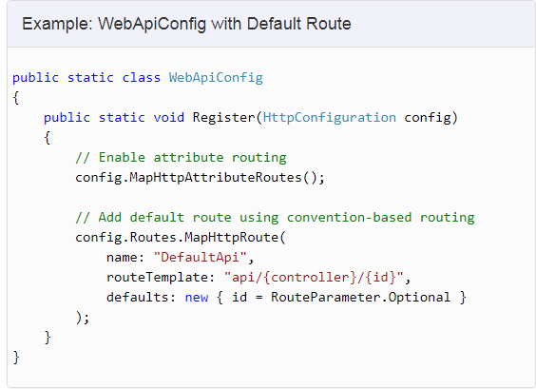
Web API Routing

Slide 22
parameters of MapHttpRoute()
Parameter | Description
name | Name of the route
routeTemplate | URL pattern of the route
defaults | An object parameter that includes default route values
constraints | Regex expression to specify characteristic of route values

Slide 23
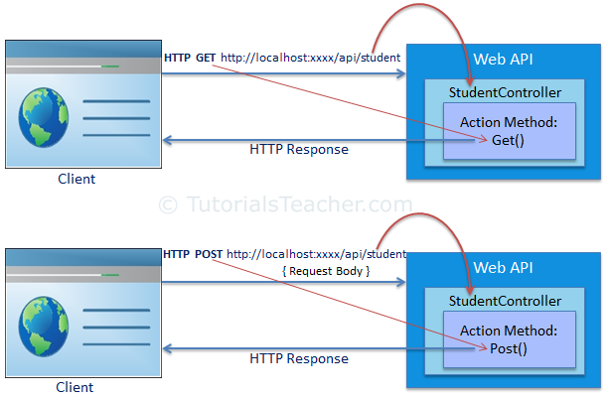
Web API Routing

Slide 24
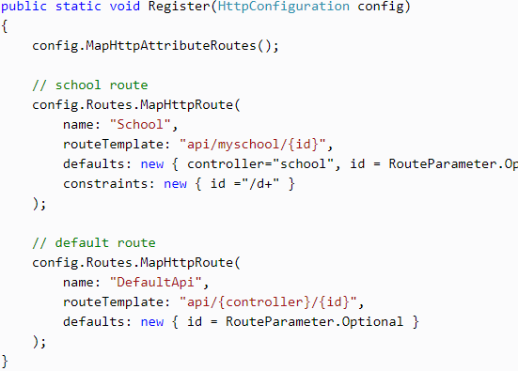
Configure Multiple Routes

Slide 25
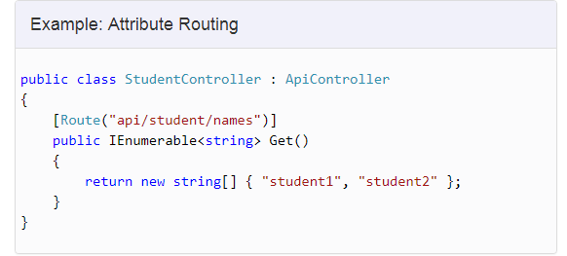
Attribute Routing
Attribute routing is supported in Web API 2.
attribute routing uses [Route()] attribute to define routes. The Routeattribute can be applied on any controller or action method.
In order to use attribute routing with Web API, it must be enabled in WebApiConfig by calling config.MapHttpAttributeRoutes() method.

Slide 26
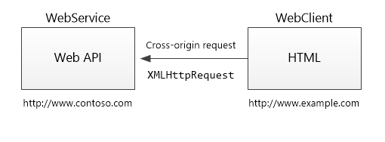
Enabling Cross-Origin Requests (CORS)
Browser security prevents a web page from making AJAX requests to another domain. This restriction is called the same-origin policy, and prevents a malicious site from reading sensitive data from another site. However, sometimes you might want to let other sites make cross-origin requests to your web app.+
Cross Origin Resource Sharing (CORS) is a W3C standard that allows a server to relax the same-origin policy. Using CORS, a server can explicitly allow some cross-origin requests while rejecting others. CORS is safer and more flexible than earlier techniques such as JSONP.

Slide 27
Enabling Cross-Origin Requests (CORS)
What is "same origin"?
Two URLs have the same origin if they have identical schemes, hosts, and ports.
These two URLs have the same origin:
http://example.com/foo.html
http://example.com/bar.html
These URLs have different origins than the previous two:
http://example.net - Different domain
http://example.com:9000/foo.html - Different port
https://example.com/foo.html - Different scheme
http://www.example.com/foo.html - Different subdomain

Slide 28
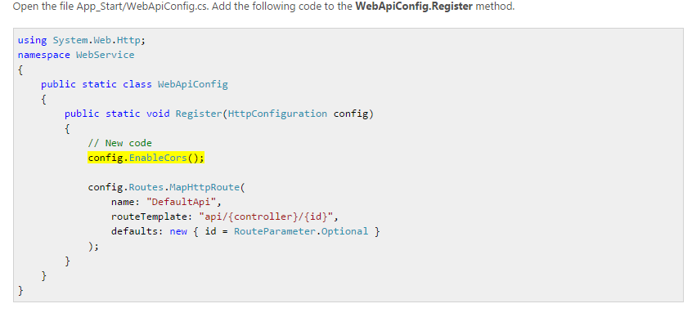
Enabling Cross-Origin Requests (CORS)
Setting up CORS
To setup CORS for your application add the Microsoft.AspNet.WebApi.Cors package to your project.

Slide 29
Enabling Cross-Origin Requests (CORS)
add the [EnableCors] attribute to the TestController class
using System.Net.Http;
using System.Web.Http;
using System.Web.Http.Cors;
namespace WebService.Controllers
{
[EnableCors(origins: "*", headers: "*", methods: "*")]
public class TestController : ApiController
{
// Controller methods not shown...
}
}

Slide 30
Enabling Cross-Origin Requests (CORS)
add the [EnableCors] attribute to the TestController class
using System.Net.Http;
using System.Web.Http;
using System.Web.Http.Cors;
namespace WebService.Controllers
{
[EnableCors(origins: "*", headers: "*", methods: "*")]
public class TestController : ApiController
{
// Controller methods not shown...
}
}

Slide 31
Enabling Cross-Origin Requests (CORS)
Scope Rules for [EnableCors]
You can enable CORS per action, per controller, or globally for all Web API controllers in your application.
Per Action
To enable CORS for a single action, set the [EnableCors] attribute on the action method. The following example enables CORS for the GetItem method only.
public class ItemsController : ApiController
{
public HttpResponseMessage GetAll() { ... }
[EnableCors(origins: "http://www.example.com", headers: "*", methods: "*")]
public HttpResponseMessage GetItem(int id) { ... }
public HttpResponseMessage Post() { ... }
public HttpResponseMessage PutItem(int id) { ... }
}

Slide 32
Enabling Cross-Origin Requests (CORS)
Per Controller
If you set [EnableCors] on the controller class, it applies to all the actions on the controller. To disable CORS for an action, add the [DisableCors] attribute to the action.
The following example enables CORS for every method except PutItem.
[EnableCors(origins: "http://www.example.com", headers: "*", methods: "*")]
public class ItemsController : ApiController
{
public HttpResponseMessage GetAll() { ... }
public HttpResponseMessage GetItem(int id) { ... }
public HttpResponseMessage Post() { ... }
[DisableCors]
public HttpResponseMessage PutItem(int id) { ... }
}

Slide 33
Enabling Cross-Origin Requests (CORS)
Globally
To enable CORS for all Web API controllers in your application, pass an EnableCorsAttribute instance to the EnableCors method:
public static class WebApiConfig
{
public static void Register(HttpConfiguration config)
{
var cors = new EnableCorsAttribute("www.example.com", "*", "*");
config.EnableCors(cors);
// ...
}
}

Slide 34
Enabling Cross-Origin Requests (CORS)
If you set the attribute at more than one scope, the order of precedence is:
Action
Controller
Global
Set the Allowed Origins
The origins parameter of the [EnableCors] attribute specifies which origins are allowed to access the resource. The value is a comma-separated list of the allowed origins.
[EnableCors(origins: "http://www.contoso.com,http://www.example.com", headers: "*", methods: "*")]
Allow CORS for all origins. (Caution!)
[EnableCors(origins: "*", headers: "*", methods: "*")]

Slide 35
Enabling Cross-Origin Requests (CORS)
Set the Allowed HTTP Methods
The methods parameter of the [EnableCors] attribute specifies which HTTP methods are allowed to access the resource. To allow all methods, use the wildcard value "*". The following example allows only GET and POST requests.
[EnableCors(origins: "http://www.example.com", headers: "*", methods: "get,post")]
Set the Allowed Request Headers
[EnableCors(origins: "http://example.com", headers: "accept,content-type,origin,x-my-header", methods: "*")]

Slide 36
Difference between WCF and Web API. When to choose one over the other?
One of the choices available in .NET for creating RESTful services is WCF. The problem with WCF is that, a lot of configuration is required to turn a WCF service into a RESTful service. The more natural choice for creating RESTful services is ASP.NET Web API, which is specifically created for this purpose.
WCF is more suited for building services that are transport/protocol independent. For example, you want to build a single service, that can be consumed by 2 different clients - Like, a Java client and .NET client. Java client expects transport protocol to be HTTP and message format to be XML for interoperability, where as the .NET client expects the protocol to be TCP and the message format to be binary for performance. For this scenario WCF is the right choice. What we do here is create a single WCF service, and then configure 2 end points one for each client
There is nothing wrong to use WCF to create RESTful services. It's just that it's a bit more complex and configuration can be a headache. If you are stuck with .NET 3.5 or you have an existing SOAP service you must support but want to add REST to reach more clients, then use WCF.
If you don't have the limitation of .NET 3.5 and you want to a create brand new restful service then use ASP.NET Web API.

Slide 37
Web API
When to choose Web API ?
If we need a Web Service and don’t need SOAP, then ASP.Net Web API is best choice.
It is Used to build simple, non-SOAP-based HTTP Services
It doesn't have tedious and extensive configuration like WCF REST service.
Simple service creation with Web API. With WCF REST Services, service creation is difficult.
It is only based on HTTP and easy to define, expose and consume in a REST-ful way.
It is light weight architecture and good for devices which have limited bandwidth like smart phones.
It is open source.
It can be hosted with in the application or on IIS.

