Slide 1
Angular Databinding
Data Binding in Angular is the mechanism that connects the component's data (TypeScript code) with the view (HTML template)
It allowing data to flow between them.
Data binding in Angular is a key mechanism that synchronizes data between a component (the model) and the user interface (the view).
This mechanism automatically synchronizes data, reducing the need for manual DOM manipulation and making your applications more dynamic and responsive.
There are two main types of data binding in Angular:
1. one-way binding
2. Two-Way Data Binding

Slide 2
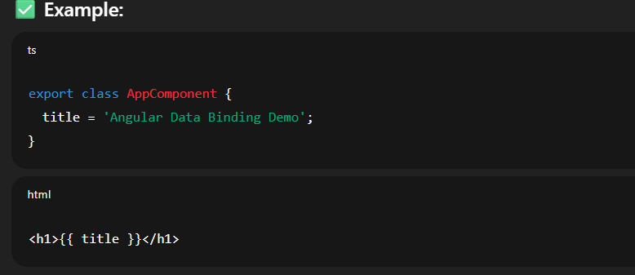
Angular Databinding
One-way Data Binding
Data flows in a single direction, either from the component to the view or from the view to the component
1. Interpolation
This is the simplest form of data binding. It allows you to display a component's property value as text within your HTML template.
Displays component data in the view using double curly braces, e.g., {{ userName }}

Slide 3
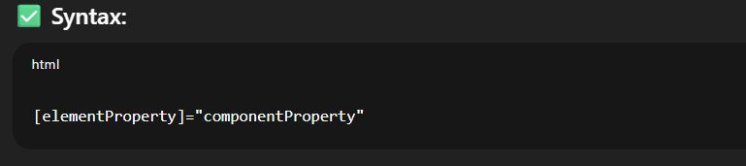
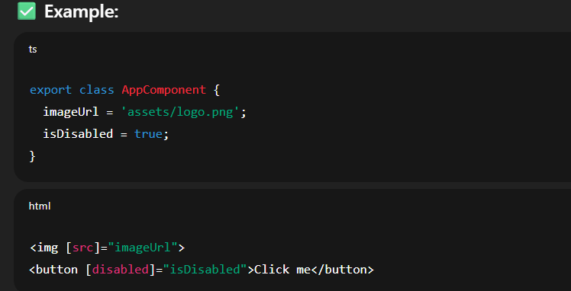
Angular Databinding
2. Property Binding
Property binding allows you to set the value of an HTML element's property from a component property.
Binds a DOM property to a component property using square brackets, e.g., [src]="imageUrl"
Binds a DOM property to a component property or expression.

Slide 4
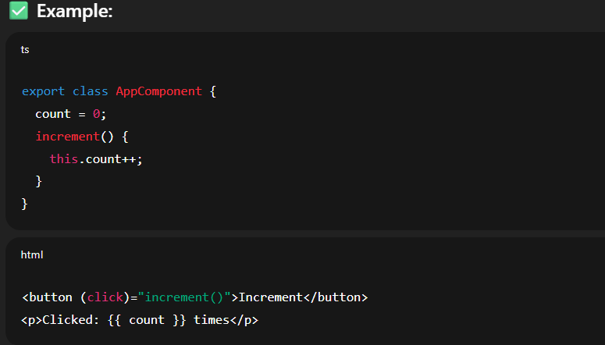
Angular Databinding
3. Event Binding:
Event binding lets you listen for events from the view (like a button click or a keypress) and execute a method in your component in response.
Binds an event in the view to a method in the component using parentheses, e.g., (click)="doSomething()“
Allows your template to listen to user events like click, input, submit, etc.

Slide 5
Angular Databinding
Two-Way Data Binding
Two-way binding synchronizes data between the component and the view.
Two-way data binding combines property and event binding to create a two-way flow of data. Changes in the component are reflected in the view, and changes in the view (typically from user input) are reflected back in the component.
it allows changes in the UI to update the component data and vice versa.
Commonly used with form controls, such as <input [(ngModel)]="firstName">, so any change in the input box immediately updates the component property and vice versa
It requires FormsModule or provideForms() in standalone apps

Slide 6
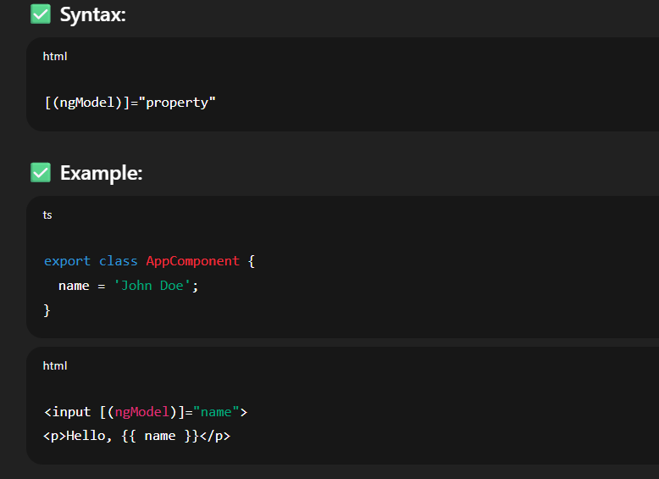
Angular Databinding
Two-Way Data Binding

Slide 7
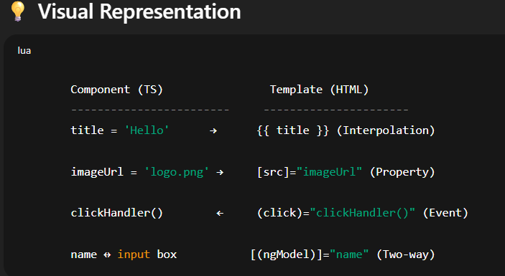
Angular DataBinding
Type | Template Syntax | Direction | Use Case
Interpolation | {{ value }} | Component → View | Display values like text or numbers
Property Binding | [prop]="value" | Component → View | Set DOM properties or attributes
Event Binding | (event)="method()" | View → Component | Respond to user interactions
Two-Way Binding | [(ngModel)]="value" | Both Directions | Form inputs with live sync

Slide 8
Key Features of Angular
TypeScript Foundation
Angular is built with TypeScript, which adds static typing and better syntactic structure to JavaScript, improving code quality and maintainability. While TypeScript is not strictly required, it is highly recommended
Component-Based Architecture
Angular applications are built using components, which are the fundamental building blocks. Each component consists of:
A template (HTML) that defines the view.
A class (TypeScript) that contains the logic and data for the component.
Styles (CSS) that are scoped to the component. This modularity promotes reusability, testability, and easier management of complex UIs.

Slide 9
Key Features of Angular
Data Binding
Angular supports two-way data binding, which automatically synchronizes data between the model (component's logic) and the view (HTML template). This reduces the need for manual DOM manipulation.
Directives
Special markers in the DOM that tell Angular to do something with a DOM element (add behavior or modify structure).
Dependency Injection (DI)
A design pattern where components receive their dependencies from a central container instead of creating them manually.
Makes code modular, testable, and scalable
Angular CLI (Command Line Interface)
A powerful tool to generate, build, serve, and test Angular applications.
Testing Support
Angular supports unit and integration testing through frameworks like Jasmine and Karma

Slide 10
Advantages of Angular
Structured and Opinionated: Provides a clear structure and set of best practices, which can be beneficial for large teams and complex projects.
Robust Ecosystem and Tooling: Backed by Google, it has a comprehensive set of tools (like Angular CLI) and a large community, offering extensive documentation and third-party libraries.
Performance: Features like Ahead-of-Time (AOT) compilation, tree shaking, and lazy loading contribute to fast loading times and efficient performance.
Maintainability and Scalability: Component-based architecture and TypeScript contribute to clean, reusable, and maintainable code, making it suitable for enterprise-level applications.
Cross-Platform Development: Can be used to build web, mobile (with NativeScript), and desktop (with Electron) applications from a single codebase.

Slide 11
Angular Core Building Blocks
Block | Description
Component | Basic UI unit, with a TypeScript class, HTML template, and CSS
Module | Groups components and services (e.g., AppModule)
Template | HTML with Angular syntax
Service | Logic that is shared across components
Directive | Custom behavior on elements (e.g., *ngIf, *ngFor)
Pipe | Transforms data in templates (e.g., date, currency)
Routing | Navigation between different views/pages

Slide 12
Companies Using Angular
Many popular applications and services use Angular, including:
Gmail
Forbes
Upwork
PayPal
YouTube (and YouTube TV)
Microsoft Office Online
Xbox web interfaces
Google Cloud Console

Slide 13
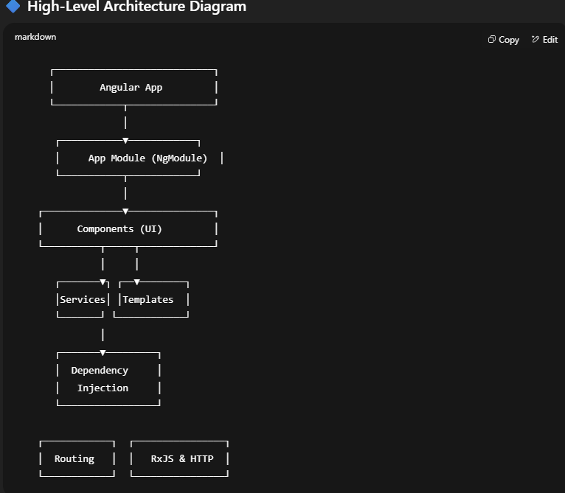
Architecture of Angular
Angular is built on a component-based architecture and follows a modular design pattern. It combines HTML, CSS, and TypeScript to create dynamic single-page web applications.

Slide 14
Angular Environment Setup
Prerequisites
Before installing Angular, ensure the following tools are installed:
Tool | Purpose | Download Link
Node.js | JavaScript runtime for Angular CLI | https://nodejs.org
npm | Node Package Manager (comes with Node.js) | Installed automatically with Node.js
VS Code | Code editor (recommended) | https://code.visualstudio.com
Git | Version control (optional) | https://git-scm.com

Slide 15
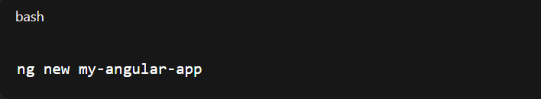
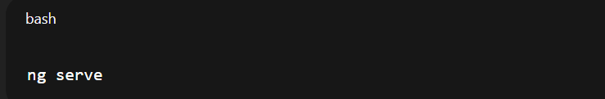
Step-by-Step Installation(Cont..)
3. Create a New Angular Project
4. Run the Angular App
Visit http://localhost:4200 in the browser to see the running app.

Slide 16
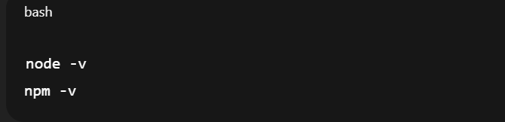
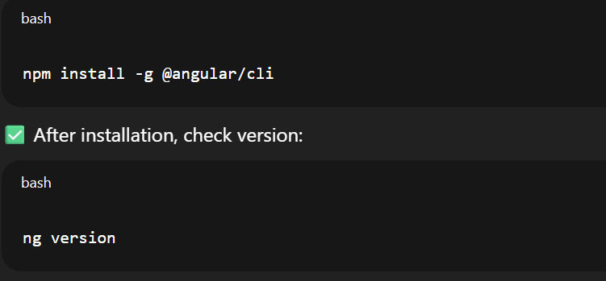
Step-by-Step Installation
1. Install Node.js and npm
Download from: https://nodejs.org
Verify installation:
2. Install Angular CLI
The Angular CLI is a command-line tool to create and manage Angular apps.

Slide 17
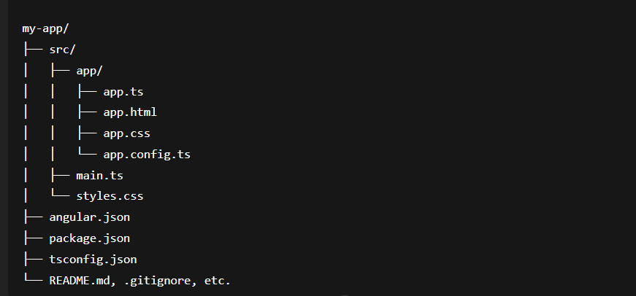
Project Structure Overview

Slide 18
📁 Folder & File Description
/src
Your application source code.
/app/
Contains the root component and app-level configuration.
File | Purpose
app.ts | Root standalone component (replaces app.component.ts).
app.html | HTML template of the root component.
app.css | Component-scoped styles.
app.config.ts | Replaces app.module.ts. Used to configure the app (routes, providers, etc.).

Slide 19
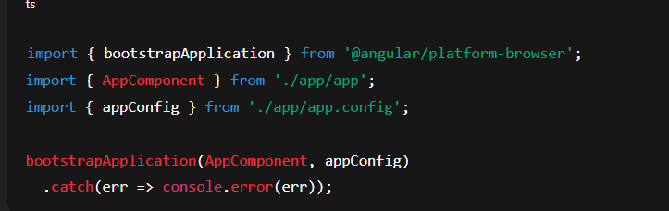
📁 Folder & File Description
main.ts
Entry point of the application. Uses bootstrapApplication() to start the app.
styles.css
Global styles for the entire application.

Slide 20
📁 Folder & File Description
⚙️ Root Configuration Files
File | Purpose
angular.json | Angular CLI config (build, test, lint, serve, etc.).
package.json | Project dependencies, scripts, and metadata.
tsconfig.json | TypeScript compiler options.

Slide 21
Classic Angular(Pre-v17) vs Modern Angular(v17+)
Feature | Classic Angular (Pre-v17) | Modern Angular (v17+)
Component naming | app.component.ts | app.ts
Uses NgModules | Yes (AppModule) | No (Standalone components)
Bootstrapping | platformBrowserDynamic | bootstrapApplication
Routing setup | app-routing.module.ts | Inline in app.config.ts
environments/ folder | Present by default | Must be added manually
assets/ folder | Present by default | Created only if you opt in

Slide 22
Classic Angular(Pre-v17) vs Modern Angular(v17+)
Highlights from Angular v17+
Feature | Description
standalone: true | Implied here. No need for a module file (app.module.ts)
Signals | Modern reactive state mechanism
imports array | Declares required directives (like RouterOutlet) directly
Modern File Naming | app.ts, app.html, app.css instead of .component.ts etc.

Slide 23
Component Structure
import { Component, signal } from '@angular/core';
import { RouterOutlet } from '@angular/router';
@Component({
selector: 'app-root',
imports: [RouterOutlet],
templateUrl: './app.html',
styleUrl: './app.css'
})
export class App {
protected readonly title = signal('angular-app');
}
Component: Decorator to define a component.
RouterOutlet:A directive that acts as a placeholder for routed components.
styles.css
Global styles for the entire application.

Slide 24
Component Structure
@Component({
selector: 'app-root',
imports: [RouterOutlet],
templateUrl: './app.html',
styleUrl: './app.css'
})
Selector:Custom HTML tag to use this component (<app-root></app-root>)
Imports: This is new! Instead of declaring dependencies in a NgModule, we import them directly in the component using standalone features.
templateUrl: HTML file for the UI.
styleUrl: CSS file for styles.
styles.css
Global styles for the entire application.

