Slide 1
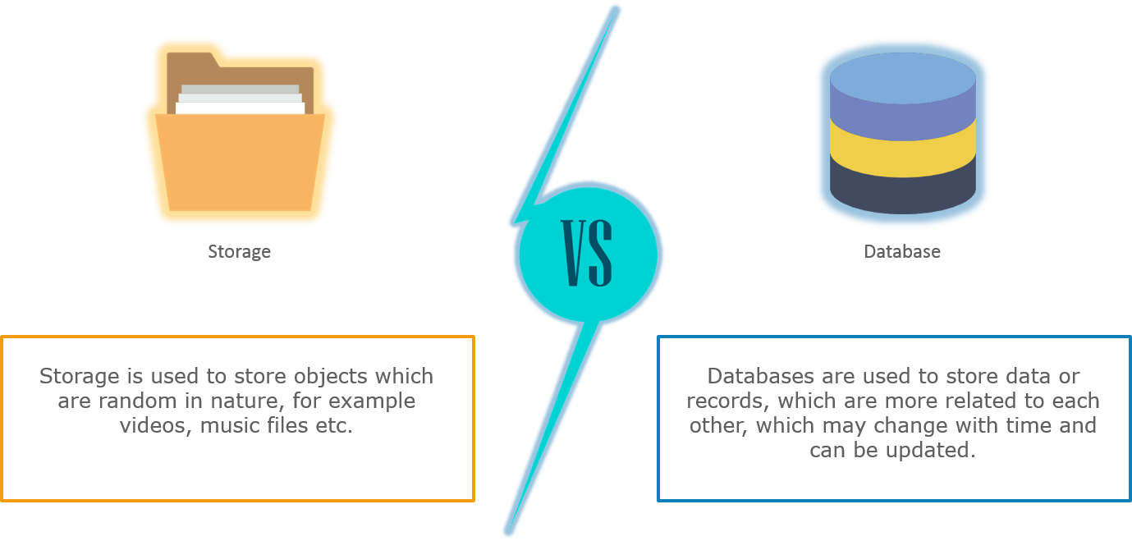
Filesystem vs Database
File systems not only require lower processing, they are easy to access as well.
If you store images on database, you would have to do a query request to database, every time you need an image. Imagine the same case with a file system, it will not take that much processing because accessing a file is quite simple and light weight.
Also, database storage is more expensive than file system storage.

Slide 2
Azure Storage
Azure Storage is the modern-day solution to all storage problems. Its storage capacity is limitless, virtually.
The Azure Storage platform is Microsoft's cloud storage solution for modern data storage scenarios.
Azure Storage offers highly available, massively scalable, durable, and secure storage for a variety of data objects in the cloud.
Azure Storage data objects are accessible from anywhere in the world over HTTP or HTTPS via a REST API.
Azure Storage also offers client libraries for developers building applications or services with .NET, Java, Python, JavaScript, C++, and Go.
Being a pay-as-you-go model, it gives you the flexibility of paying only for what you have used.
Azure Storage services support different languages like .NET, Ruby, Java, etc. which gives developers an option. To access any of the storage services.

Slide 3
Benefits of Azure Storage
Durability and high availability: Stored data is replicated and kept in different geographical locations. Hence, in the case of any hardware failure, you have your replicas safe and so your data. Also, if there is any natural disaster, your data will remain secure and you can avail them pretty easily.
Scalability: The storage is massively scalable depending on the requirements. Data is automatically scaled up to accommodate any peak demands.
Security: Accessing any information by an intruder from your storage is not an easy task, and hence your data is secure. Azure Storage uses a shared key model to authenticate a user. Usage of the shared access signature (SAS) can restrict access to data.
Accessibility: You can access your data from anywhere over HTTP or HTTPS. You can write your code on Azure PowerShell or on Azure CLI. Azure Storage Explorer and Azure portal provide you with an easy way to work with your data.

Slide 4
Azure Storage Types
The Azure Storage platform includes the following storage types
Azure blob storage: It is optimized to store huge unstructured data. Storage is in terms of binary large objects (BLOBs).
Azure table storage: It has now become a part of Azure Cosmos DB. Azure table stores structured NoSQL data.
Azure file storage: It is a fully managed file sharing service in the cloud or on-premise via the Server Message Block (SMB) protocol.
Azure queue storage: It is a storage service that stores messages that can be accessed through HTTP or HTTPS from any part of the globe.
Disk storage: It is a virtual hard disk (VHD) that is of two types: managed and unmanaged.

Slide 5

Azure Blob Storage
Blob’ stands for Binary Large Object and includes text files, images, audios, and videos.
Azure Blob is a service that stores massive unstructured data that can be accessed from any place via protocols like HTTP or HTTPS.
Azure Blob storage is a service that stores unstructured data in the cloud as objects/blobs.
Blob storage is optimized for storing massive amounts of unstructured data.
Unstructured data is data that doesn't adhere to a particular data model or definition, such as text or binary data.
Blob storage can store any type of text or binary data, such as a document, media file, or application installer.
Blob storage is also referred to as object storage.

Slide 6

Azure Table Storage
Allow you to store structured NoSQL data in the cloud
It is schemaless, i.e., the data does not have a fixed structure.
The Azure Table storage service stores large amounts of structured data.
Azure tables are ideal for storing structured, non-relational data.
You can scale up the tables based on your requirements

Slide 7
Azure Queue Storage
Azure queue stores a large number of messages that can be accessed from any location using HTTP or HTTPS
Azure Queue storage is a service for storing large numbers of messages that can be accessed from anywhere in the world via authenticated calls using HTTP or HTTPS.
The size of a queue message can be up to 64 KB.
Allows for asynchronous message queueing between application components.
A single queue message can be up to 64 KB in size, and a queue can contain millions of messages, up to the total capacity limit of a storage account.

Slide 8
Azure Queue Storage Pricing
Data Storage Option:
LRS GRS RA-GRS
Storage in GB/month 2.9744/GB 3.9658/GB 4.9573/GB
Operation and Data Transfer Pricing (in Rupees):
LRS GRS RA-GRS
Queue class 1 operations (in 10,000) 0.0238 0.0238 0.0238
Queue class 2 operations (in 10,000) 0.0238 0.0238 0.0238
Geo-replication Data Transfer (per GB) NA Free Free

Slide 9

Azure File Storage
It provides managed file sharing in the cloud. Applications on Azure can easily share files between the virtual machines, and they are accessible via SMB.
A File Storage share is an SMB(Server Message Block) file share in Azure. All directories and files must be created in a parent share. An account can contain an unlimited number of shares, and a share can store an unlimited number of files, up to the 5 TB total capacity of the file share.

Slide 10
Azure File Storage
Responsibilities of Azure file storage are:
Replacing on-premise file servers
Making lift and shift of applications easy to the cloud and offering both classic and hybrid lift and shift
Simplifying cloud development with diagnostic share, shared application settings, and Dev/Test/Debug
Azure File Storage Pricing
The pricing is with respect to the LRA redundancy option.
Data Storage Pricing (in Rupees):
Premium Standard
GiB/month 9.518/used GiB 3.966/used GiB
Snapshots GiB/month 7.932/used GiB 3.966/used GiB
Operations and Data Transfer Pricing (in Rupees):
Standard Premium
Put and Create Container Operations 0.9915 Free
List Operations (per 10,000) 0.9915 Free
Other operations, except Delete, (free) per 10,000 0.0992 Free
Geo-replication Data Transfer (per GiB) NA Free

Slide 11
Azure Disk Storage
Azure Disk
Azure Managed Disk is a virtual hard disk which is mostly like a physical disk that is virtualized.
Allows data to be persistently stored and accessed from an attached virtual hard disk.
Azure Disk Storage is further divided into two:
Managed
Unmanaged
When to use:
You want to store data that is not required to be accessed from outside the virtual machine to which the disk is attached.

Slide 12
Azure Disk Storage Pricing
There are four types of managed disks:
Ultra SSD Managed Disks
Premium SSD Managed Disks
Standard SSD Managed Disks
Standard HDD Managed Disks

Slide 13
Storage account overview
An Azure storage account contains all of your Azure Storage data objects, including blobs, file shares, queues, tables, and disks.
The storage account provides a unique namespace for your Azure Storage data
That's accessible from anywhere in the world over HTTP or HTTPS.
Data in your storage account is durable and highly available, secure, and massively scalable.

Slide 14
Storage account Types
Azure Storage offers several types of storage accounts. Each type supports different features and has its own pricing model.
The following table describes the types of storage accounts recommended by Microsoft for most scenarios.
Type of storage account | Supported storage services | Redundancy options | Usage
Standard general-purpose v2 | Blob Storage (including Data Lake Storage¹), Queue Storage, Table Storage, and Azure Files | Locally redundant storage (LRS) / geo-redundant storage (GRS) / read-access geo-redundant storage (RA-GRS) Zone-redundant storage (ZRS) / geo-zone-redundant storage (GZRS) / read-access geo-zone-redundant storage (RA-GZRS)² | Standard storage account type for blobs, file shares, queues, and tables. Recommended for most scenarios using Azure Storage. If you want support for network file system (NFS) in Azure Files, use the premium file shares account type.

Slide 15
Storage account Types
Type of storage account | Supported storage services | Redundancy options | Usage
Premium block blobs³ | Blob Storage (including Data Lake Storage¹) | LRS ZRS² | Premium storage account type for block blobs and append blobs. Recommended for scenarios with high transaction rates or that use smaller objects or require consistently low storage latency. Learn more about example workloads.
Premium file shares³ | Azure Files | LRS ZRS² | Premium storage account type for file shares only. Recommended for enterprise or high-performance scale applications. Use this account type if you want a storage account that supports both Server Message Block (SMB) and NFS file shares.

Slide 16
Performance Tiers In Storage Account
Standard
Standard storage is backed by magnetic hard drives like HDD and provides the lowest cost per GB.
They are best for applications that required bulk of data storage where data is access infrequently because read-write speeds are less as compare to premium.
Premium
Premium storage accounts are backed by SSD (Solid-state drives) and offers low latency performance.
They are mostly used with high-end systems and high-intensity applications like databases.
You can not switch from standard storage account to premium storage account, you must create a new storage account with premium or standard base on your requirement and then copy the data

Slide 17
Azure Redundant Types
Locally Redundant Storage
Locally Redundant Storage (LRS) replicates your data three times within a storage scale unit i.e inside a datacenter. The datacenter resides in the region where you created your storage account. A write request returns successfully only when it has been written to all three replicas. Each of these replicas reside in separate fault domains and upgrade domains within one storage scale unit.
Zone Redundant Storage
Zone-Redundant Storage (ZRS) replicates your data asynchronously across datacenters within one or two regions in addition to storing three replicas similar to LRS, thus providing higher durability than LRS. Data stored in ZRS is durable even if the primary datacenter is unavailable or unrecoverable.
Geo-Redundant Storage
Geo-redundant storage (GRS) replicates your data to a secondary region that is hundreds of miles away from the primary region. If your storage account has GRS enabled, then your data is durable even in the case of a complete regional outage or a disaster in which the primary region is not recoverable.
Read Access Geo-Redundant Storage
Read-access geo-redundant storage (RA-GRS) maximizes availability for your storage account, by providing read-only access to the data in the secondary location, in addition to the replication across two regions provided by GRS.

Slide 18
Storage account endpoints
A storage account provides a unique namespace in Azure for your data.
Every object that you store in Azure Storage has an address that includes your unique account name.
The combination of the account name and the Azure Storage service endpoint forms the endpoints for your storage account.
When naming your storage account, keep these rules in mind:
Storage account names must be between 3 and 24 characters in length and may contain numbers and lowercase letters only.
Your storage account name must be unique within Azure. No two storage accounts can have the same name.
The following table lists the format of the endpoint for each of the Azure Storage services.
Storage service | Endpoint
Blob Storage | https://<storage-account>.blob.core.windows.net
Azure Files | https://<storage-account>.file.core.windows.net
Queue Storage | https://<storage-account>.queue.core.windows.net
Table Storage | https://<storage-account>.table.core.windows.net

Slide 19
Azure Blob Storage
Binary Large Object is the storage arena for text, audio, images, and video.
Every blob resides inside a container. Blob storage act as the persistent store, where the data is stored for a long time.
Three options include Private, Public Container, and Public Blob.
One of the advantages of Blob Storage is that it offers zone-wise redundant processes. Different copies of data are created in the same zone or across two separate zones in a zone redundant.
So, creating copies in two distinct zones helps in data recovery. If one of the zones faces any failure, then the Azure redundant process can still help retain data. It even allows data read options from another location.
There are many ways to access data in Blob Storage, for example, through Storage Explorer, by building an SDK tool kit or using PowerShell

Slide 20
Blob Storage Features
Store Unstructured Data – All the unstructured data like images, videos, and audio can be stored in Blob.
Scalable and Availability – It has a zone replication process that helps store the copy of data and stands on high availability characteristics.
Secured – Blob provides utmost security by following encryption technology, RBAC, and Active Directory.
Data Lake Optimisation – It also supports a multi-protocol access system that helps provide insights into the workloads. File namespace and WORM also help in optimising the data.
Cloud Applications – Moreover, it is built keeping in mind the storage demand for developing mobile and web applications. Blob Storage also supports various languages such as Python, Java, Node.Js, and .Net. To conduct low-latency sessions, Blob is built with SSD storage toes.
Cost-effectiveness – Blob storage contains different tiers that help store a massive amount of data in a cost-efficient manner. Due to its lifecycle management, it becomes easy to manage those huge volume data.

Slide 21
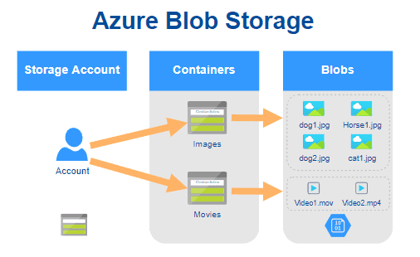
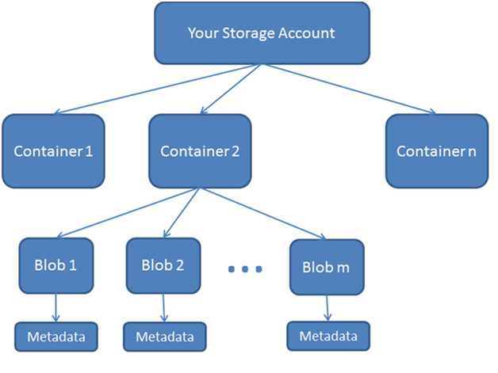
Resources of Blob Storage
Blob storage includes three types of resources explained below:
Storage Account – In Storage Account, you specify the namespace for the data. Objects stored in Azure Storage will have unique address linked to the individual account.
Container – It acts as a directory that helps establish and manage the blobs. The storage account can contain numerous containers, which can hold blobs of various range. Container’s names are always specified in lowercases.
Blob – Blobs are objects in the form of unstructured data, including images, audio, video, and files.

Slide 22
Types of Blob Storage
There are three types of Blob Storage, as explained below:
Block Blobs – In this storage option, individual blocks with unique IDs are created. It is mainly used for uploading big-size data. Block Blob stores data in block series and then conglomerate them into a single document file. Block Blob helps in achieving throughput and uploading the process faster. The size of the Block Blob is 200 GB.
Page Blobs – They are the default type and used for page compilation. Page Blob is used for conducting a read and write operation. Data of the virtual machines are stored as virtual documents and files on the page blob. It can store files of size 8 TiB. For the virtual machine, it acts as disks.
Append Blobs – The Append Blob is specifically customized to increase efficiency. It can also help in logging the data directly from the VMs.

Slide 23
Blob Storage Pricing
Hot Access – Data that is frequently used is stored in hot storage. It stores data utilized during migration processing. The storage cost is higher than Cool and Archive access but, the access cost is lower than the other two.
Cool Access – This tier helps store the data that is not accessed frequently. Its storage cost is lower, but the access cost is more than the Hot tier. It contains data that is going to stay for 30 days or more.
Archive Access – Data in this tier is stored for more than 180 days. The data stored in this tier are seldom accessed. It has a lower storage cost but a higher accessing cost. Also, it takes time while retrieving the data because data is often considered to be in offline mode.

Slide 24
Azure Blob Storage Pricing
Data Storage Pricing (in Rupees):
Data Transfer and Operations Pricing (in Rupees):
 | Premium | Hot | Cool | Archive
First 50 TB/month | 12.8888/GB | 1.3220/GB | 1.0576/GB | 0.1322/GB
Next 450 TB/month | 12.8888/GB | 1.2691/GB | 1.0576/GB | 0.1322/GB
Over 500 TB/month | 12.8888/GB | 1.2162/GB | 1.0576/GB | 0.1322/GB
 | Premium | Hot | Cool | Archive
Write Operations (per 10,000) | 1.5070 | 3.3049 | 6.6097 | 7.9316
List and Create Container Operations (per 10,000) | 4.2963 | 3.3049 | 3.3049 | 3.3049
Read Operations (per 10,000) | 0.1203 | 0.2644 | 0.6610 | 396.5775
All other operations (per 10,000), except Delete which is free | 0.1203 | 0.2644 | 0.2644 | 0.2644
Data Retrieval (per GB) | Free | Free | 0.6610 | 1.5864
Data Write (per GB) | Free | Free | Free | Free

Slide 25
Why and When to Choose Azure Blob Storage?
Azure Blob Storage is created for storing unstructured data. One can opt for Blob Storage for streaming audio and video files.
Likewise, Blob storage is also used for storing data during backup, archiving, restoring, and recovering. Extensive volume data used for analysis by Azure services are also stored here.
Similarly, one can go for Blob Storage when uploading large files. Azure Blob storage breaks the large files into smaller chunks, and these chunks get uploaded individually. After uploading these chunks, they get merged into a single initial file.
Blob storage is also used to serve images directly to gateways.
Azure Blob storage also allows the storage of files and documents for providing distributed access.
In addition to it, it can also be used for off-loading excess content from the servers to minimise the load.
It is also used for Big Data analysis by Azure Data Lake, an extension of Azure Blob Storage

Slide 26
Azure Table Storage
Microsoft Azure cloud service offers Azure Table Storage as a service to store and manage the big volume of structured NoSQL data (Big Data) on the cloud.
Table storage stores data in keys or attributes by using schema-less design and due to schema-less property this service can be scaled dynamically
Azure Table storage service is cost-effective and also has low latency while reading and writing data from tables.
Compared to traditional relational or SQL database storage It is very low in cost for the same volume of data
It can also store data coming from web apps, IoT devices, or other metadata which is flexible can increase and decrease datasets easily.

Slide 27
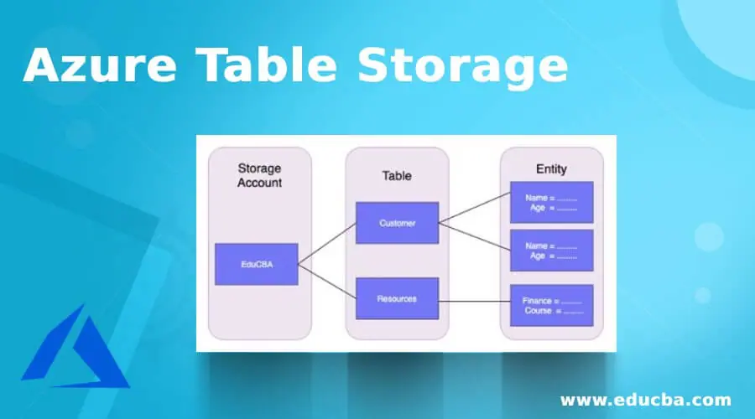
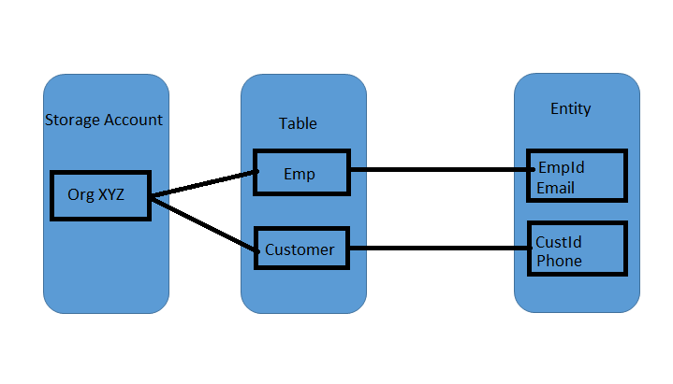
Architecture of Azure Table Storage
Azure Table Storage can store a huge volume of data in NoSQL datastores and users can query this structured and non-relational data to read and write tables.

Slide 28
Azure Table Storage
1. Storage Account
Azure Storage Account is used to provide and manage all the access related to the storage account and It is the basic building block of the Azure services. To transfer or migrate the data from one service in the storage user needs to have a storage account as it provides a unique namespace. It contains all the data objects used in Azure like Blob Storage, File Storage, Queues, disks, and Azure Table storage. So to access Azure Table Storage service users need to create a storage account.
2. Table
It is a collection of one or more schemeless entities. Azure tables do not impose the schema so that one table can store various types of entities with different properties.
3. Entity
It is the same as a row in a database with a set of properties. An entity can store the data up to 1MB of size in Azure storage and Azure Cosmos Database can store the entity with size 2MB
4. URL Format
In Azure storage account is created with unique namespace and the URL format of this storage account as below: Azure Storage Format: http://<storage_account_name>.table.core.windows.net/<table_name> Azure Cosmos Db Format: http://<storage_account_name>.table.cosmosdb.azure.com/<table_name>

Slide 29
Azure Queue Storage
Microsoft Azure Queue storage is a service used for storing the various large number of messages
You access messages from anywhere in the world via authenticated calls using HTTP or HTTPS.
Azure Queue storage can store millions of incoming messages up to the total capacity of the storage account
Each message size can be up to 64 KB.
It is also cost-effective storage which queues up all the incoming calls and messages them between different applications.
Queues are commonly used to create a backlog of work to process asynchronously.

Slide 30
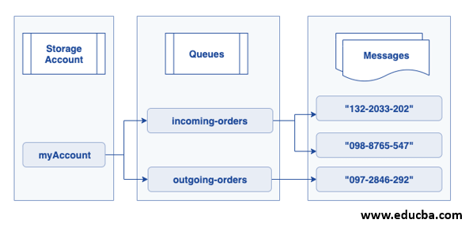
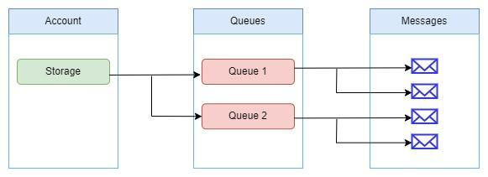
The Architecture of Azure Queue Storage

Slide 31
The Architecture of Azure Queue Storage
1. URL Format
In this account, queues are created with unique namespace and addressable using the URL format of this storage account as below.
Azure Storage Format:
http://<storage_account_name>.queue.core.windows.net/<queue_name>
2. Storage Account
This used to provide and manage all the access related to the storage account and It is the basic building block of the Azure services. To transfer or migrate the incoming orders from one application to another in the storage user needs to have a storage account as it provides a unique namespace. It contains all the data objects used in Azure like Blob Storage, File Storage, Queues storage, disks, and Azure Table storage. So to access Azure Table Storage service users need to create a storage account.

Slide 32
The Architecture of Azure Queue Storage
3. Queue
This is the set of messages in queue and queue name needs to be in lowercase and unique with valid DNS(Domain Name System) name with 3 to 63 characters.
4. Message
This can store a single message up to 64 KB in any format.
Queue storage capacity (maximum time to live) of the older version came before 2017-07-29 was 7 days. The latest version came after 2017-07-29 has maximum time to live is any positive number or -1 so that message does not expire. If the above maximum time-to-live parameter is not set in the newest version by default message queued capacity is 7 days.

Slide 33
ADVANTAGES OF AZURE QUEUE STORAGE
The following are the main benefits of Azure Queue Storages:
When compared to similar services, Azure Queue Storage is not expensive.
You will be charged based on the desired amount of redundancy, necessary storage space, and the number of transactions (i.e., read, write, delete).
Data in Queue Storage is substantially more secure because it must be accessed over the HTTP or HTTPS protocol through apps.
All you have to pay for is storage and operations. An Event Hub or a Service Bus, for example, has no ongoing costs.

Slide 34
Azure File Storage
Microsoft Azure file storage service is a cloud-based, fully managed storage service that provides a highly available, durable, scalable, and redundant storage system to store and share the files in the cloud.
Azure storage offers a shared storage platform across two or more servers or machines.
Azure file storage uses Server Message Block 3.0 (SMB) protocol to share applications, and SMB makes the movement of applications or data to the cloud simpler as it handles encryption and persistent handling.

Slide 35
Azure File Storage Components
Azure file storage has a top-level object to share the pool of storage which is used to deploy the multiple file shares to the cloud. To use the Azure File storage services user needs to have a storage account created. Here are the components used in the Azure files storage service:
1. Azure Storage Account: Azure storage account provides access to all the storage objects from azure like Queue, Blob, Files, Tables, and disks. It has a unique name and can be accessed from all over the world. Storage accounts provide options for different configurations users can use over resources; it also provides information on the number of resources available so that the limitation of storage account is shared across all the storage services.
2. Azure Storage Shares: Azure storage uses industry-standard SMB protocol to share the files and directories on the cloud. SMB file share has all the files and directory in it, and the user can create his files and directory in SMB share only and not in a storage account. Each azure storage can contain an unbounded number of shares, and each share can have one or more files. Azure creates file storage shares before loading or creating any file or directory; once file share is created, the user can use the same to upload the files and directory.

Slide 36
Azure File Storage Components
3. Azure Directory: Azure directory has the hierarchy of files or directory based on the specific category data like documents, logs, and media-related files stored in the specific categorical directory in the hierarchy.
4. Files: Files are created or uploaded in the azure storage shares. this file can be in any format, either text, csv, image (jpeg/png), or any application. Azure files have support for identity-based authentication over the SMB protocol.
5. URL Format: It is needed if the request is made for Azure share using the REST protocol, and the URL format should be :
https://<storage_account_name>.file.core.window.net/<storage_share_name>/<direcotory_name>/<file_name>

Slide 37
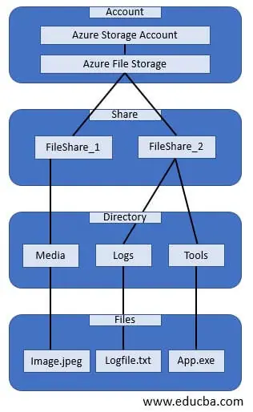
Azure File Storage Components

Slide 38
Azure File Storage data access methods
Azure file storage service has two methods to provide access to the files stored in the storage shares.
1. Direct Cloud Access
Azure file share can be mounted on any machines or servers with Windows, MacOS, or Unix platform, and it uses service message block (SMB) protocol or REST API for the file share as Azure provides SMB access.
2. Azure File Sync
Azure file sync is used to replicate the file shares on the on-premise server or the Azure Window platform.
Users can access the file shared in SMB or NFS using the Azure window server.
Azure file sync continuously synchronizes the files by keeping frequently accessed data at the endpoint and the rarely accessed on the Azure file share so that access can be faster with good performance.

Slide 39
Azure Blob and File Storage Differences
.
Use Case | Azure Blob Storage | Azure File Storage
Unstructured Data Storage | Best suited for storing unstructured data, such as text, images, audio, and video files. | Designed for structured data storage, such as application data and virtual machine files.
Data Access | Provides block-level access to data, making it ideal for streaming and storing large media files. | Provides SMB-based file access, making it ideal for sharing files across Windows and Linux clients.
Scalability | Highly scalable and can handle large amounts of data. | Can also scale to meet business needs, but not as well-suited for extremely large data sets.
Security | Provides granular access control, ensuring that data is secure. | Provides granular access control, ensuring that data is secure.
Integration | Can integrate with other Azure services, such as Azure Data Factory, Azure Functions, and Azure Stream Analytics. | Can easily integrate with other Azure services, such as Azure Virtual Machines and Azure Backup.

