Slide 1
Azure API Management
Azure API Management is a hybrid, multi-cloud management platform for APIs across all environments.
As a platform-as-a-service, API Management supports the complete API lifecycle.

Slide 2
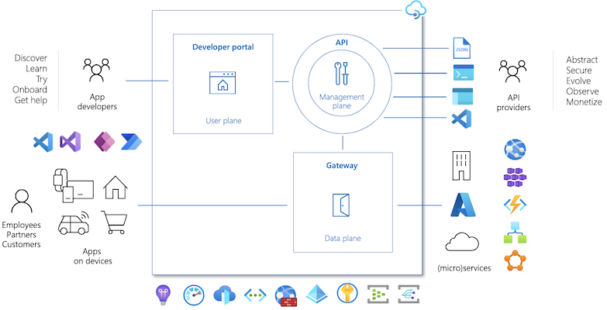
API Management components
Azure API Management is made up of 3 components like API gateway, a management plane, and a developer portal.
These components are Azure-hosted and fully managed by default.
API Management is available in various tiers differing in capacity and features.

Slide 3
API Management components
API gateway
All requests from client applications first reach the API gateway, which then forwards them to respective backend services.
The API gateway acts as a facade to the backend services, allowing API providers to abstract API implementations and evolve backend architecture without impacting API consumers.
The gateway enables consistent configuration of routing, security, throttling, caching, and observability.

Slide 4
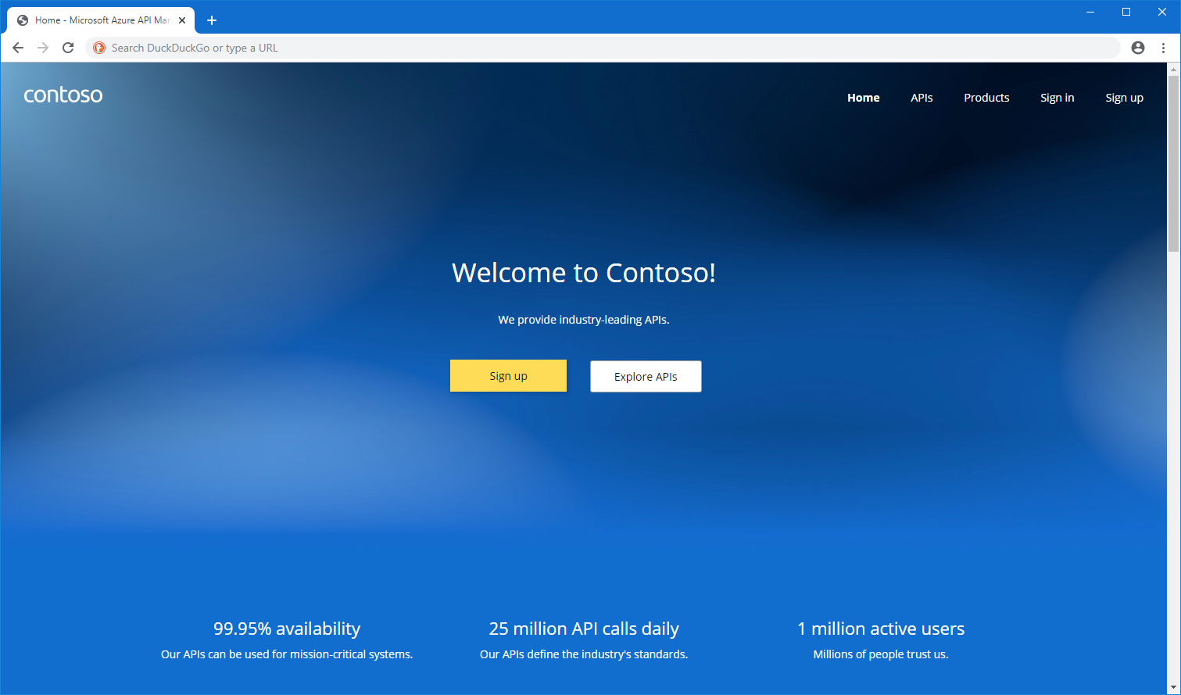
Developer portal
The open-source developer portal is an automatically generated, fully customizable website with the documentation of your APIs.

Slide 5
Developer portal
Using the developer portal, developers can:
Read API documentation
Call an API via the interactive console
Create an account and subscribe to get API keys
Access analytics on their own usage
Download API definitions
Manage API keys

Slide 6
API Management tiers
API Management is offered in a variety of pricing tiers to meet the needs of different customers.
Each tier offers a distinct combination of features, performance, capacity limits, scalability, SLA, and pricing for different scenarios.
Classic - The original API Management offering, including the Developer, Basic, Standard, and Premium tiers. The Premium tier is designed for enterprises requiring access to private backends, enhanced security features, multi-region deployments, availability zones, and high scalability. The Developer tier is an economical option for non-production use, while the Basic, Standard, and Premium tiers are production-ready tiers.
V2 - A new set of tiers that offer fast provisioning and scaling, including Basic v2 for development and testing, and Standard v2 for production workloads. Standard v2 supports simplified connection to network-isolated backends.
Consumption - The Consumption tier is a serverless gateway for managing APIs that scales based on demand and billed per execution. It is designed for applications with serverless compute, microservices-based architectures, and those with variable traffic patterns.

Slide 7
Integration with Azure services
API Management integrates with many complementary Azure services to create enterprise solutions, including:
Azure Key Vault for secure safekeeping and management of client certificates and secrets​
Azure Monitor for logging, reporting, and alerting on management operations, systems events, and API requests​
Application Insights for live metrics, end-to-end tracing, and troubleshooting
Virtual networks, private endpoints, and Application Gateway for network-level protection​
Azure Defender for APIs and Azure DDoS Protection for runtime protection against malicious attacks​
Microsoft Entra ID for developer authentication and request authorization​
Event Hubs for streaming events​
Several Azure compute offerings commonly used to build and host APIs on Azure, including Functions, Logic Apps, Web Apps, Service Fabric, and others including Azure OpenAI service.​

