Slide 1
Azure CLI
Azure CLI is useful to create the resources or monitor the resources on the Microsoft Azure cloud platform.
we can run, manage any Azure service via Azure CLI.
The major proposal for designing is to support the automation technique. It is very easy to work with. There is no restriction with any programming language.
It is compatible with all programming languages. Majorly the Azure CLI will work on both the Linux as well as Windows platforms.
It is very lightweight and easy to use. It will provide quick access to all the Azure services.

Slide 2
Get Started with Azure CLI
Azure CLI is useful to access the Azure cloud platform services. It will help to manage or create the resources on the Azure platform.
On the Azure dashboard, we are getting the cloud shell window. The cloud shell is providing the CLI functionality.
In the default way, the Azure cloud shell is providing the PowerShell as well as the bash CLI prompt.
As per the requirement, we need to choose the shell window.
It will depend on the application or project requirement also. Which type of shell window do we need to choose on the browser level? In some cases, we have seen that choosing the bash or PowerShell window. It will also depend on the developer or admin.

Slide 3
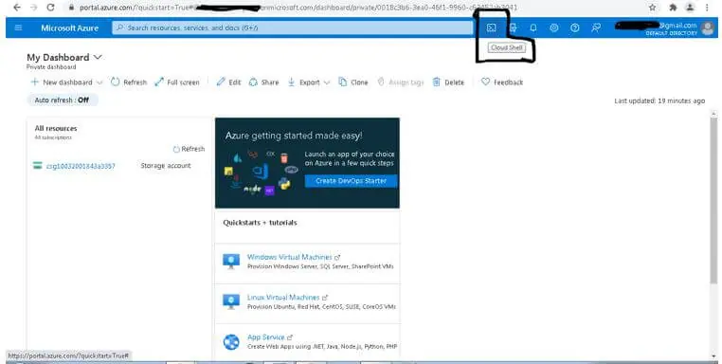
Get Started with Azure CLI

Slide 4
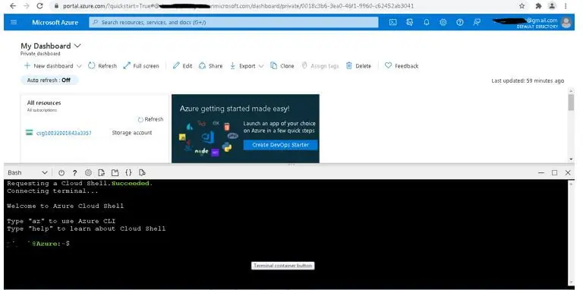
Get Started with Azure CLI
Once we will click on the Azure cloud shell. The first time, it will ask which type of shell prompt we need to use. It will be bash or the PowerShell one.
As per the requirement or the application use, we need to choose the best option for it.
To explore it more, we need to choose the bash CLI or the PowerShell CLI. As per the below screenshot, we have chosen the bash CLI window. Now in the same bash CLI window, we can trigger the different command or the query on the Azure cloud environment.

Slide 5
How to Install Azure CLI
There are different ways to install the Azure CLI on different operating systems like on Linux or windows.
But as per the requirement or convenience, we need to choose on which platform we need to deploy or run it. Here, we are using the Linux platform.
Azure CLI Windows installation:
https://learn.microsoft.com/en-us/cli/azure/install-azure-cli-windows?tabs=azure-cli

Slide 6
Azure CLI vs Azure PowerShell
Azure CLI and Azure PowerShell are command-line tools that enable you to create and manage Azure resources. Both are cross-platform, installable on Windows, macOS, and Linux.
Azure CLI
Cross-platform command-line interface, installable on Windows, macOS, Linux
Runs in Windows PowerShell, Cmd, or Bash and other Unix shells.
Azure PowerShell
Cross-platform PowerShell module, runs on Windows, macOS, Linux
Requires Windows PowerShell or PowerShell
Different shell environments
Shell Environment | Azure CLI | Azure PowerShell
Cmd | Yes
Bash | Yes
Windows PowerShell | Yes | Yes
PowerShell | Yes | Yes

