Slide 1
Azure Event Grid
Microsoft Azure Event Grid is a service where users can build serverless applications quickly with event-based architecture.
It is an event routing service that distributes events from sources like Blob Storage, Media Services to Azure functions, and Webhooks.
. Event Grid can be used as a Third-party service and supports Azure services as a publisher or Subscriber.
It has the support to create its event using custom topics.

Slide 2
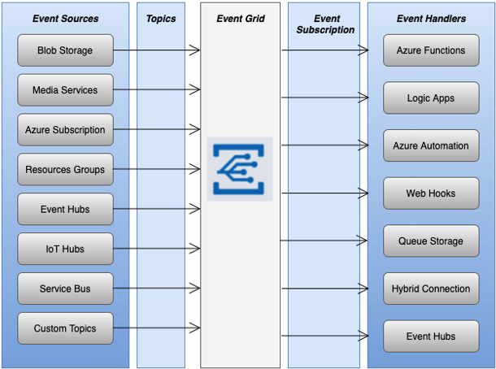
Azure Event Grid Components

Slide 3
Azure Event Grid Components
above Azure event grid uses the below components to connect to the source and Subscriber(As illustrated in the figure):
Events: It is the notification of certain conditions or the state change of what happened in the application.
Event Sources: Sources where the event is running or executing. Event sources used are Event Hubs, IoT Hubs, Blob Storage, etc.
Topics: It is the endpoint to receive events from publishers.
Event Subscriptions: The built-in mechanism used by the endpoint to route the events to the single or multiple event handlers. Subscriptions decide relevant events from incoming events.
Event Handlers: It is a service or apps like Event Hubs, Queue Storage, WebHooks, etc., to react to events.

