Slide 1
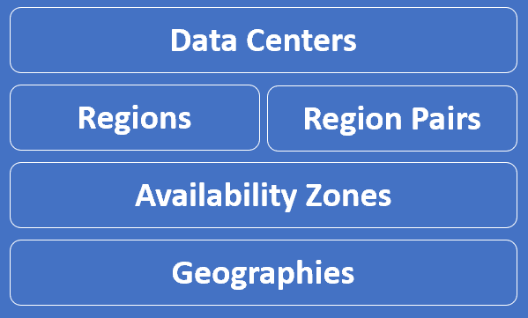
Azure
To understand azure better, we need to understand azure global infrastructure specific terms like
Datacenters
Regions
Region Pairs
Availability Zones and
Geographies

Slide 2
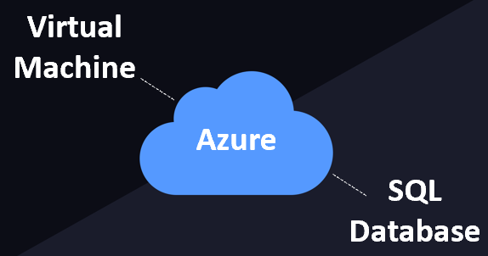
Azure-Datacenters
When we provision a resource from Azure cloud, like a Virtual Machine or an Azure SQL Database for example.
These resources obviously require a physical server space to be created.
A datacenter is simply a building that contains the physical server. Not just one server, many many physical servers which are connected over a network. It also has it's own power, and cooling.
So, in simple terms, an Azure data center is a unique physical building that contains many many physical servers with it's own power, cooling and networking infrastructure.

Slide 3
Azure-Datacenters
Azure is made up of datacenters located around the globe.
Datacenters are building blocks of azure infrastructure.
Azure datacenters are contains thousands of physical servers.
Azure datacenter is a unique physical building contains thousands of physical servers.
Datacenters are located all over the globe.
Datacenters contains their own power, cooling and network system.
There are 160+ datacenters world-wide.
All azure datacenters on land.
The exact location of these datacenters is not published by Microsoft for obvious security reasons.

Slide 4

Azure-Datacenters

Slide 5
Azure regions
A region is a geographical area on the planet that contains at least one or multiple datacenters that are nearby and networked together with a low-latency network.
Azure Region is a set of Datacenters that are connected through a dedicated low-latency network.
A Region could be made up of just 1 datacenter or multiple datacenters.
When you use a service or create a resource such as a SQL database or virtual machine (VM), you're using physical equipment in one or more of these locations.
These specific datacenters aren't exposed to users directly. Instead, Azure organizes them into regions.
There are regions of different sizes
Azure intelligently assigns and controls the resources within each region to ensure workloads are appropriately balanced.
When you deploy a resource in Azure, you'll often need to choose the region where you want your resource deployed.
Azure has 58 regions worldwide.

Slide 6
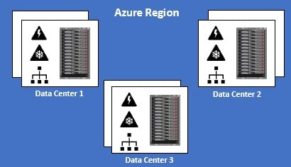
Azure regions

Slide 7
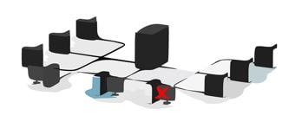
Azure regions
You have the flexibility to deploy your applications and data to any Azure region you want. You can even deploy across multiple regions to deliver cross-region resiliency.
What is cross-region resiliency
Resilience is the ability of a software to react to problems in one of its components and still provide the best possible service.
Both your software and the underlying infrastructure must be resilient. If there is a problem, the end user should not know about it. The request must be handled and processed by another region. The end user should get the same level of service.

Slide 8
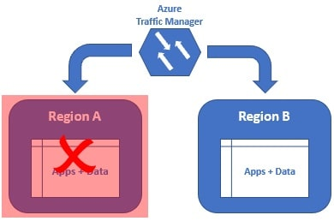
Azure regions
We can get this resiliency, by deploying our application and data in at least 2 regions. In this example we have our application and data deployed in two regions - Region A and Region B.
If there is a region level failure, for example, let's say Region A has gone down. The Azure Traffic Manager is smart enough to send all the requests to Region B. The end user gets the same response. He does not even know there is a region level failure. When Region A is back online, the Azure Traffic Manager will distribute the traffic between both the regions again.

Slide 9
Azure regions
Some services or VM features are only available in certain regions, such as specific VM sizes or storage types.
There are also some global Azure services that don't require you to select a particular region, such as Azure Active Directory, Azure Traffic Manager, and Azure DNS.
A few examples of regions are West US, Canada Central, West Europe, Australia East, Central India and Japan West.

Slide 10
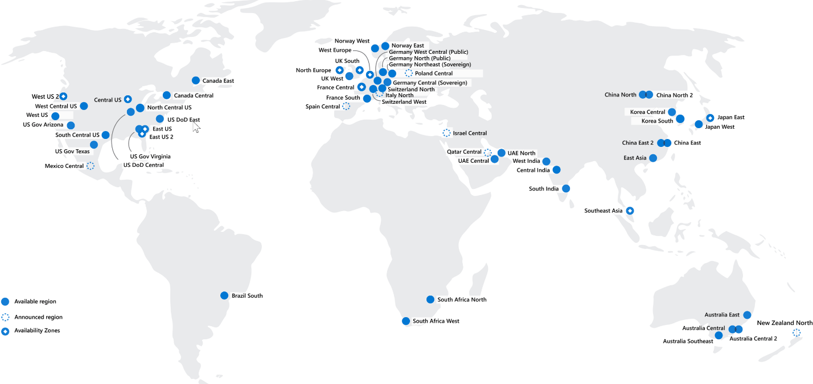
Azure regions

Slide 11
Azure regions
Why are regions important?
Azure has more global regions than any other cloud provider. These regions give you the flexibility to bring applications closer to your users no matter where they are.
Global regions provide better scalability and redundancy. They also preserve data residency for your services.
Special Azure regions
Azure has specialized regions that you might want to use when you build out your applications for compliance or legal purposes. A few examples include:
US DoD Central, US Gov Virginia, US Gov Iowa and more: These regions are physical and logical network-isolated instances of Azure for U.S. government agencies and partners. These datacenters are operated by screened U.S. personnel and include additional compliance certifications.
China East, China North, and more: These regions are available through a unique partnership between Microsoft and 21Vianet, whereby Microsoft doesn't directly maintain the datacenters.

Slide 12
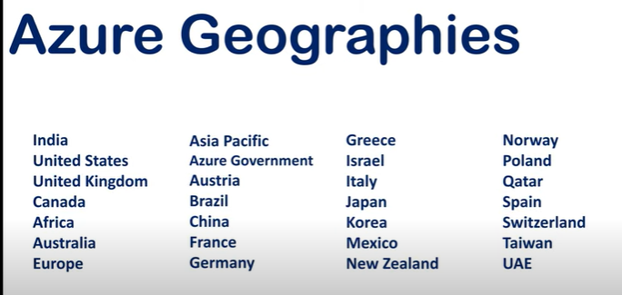
Azure Geographies
Azure Geography is an area of the world that contains at one or more azure regions.
For example, India is a geography. Similarly United States and United Kingdom are geographies.
In simple terms, an Azure geography is an area of the world that contains one or more Azure regions.

Slide 13
Azure Geographies
Why Geographies
regulated data like financial, health care or credit data may not be allowed to leave the country.
Legally your organization is required to store such data in the same country where the operations are being carried out.
So, if you select a geography like India for example, Azure ensures your data is not stored outside of India. Similarly if you select United States, the data stays inside the states.
You have complete control on which geographies you want your data and applications to be deployed. You can be assured, Microsoft will not store customer data outside the geography you specify
https://azure.microsoft.com/en-us/global-infrastructure/geographies/

Slide 14
Azure availability zones
An Azure Availability Zone is a unique physical location within an Azure region.
Each Availability Zone is made up of one or more datacenters with independent power, cooling, and networking
Not all Regions have Availability Zones.
Regions that support Availability Zones have a minimum of three separate zones to ensure resiliency(to recover quickly from difficulties).
If one of the Availability Zones has gone down for some reason, we still have our applications and data available from the rest of the two Availability Zones.
There is a physical separation between each Availability Zone and it is this separation that protects our applications and data from Datacenter failures.
With Availability Zones, Azure offers industry best 99.99% VM uptime SLA.
Availability zones are connected through high-speed, private fiber-optic networks.

Slide 15
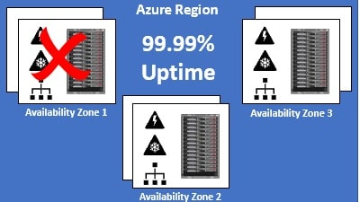
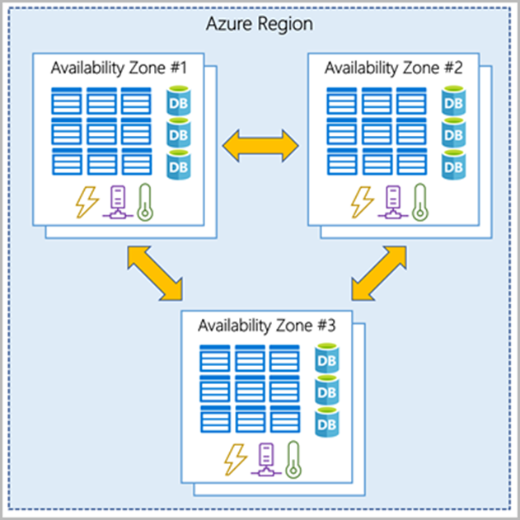
Azure availability zones

Slide 16
Azure availability zones
Azure services that support availability zones fall into three categories:
Zonal services: You pin the resource to a specific zone (for example, VMs, managed disks, IP addresses).
Zone-redundant services: The platform replicates automatically across zones (for example, zone-redundant storage, SQL Database).
Non-regional services: Services are always available from Azure geographies and are resilient to zone-wide outages as well as region-wide outages.

Slide 17
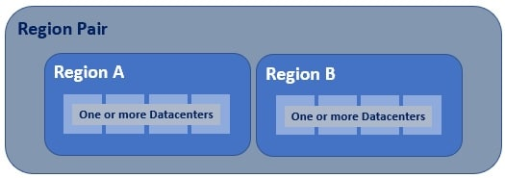
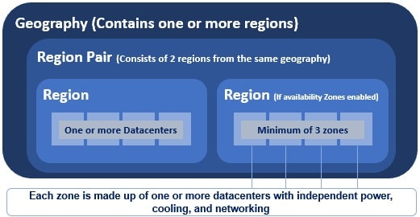
Azure region pair
Azure regional pair consists of two regions within the same geography.

Slide 18
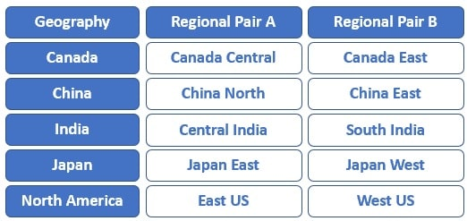
Azure region pair
The following are a few examples of azure paired regions.

