Slide 1
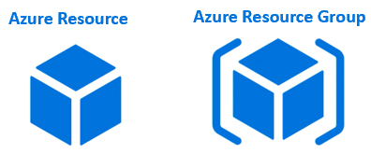
Azure-Resources and Resource Groups
What are Azure Resources
Resources are instances of azure services that you create, like virtual machines, app services, storage accounts, SQL databases, function apps etc.
All these are azure services. Everytime you create an instance of a service, you are creating a resource.

Slide 2
Azure-Resources and Resource Groups
What is an Azure Resource Group
A Resource Group is a group of azure resources like virtual machines, app services, storage accounts, SQL databases etc.
It's a logical container for grouping related azure resources.
The first step of using Microsoft Azure is creating a resource group.
A resource group is a container that holds related resources for u r Azure solution/Project.
A resource group includes all those resources that need to be managed as a group.
Generally, add resources that share the same lifecycle to the same resource group so you can easily deploy, update, and delete them as a group.
We can create a resource group in Azure either through a portal provided by Azure or through Azure Cloud Shell.

Slide 3
Azure-Resources and Resource Groups
Azure Resource Group Example
Let's say we are developing a web application. let's just assume we need the following 3 azure resources.
Virtual Machine - To host and run our web application
Storage Account - To store images, videos and other resources that our web application needs
SQL database - To store our application data
Let's say for this example sake we have the following environments. Most organisations have these deployment environments.
Development
Testing
Staging
Preproduction
Production

Slide 4
Azure-Resources and Resource Groups
Let's say our web application name is abc.com. We might create the following 4 resource groups, one for each environment.
rg-abc-development
rg-abc-staging
rg-abc-preproduction
rg-abc-production
We have the following naming pattern here. The prefix rg stands for resource group.
rg-<applicationName>-<deploymentEnvironment>
In general, resources that share the same deployment lifecycle are grouped, so these resources can be easily provisioned i.e created, deployed, updated, and deleted as a single unit.

Slide 5
Azure resource groups - Imporantant points to remember
An azure resource is any service instance that you create. For example, virtual machine, Azure sql database, storage account etc.
A resource group, as the name implies, a group of related azure resources.
In general, resources in a resource group share the same life cycle, so they can be easily created, deployed, updated, and deleted as a single unit.
When you create a resource group, you specify a region. It is this region where the meta-data about the resource group is stored.
However, the resources themselves can be in any azure region.
Resources in one resource group can interact with resources in other resource groups.
Each resource must be in one and only one resource group. You cannot have a resource in more than 1 resource group at the sametime.
You can move a resource from one resource group to another.
You can add or remove a resource from a resource group at any time.
You can group resources any way you want. Anyway that makes sense to your oragnisation really - By department, By country, By application, By resource type or a combination of these.

Slide 6
Benefits of Azure Resource Groups
Administration is much easier
Cost management is easier
Role-based access control (RBAC)
Create resource group step by step(click here)

Slide 7
Azure management groups and subscriptions
If there are only a few subscriptions in your organisation, then it's relatively simple to manage them independently.
However, in an organisation there are usually many employees and may be, many applications.
If all these employees are provided azure subscriptions and if they start creating azure resources at will, it may soon become difficult to control, manage and track who is creating what and eventually the costs may go out of control.
So, Azure has four levels of management-scope to organize, secure, manage and track the costs.

Slide 8
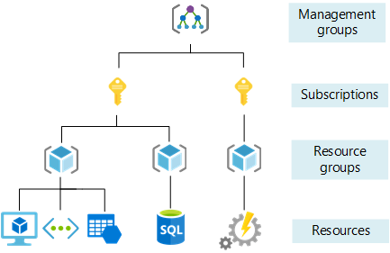
Azure management groups and subscriptions
The following image from MSDN shows the four levels of management-scope and the relationship between them.

Slide 9
Azure management groups and subscriptions
Management groups
Management group is at the top of the hierarchy. All subscriptions in a management group automatically inherit the conditions or settings specified at the management group level. So, a management group is like a container for all your subscriptions. Just like how there can be multiple subscriptions, there can also be multiple management groups in an organisation.

Slide 10
Azure management groups and subscriptions
Subscriptions
A subscription sits under a management group. It associates user accounts and the resources that were created by those user accounts. Each subscription has limits or quotas on the amount of resources you can create and use. Organizations can use subscriptions to manage costs and the resources that are created by users, teams, or projects.
Resource groups
A resource group, as the name implies, is a group of related azure resources. It is basically a logical container into which Azure resources like web apps, databases, and storage accounts are deployed and managed. We discussed resource groups in detail in Parts 5 and 6 of this azure tutorial.
Resources
An azure resource is any service instance that you create. For example, virtual machine, Azure sql database, storage account etc.

