Slide 1
Azure Service Bus
Microsoft Azure Service Bus is a message broker service that helps in the transfer of messages.
The data transferred between various applications and services can be any type of information, including data encoded in standard formats like structured Plain Text, JSON, XML, etc.
Azure Service Bus serves as a messenger for these data transfers.
Azure provides three services to help with an event or message delivery across a solution. These services are:
Azure Event Grid
Azure Event Hubs
Azure Service Bus

Slide 2
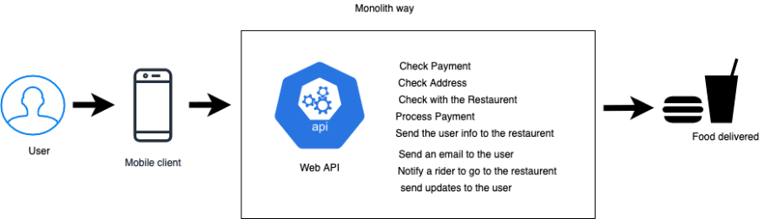
Traditional application
In a traditional web application, the entire processing will be in the monolith so processing a request can take up to a minute or two and the user will have to wait in the unknown until the request has been processed
In this case all of the requests are being processed by the API server
Pros:
Easy to host
Single point of processing
Cons:
Single point of failure
Very hard to scale
bad user experience
difficult to maintain without down time

Slide 3
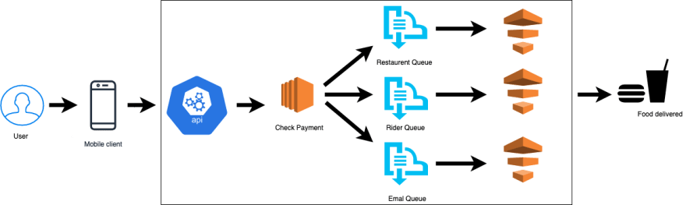
Service based application
The application divide the work that needs to be done to different services. Services can run asynchronously and the user will get a faster response while the application does it processing and once the process has been complete the user will get a confirmation.
We can see that the API delegate the processing of the order to different queue and every single one of them is running asynchronously to process the order

Slide 4
Service based application
Pros
Scalable
Easy to maintain without down time
better user experience
less error prone
Cons:
Complicated to host
multiple services to manage

Slide 5

Azure Service bus Types
There is 2 types in Azure Service bus: Queue and Topics
Queue:
Follow the FIFO model (First in first out)
The consumer is 1 type of the application
Point to point model
We cannot have multiple types of the application as when its consumed by 1 service its lost of ever no other service will be able to pick it up

Slide 6
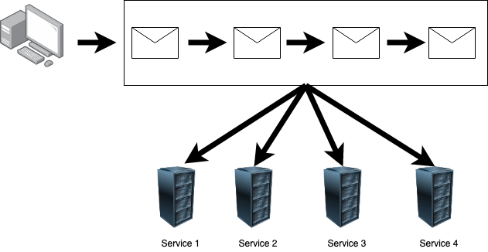
Azure Service bus Types
Topics:
Topics will have subscriptions
Once there is a message in the queue every application that is subscribed to the queue will receive a copy of that message
Publish and subscribe model: deals with contract negotiations and changes because there is more consumers
Services can have filter to allow only certain types of messages to be sent to them

