Slide 1
What is virtualization?
Virtualization is a process that allows a computer to share its hardware resources with multiple digitally separated environments.
Each virtualized environment runs within its allocated resources, such as memory, processing power, and storage.
With virtualization, organizations can switch between different operating systems on the same server without rebooting.
Virtual machines and hypervisors are two important concepts in virtualization.
Virtual machine
A virtual machine is a software-defined computer that runs on a physical computer with a separate operating system and computing resources. The physical computer is called the host machine and virtual machines are guest machines. Multiple virtual machines can run on a single physical machine. Virtual machines are abstracted from the computer hardware by a hypervisor.
Hypervisor
The hypervisor is a software component that manages multiple virtual machines in a computer. It ensures that each virtual machine gets the allocated resources and does not interfere with the operation of other virtual machines. There are two types of hypervisors.

Slide 2
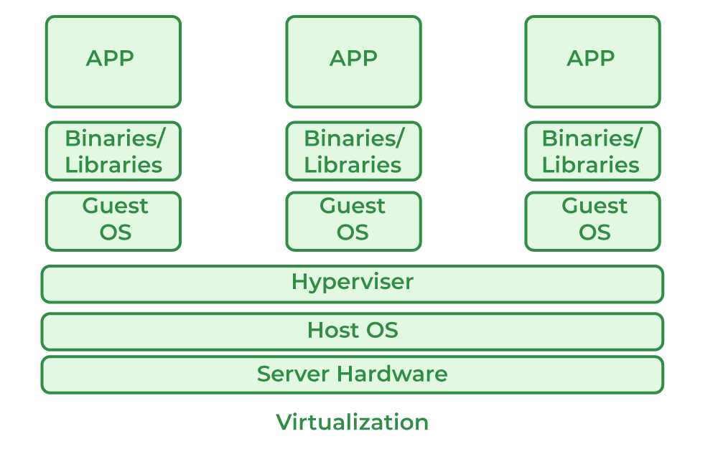
What is virtualization?
Host Machine: The machine on which the virtual machine is going to be built is known as Host Machine.
Guest Machine: The virtual machine is referred to as a Guest Machine.

Slide 3
What is virtualization?
Benefits of Virtualization
More flexible and efficient allocation of resources.
Enhance development productivity.
It lowers the cost of IT infrastructure.
Remote access and rapid scalability.
High availability and disaster recovery.
Pay peruse of the IT infrastructure on demand.
Enables running multiple operating systems.

Slide 4
What is virtualization?
Types of Virtualization
Hardware Virtualization.
Operating system Virtualization.
Server Virtualization.
Storage Virtualization.
Hardware Virtualization
When the virtual machine software or virtual machine manager (VMM) is directly installed on the hardware system is known as hardware virtualization.
The main job of hypervisor is to control and monitoring the processor, memory and other hardware resources.
After virtualization of hardware system we can install different operating system on it and run different applications on those OS.
Usage:
Hardware virtualization is mainly done for the server platforms, because controlling virtual machines is much easier than controlling a physical server.

Slide 5
What is virtualization?
Operating System Virtualization
When the virtual machine software or virtual machine manager (VMM) is installed on the Host operating system instead of directly on the hardware system is known as operating system virtualization.
Usage:
Operating System Virtualization is mainly used for testing the applications on different platforms of OS.
Server Virtualization
When the virtual machine software or virtual machine manager (VMM) is directly installed on the Server system is known as server virtualization.
Usage:
Server virtualization is done because a single physical server can be divided into multiple servers on the demand basis and for balancing the load.
Storage Virtualization
Storage virtualization is the process of grouping the physical storage from multiple network storage devices so that it looks like a single storage device.
Storage virtualization is also implemented by using software applications.
Usage:
Storage virtualization is mainly done for back-up and recovery purposes.

Slide 6
What are Virtual Machines?
A virtual machine is like a physical computer but it is actually a digital version of it.
A Virtual machine is a ready-made computer system that has been made available by Visualization concept.
It is a computer file typically called as an image which behaves like an actual computer.
Actually, it is not so much different from physical computers because they have also memory, CPU, as well as they have disks to store our data or various files.
VM can also connect to the internet.
Each VM can act like a computer machine
It runs in windows, Linux etc.
VM gives you a flexibility that can run multiple machines in a physical computer.
Each VM can have a different operating system.
Each of these virtual machines provides its own virtual hardware which includes CPUs, memory, hard drives, network interfaces and other such devices.

Slide 7
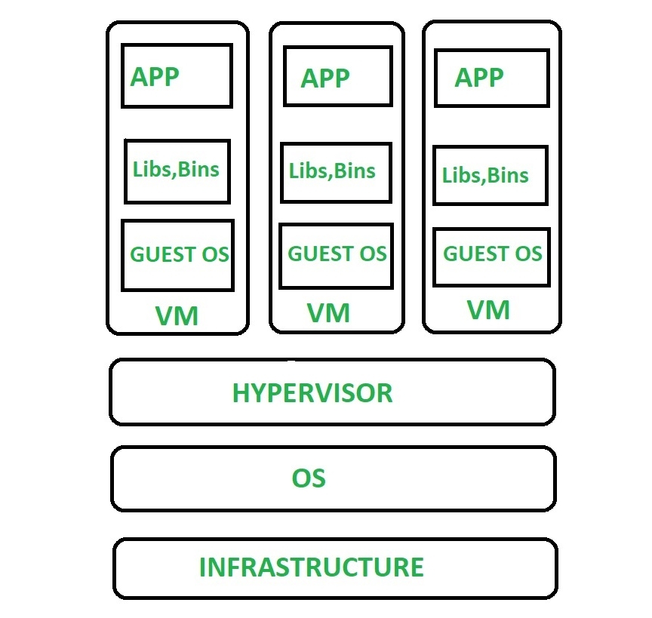
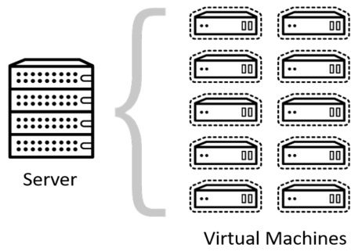
What are Virtual Machines?

Slide 8
Azure Virtual Machines
It is one of the services provided by Azure to create your own instances.
It is a IaaS Service offered by Azure
It is to remember that when you are running Azure VM you must pay for the compute time on a per- minute basis.
the pricing of this is based on their size, operating system and any licensed software that has been installed in it.
In order to avoid corresponding charges when you are not using it, it is to be seen that you change its state to Stopped (Deallocated)

Slide 9
Why Azure Virtual Machine?
Azure PaaS Services and Azure IaaS Services to build and develop cloud-based solutions that allows to make use of best features in Azure. In such scenarios
it is important to understand the capabilities of Azure IaaS and Azure PaaS.
let us try to understand some features and capabilities of Azure VMs
More Control – With Azure VMs, Developer have more control over the development environment which is very helpful in case of building a highly secured architecture for a complex solution. Developers can choose operating system, Networking, Storage connections etc. to build a sandbox solution.
Easy Diagnostics – Azure VMs provides the facility to troubleshoot issues with options like remote debugging, event logs, IIS logs, application logs etc.
Alerts – We can trigger actions and alerts based on metrics of computing resources consumed by VM.

Slide 10
Why Azure Virtual Machine?
Pricing – We can shut down and stop the VMs if not in use. A stopped VM will not incur any charge. Restarting the VM will maintains its state based on persistent disks.
Scaling – We can scale up/down and out/In the Virtual machines. Auto scale feature is also there to support based on some metrics. For example, scale out to 5 instances when CPU utilization is greater than 70% for more than 5 minutes.
Scale Sets – Virtual Machine Scale Sets are group of VMs with identical configuration and will be managed by a load balancer.

Slide 11
Azure Virtual Machines VM Sizes
It is important to select the right VM size and type for the working of our virtual machine perfectly. So, these are the VM sizes that are available within Azure.
General purpose – Sizes: Av2, B, Dv2, Dv3, DSv2, Dsv3 These sizes of Azure VMs are generally used for small or medium traffic web servers and can be used as a development or test environment. It has a balanced CPU to memory ratio.
Compute optimized - Sizes: F, Fs, FSv2 This category is optimized for running heavy background work loads. This size group is suitable for medium traffic web server and has high CPU to memory ratio.
Memory Optimized – Sizes: Ev3, ESv3, G, M, GS These VMs have High memory to CPU ratio and recommended for relational databases and in memory analytics.
Storage Optimized – Size: Ls This VM category is suitable for large databases like No SQL and Big Data storage. It has high through put and IO operations.
GPU optimized -Sizes: NV, NC, NCv2, NCv3 GPU optimized VM sizes are specialized virtual machines available for high density graphical rendering work or video editing. These sizes are designed for compute-intensive, graphics-intensive, and visualization workloads.
High Performance – Size: H This is the highest power category VM with highest throughput and network interfaces.

Slide 12
Azure Virtual Machines VM Sizes
Type | Sizes | Description
General-purpose | B, Dsv3, Dv3, DSv2, Dv2, DS, D, Av2, A0-7 | It has balanced CPU-to -memory ratio, It is ideal for testing and development, small to medium databases, and low to medium traffic web servers.
Compute-optimized | Fsv2, Fs, F | It has a high CPU-to-memory ratio. It is suitable for medium traffic web servers, network appliances, batch processes.
Memory-optimized | Esv3, Ev3, M, GS, G, DSv2, DS, Dv2, D | Is has a high memory-to-CPU ratio. Great for relational database servers, medium to large caches, and in-memory analytics.
Storage optimized | Ls | It has high disk throughput and IO that is Ideal for Big Data, SQL, and NoSQL databases.
GPU | NV, NC, NCv2, ND | It is a specialized virtual machine that is targeted for heavy graphic rendering and video editing. Available with single or multiple GPUs.
High performance compute | H, A8-11 | It is the fastest and most powerful CPU virtual machine with optional high-throughput network interfaces (RDMA).

Slide 13
Virtual Machine Prices
Azure VM has two kind of pricing modals - Pay as you Go and Reserved Virtual machine Instance.
Pay as you Go – This modal charge only for the time compute resource like Azure VM is used. It does not have any long-term commitment or any fixed monthly charges. We can scale out or even stop the VM in order to utilize efficiently and reduce bills. This kind of plan works for short term projects with un-predictable business requirements. Developers try out the stability of application in this plan.
Reserved Instances – This plan brings an advanced purchase option for a reserved VM instance for a period of 1 or 3 years. With this, users get up to 72 % price savings than pay as you go plan. Reserved Virtual machines can easily be replaced with another one in case of any downgrade in performance. This plan suits with stable traffic on applications deployed on Azure VM. Software development with the fixed budget can prefer having a reserved Azure VM.

Slide 14
Azure Virtual Machines
Virtual machines can be created and managed using:
Azure Portal
Azure PowerShell and ARM templates
Azure CLI
Client SDK's
REST APIs

Slide 15
Azure Virtual Machines
Following are the configuration choices that Azure offers while creating a Virtual Machine.
Operating system (Windows and Linux)
VM size, which determines factors such as processing power, how many disks we attach etc.
The region where VM will be hosted
VM extension, which gives additional capabilities such as running anti-virus etc.
Compute, Networking, and Storage elements will be created during the provisioning of the virtual machine.

Slide 16
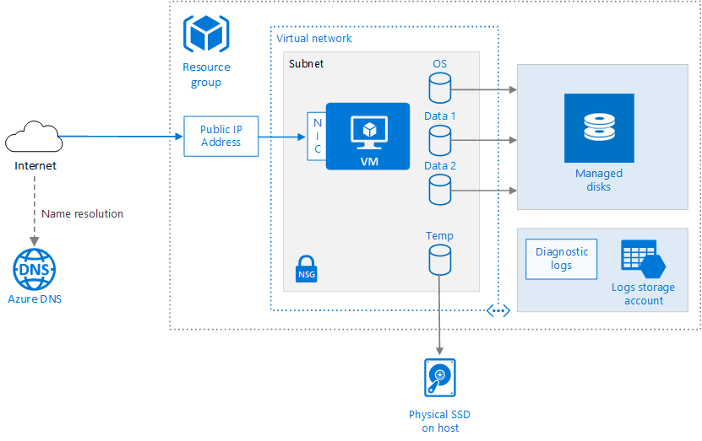
Virtual Machine Architecture

Slide 17
Azure Virtual Machines
Resource Group – A resource group a logical container for all related resources based on the lifetime of resources. This also helps to provide access to users for a particular set of resources attached to same resource group.
Virtual machine - This can be created in Azure by portal, PowerShell or Azure CLI from the list of published images or by a custom image VHD file uploaded into Azure Blob.
Temporary disk -The VM also has a temporary disk stored on a physical drive on the host machine. It is not persisted during reboot events.
Virtual network – VMs can be deployed in a separate Virtual network (VNet) that can be divided into multiple subnets to support different layers of application architecture. Each Subnet should be associated with different Network Security Group (NSG) with defined inbound and outbound rules which takes care of allowing or denying web traffic.
Network Interface – The Network Interface (NIC) allows the VM to be configured for the Virtual Network.
Public IP – A public IP address is by default added with a VM. This is used to communicate with VM from outside like Remote Desktop.

Slide 18
VM Availability Sets
In order to ensure high availability of Azure VM Solutions, there is a unique feature called Availability Sets. This manages the VMs by deploying them in different cluster nodes in data centers. To understand Virtual Machine Availability Sets, we need to first understand these two terms
Fault Domain
A set of racks in a data centre that has a common power source. This means that if the power supply goes off, the VMs deployed in those set of racks will shut down. Like how we organize bookshelves in a library, a particular shelveset for a particular section of books can be considered to a fault domain.
Update Domain
One rack in a Fault domain is called update domain. This can be considered as one unit in a cabinet of hardware or one unit of the subsection in a book shelve. Multiple update domains are part of a fault domain. If the power goes off for the fault domain, the update domains automatically go down.

Slide 19
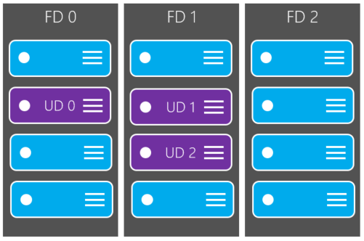
VM Availability Sets
To meet the SLA of 99.95%, it is recommended to group one or more virtual machines in an Availability Set. This ensures that in case of planned or unplanned maintenance activities, at least one VM is up and running. By default, Azure deploys the virtual machines in an availability set in 3 Fault domains and 5 update domains.
We can configure it to use up to 20 update domains. It is recommended to have different availability sets for web servers and API servers. We cannot assign existing VMs to an Availability Set. We should first create an availability set and then while creating VMs we should associate Availability Sets to VMs.

Slide 20
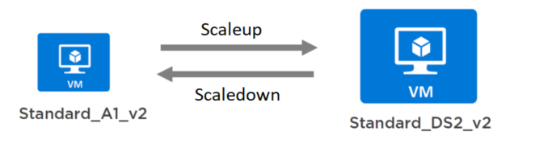
Scaling
We can perform scale up/down and Scale out/in operations on virtual machines.
Vertical Scaling
In vertical scaling, the size of the VM is changed. Scale up for VMs is to upgrade the size of VM to a higher level. This will require reboot of the system and that will have an outage. Similarly, scale down of VM instance is to downgrade the size of VM.

Slide 21
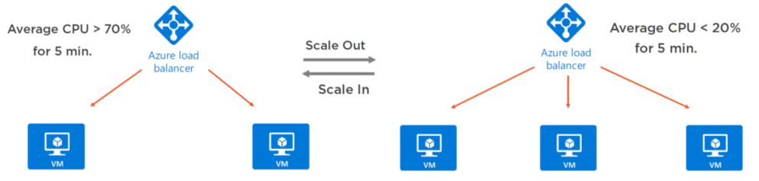
Scaling
Horizontal Scaling
Horizontal scaling means increasing or decreasing the number of VM instances. For Scale-out operation of VM, we can add another similar configuration VM instance and add a load balancer to distribute the incoming HTTP requests. This kind of scaling is well supported with Virtual machine Scale Sets. For Scale-In, VM instances are removed. It is easy to manage VMs with Scale sets as VMs can be created on demand or scheduled time from a central configuration. A load balancer will automatically be created and integrated. This also takes care of deploying multiple VMs across Availability sets.

