Slide 1
Azure App Service
Azure App Service enables you to build and host web applications in the programming language of your choice without managing infrastructure.
Azure App Service is an HTTP-based service for hosting web applications, REST APIs, and mobile back ends.
You can develop in your favorite programming language or framework, be it .NET, .NET Core, Java, Ruby, Node.js, PHP, or Python.
App Service is a Platform as a Service (PaaS) offering from Microsoft.
App Service use it to host web applications, REST API's and backend services for mobile applications.
App Service supports Windows and Linux and enables automated deployments from GitHub, Azure DevOps, or any Git repo to support a continuous deployment model.
This platform as a service (PaaS) environment allows you to focus on the website and API logic while Azure handles the infrastructure to run and scale your web applications.

Slide 2
Azure App Service
Hosting your web application using Azure App Service makes deploying and managing a web app much easier when compared to managing a physical server.
Azure App Service is a fully managed web application hosting platform. This platform as a service (PaaS) offered by Azure allows you to focus on designing and building your app while Azure takes care of the infrastructure to run and scale your applications.
Note:
The languages, and their supported versions, are updated on a regular basis. You can retrieve the current list by using the following command in the Cloud Shell.
Bash
az webapp list-runtimes --os-type linux

Slide 3
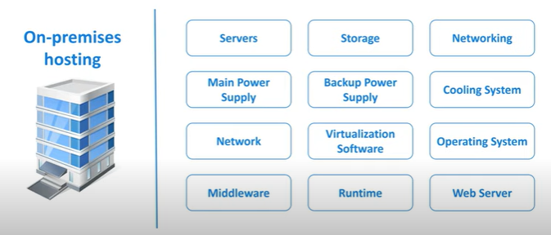
Azure App Service

Slide 4
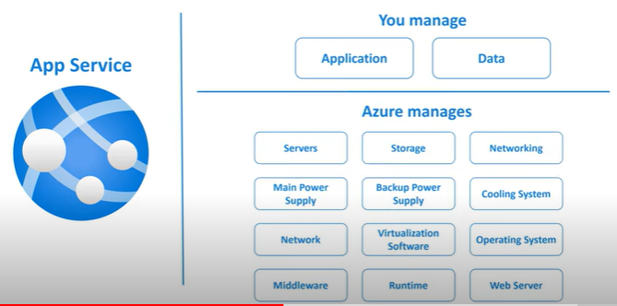
Azure App Service

Slide 5
Azure App Service Features
Built-in auto scale support
Azure App Service is the ability to scale up/down or scale out/in.
Depending on the usage of the web app, you can scale the resources of the underlying machine that is hosting your web app up/down .
Resources include the number of cores or the amount of RAM available. Scaling out/in is the ability to increase, or decrease, the number of machine instances that are running your web app.
Continuous integration/deployment support
The Azure portal provides out-of-the-box continuous integration and deployment with Azure DevOps, GitHub, Bitbucket, FTP, or a local Git repository on your development machine.
Connect your web app with any of the above sources and App Service will do the rest for you by auto-syncing code and any future changes on the code into the web app.
App Service on Linux
App Service can also host web apps natively on Linux for supported application stacks. It can also run custom Linux containers (also known as Web App for Containers). App Service on Linux supports a number of language specific built-in images. Just deploy your code. Supported languages and frameworks include: Node.js, Java (JRE 8 & JRE 11), PHP, Python, .NET, and Ruby.
If the runtime your application requires is not supported in the built-in images, you can deploy it with a custom container.

Slide 6
Benefits of using azure app service
Fully managed environment
It's a fully managed environment, meaning App Service automatically patches and maintains the OS and language frameworks for you. You get the time to focus on designing, developing and maintaining your application and data.
Multiple programming languages and frameworks are supported
Azure App Service supports a wide variety of programming languages and frameworks.
.NET
.NET Core
Java
Ruby
Node.js
PHP
Python
Scalability
Based on the demand for your application, App Service can scale resources up and down or in and out. You can do this either manually if you want to or automatically based on metrics like CPU utilization for example.

Slide 7
Benefits of using azure app service
Compliance
App Service is ISO (International Organization for Standardization), SOC (Service Organization Controls), and PCI (Payment Card Industry) compliant.
Security
Authenticate users with Azure Active Directory or any of the external authentication providers like Google, Facebook, Twitter, or Microsoft.
Support for Containerization and Docker
You can also host a custom Windows or Linux container in App Service. So, if you want to, you can dockerize your app and host it in App Service. You can also run multi-container apps with Docker Compose
DevOps optimization
Set up CI/CD i.e. continuous integration and deployment with Azure DevOps, GitHub, BitBucket, Docker Hub, or Azure Container Registry.
Access on-premises data
With App Service you can still access data on your on-premise servers using Hybrid Connections and Azure Virtual Networks.

Slide 8
Azure App Service plans
In App Service, an app (Web Apps, API Apps, or Mobile Apps) always runs in an App Service plan. An App Service plan defines a set of compute resources for a web app to run. One or more apps can be configured to run on the same computing resources (or in the same App Service plan). In addition, Azure Functions also has the option of running in an App Service plan.
When you create an App Service plan in a certain region (for example, West Europe), a set of compute resources is created for that plan in that region. Whatever apps you put into this App Service plan run on these compute resources as defined by your App Service plan. Each App Service plan defines:
Region (West US, East US, etc.)
Number of VM instances
Size of VM instances (Small, Medium, Large)
Pricing tier (Free, Shared, Basic, Standard, Premium, PremiumV2, PremiumV3, Isolated)

Slide 9
Azure App Service plans
The pricing tier of an App Service plan determines what App Service features you get and how much you pay for the plan. There are a few categories of pricing tiers:
Shared compute: Both Free and Shared share the resource pools of your apps with the apps of other customers. These tiers allocate CPU quotas to each app that runs on the shared resources, and the resources can't scale out.
Dedicated compute: The Basic, Standard, Premium, PremiumV2, and PremiumV3 tiers run apps on dedicated Azure VMs. Only apps in the same App Service plan share the same compute resources. The higher the tier, the more VM instances are available to you for scale-out.
Isolated: This tier runs dedicated Azure VMs on dedicated Azure Virtual Networks. It provides network isolation on top of compute isolation to your apps. It provides the maximum scale-out capabilities.
Consumption: This tier is only available to function apps. It scales the functions dynamically depending on workload.

Slide 10
Deploy to App Service
App Service supports both automated and manual deployment
Automated deployment
Automated deployment, or continuous deployment, is a process used to push out new features and bug fixes in a fast and repetitive pattern with minimal impact on end users.
Azure supports automated deployment directly from several sources. The following options are available:
Azure DevOps: You can push your code to Azure DevOps, build your code in the cloud, run the tests, generate a release from the code, and finally, push your code to an Azure Web App.
GitHub: Azure supports automated deployment directly from GitHub. When you connect your GitHub repository to Azure for automated deployment, any changes you push to your production branch on GitHub will be automatically deployed for you.
Bitbucket: With its similarities to GitHub, you can configure an automated deployment with Bitbucket.

Slide 11
Deploy to App Service
Manual deployment
There are a few options that you can use to manually push your code to Azure:
Git: App Service web apps feature a Git URL that you can add as a remote repository. Pushing to the remote repository will deploy your app.
CLI: webapp up is a feature of the az command-line interface that packages your app and deploys it. Unlike other deployment methods, az webapp up can create a new App Service web app for you if you haven't already created one.
Zip deploy: Use curl or a similar HTTP utility to send a ZIP of your application files to App Service.
FTP/S: FTP or FTPS is a traditional way of pushing your code to many hosting environments, including App Service.

Slide 12
What is the difference between Azure Web App and Azure App Service?
Azure Web App and Azure App Service are two different services offered by Microsoft Azure.
They are both Platform as a Service (PaaS) offerings that provide a managed environment for hosting web applications, API’s, and mobile backends.
While they both offer similar features and benefits, there are some key differences that you should be aware of before choosing one over the other.
Azure Web App is a newer service that was introduced in 2015. It offers a more simplified development experience and supports a wider range of programming languages and frameworks than Azure App Service.
Azure Web App also provides built-in auto-scaling and monitoring capabilities.
Azure App Service has been around longer than Azure Web App and offers more features and flexibility. It supports a wider range of app types including web, mobile, API, and Logic Apps.
Azure App Service also provides the ability to deploy apps in containers, which can be useful for certain development scenarios.

Slide 13
What is the difference between Azure Web App and Azure App Service?
So, which one should you choose? It really depends on your specific needs and requirements. If you need a more simple development experience or want to use a language or framework that is not supported by Azure App Service, then Azure Web App would be a good choice. If you need more features.
Azure App Service is a platform-as-a-service (PaaS) that enables you to create, deploy, manage, and scale applications that are built on the .NET Framework.
Azure App Service provides a cloud-based platform that you can use to create and deploy applications with the same tools and management capabilities that you use to manage other Azure services. You can also use the Azure App Service to access the Azure platform services that are available in the cloud.

