Slide 1
Azure COSMOS DB
What is a Database?
A database is a collection of data that is organized so that it can be easily retrieved and managed. A database is typically stored in a computer system, so that the applications associated with it can access it. It is also associated with a database management system which can be used to create, edit or update them. The term database is most often used to represent both the database and the database management system.
There are different types of databases depending on the way we intend to use it. They are:
Relational databases
Object-oriented databases
Distributed databases
Data warehouses
NoSQL databases
Graph databases
OLTP databases.
Open source databases
Cloud databases
Multi Model database
Document/JSON database
Self-driving databases

Slide 2
Azure COSMOS DB
For our understanding of Cosmos DB, we need to know what relational, NoSQL, distributed, and Multi-model databases are.
Relational Database
A relational database is used to store data that is related to one another. In a relational model, data is stored in the form of tables as rows and columns. The columns are used to store a certain kind of information of different objects and the rows represent different details of one object. The rows can be uniquely identified using primary keys and different tables can be connected to one another using foreign keys.
NoSQL Database
NoSQL databases are used for data modeled in ways that are not like relational databases. The data structures like key-value pair, wide column, graph, or document are not like those used in relational databases and are supported in NoSQL. This makes them more flexible and can make operations on them faster.

Slide 3
Azure COSMOS DB
Distributed Database
When data in a database is stored in different physical locations it is called a distributed database. The data can be stored at multiple computers in one physical location or either at different interconnected locations.
There are two ways in which data is stored in different locations:
Replication: Redundant copies of the database are stored in every location. Hence every update made in one location needs to be made in every other location also.
Fragmentation: The database is split into fragments and each of them is stored in different locations.
Multi Model Database
A database model that can support both the relational data models as well as the NoSQL models is called Multi-Model Databases.

Slide 4
Azure COSMOS DB
Cosmos Database (DB) is a globally distributed, low latency, multi-model database for managing data at large scales.
It is a cloud-based NoSQL database offered as a PaaS (Platform as a Service) from Microsoft Azure.
It is a highly available, high throughput, reliable database and is often called a serverless database.
Microsoft Azure Cosmos Db is not a traditional relational database and is a type of NoSQL database.
It allows users to build and distribute their applications across an Azure data centre automatically without any need for prior configuration
In today’s world data generated is massive and to handle this unstructured massive data big data technologies are used.
Cosmos Db is used to store this massive data by partitioning.
This stores data by distributing it over global data centers and data can be accessed fast so that it provides low latency.
Azure Cosmos db is a distributed database spread globally and has multi-modal information services.

Slide 5
Key Benefits of Azure Cosmos DB
Globally Distributed: With Azure regions spread out globally, the data can be replicated globally.
Scalability: Cosmos DB is horizontally scalable to support hundreds of millions of reads and writes per second.
Multi-Model: It can store data in Key-value Pairs, Document-based, Graph-based, Column Family-based databases. Global distribution, horizontal partitioning, and automatic indexing capabilities are the same irrespective of the data model.
High Availability: It has 99.99 % availability for reads and writes for both multi region and single region Azure Cosmos DB accounts.
Low Latency: The global availability of Azure regions allows for the global distribution of data, which further makes it available nearest to the customers. This reduces the latency in retrieving data.

Slide 6
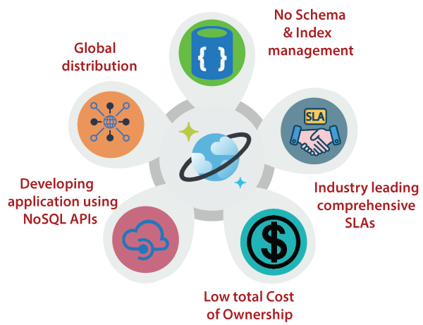
Advantages of Azure COSMOS DB

Slide 7
Advantages of Azure COSMOS DB
No Schema & Index management: The Azure database engine is fully schema-agnostic. Therefore no schema and index management are required. We also don't have to worry about application downtime while migrating schemas.
Industry-leading comprehensive SLAs: Cosmos DB is the first and only service to offer industry-leading full 99.99% high availability, read and write latency at the 99th percentile, guaranteed throughput, and consistency.
The low total cost of Ownership: Since Cosmos DB is a fully managed service, we no longer need to manage and operate complex multi-datacenter deployment, and upgrades of our database software pay for the support, licensing, or operations.
Developing application using NoSQL APIs: Cosmos DB implements Cassandra, MongoDB, Gremlin, and Azure Table Storage wire protocol directly on the service.
Global distribution: Cosmos DB allows us to add or remove any of the Azure regions to our Cosmos account at any time, with a click of a button.

Slide 8
How does Azure Cosmos DB work?
If a website used by people all over the world writes its data into a primary database in one location (non-multi-master mode), the people near to the location will be able to retrieve the data faster than the rest of the world due to network latency issues.
But Cosmos DB has multi-master support where the data can be simultaneously written into different databases spread out globally. In this way, the data is replicated onto the user’s nearest region so that it can be accessed faster. But there can still be a difference of milliseconds between the data being replicated and this affects the consistency.
Consistency indicates whether the data are in sync and are at the same state at any given point in time. Cosmos DB offers multiple levels of consistency with varying performances and availability.

Slide 9
Data Provisioning
With an Azure Cosmos DB account, we can manage the data by creating multiple databases, containers and items.
Cosmos Database: The rich API support of Azure Cosmos DB architecture allows us to create and manage databases using SQL API, Cassandra API, Azure Cosmos DB API for MongoDB, etc. These can be used to enumerate, read, create and update the databases.
Cosmos Containers: They are horizontally partitioned and replicated across multiple regions for scalability and throughput. They are schema-agnostic and are indexed automatically. Containers can also be created, updated, and edited using the Cosmos DB APIs
Cosmos Items: Depending on the API in use, an item can be a row in a table, a document, or a part of a graph. Insert, delete, update, read, replace, etc can be done on these items using the APIs

Slide 10
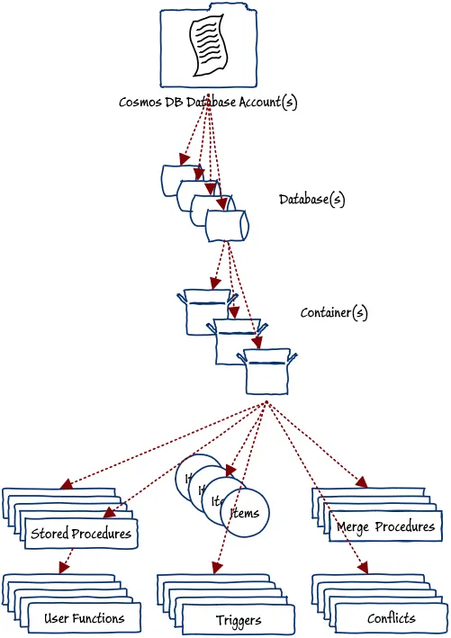
Structure of Azure COSMOS DB

Slide 11
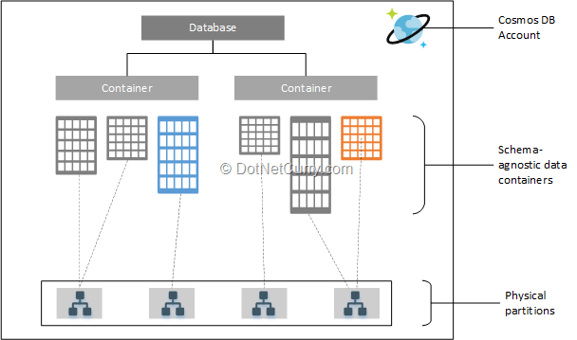
Structure of Azure COSMOS DB

Slide 12
Structure of Azure COSMOS DB
Azure Cosmos Account: It is the basic unit of scalability and high availability of the cosmos db. Users have virtual storage systems of unlimited capacity on the container, and this data is distributed on worldwide data-center of Microsoft's. Based on the incoming data users modify the azure regions by adding or removing.
Database: Azure users can create more than one cosmos databases using the single database account asper the storage requirement. This database manages users , permissions and containers.
Container: It is the unit of scalability for provisioned throughput and storage and it helps in partitioning and duplicating data on different regions. Item added to the container and throughput on it is distributed using logical partitions based on the partition key.

Slide 13
Backup and Restore
Automatic backups of the data are taken at regular intervals without interference to the performance or availability of the databases. The backups are stored in separate services and can be helpful in scenarios of accidental delete or update of the database.
There are two types of backup:
Periodic Backup Mode: This is the default mode in which backups are taken periodically and we can set the time interval and retention interval.
Continuous Backup Mode: In this mode, the data is backed up continuously and can be restored to any point in time within the last 30 days.

Slide 14
Global Distribution and Partitioning
To achieve faster response and high availability data needs to be stored in data centers which are closer to the users.
typically azure deploys applications on multiple data centers distributed across the world and is often called as global distribution.
Cosmos DB uses this global distribution concept to store the data in its NoSQL databases structure.
In cosmos DB containers are used to store items, this items can be partitioned based on partition key so that particular items with partition key can be stored in one partition this partitions are also called as logical partition but are stored in a physical partition.
A container in the cosmos DB can have millions or billions of rows or items inside and these are divided using the concept of logical partition based on logical partition key.
Cosmos DB handles the partition and other operations like splitting the data, replicating and deleting from different regions.

Slide 15
Common Use Cases
Some of the common Cosmos DB use cases are:
IoT: The use cases in IoT have to deal with large chunks of data from different locations of the world. This data needs to be written, analyzed, and retrieved quickly. Cosmos DB can be leveraged here for the same.
Retail and Marketing: Cosmos DB can make the smooth addition, updating, and retrieval of huge volumes of data related to product catalogs, logistics, inventory, etc.
Gaming: Popular games like The Walking Dead: No Man’s Land by Next Games, and Halo 5: Guardians, use Azure Cosmos DB to provide low latency in-game stats, scoreboards, social media integration, etc.
Web and mobile applications: It can be used in web and mobile applications for modeling social interactions, integrating with third-party services, and building rich personalized experiences.

Slide 16
APIs in Azure Cosmos DB
Azure Cosmos DB offers multiple database APIs, which include NoSQL, MongoDB, PostgreSQL Cassandra, Gremlin, and Table.
By using these APIs, you can model real world data using documents, key-value, graph, and column-family data models.
Azure Cosmos DB helps you to use the ecosystems, tools, and skills you already have for data modeling and querying with its various APIs.
All the APIs offer automatic scaling of storage and throughput, flexibility, and performance guarantees. There's no one best API, and you may choose any one of the APIs to build your application.

Slide 17
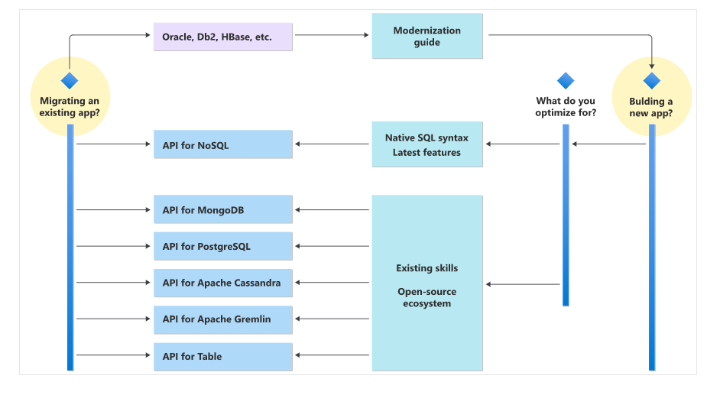
APIs in Azure Cosmos DB

Slide 18
APIs in Azure Cosmos DB
API for NoSQL
The Azure Cosmos DB API for NoSQL stores data in document format.
API for MongoDB
The Azure Cosmos DB API for MongoDB stores data in a document structure, via BSON format. It's compatible with MongoDB
API for PostgreSQL
Azure Cosmos DB for PostgreSQL is a managed service for running PostgreSQL at any scale,.It stores data either on a single node, or distributed in a multi-node configuration.
API for Apache Cassandra
The Azure Cosmos DB API for Cassandra stores data in column-oriented schema. Apache Cassandra offers a highly distributed, horizontally scaling approach to storing large volumes of data
API for Apache Gremlin
The Azure Cosmos DB API for Gremlin allows users to make graph queries and stores data as edges and vertices.
API for Table
The Azure Cosmos DB API for Table stores data in key/value format. If you're currently using Azure Table storage, you may see some limitations in latency, scaling, throughput, global distribution, index management, low query performance. API for Table overcomes these limitations

Slide 19
Key Terminology
Partition key:
The partition key is the concept of defining uniqueness and improving performance. Most databases with large amounts of data or frequently accessed data should have certain unique and categorical information defined. This information will help read or update the data in bulk.
Throughput:
Throughput is a measure of how many units of information a system can process in a given amount of time.
In Azure Cosmos DB, we are charged for the throughput and storage that we provision on our Azure Cosmos DB databases and collections

