Slide 1
Azure Key Vault
Azure Key Vault is a cloud service that provides a secure store for keys, secrets, and certificates.
Microsoft Azure Key Vault is a cloud-based service that stores the data or secret securely and can be accessed with that data and secret securely.
Azure Key Vault is a cloud service that helps you store your application's secrets securely
This secret data can be anything of which the user wants to control access such as passwords, TLS/SSL certificate or API keys, or cryptographic keys.
It enables you to isolate the sensitive and non-sensitive data in your application. For example, you can use application settings to store default parameters or key-value pairs containing some default settings used by the application. On the contrary, you can use Azure Key Vault to store API keys, secret keys, database connection strings, or Client IDs used in your application.

Slide 2
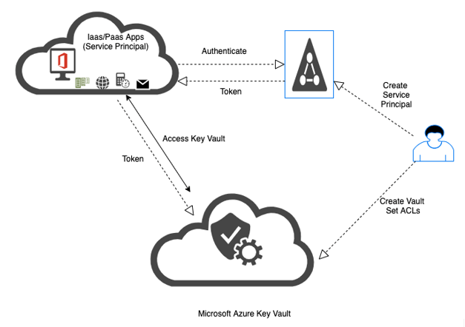
How does Microsoft Azure Key Vault Work?
Azure Key Vault service can be created by anyone who has access to the Azure subscription and it can be implemented and managed by the security administrator of the organization along with other services.

Slide 3
How does Microsoft Azure Key Vault Work?
Vault Owner: Vault owner has full access to the Key vault and has control over the vault.
Vault Consumer: Vault owners can grant access to the vault consumer so that vault consumer can perform various actions depending on the access granted. Once vault consumer access is enabled then consumers can design key lifecycles and grant access to sensitive data to others if required. Depending on the audit log, vault owners can know what the consumer is doing and are they trustworthy.
Secrets: It is a sequence of bytes with a limit of 10kB which can be assigned to the value. This value can be a certificate or password. Consumers can read and store the values based on name and permission granted and store this data in HSM as a Key-Value pair.
Keys: Consumers can use the keys for particular key operations like a sign, encrypt, decrypt, verify, etc. key vault handles all these operations as consumers can not read value. Keys are stored in two format
Software Keys: These are cheap and less secure. This key uses Azure VMs to handle operations and is used for dev/test scenarios.
HSM Keys: These are more secure and perform operations directly on HSM and these keys are expensive and users need to use Premier-tier vault.

Slide 4
How does Microsoft Azure Key Vault Work?
Authentication: Azure key vault is highly secure with high-grade authentication and authorization as it integrates Azure Active Directory (AAD). AAD is used to grant permission to a person or application to access a vault.
Each account will have a unique account ID and Users with Azure subscription and Admin privileges can log in into Microsoft Azure to create a vault and store secret data.

Slide 5
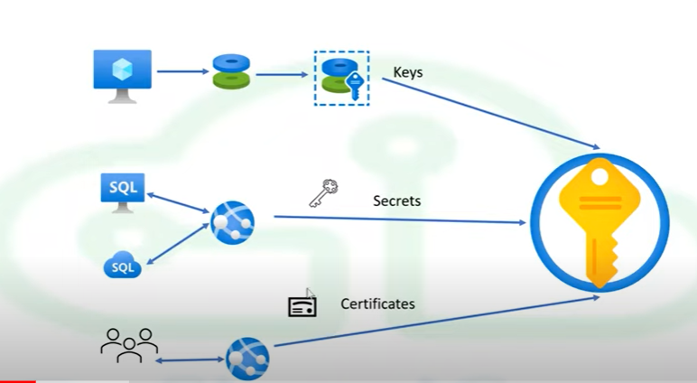
How does Microsoft Azure Key Vault Work?

