Slide 1
What is Load Balancing?
The logical and efficient distribution of network or application traffic among numerous servers in a server farm is known as load balancing.
Each load balancer lies between client devices and backend servers, accepting and then efficiently distributing incoming requests to a server that can handle them.
A load balancer distributes traffic to several web servers in the resource pool, regardless of whether it’s hardware or software.
This ensures that no single server becomes overloaded and hence, unreliable.
Load balancers are useful for reducing server response time and increasing throughput.

Slide 2
Load Balancing Services in Azure
Azure provides many load balancing services of which the users can select the one that matches their workload’s requirement. They are
Azure Traffic Manager
Azure Load Balancer
Azure Application Gateway
Azure Front Door

Slide 3
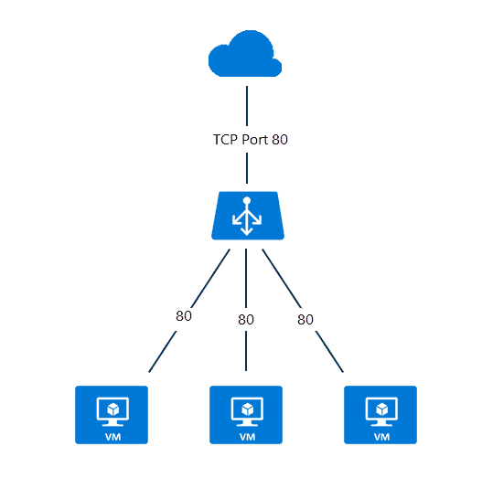
Azure Load Balancer
Load Balancing in Azure is a cloud-based system that accepts client requests, determines which machines in the set can handle them, and then forwards those requests to the appropriate machines.
Azure load balancer allows you to distribute traffic to your backend virtual machines.
An Azure load balancer provides high availability for your application.
The Azure load balancer is a fully managed service itself.

Slide 4
Why Choose Azure Load Balancer?
With Standard Load Balancer, you can scale your applications and create highly available services.
Load balancer supports both inbound and outbound scenarios.
A load balancer provides low latency and high throughput and scales up to millions of flows for all TCP and UDP applications.
Some of the key scenarios that you can accomplish using Standard Load Balancer include:
Load balance internal and external traffic to Azure virtual machines.
Increase availability by distributing resources within and across zones.
Use health probes to monitor load-balanced resources.
Employ port forwarding to access virtual machines in a virtual network by public IP address and port.
Load balance services on multiple ports, multiple IP addresses, or both.

Slide 5
types of load balancer in Azure
In Azure, you can create two types of the load balancer
Public load balancer
Internal/ private load balancer

Slide 6
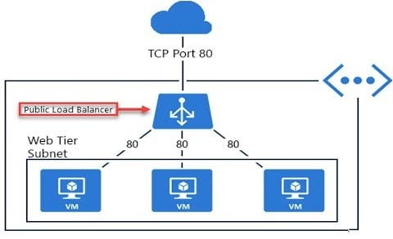
Public Load Balancer
A public load balancer can be used to load balance internet traffic to virtual machines.
It can provide outbound connections for virtual machines (VMs) inside your virtual network.

Slide 7
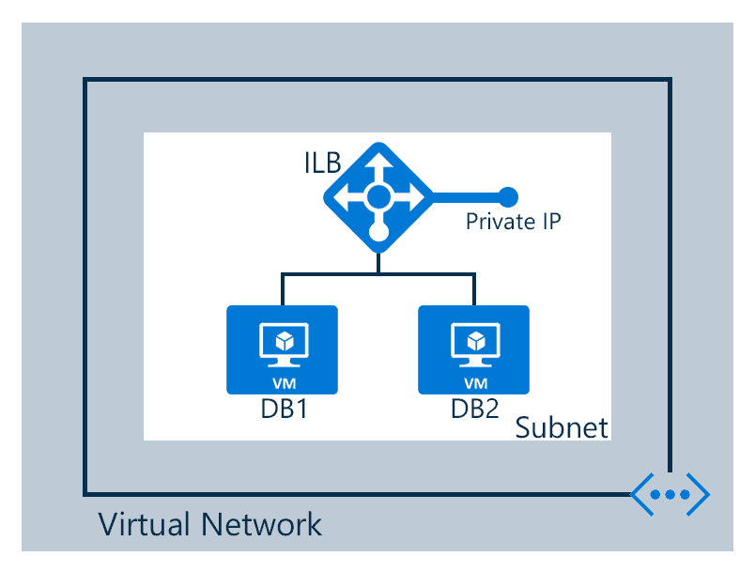
Internal/ Private Load Balancer
An internal (or private) load balancer is used to balance traffic from within a virtual network.

Slide 8
Pricing Tiers
there are two pricing tiers available Basic and Standard
Basic: Basic tier load balancer provides basic features and is restricted to some limits for backend pool size it is restricted to only 300 instances, it’s restricted to a single availability set and it only supports multiple frontends for inbound traffic.
Standard: Standard tier load balancer is generally available and offers higher-scale and new features. It is a paid-for feature using a complex set of consumption-based charges and the Basic tier continues to be free. Also, we can scale out to 1000 instances and can span any virtual machine in a single virtual network, including blends of scale sets, availability sets, and machines.

Slide 9
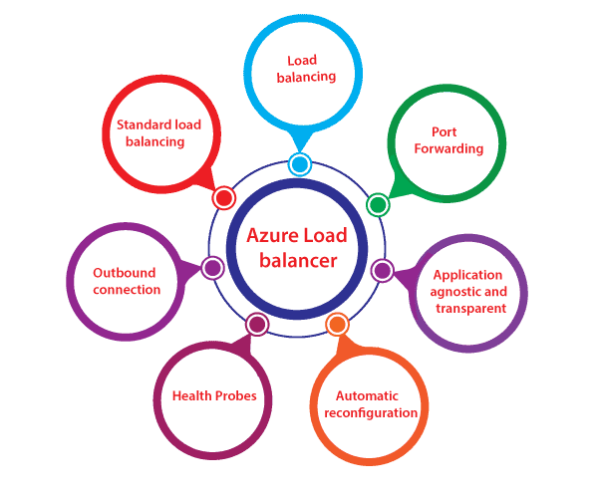
Features Of Azure Load Balancer

Slide 10
Features Of Azure Load Balancer
Load Balancing: Azure load balancer uses a 5-tuple hash that contains source IP, source port, destination IP, destination port, and protocol.
Outbound connection: All the outbound flows from a private IP address inside our virtual network to public IP addresses on the Internet can be translated to a frontend IP of the load balancer.
Automatic reconfiguration: The load balancer is able to reconfigure itself when it scales up or down instances on the basis of conditions. So, if more virtual machines are added into the backend pool, automatically load balancer will reconfigure.
Application agnostic and transparent: It doesn’t directly interact with TCP or UDP protocols. We can route the traffic based on URL or multi-site hosting
Health probes: When any failed virtual machines in a load balancer are recognized by the health probe in the backend pool then it stop routing the traffic to that particular failed virtual machine. It can configure a health probe to determine the health of the instances in the backend pool.
Port forwarding: The load balancer supports port forwarding ability if we have a pool of web servers, and we don’t want to attach a public IP address for every web server in that pool.

Slide 11
Configuration elements of Load Balancer
Front-end IP configuration: It is the IP address to which the incoming traffic will initially come to, and Azure load balancer can have one or more front end IP addresses. They are sometimes also called as virtual IPs.
Back-end address pool: These are the pool of virtual machines to which the traffic will eventually go to.
Load balancing rules: A load balancing rule is simply a mapping between the front end IP configuration and back-end address pool.
Probes: Probes enable us to keep track of the health of VM instances. If a health probe files, the VM instance will be taken out of rotation automatically.
Inbound & Outbound NAT rules: NAT rules defining the inbound traffic flowing through the front end IP and distributes to the backend IP. Outbound rules will transmit VM private IP to load balancer public IP.

