Slide 1
Azure Logic Apps
Azure Logic Apps, is a cloud-based service that is used to automate tasks, workflows, etc.
Azure Logic Apps is a Platform-as-a-Service (PaaS) .
Azure Logic Apps helps in creating and designing automated workflows that are capable of integrating services, systems, and applications.
Azure Logic Apps are configured within a web portal and can execute your logic without programming any code.
Azure Logic Apps is a cloud service. Using Logic Apps defines the workflow at ease consuming a range of APIs exposed as Connectors.
These Logic App connectors will perform the sequence of actions defined in the workflow whenever the trigger gets fired.

Slide 2
Advantages of Azure Logic Apps
Here are a few work that can be automated with logic apps
Process and route orders on-premises systems and cloud services.
Send email notifications by Office 365 when events happen in different systems, applications, and services.
Transfer uploaded files from an SFTP or FTP server to Azure Storage.
Track tweets related to particular topics, study the sentiments and develop task alerts or reminders for things that require review.
Out-of-the-box connector reduces the integration challenges.
Easy to define the workflow – User can easily define the workflow with triggers and actions with user-intuitive GUI
Support for Enterprise applications – Logic Apps support integration with Office 365, Twitter, Dropbox and more
Easy debugging – User can easily debug the Logic App using Trigger and Run history
200+ Connector available on azure.

Slide 3
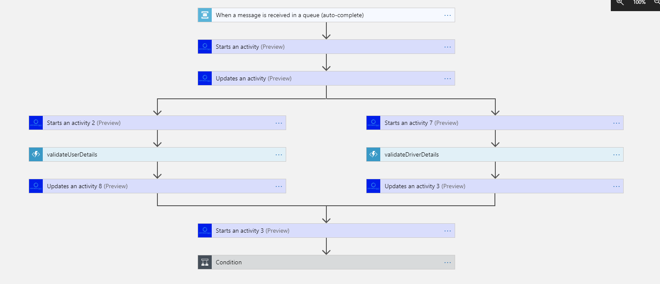
Logic App workflow

Slide 4
Benefits of using Azure Logic Apps
Ease of Defining Workflows: Azure Logic Apps make it easy to define the right workflow with actions, processes, and triggers through a user-friendly graphical user interface (GUI).
Robust Applications: Azure Logic Apps play an important role in providing support integration with enterprise-level applications such as Office 365, Dropbox, etc.
Debugging: Azure Logic Apps allow easy debugging through triggers, workflow, and processes running history.
Ease of Automation: When the workflows are defined with triggers and the trigger is successfully initiated, the Logic App is automatically fired.
Easy Integration: Azure Logic Apps help in the easy integration of Logic Apps with on-premise solutions such as SAP, etc.

Slide 5
Logic App connectors
Connectors in Azure Logic Apps are used to perform certain actions or processes.
These connectors are designed to connect and work with user data.
There are numerous connectors available for Azure Logic Apps.
Users can use pre-defined connectors as well as create their own custom connectors.
Connectors in Azure Logic Apps may act either as actions or as triggers.

Slide 6
Logic app concepts
Workflow
Provides a graphical way to model our business processes as a series of steps or a Workflow.
Managed Connectors
Our Logic apps need access to the data and Services. Managed connectors are created specifically to aid you, when we are connecting to and working with our data.
Triggers
A trigger starts a new instance of a Workflow, which is based on a specific event like the arrival of an E-mail or a change in our Azure Storage account.
Actions
Each step after the trigger in a Workflow is called an action. Each action typically maps to an operation on our managed connector or custom API apps.

Slide 7
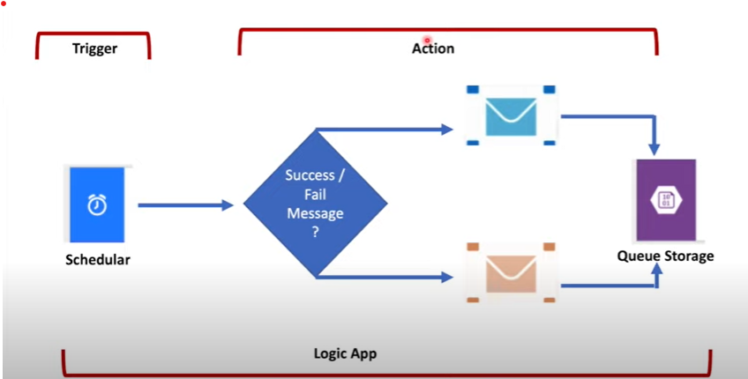
Logic app concepts

