Slide 1
Attribute Routing in ASP.NET MVC
ASP.NET MVC5 supports a new type of routing, called attribute routing. In this routing, attributes are used to define routes.
Attribute routing provides more control over the convention-based routing in ASP.NET MVC.
Attribute routing should configure before the convention-based routing.
When you combine attribute routing with convention-based routing, actions which do not have Route attribute for defining attribute-based routing will work according to convention-based routing.
When you have only attribute routing, actions which do not have Route attribute for defining attribute-based routing will not be the part of attribute routing. In this way they can’t be access from outside as a URI.

Slide 2
Attribute Routing in ASP.NET MVC
Enabling Attribute Routing in ASP.NET MVC
Enabling attribute routing in your ASP.NET MVC5 application is simple, just add a call to routes.MapMvcAttributeRoutes() method with in RegisterRoutes() method of RouteConfig.cs file.
public class RouteConfig
{
public static void RegisterRoutes(RouteCollection routes)
{
routes.IgnoreRoute("{resource}.axd/{*pathInfo}");
//enabling attribute routing
routes.MapMvcAttributeRoutes();
}
}

Slide 3
Attribute Routing in ASP.NET MVC
You can also combine attribute routing with convention-based routing.
public class RouteConfig
{
public static void RegisterRoutes(RouteCollection routes)
{
routes.IgnoreRoute("{resource}.axd/{*pathInfo}");
//enabling attribute routing
routes.MapMvcAttributeRoutes();
//convention-based routing
/routes.MapRoute(
name: "Default",
url: "{controller}/{action}/{id}",
defaults: new { controller = "Home", action = "Index", id = UrlParameter.Optional });
}
}

Slide 4
Attribute Routing in ASP.NET MVC
When to use Attribute Routing
The convention-based routing is complex to support certain URI patterns that are common in RESTful APIs. But by using attribute routing you can define these URI patterns very easily.
For example, resources often contain child resources like Clients have orders, movies have actors, books have authors and so on. It’s natural to create URIs that reflects these relations like as: /clients/1/orders
This type of URI is difficult to create using convention-based routing. Although it can be done, the results don’t scale well if you have many controllers or resource types.
With attribute routing, it’s pretty much easy to define a route for this URI. You simply add an attribute to the controller action as:
[Route("clients/{clientId}/orders")]
public IEnumerable GetOrdersByClient(int clientId)
{
//TO DO
}

Slide 5
Attribute Routing in ASP.NET MVC
Area:
Areas are logical grouping of Controller, Models and Views and other related folders for a module in MVC applications.
Using areas, we can write more maintainable code for an application cleanly separated according to the modules.

Slide 6
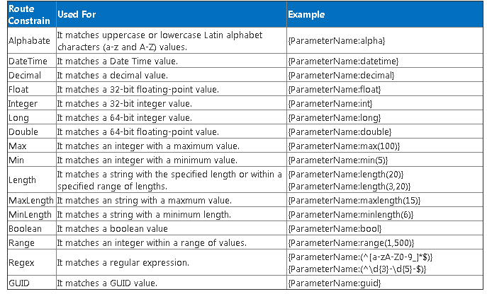
Attribute Routing in ASP.NET MVC

