Slide 1
Design Patterns
A design pattern is a pattern whose form is described by means of software design constructs, for example objects, classes inheritance, aggregation and use-relationship.”
Design Patterns is a way of reusing object-oriented code between projects and between programmers.
It is the way of designing reusable object-oriented software or component.
It is not just design of objects but about interaction between objects.
Design patterns suggest to always program to an interface and not to an implementation.
There are 23 design patterns in c#
Design Patterns are grouped into 3 parts
Creational Patterns
Structural Patterns
Behavioral Patterns

Slide 2
“GoF” Design Patterns
Design Patterns: Elements of Reusable Object-Oriented Softwaare
Software by the “Gof (Gang of Four)”
Erich Gamma
Richard Helm
Ralph Johnson
John Vlissides

Slide 3
Design Patterns
Creational Pattern:
Patterns relating to the creation of objects
focus on how objects are created and utilized in an application.
Abstract factory pattern
Factory pattern
Builder pattern
Lazy pattern
Prototype pattern
Singleton pattern

Slide 4
Design Patterns
Structural Pattern:
Patterns relating to the structural relationship between objects
establishes a relationship between objects so that different components of an appln interact with each other.
Adapter pattern
Bridge pattern
Composite pattern
Decorator pattern
Façade pattern
Flyweight pattern
Proxy pattern
Remote proxy
Virtual proxy
Cache proxy

Slide 5
Design Patterns
Behavioral Pattern:
Patterns relating to communication between objects
focus on improving communication between different objects.
Chain or responsibilities pattern
Command pattern
Observer pattern

Slide 6
Singleton Pattern
Ensure a class has only one instance.
To be used when there should be only one instance of a class accessible by multiple users
Singleton is used to provide a single point of global access to a class.

Slide 7
Factory Pattern
This is the Common Pattern in OOPS.
A Simple Factory pattern is one that returns an instance of one of several possible classes, depending on the data provided to it.
Usually all of the classes it returns have a common parent class and common methods, but each of them performs a task differently and is optimized for different kinds of data.

Slide 8
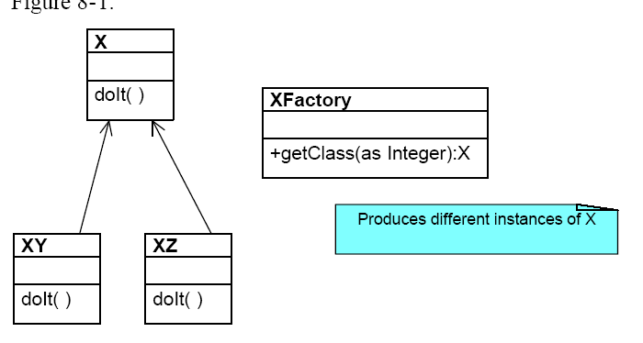
Factory Pattern

