Slide 1
Blazor

Slide 2
data-driven web applications
In order to develop a data-driven web application, we need two things. Server-side development as well as client-side development.
For server-side development, we generally use server-side programming languages such as C#, Java, PHP, etc.
For client-side development, we generally use JavaScript frameworks such as Angular, React, Vue, etc.
A Full-stack developer need to learn a client-side programming language (such as Angular, React, Vue, etc.) as well as a server-side programming language (such as C#, Java, PHP, etc.).

Slide 3
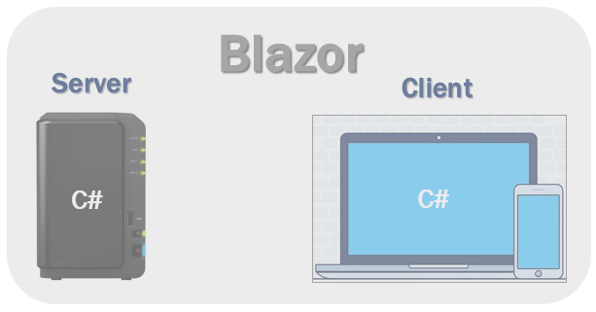
data-driven web applications
why should we learn 2 different sets of programming languages and frameworks.
Can we use C# both for server-side and client-side development?
Yes, we can use C# for both client-side as well as server-side development and this is possible because of ASP.NET Core Blazor.
With the introduction of Blazor, now you can develop client-side web user interfaces using C# instead of JavaScript. The C# code can be executed both on the server as well as in the client browser.

Slide 4
What is Blazor
Blazor is a web framework that allows you to build interactive web applications using C# and .NET, instead of JavaScript.
Blazor is a modern front-end framework from Microsoft built on ASP.NET Core that enables developers to create interactive web UIs using C# instead of JavaScript.
It bridges the gap between client-side and server-side development, allowing you to use .NET and Razor syntax to build full-stack web apps.
It’s part of the ASP.NET Core ecosystem, and its name comes from “Browser + Razor”.
Traditionally, front-end interactivity required JavaScript frameworks like React, Angular, or Vue.
But with Blazor, you can write C# for both client and server
Blazor is a Single Page Application development framework.
Blazor is a .NET frontend web framework that supports both server-side rendering and client interactivity in a single programming model

Slide 5
Blazor Key Highlights
Built on ASP.NET Core platform.
Uses Razor syntax (mixing HTML + C#).
Supports both client-side and server-side rendering.
Allows component-based UI development (like React components).
Provides data binding, event handling, dependency injection, and routing and others.
Blazor also supports features of a SPA (Single Page Application) framework such as:
  Routing
  Layouts
  Dependency Injection
  JavaScript interop
  Forms and validation
  Server-side rendering

Slide 6
Blazor Key Features
Feature | Description
C# instead of JavaScript | Write both frontend and backend logic in C#.
Component-based architecture | UI is made up of reusable Razor components.
Full .NET runtime in browser | Thanks to WebAssembly (WASM).
Cross-platform | Works on Windows, Linux, macOS, or even in browsers.
Integrated with ASP.NET Core | Built into the same ecosystem.

Slide 7
Blazor Key Concepts
Concept | Description
Component | Reusable unit of UI (written in Razor).
Razor Syntax | Combines HTML + C# code in .razor or .cshtml files.
Binding | Synchronizes UI and data automatically.
Event Handling | Handles UI events like @onclick, @onchange directly in C#.
Routing | Uses @page directive to navigate between components.
Dependency Injection (DI) | Built-in support for injecting services into components.

Slide 8
Blazor Hosting Models
Blazor offers following hosting models.
  Blazor Server
  Blazor WebAssembly (WASM)
  Blazor Hybrid
Model | Runs On | Communication | Use Case
Blazor Server | Server | SignalR | Internal/enterprise apps
Blazor WebAssembly | Browser | Direct (no server) | Public/client apps
Blazor Hybrid | Native device | Local runtime | Mobile/Desktop apps

Slide 9
Advantages of Using Blazor
Write all logic in C# — no JavaScript dependency.
Share code between client and server easily.
Built-in dependency injection and routing.
Strong security, maintainability, and testability.
Integrates with ASP.NET Core Web APIs, Entity Framework, and Azure.

Slide 10
Blazor server-side hosting model
in this model, the application is executed fully on the server within the ASP.NET Core application.
In this model, between the client and the server, a SignalR connection is established.
To communicate with the HTML, the server-side application uses SignalR.
With this hosting model, the application is executed on the server. Between the client and the server a SignalR connection is established.
In this model, When an event occurs on the client such as a button click, the information about the event is sent to the server over the SignalR connection.
We use the Blazor Server App template, to create a Blazor application with the server hosting model.

Slide 11
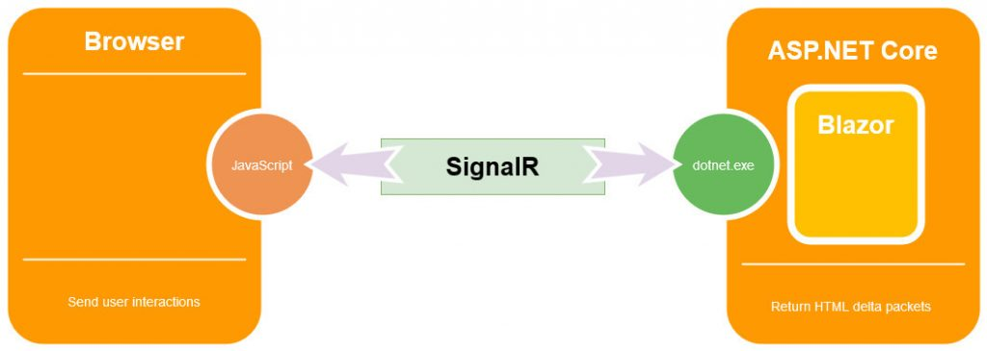
Blazor server-side

Slide 12
Benefits of Blazor Server Applications
the benefit of this type of application is that the download size is really small, significantly smaller than the Blazor WebAssembly, which means the application loads much faster.
Because it runs on the server-side, it uses all the advantages of server capabilities with all the server-side APIs available.
Blazor server-side pre-renders HTML content before it is sent to the client's browser. This makes it search-engine friendly, and there is no perceivable start-up time.
Blazor server-side apps will work on older browsers (such as Internet Explorer 11) as there is no requirement for Web Assembly, only HTML and JavaScript. As the code executes on the server, it is also possible to debug our .NET code in Visual Studio.
Additionally, we have full debugging support and our application can work on browsers that don’t support WebAssembly. This means, older browsers are supported.

Slide 13
Blazor WebAssembly
It is the client-side hosting model.
This type of application runs on the client in the browser with the help of WebAssembly.
Blazor WebAssembly is a single-page app (SPA) framework for building interactive client-side web apps with . NET.
Running . NET code inside web browsers is made possible by WebAssembly (abbreviated wasm ).
As soon as the application starts it downloads everything to the browser (HTML, CSS, and JavaScript files) and it also downloads the assembly (.NET Standard DLL) files required for the application.
So, once the application starts, it can work in offline mode, meaning, it doesn’t require the server. Because this type of application is composed of static files, we can deploy it to the CDN or Server, or Azure Storage for static websites.

Slide 14
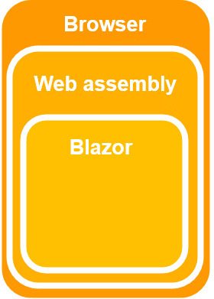
Blazor WebAssembly
We use the Blazor WebAssembly App template, to create a Blazor application with the client-side hosting model.
WebAssembly is a web standard, it is supported on all major browsers, which means also client-side Blazor apps will run inside a browser on Windows/Linux/Mac/Android and iOS.
Blazor does not require .NET to be installed on the client in order to run through WebAssembly.

Slide 15
Benefits of Blazor WebAssembly Applications
The first benefit is that this type of application is very fast, with the speed almost like the native browser applications.
As we’ve said, the Blazor WebAssembly can work in offline mode, which means it doesn’t require a connection to the server.
Additionally, serverless deployment is possible, which means you don’t need a server, just something to get the files to the browser.
Finally, this type of application can run in all modern browsers without additional plugins. This makes deployment easy on all sorts of devices.

Slide 16
Downsides of Blazor WebAssembly Applications
Since this type of application runs only in the browser, it is restricted to the browser’s capabilities.
Another thing is that everything executes in the browser. This could be a downside if the application does some heavy lifting, and our browser may not have enough resources to support that.
An additional downside is that Blazor WebAssembly downloads all the files to the client, meaning loading times are longer.
Finally, because WebAssembly is required to run this type of application, older browsers (without WebAssembly support) can’t run the Blazor WebAssembly applications. That said if our application requires running on an older browser then it is a better choice to use the Blazor server-side application.

