Slide 1
Docker
Docker is an open-source containerization tool or Docker is a container management service.
The initial release of Docker was in March 2013
Docker is an in-demand, DevOps technology
The idea of Docker is for developers to easily develop applications, ship them into containers which can then be deployed anywhere.
Docker is for Build, Ship, and Run Any App, Anywhere using containers.
Docker is a tool designed to make it easier to deploy, and run applications by using containers.
Docker is for developers to easily develop applications, ship them into containers which can then be deployed anywhere.
Docker enables you to separate your applications from your infrastructure so you can deliver software quickly.
Docker provides the ability to package and run an application in a loosely isolated environment called a container.
The initial release of Docker was in March 2013.
Note: dockerizing, an application means deploying and running an application using containers.

Slide 2
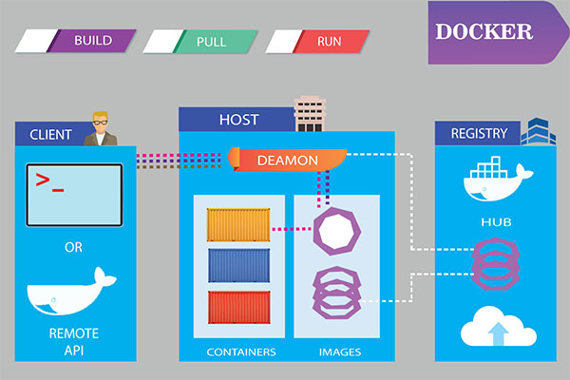
Why Docker?
Docker enables developers to easily pack, ship, and run any application as a lightweight, portable, self-sufficient container
Docker containers are lightweight and modular.

Slide 3
When do I use Docker?
Using Docker, you can move your application from a local development server to a production server without any error. Docker containers are lightweight and modular.
Docker is highly recommended for all application development. Docker offers so many tools (software such as NodeJS, PHP, Java, Any Database, etc) as images.
Using Docker we can easily install the needed software using Docker and create a container for the application development. Databases are a great fit for Docker.

Slide 4
Features of Docker
Docker has the ability to reduce the size of development by providing a smaller footprint of the operating system via containers.
With containers, it becomes easier for teams across different units, such as development, QA and Operations to work seamlessly across applications.
You can deploy Docker containers anywhere, on any physical and virtual machines and even on the cloud.
Since Docker containers are pretty lightweight, they are very easily scalable.
With the consistent environment of Docker, the development lifecycle of applications is easy and seamless.

Slide 5
Docker Advantages
Consistency across multiple environments.
simplifies configuration.
Large community support.
Containers are lighter and use less resources than virtual machines.
Isolated environments simplify debugging.
Provides access to thousands of configured images with Docker Hub.
The platform supports CI/CD.

Slide 6
Tools and terminology commonly used with Docker
Docker Engine
It is used for building Docker images and creating Docker containers.
The runtime environment that allows developers to build and run containers.
Docker File
A simple text file that defines everything needed to build a Docker container image, such as OS network specifications and file locations.
It’s essentially a list of commands that Docker Engine will run in order to assemble the image.
Docker Hub
This is the registry which is used to host various Docker images
Docker Compose
A tool for defining and running multi-container applications. It creates a YAML file to specify which services are included in the application and can deploy and run containers with a single command via the Docker CLI.
Docker Image
Docker Container

Slide 7
Docker Desktop
Docker Desktop is an easy-to-install application for your Mac or Windows environment that enables you to build and share containerized applications and microservices.
Docker Desktop includes the Docker daemon , the Docker client (docker), Docker Compose, Docker Content Trust, Kubernetes, and Credential Helper.

Slide 8
Docker Image
An image is a read-only template with instructions for creating a Docker container.
Often, an image is based on another image, with some additional customization.
It contains a list of commands and instruction on how to build and run a container.
So basically Images contains all the data and metadata required to fire up a container.
We can't lunch a container without specifying Images.
Images are stored in a Docker registry such as Docker hub or private repositories such as Azure or AWS.
Images may come from two sources
image repository, which is Docker Hub.
create your own images using DockerFiles.
Each image has the following attributes
TAG − This is used to logically tag images.
Image ID − This is used to uniquely identify the image.
Created − The number of days since the image was created.
Virtual Size − The size of the image.

Slide 9
Docker Container
A container is a runnable instance of an image.
Containers allow a developer to package up an application with all of the parts it needs, such as libraries and other dependencies, and deploy it as one package.
Containers allow us to package all the parts of an application and deploy it as one entity.
Containers are creating from Images so we can say container is the running instance of an Images.
Container is a runtime construct.
You can think of a Docker image as a class, where as a Docker container is an instance of that class.
inside that container, we have all the libraries/Binaries and dependencies we need to run our application.
You can create, start, stop, move, or delete a container using the Docker API or CLI.

Slide 10
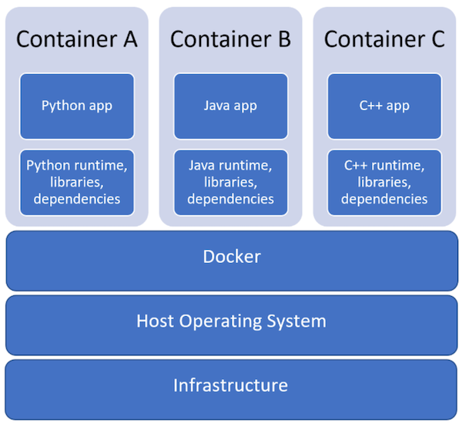
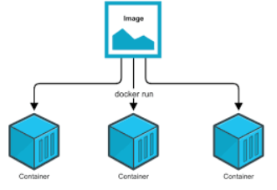
Docker Container

Slide 11
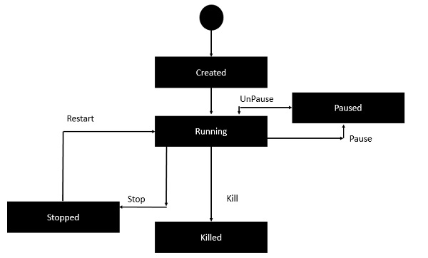
Docker Container LifeCycle

Slide 12
Dockerfile
A Docker File is a simple text file with instructions on how to build your images.
You’ll use a Dockerfile to create your own custom Docker image.
A Dockerfile produces a Docker image when you build it.
A Dockerfile is a text file that Docker reads in from top to bottom. It contains a bunch of instructions which informs Docker HOW the Docker image should get built.
A Dockerfile must not have any extension and must be named as Dockerfile with capital D.

Slide 13
Dockerfile
FROM node:alpine AS builder
WORKDIR /app
COPY . .
RUN npm install
RUN npm run build --prod
FROM nginx:alpine
COPY --from=builder /app/dist/* /usr/share/nginx/html/

Slide 14
Dockerfile
FROM mcr.microsoft.com/dotnet/aspnet:5.0 AS base
WORKDIR /app
EXPOSE 80
FROM mcr.microsoft.com/dotnet/sdk:5.0 AS build
WORKDIR /src
COPY ["Demo2.csproj", ""]
RUN dotnet restore "./Demo2.csproj"
COPY . .
WORKDIR "/src/."
RUN dotnet build "Demo2.csproj" -c Release -o /app/build
FROM build AS publish
RUN dotnet publish "Demo2.csproj" -c Release -o /app/publish
FROM base AS final
WORKDIR /app
COPY --from=publish /app/publish .
ENTRYPOINT ["dotnet", "Demo2.dll"]

Slide 15
Dockerfile commands
FROM - specifies the base(parent) image. Alpine version is the minimal docker image based on Alpine Linux which is only 5mb in size.
RUN - runs a Linux command. Used to install packages into container, create folders, etc.
ENV - sets environment variable. We can have multiple variables in a single dockerfile.
COPY - copies files and directories to the container.
EXPOSE - expose ports
ENTRYPOINT - provides command and arguments for an executing container.
CMD - provides a command and arguments for an executing container. There can be only one CMD.
VOLUME - create a directory mount point to access and store persistent data.
WORKDIR - sets the working directory for the instructions that follow.
LABEL - provides metadata like maintainer.
ADD - Copies files and directories to the container. Can unpack compressed files.

Slide 16
Dockerfile commands
Command | Description
FROM | The first instruction must be FROM to specify the base image from which you are building.
COPY | copy files from our local machine into the image.
ADD | Copies a file from the host system onto the container
CMD | CMD command is used to display a message to the user.
ENTRYPOINT | tells the container what to run when it starts up
ENV | Sets an environment variable in the new container
EXPOSE | Opens a port for linked containers
MAINTAINER | An optional value for the maintainer of the script
ONBUILD | A command that is triggered when the image in the Dcokerfile is used as a base for another image
RUN | The RUN command is used to run instructions against the image.
USER | Sets the default user within the container
VOLUME | Creates a shared volume that can be shared among containers or by the host machine
WORKDIR | Set the default working directory for the container which sets the working directory for other instructions like RUN, COPY, or ENTRYPOINT.

Slide 17
Docker Registries
A Docker registry stores Docker images.
A registry is where we store our images, you can host your own registry, or you can use Docker’s public registry which is called DockerHub.
Inside a registry, images are stored in repositories. Docker repository is a collection of different Docker images
Docker Hub is a public registry that anyone can use, and Docker is configured to look for images on Docker Hub by default. You can even run your own private registry.
Note: When you use the docker pull or docker run commands, the required images are pulled from your configured registry. When you use the docker push command, your image is pushed to your configured registry.

Slide 18
Docker Hub
Docker hub is a public registry that contains a large number of images you can use.
Docker Hub is a registry service on the cloud that allows you to download Docker images that are built by other communities.
You can also upload your own Docker built images to Docker hub.
The official site for Docker hub is − https://hub.docker.com.
Images can be downloaded from Docker Hub using the Docker run command.
docker run hello-world
Pull the images from Docker Hub
docker pull hello-world
docker pull nginx
docker pull Jenkins

Slide 19
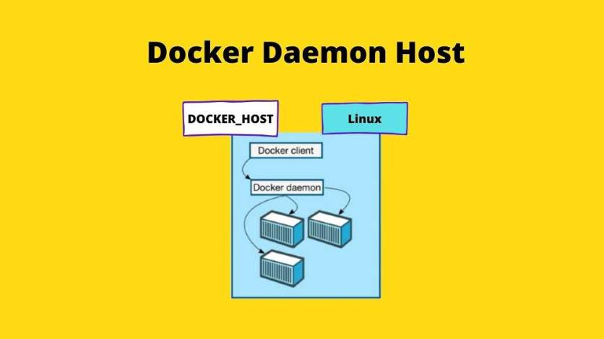
Docker Daemon
Docker daemon is often referred to as the Docker engine or Docker server.
The Docker daemon listens for Docker API requests and manages Docker objects such as images, containers, networks, and volumes.
A daemon can also communicate with other daemons to manage Docker services.

Slide 20
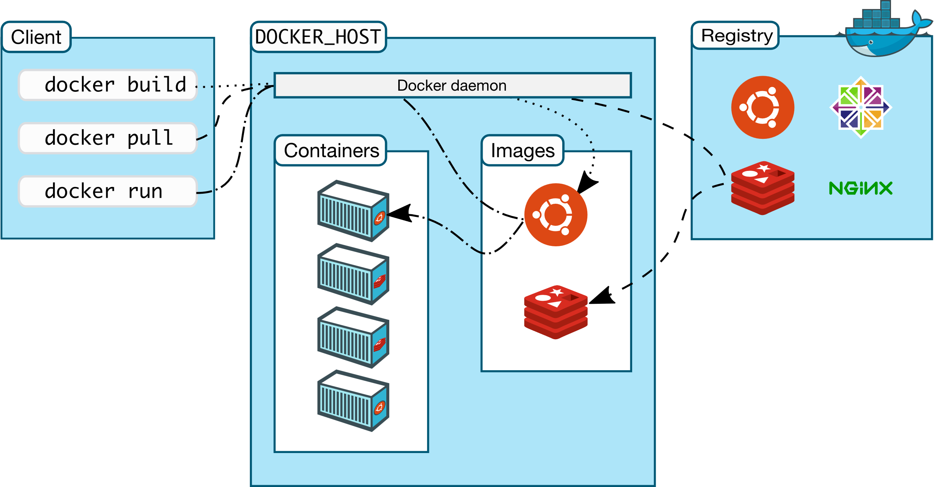
Docker architecture
Docker uses a client-server architecture.
The Docker client talks to the Docker daemon, which does the building, running, and distributing your Docker containers.
The Docker client and daemon can run on the same system, or you can connect a Docker client to a remote Docker daemon.

Slide 21
Docker architecture
The Docker daemon
The Docker daemon (dockerd) listens for Docker API requests and manages Docker objects such as images, containers, networks, and volumes. A daemon can also communicate with other daemons to manage Docker services.
The Docker client
The Docker client (docker) is the primary way that many Docker users interact with Docker. When you use commands such as docker run, the client sends these commands to dockerd, which carries them out. The docker command uses the Docker API. The Docker client can communicate with more than one daemon.
Docker Desktop
Docker Desktop is an easy-to-install application for your Mac or Windows environment that enables you to build and share containerized applications and microservices. Docker Desktop includes the Docker daemon (dockerd), the Docker client (docker), Docker Compose, Docker Content Trust, Kubernetes, and Credential Helper. For more information, see Docker Desktop.
Docker registries
A Docker registry stores Docker images. Docker Hub is a public registry that anyone can use, and Docker is configured to look for images on Docker Hub by default. You can even run your own private registry.
When you use the docker pull or docker run commands, the required images are pulled from your configured registry. When you use the docker push command, your image is pushed to your configured registry.
Docker objects
When you use Docker, you are creating and using images, containers, networks, volumes, plugins, and other objects. This section is a brief overview of some of those objects.

