Slide 1
TFS
Team Foundation Server (commonly abbreviated to TFS) is a Microsoft product.
TFS provides source code management (either via Team Foundation Version Control or Git).
TFS provide other services like reporting, requirements management, project management (for both agile software development and waterfall teams), automated builds, lab management, testing and release management capabilities
Or
Team Foundation Server (TFS) is an ALM(Application Life Cycle Management) product from Microsoft which provides the capabilities for an end-to-end development and testing using Work Item Management, Project Planning (Waterfall or Scrum), Version Control, Build/Release (Deploy) and Testing capabilities.
TFS can be used as a back-end to numerous integrated development environments (IDEs) but is tailored for Microsoft Visual Studio and Eclipse on all platforms.
TFS is more widely used for .NET development using Visual Studio .NET IDE.

Slide 2
TFS
TFS Requirement:
TFS installation is supported on a Microsoft Windows server/client OS.
System requirements for Team Foundation Server.
Operation System
Server OS a. 64-bit versions of Windows Server 2012 R2 (Essentials, Standard, Datacenter) b. 64-bit versions of Windows Server 2012 c. 64-bit versions of Windows Server 2008 R2 (Standard, Enterprise, Datacenter)
Client OS a. Windows 10 b. Windows 8.1 (Basic, Professional, Enterprise) c. Windows 8 d. Windows 7 (Home Premium, Professional, Enterprise, Ultimate)
SQL Server
SQL Server 2014 ¹ (Express, Standard, Enterprise)
SQL Server 2012

Slide 3
TFS
COMMON TFS TERMS
Bind This means to connect your project to Microsoft Team Foundation Server. After doing this, you can then take advantage of all the automated source control tasks (such as check in, check out, instant messaging, and so on).
Check In This means to copy your local Flare files to Microsoft Team Foundation Server, overwriting the copies stored in Microsoft Team Foundation Server. This enables other authors on your team to access and edit the latest files.
Check Out This means to copy the latest source control files to your local Flare project and remove the "Read Only" designation from them so that you can edit the files.
Get Latest Version This means to copy the latest source control files to your local project without necessarily checking out the files. This means that the "Read Only" designation will remain associated with the files until you check them out.

Slide 4
TFS
TFS Version Control | Git
Workspace | Repository (aka. “Repo”)
Get Latest (First time) | Clone
Get Latest (After first time) | Pull
Check in | Commit + Push
Check out | (just start typing)
Branch | Branch
Merge | Merge
Code Review | “pull request”
Shelveset | Stash
Label | Tag

Slide 5
TFS
Microsoft provides Team Foundation Service Free Plan for up to 5 users.
If you don’t have an in-house TFS Server, you can also take advantage of it and sign up for an account https://azure.microsoft.com/en-in/services/devops/

Slide 6
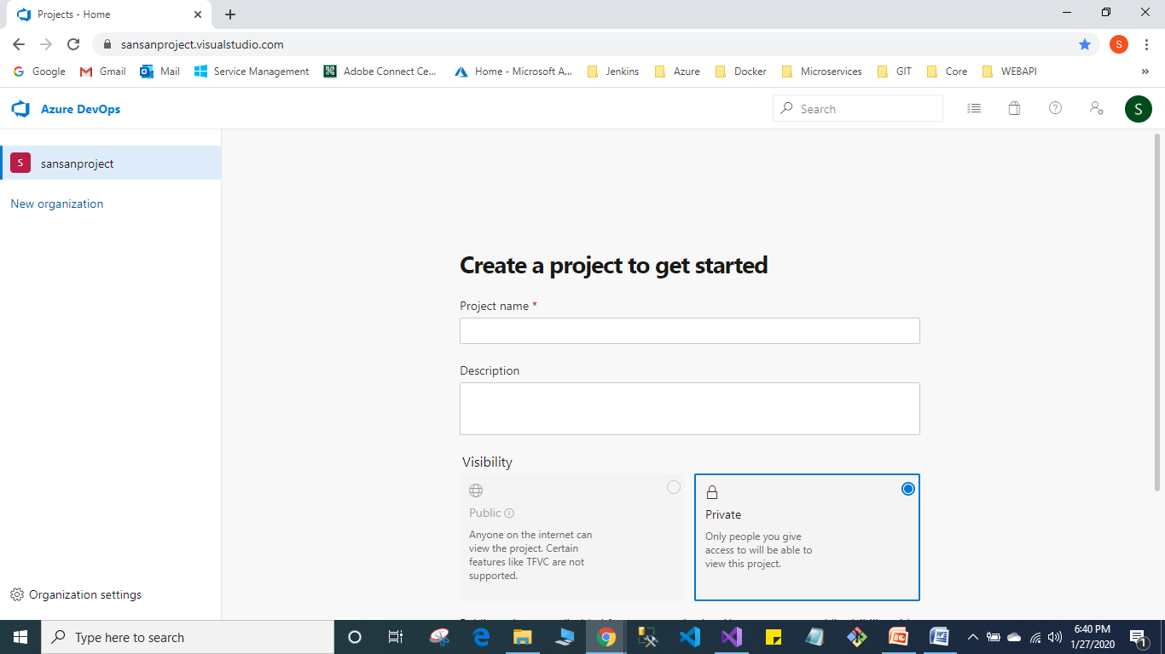
TFS

Slide 7
Azure DevOps Services Vs. Server
Both the services and the server were known as Visual Studio Team Services (VSTS) and Team Foundation Server (TFS), respectively. They provide environments that support Git, Agile tools, and continuous integration. Let us see the differences between them
Azure DevOps Services | Azure DevOps Server
It is a cloud offering. | It is an on-premise offering.
It offers two options for scaling and scoping data: organizations and projects. | It offers three options for scaling and scoping data: deployment, project collections, and projects.
You can connect over the public network. | You can connect to the intranet server.
The access level must be assigned to each user. | Access levels must be set based on the license.

