Slide 1
CICD Overview
CI/CD is a core DevOps practice that automates and streamlines the process of integrating code changes, testing them, and deploying them to production
It helps deliver software faster, safer, and more reliably.
🔁 1. Continuous Integration (CI)
CI is the process where developers frequently push code changes to a shared repository. Each change automatically triggers a build and test cycle to ensure the code integrates smoothly.
🎯 Goals of CI:
Catch bugs early by testing code changes as soon as they are pushed.
Improve code quality with frequent, automated testing.
Enable faster development with quicker feedback loops.
Ensure integration works continuously, avoiding the “integration hell” of merging big chunks of code at the end.
Tools: Jenkins, GitHub Actions, GitLab CI, Travis CI
Key Steps:
Code commit → Automated build → Automated test

Slide 2
🔧 Key Components of CI
Component | Description
Version Control | Central source repository (e.g., Git) for all code changes.
Build Automation | Scripts or tools to compile, test, and package the application.
CI Server | Tool (e.g., Jenkins, GitHub Actions, GitLab CI) that runs automated tasks.
Automated Tests | Unit/integration tests that validate each commit.
Notification System | Notifies developers of build/test results (e.g., via email, Slack).

Slide 3
Continuous Integration
🔄 CI Workflow (Typical)
Developer pushes code to main or feature branch.
CI tool (like Jenkins) detects the change.
It runs the build and executes tests.
If all tests pass ✅ → changes are considered integrated.
If anything fails ❌ → developers are notified immediately.

Slide 4
Continuous Integration
✅ Benefits of CI
Faster feedback → fix problems early
Less risk in merging changes
Improved collaboration among teams
Higher quality software
Easier deployment readiness

Slide 5
Continuous Integration
📦 Popular CI Tools
Jenkins
GitHub Actions
GitLab CI/CD
CircleCI
Travis CI
Azure DevOps Pipelines

Slide 6
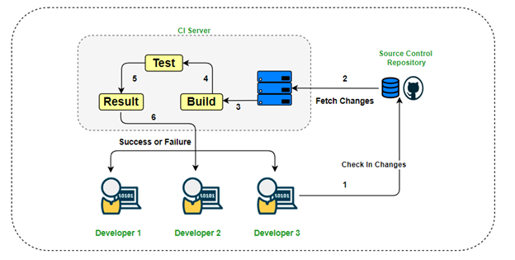
Continuous Integration

Slide 7
CICD Overview
🚀 2. Continuous Deployment (CD)
CD takes the output from CI and automatically deploys it to production (or staging) after passing all quality gates.
Goal: Deliver features to users quickly and safely.
Tools: Argo CD, Spinnaker, Octopus Deploy, GitLab
Key Steps:
Build artifact → Deploy → Monitor

Slide 8
CICD Components
🔄 CI/CD Pipeline Components
Source Control: Git (GitHub, GitLab, Bitbucket)
Build Tools: Maven, Gradle, npm
Testing: JUnit, Selenium, Postman
Deployment: Docker, Kubernetes, Ansible
Monitoring: Prometheus, Grafana, Datadog

Slide 9
Benefits of CI/CD
🎯 Benefits of CI/CD
Faster release cycles
Reduced integration problems
Higher code quality
Shorter feedback loops
Lower risk of production failures

Slide 10
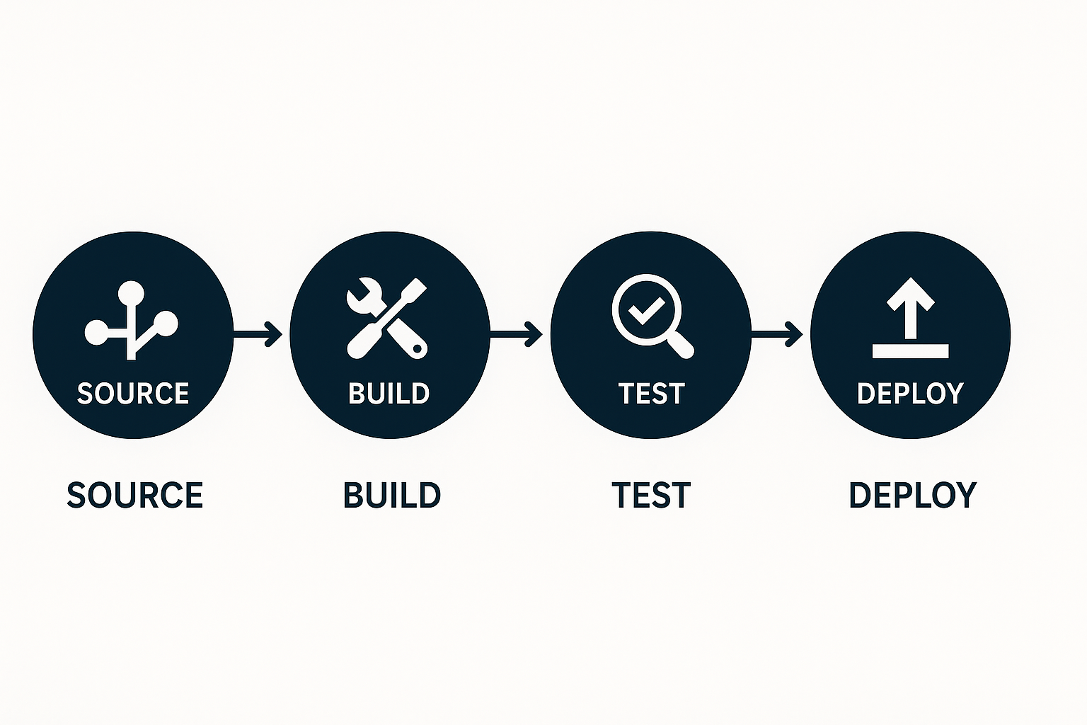
CI/CD Overview

