Slide 1
Jenkins
Jenkins is an open source automation tool that allows continuous integration.
Jenkins is an open-source automation server used primarily for continuous integration (CI) and continuous delivery (CD). It automates the process of building, testing, and deploying software, allowing teams to deliver code faster and with fewer errors.
Jenkins is one of the most popular tools for performing continuous integration and continuous delivery of software projects on any platform.
Jenkins is one of the DevOps Tool
Jenkins builds, tests and deploy software projects, which continuously making it easier for developers to integrate changes to the project, and making it easier for users to obtain a fresh build.
Jenkins offers a straightforward way to set up a continuous integration or continuous delivery environment for almost any combination of languages and source code repositories(GIT,SVN,TFS), as well as automating other routine development tasks(build, test ,deployment).

Slide 2
Jenkins
Jenkins helps organizations to speed up the software development process through automation.
Jenkins adds development life-cycle processes of all kinds, including build, document, test, package, stage, deploy static analysis and much more.
Jenkins achieves CI (Continuous Integration) with the help of plugins. Plugins is used to allow the integration of various DevOps stages. If you want to integrate a particular tool, you have to install the plugins for that tool. For example: Msbuild,Maven 2 Project, Git, HTML Publisher, Amazon EC2, etc.
Jenkins will be installed on a server where the central build will take place.
Jenkins has many plugins for automating almost everything at the infrastructure level.
The use of Jenkins has widely increased rapidly due to a rich set of functionalities, which it provides in the form of plugins.

Slide 3
Benefits of Using Jenkins
It is an open source tool and widely used.
Easily configurable.
It supports 1000 or more plugins to ease your work
It is platform independent. It is available for all platforms and different operating systems. Like OS X, Windows or Linux.
Automates repetitive tasks
Increases development speed and confidence
Works with nearly any language or tech stack
Reduces integration issues through early feedback

Slide 4
Key Features of Jenkins
Feature | Description
Open Source | Free to use, with a large plugin ecosystem.
Extensible | Over 1,800 plugins to integrate with tools like Git, Docker, Maven, etc.
Cross-platform | Runs on Windows, macOS, Linux, and supports cloud-based deployment.
Pipeline Support | Supports scripted and declarative pipelines (CI/CD as code).
Integration Ready | Works with GitHub, GitLab, Bitbucket, Docker, Kubernetes, and more.
Build Triggers | Supports triggers like SCM commits, cron jobs, pull requests, and webhooks.

Slide 5
Jenkins Architecture
Master (Controller):
Manages jobs, schedules builds, and distributes tasks.
Agents (Slaves):
Execute jobs on different platforms/environments.
Jobs/Pipelines:
Define the tasks: build, test, deploy, etc.

Slide 6
Typical Jenkins Workflow (CI/CD)
Code Push → A developer pushes code to GitHub or GitLab.
Trigger → Jenkins detects the change (via webhook or polling).
Build → Jenkins pulls the code and runs the build process.
Test → Unit/integration tests are executed automatically.
Deploy → If all steps pass, code is deployed to staging/production.

Slide 7
Job Types in Jenkins
Freestyle Project – Basic jobs with GUI-based configuration.
Pipeline – Defines CI/CD as code using Jenkinsfile
Multibranch Pipeline – Auto-creates jobs for each branch.

Slide 8
Popular Plugins
Git Plugin – Integrate with Git repositories.
Pipeline Plugin – Enables scripted/declarative pipelines.
Docker Plugin – Build and run containers.
Blue Ocean – Modern UI for pipelines.
Slack Notification Plugin – Alerts for builds.

Slide 9
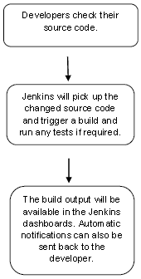
Jenkins

Slide 10
Jenkins
Continuous Integration with Jenkins
Let's consider a scenario where the complete source code of the application was built and then deployed on test server for testing. It sounds like a perfect way to develop software, but this process has many problems.
Developer teams have to wait till the complete software is developed for the test results.
There is a high prospect that the test results might show multiple bugs. It was tough for developers to locate those bugs because they have to check the entire source code of the application.
It slows the software delivery process.
Continuous feedback pertaining to things like architectural or coding issues, build failures, test status and file release uploads was missing due to which the quality of software can go down.
The whole process was manual which increases the threat of frequent failure.
It is obvious from the above stated problems that not only the software delivery process became slow but the quality of software also went down. This leads to customer dissatisfaction.
So to overcome such problem there was a need for a system to exist where developers can continuously trigger a build and test for every change made in the source code.
This is what Continuous Integration (CI) is all about. Jenkins is the most mature Continuous Integration tool available so let us see how Continuous Integration with Jenkins overcame the above shortcomings.

Slide 11
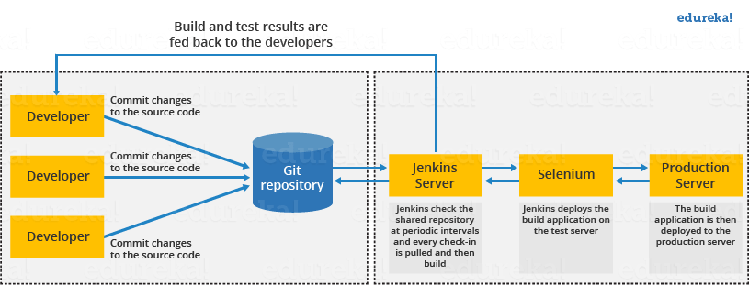
Jenkins Architecture
generic flow diagram of Continuous Integration with Jenkins:

Slide 12
Jenkins
Let's see how Jenkins works. The above diagram is representing the following functions:
First of all, a developer commits the code to the source code repository. Meanwhile, the Jenkins checks the repository at regular intervals for changes.
Soon after a commit occurs, the Jenkins server finds the changes that have occurred in the source code repository. Jenkins will draw those changes and will start preparing a new build.
If the build fails, then the concerned team will be notified.
If built is successful, then Jenkins server deploys the built in the test server.
After testing, Jenkins server generates a feedback and then notifies the developers about the build and test results.
It will continue to verify the source code repository for changes made in the source code and the whole process keeps on repeating.

Slide 13
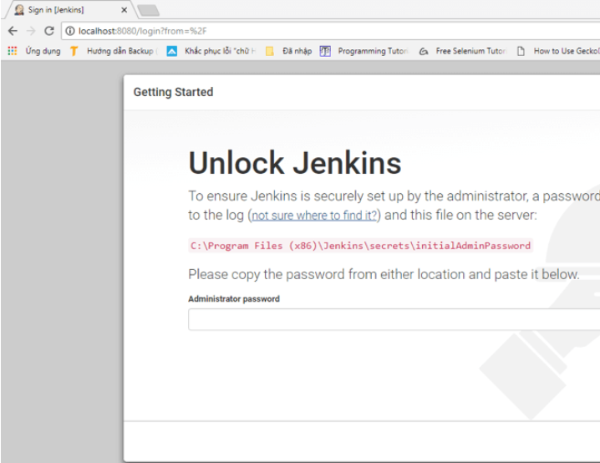
Jenkins Installation
Step by Step Installation: Below is URL to download Jenkins from
https://jenkins.io/download/thank-you-downloading-windows-installer-stable/
Follow onscreen Instructions to complete installation.
Open URL http://localhost:8080

Slide 14
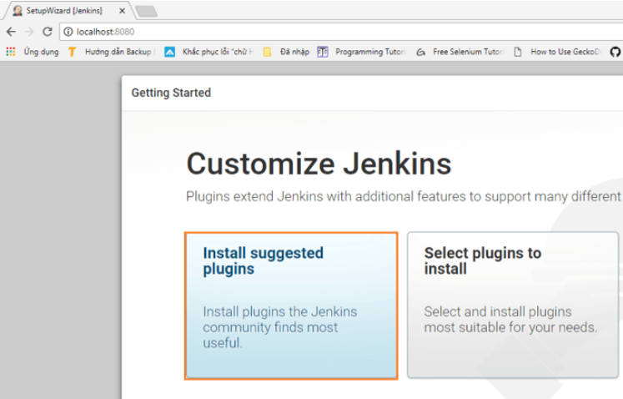
Jenkins
To unlock Jenkins, copy the password from the file at C:\Program Files (x86)\Jenkins\secrets\initialAdminPassword and paste it in the Administratorpassword field. Then, click the "Continue" button.

Slide 15
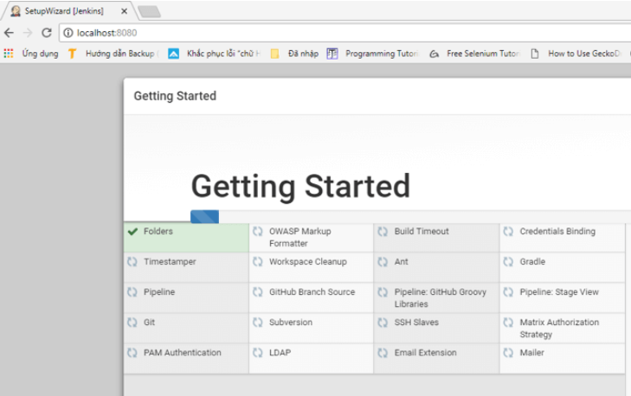
Jenkins
In Next Screen, wait until all plugins are installed

Slide 16
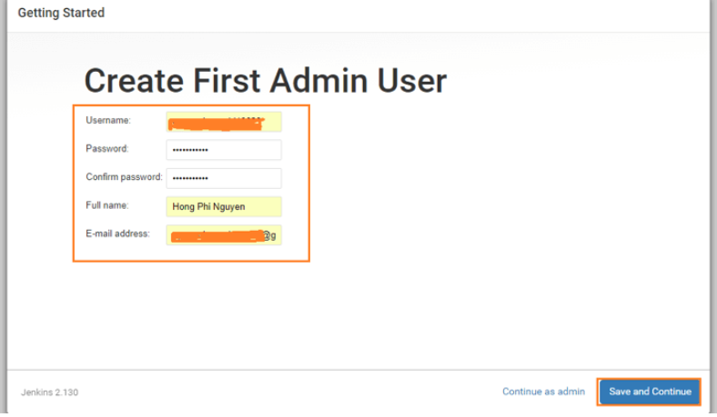
Jenkins
Provide username and password of Admin. From now on use this admin username/password to login to Jenkins

Slide 17
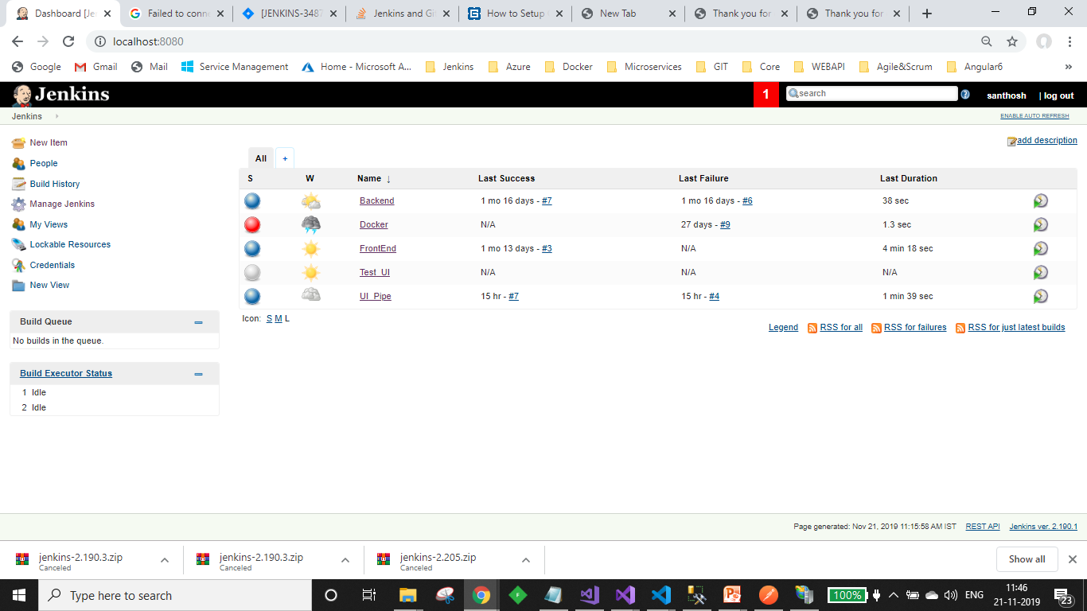
Jenkins

Slide 18
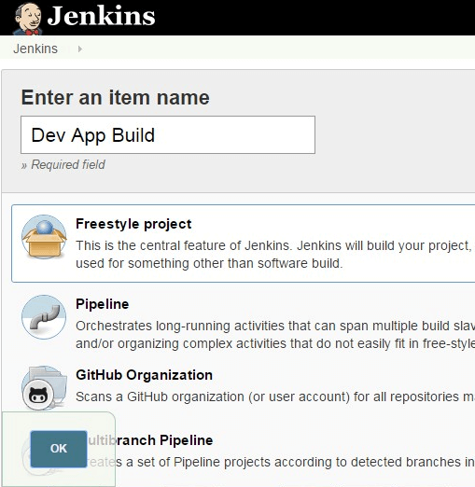
Jenkins – Create First Job – Non GIT
After Login to Jenkins, click New Item
Provide a Name for the New Job, select “Freestyle”
Click Ok.
Under Build, Select Execute Windows batch Command. And provide below commands in window

Slide 19
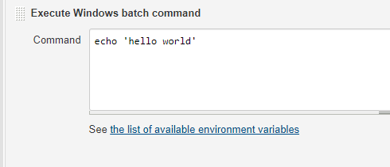
Jenkins
Under Build, Select Execute Windows batch Command. And provide below commands in window
Click Save, to Complete creation of Job Item.
Now Select Build Now from left side menu, observe that build gets done, after that, you can observe Console output

Slide 20
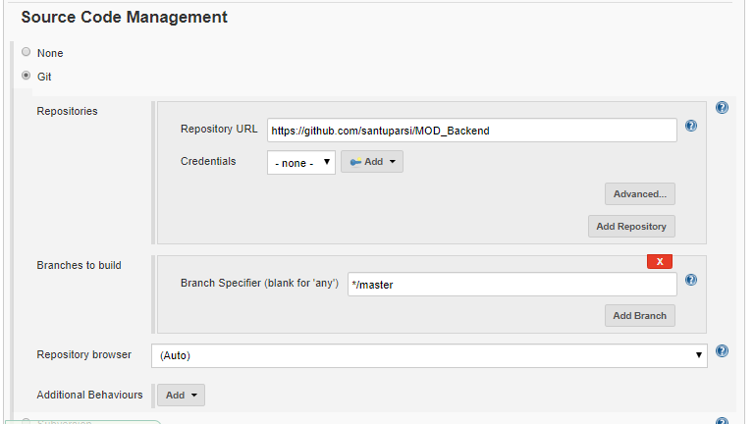
Jenkins – Get GIT Project ready
Create Item just like before, now select Configure from left side.
Now on the next web page, under “Source Code management” select “Git”
This option gets expanded, and asks for GIT repo URL

Slide 21
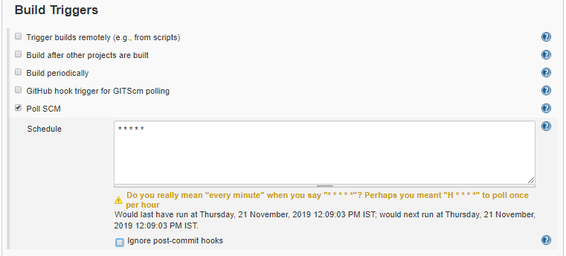
Jenkins – Get GIT Project ready
In Build Trigger, select Poll SCM, specify * * * * *
Above indicates that SCM need to be polled for every one minute, for changes. Once Jenkins Job finds changes, build is initiated.

Slide 22
Jenkins – Get GIT Project ready
In Build Environment, select Delete work space before build starts
Above indicates that work space is deleted before build starts.

Slide 23
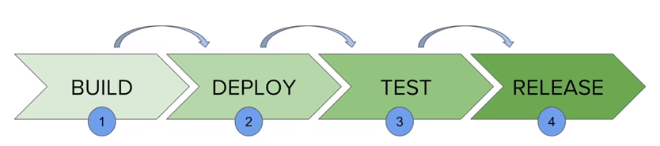
Jenkins Pipeline
In Jenkins, a pipeline is a group of events or jobs which are interlinked with one another in a sequence.
In simple words, Jenkins Pipeline is a combination of plugins that support the integration and implementation of continuous delivery pipelines using Jenkins.
What is Continuous Delivery Pipelines? How it Works?
In a Jenkins pipeline, every job or event has some sort of dependency on at least one or more events.
The picture above represents a continuous delivery pipeline in Jenkins. It contains a group of states called build, deploy, test and release. These events are interlinked with each other. Every state has its events, which work in a sequence called a continuous delivery pipeline.

Slide 24
Jenkins Pipeline
Jenkins Pipeline Concepts
Pipeline
The pipeline is a set of instructions given in the form of code for continuous delivery and consists of instructions needed for the entire build process. With pipeline, you can build, test, and deliver the application.
Stage
A stage block contains a series of steps in a pipeline. That is, the build, test, and deploy processes all come together in a stage. Generally, a stage block is used to visualize the Jenkins pipeline process.
Step
A step is nothing but a single task that executes a specific process at a defined time. A pipeline involves a series of steps.

Slide 25
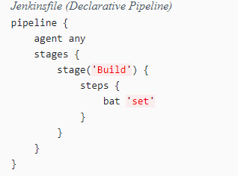
Jenkins Pipeline

