Slide 1
Docker Overview
Docker is an open-source platform that lets you build, package, and run applications in lightweight, portable containers.
Docker is like a shipping container for software. It bundles your app with everything it needs—code, runtime, libraries—so it runs the same everywhere.
Docker was Released in March 2013
Docker is for Build, Ship, and Run Any App, Anywhere using containers.
Docker is a tool designed to make it easier to deploy, and run applications by using containers.
Docker is for developers to easily build applications, ship them into containers which can then be deployed anywhere.

Slide 2
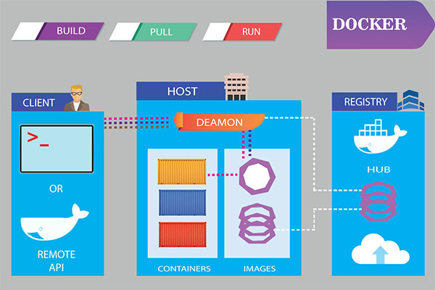
Docker Overview

Slide 3
📦 How Docker Works (High-Level)
1.You write code.
2.Create a Dockerfile (instructions to build your app image).
3.Build an image using docker build.
4.Run a container using docker run — it runs your app isolated from the rest of the system.

Slide 4
Docker Advantages
Consistency across multiple environments.
simplifies configuration.
Large community support.
Containers are lighter and use less resources than virtual machines.
Isolated environments simplify debugging.
Provides access to thousands of configured images with Docker Hub.
The platform supports CI/CD.

Slide 5
Features of Docker
1. Lightweight
Containers share the host OS kernel, making them smaller and faster than virtual machines.
2. Portability
"Build once, run anywhere" – Docker containers run consistently across different environments (development, test, production).
3. Fast Startup
Containers start almost instantly, which improves speed during development and deployment.
4. Isolation
Each container runs in its own isolated environment with its own filesystem, processes, and network.
5. Version Control
Docker images can be versioned and rolled back easily, enabling better control over application versions.

Slide 6
Features of Docker
6. Reusability
Images can be reused across multiple containers, reducing duplication and resource use.
7. Scalability
Docker integrates well with orchestration tools like Kubernetes for scaling services efficiently.
8. Resource Efficiency
Containers use fewer resources than traditional VMs, making better use of hardware.
9. Security
Containers are isolated from the host and each other, enhancing application security.
10. CI/CD Friendly
Works seamlessly with continuous integration/continuous deployment pipelines for automated testing and deployment.
11. Docker Hub & Registry
Provides a central place to find, share, and distribute container images.

Slide 7
🔄 Docker vs Virtual Machines
Feature | Docker (Containers) | Virtual Machines (VMs)
Lightweight | ✅ Yes | ❌ No (includes entire OS)
Startup Time | ⚡ Fast (seconds) | 🐢 Slow (minutes)
Resource Usage | 🚀 Low | 🧱 High
Portability | ✅ Run anywhere | 🔁 Often platform-dependent

Slide 8
🛠 Tools Commonly Used with Docker
Docker Engine
The core software that runs and manages containers.
Docker Desktop
GUI application for managing containers, images, and volumes on Windows/macOS.
Docker CLI
Command-line interface to interact with Docker(e.g., docker run, docker build)
Docker Hub
Public registry where you can share and pull Docker images.
Docker Compose
Tool for defining and running multi-container applications using a YAML file.
Dockerfile
Text file with instructions to build a Docker image.
Kubernetes
Container orchestration tool often used with Docker in production environments.

Slide 9
Common Docker Terminology
Image
A snapshot of an application used to create containers.
Container
A running instance of a Docker image. Lightweight and isolated.
Tag
A label assigned to a Docker image version (e.g., myapp:1.0 )
Registry
A storage and distribution system for Docker images (e.g., Docker Hub).
ENTRYPOINT / CMD
Commands that define what runs when the container starts.

Slide 10
Docker Container?
A Docker container is a self-contained unit that runs an application.
It's isolated from the host system but shares the host’s operating system kernel.
It runs consistently across any environment, whether it's your laptop, a test server, or a production cloud server.
✅ A Docker container includes
App code
Runtime (e.g., .NET, Node.js, Python)
System libraries
Configuration files

Slide 11
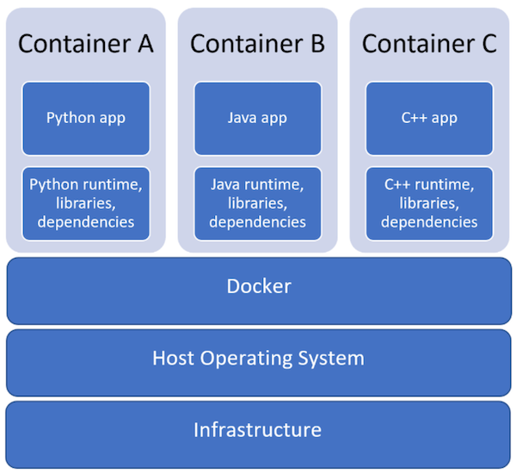
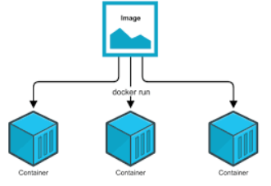
Why Use Docker Containers?
Portability: Works the same on any system with Docker.
Speed: Containers start almost instantly.
Isolation: Keeps environments clean and separate.
Scalability: Great for microservices and cloud-native deployments.

Slide 12
Dockerfile
A Dockerfile is a plain text file that contains a set of instructions used by Docker to build a Docker image
It acts like a recipe for creating containers — specifying what the container should contain and how it should behave.
A Dockerfile produces a Docker image when you build it.
A Dockerfile must not have any extension and must be named as Dockerfile with capital D.

Slide 13
🛠 Basic Syntax of a Dockerfile
# 1. Use a base image
FROM node:18
# 2. Set the working directory in the container
WORKDIR /app
# 3. Copy package files and install dependencies
COPY package*.json ./
RUN npm install
# 4. Copy the rest of the app code
COPY . .
# 5. Expose the port the app runs on
EXPOSE 3000
# 6. Define the command to run the app
CMD ["node", "index.js"]

Slide 14
Common Dockerfile Instructions
Instruction | Purpose
FROM | Specifies the base image to use.
WORKDIR | Sets the working directory inside the container.
COPY | Copies files from host to container.
RUN | Executes a command (e.g., install packages).
CMD | Sets the default command to run the container.
EXPOSE | Documents which ports the container uses.
ENV | Sets environment variables.
ENTRYPOINT | Configures a container to run as an executable.

Slide 15
How to Build and Run a Dockerfile
# Build image from Dockerfile
docker build -t myapp .
# Run a container from the image
docker run -p 3000:3000 myapp

Slide 16
Docker Image
A Docker image is a read-only template used to create Docker containers.
A Docker image is the blueprint for containers.
It contains everything needed to run an application, including:
The application code
Runtime (e.g., Python, Node.js, .NET)
Libraries and dependencies
Configuration files
Environment settings
Docker images are typically built using a Dockerfile with the following command:
docker build -t myapp:1.0

Slide 17
🔁 Image vs Container
Docker Image | Docker Container
Blueprint (static) | Live instance of the image (dynamic)
Read-only | Writable layer on top of the image
Created once, used many times | Created from an image when you run it

Slide 18
📥 Pulling and Running Images
# Pull an image from Docker Hub
docker pull nginx
# Run a container from the image
docker run -d -p 80:80 nginx

