Slide 1
Events
An event is an action or occurrence, such as button clicks, mouse clicks, key presses, mouse movements etc.
Applications can respond to evens when they occur.
Event and delegate are linked together.
Events are declared using delegates.
The Delegate used to write up an event is called Event Handler delegate
Event is a reference of delegate i.e. when event will be raised delegate will be called. when delegate will rise all associate event handlers[methods] will invokes.
events are members of a class and are declared using the event keyword

Slide 2
Events
An event is an action or occurrence, such as button clicks, mouse clicks, key presses, mouse movements etc.
Applications can respond to evens when they occur.
Event and delegate are linked together.
Events are declared using delegates.
The Delegate used to write up an event is called Event Handler delegate
Event is a reference of delegate i.e. when event will be raised delegate will be called. when delegate will rise all associate event handlers[methods] will invokes.
events are members of a class and are declared using the event keyword

Slide 3
Events
Declaration:
event eventhandler-delegate event-name;
eventhandler-delegate is the name of the delegate used in event declaration.
event-name is the name of the event object
Events can be declared as static and instance.
Once an event is declared, it must be associated with one or more event handlers before it can be raised.
An event handler is nothing but a method that is called using a event
The events are declared and raised in one class and associated with the event handlers using delegates with in the same class or other class.

Slide 4
Events
Events are part of the class and the same class is use to publish events.
The other classes can subscribe to these events.
The following objects are used in the event model:
Publisher: Contains the definition of the event and delegate.
Subscriber: Accept the event and provides a handler to the event. The delegate of the publisher class invokes the method of the subscriber class.

Slide 5
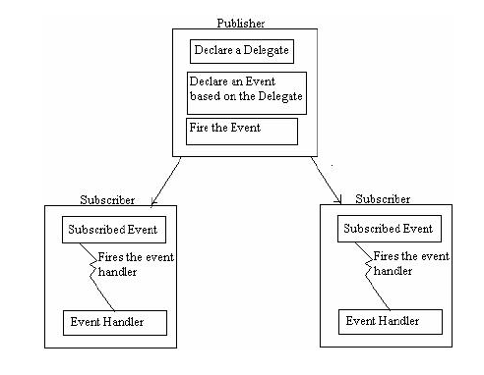
Events
The following figure shows the mechanism used by the publisher and subscriber objects.

Slide 6
Events
Different events are provide with different eventhandler-delegate
In .Net Framework all the eventhandler-delegates are provided with 2 parameters
1st parameter is object type.
2nd parameter will be class type.
public delegate void EventHandler(object sender, EventArgs e)
public delegate void CancelEventHandler(object sender, CancelEventArgs e)
public delegate void KeyPressEventHandler(object sender, KeyPressEventArgs e);

Slide 7
Where we use???
In Windows Forms or Web application, the application subscribe to events raised by controls such as buttons and TextBoxes etc.
Events that have no EventHandlers are never called.
Events are typically used to single user actions such as button clicks or menu selections in graphical user interfaces.
When an event has multiple subscribers[event handlers], that event handlers are invoked simultaneous when an event is raised.

Slide 8
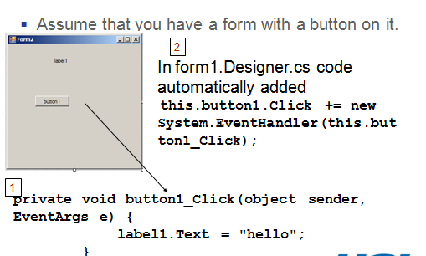
Where we use???

