Slide 1
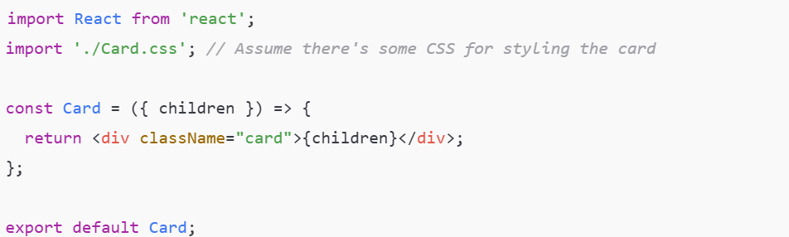
React Wrapper Component
A wrapper component in React is a component that wraps or contains other components, often adding additional behavior, styling, or logic
Wrapper components allow for reusable and composable code.
A basic wrapper component receives child components via the special children prop and renders them inside some container.

Slide 2
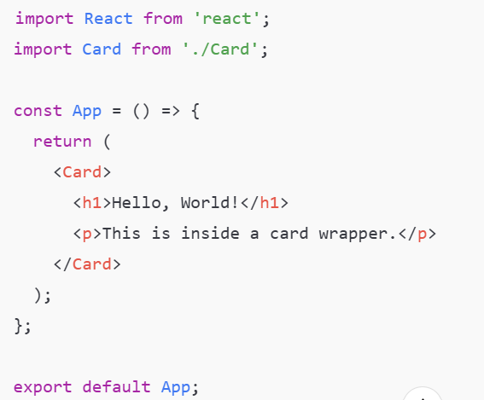
React Wrapper Component

Slide 3
React Wrapper Component
When to Use Wrapper Components
Reusability: When you need to apply the same behavior or style to multiple components.
Layout Composition: To build reusable layouts like headers, sidebars, or footers.
Behavior Enhancement: When you need to enhance existing components with additional functionality (e.g., logging, theming).

