Slide 1
Redux
Redux is a state management library that helps to better manage state in your application.
As the application grows, it becomes difficult to keep it organized and maintain data flow. Redux solves this problem by managing application’s state with a single global object called Store.
Redux provides a single store that you can use to manage a large amount of data.
Redux managing and updating application state.
Redux manages an application’s state with a single global object called Store.
Redux is a state container that store the state of your application.
It serves as a centralized store for state that needs to be used across your entire application.
Redux can be use with any JavaScript App like React, Angular, Vue and vanilla JavaScript.
State of the app is the state represented by all the individual components of the app.
Redux stores the state of the application, and the components can access the state from a state store.

Slide 2
Why Should I Use Redux?
Redux helps you manage "global" state - state that is needed across many parts of your application.
Redux is more useful when:
You have large amounts of application state that are needed in many places in the app
The app state is updated frequently over time
The app has a medium or large-sized codebase, and might be worked on by many people

Slide 3
Advantages Of Redux
Predictability of outcome – Since there is always one source of truth, i.e. the store, there is no confusion about how to sync the current state with actions and other parts of the application.
Maintainability – The code becomes easier to maintain with a predictable outcome and strict structure.
Server side rendering – You just need to pass the store that is created on the server, to the client side. This is very useful for initial render and provides a better user experience as it optimizes the application performance.
Developer tools – From actions to state changes, developers can track everything going on in the application in real time.
Community and ecosystem – Redux has a huge community behind it which makes it even more captivating to use. A large community of talented individuals contribute to the betterment of the library and develop various applications with it.
Ease of testing – Redux code are mostly functions which are small, pure and isolated. This makes the code testable and independent.
Organization – Redux is very precise about how the code should be organized, this makes the code more consistent and easier when a team works with it.

Slide 4
Principles of Redux
Predictability of Redux is determined by three most important principles as given below
Single Source of Truth
The state of your whole application is stored in an object tree within a single store.
As whole application state is stored in a single tree, it makes debugging easy, and development faster.
State is Read-only
The only way to change the state is to emit an action, an object describing what happened. This means nobody can directly change the state of your application.
Changes are made with pure functions
To specify how the state tree is transformed by actions, you write pure reducers. A reducer is a central place where state modification takes place. Reducer is a function which takes state and action as arguments, and returns a newly updated state.

Slide 5
Redux Architecture(Components Of Redux)
There are three main components of Redux architecture
STORE:
The entire state of an application lists at a place called Store. It acts as a brain and manages the status of the application. It also has a dispatch(action) function.
ACTION:
An action is a pure object which is sent or dispatched from the view. It is created to store information about the user’s event such as info about the type of action, the time of occurrence, the location of occurrence, info about its coordinates, and info about the state it aims to change.
REDUCER:
Reducer is a pure function which is used to return a new state from the initial state. It reads the payloads from the actions. The reducer then updates the store via the state accordingly.

Slide 6
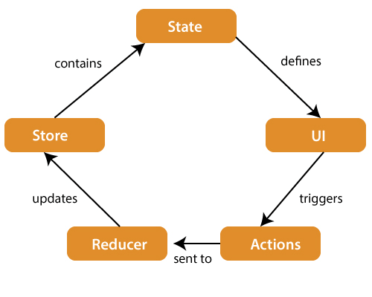
Redux Architecture(Components Of Redux)

Slide 7
Redux actions
Redux actions are events. They are the only way you can send data from your application to your Redux store. The data can be from user interactions, API calls, or even form submissions.
Actions are the only source of information for the store as per Redux official documentation.
It carries a payload of information from your application to store.
The only way to change state content is by emitting an action.
Actions are the plain JavaScript objects which are the main source of information used to send data (user interactions, internal events such as API calls, and form submissions) from the application to the store.
The store receives information only from the actions. You have to send the actions to the store using store. Dispatch().
Note: In the redux we can’t update the state directly, the only way to change the state is by calling an dispatch method with action object.
The dispatch method is provided by the redux.

Slide 8
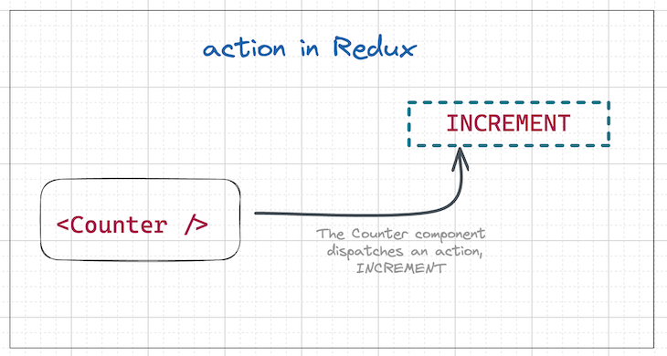
Redux actions Cont..
Actions are plain JavaScript objects that must have
A type property to indicate the type of action to be carried out. Types should typically be defined as string constants.
A payload object that contains the information that should be used to change the state
Actions are created via an action creator, which is a function that returns an action.
Actions are executed using the dispatch()method, which sends the action to the store

Slide 9
Redux actions Cont..
Here’s an example of an action
{
type: "INCREMENT",
payload: {
incrementBy: 5,
}
}
Action Creators (Action creators are exactly the functions that create actions.)
And here is an example of an action creator. It is just a helper function that returns the action
const getIncrementAction = (numberToIncrement) => {
return {
type: "INCREMENT",
payload: {
incrementBy: numberToIncrement,
}
}
}

Slide 10
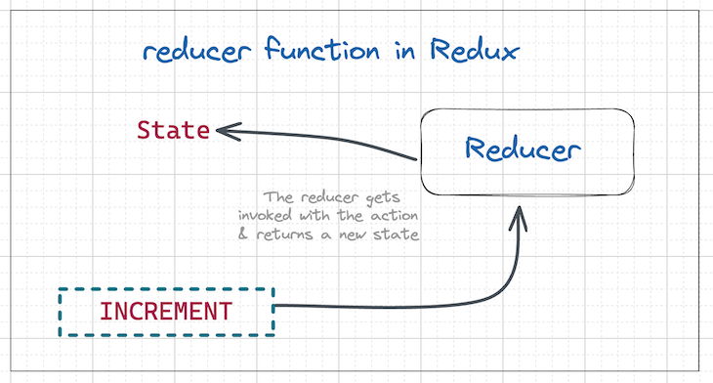
Redux reducers
Reducers are pure functions that take the current state of an application, perform an action, and return a new state.
The reducer handles how the state (application data) will change in response to an action
A pure function is a function that will always return the same value if given the same parameters, i.e., the function depends on only the parameters and no external data.

Slide 11
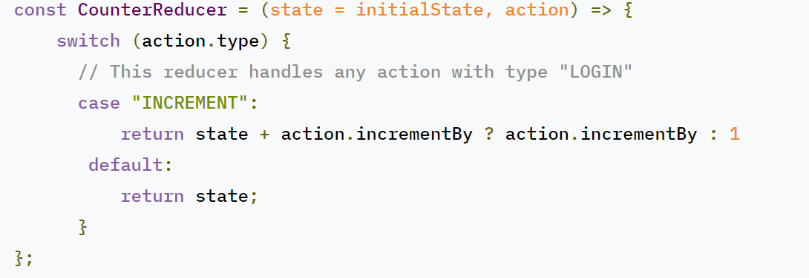
Redux reducers Cont..
Reducers are based on the reduce function in JavaScript, where a single value is calculated from multiple values after a callback function has been carried out.
Note: Reducers take the previous state of the app and return a new state based on the action passed to it. As pure functions, they do not change the data in the object passed to them or perform any side effect in the application. Given the same object, they should always produce the same result.

Slide 12
Redux store
The center of every Redux application is the store.
A "store" is a container(really, a JavaScript object) that holds your application's global state.
With Redux, the state of your application is kept in a store, and each component can access any state that it needs from this store.
Redux can have only a single store in your application.
Whenever a store is created in Redux, you need to specify the reducer.
state can change is through actions dispatched to the store.
we can create a store using the createStore method from Redux.
import { createStore } from 'redux’;
import reducer from './reducers/reducer’
const store = createStore(reducer);

Slide 13
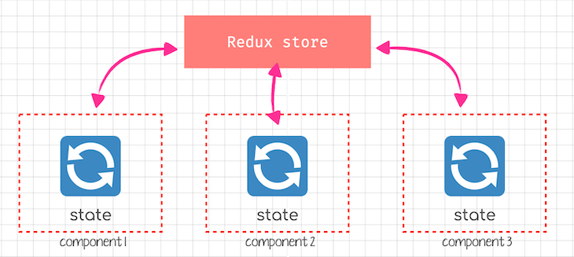
Store
With Redux, the state of your application is kept in a store, and each component can access any state that it needs from this store.

Slide 14
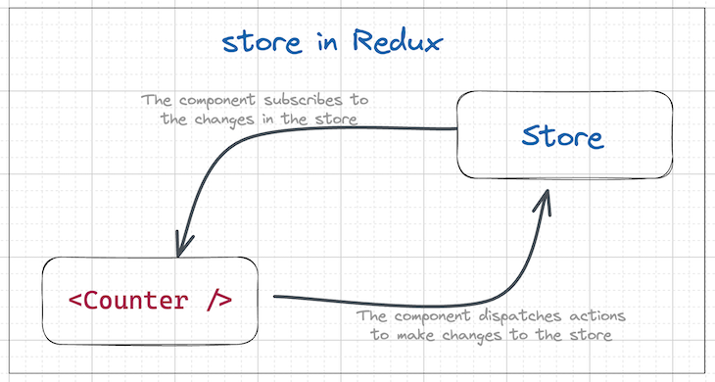
Store

Slide 15
Store Methods
A store has three important methods as given below
getState()
It helps you retrieve the current state of your Redux store.
store.getState()
Dispatch()
It allows you to dispatch an action to change a state in your application.
store.dispatch({type:'ITEMS_REQUEST'})
Subscribe()
It helps you register a callback that Redux store will call when an action has been dispatched.
As soon as the Redux state has been updated, the view will re-render automatically.
store.subscribe(()=>{ console.log(store.getState());})

Slide 16
Redux Libraries and Tools
Redux is a small standalone JS library. However, it is commonly used with several other packages:
React-Redux
Redux can integrate with any UI framework, and is most frequently used with React. React-Redux is our official package that lets your React components interact with a Redux store by reading pieces of state and dispatching actions to update the store.
Redux Toolkit
Redux Toolkit is our recommended approach for writing Redux logic. It contains packages and functions that we think are essential for building a Redux app. Redux Toolkit builds in our suggested best practices, simplifies most Redux tasks, prevents common mistakes, and makes it easier to write Redux applications.
Redux DevTools Extension
The Redux DevTools Extension shows a history of the changes to the state in your Redux store over time. This allows you to debug your applications effectively, including using powerful techniques like "time-travel debugging".

Slide 17
React-Redux
React-Redux is the official Redux UI binding library for React
React-Redux is a library that provides bindings to use React and Redux together in an application.

