Slide 1
React Hooks
Hooks are one of the main features of modern React code.
React Hooks are special functions that let you “hook into” React features like state, lifecycle, and context from function components.
Before Hooks, you had to use class components to manage state or lifecycle methods. With Hooks, you can do all of that in functional components.
They provide a cleaner and more concise way to handle state and side effects in React applications.
Why Hooks?
Without Hooks (Before) | With Hooks (Now)
Must use class components | Use functional components
More code & boilerplate | Cleaner and simpler code

Slide 2
Types of React Hooks
🔧 Commonly Used React Hooks
Hook | Purpose | Example
useState() | Adds local state to a functional component | Counter, form input
useEffect() | Handles side effects (API calls, timers) | Fetch data on mount
useContext() | Access global data via React Context | Theme, user auth info
useRef() | Access or store DOM elements/values | Focus input, timers
useMemo() | Optimize performance by memoizing values | Avoid recalculations
useCallback() | Memoize functions | Prevent unnecessary renders

Slide 3
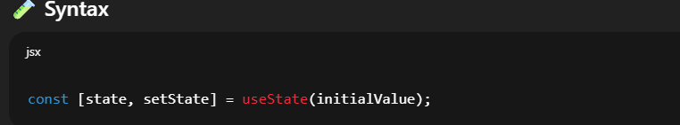
React useState Hook
useState is a React Hook that lets you add state to functional components.
It allows you to manage state within functional components
It provides a way to declare and manage state variables directly within a function component.
Before hooks, state could only be used in class components. With usestate, you can now manage local state in function components.
Importing the useState Hook
import { useState } from "react";
State: name of the state.
setState: Function used to update the state.
initialValue: The starting value for the state.
Note:Every time you call, setState, React
Update the state values
Re-renders the component with the new state

Slide 4
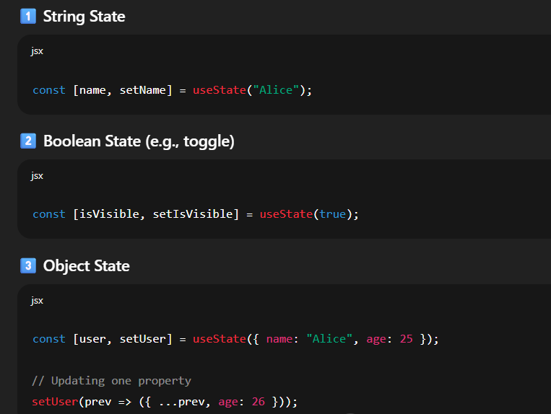
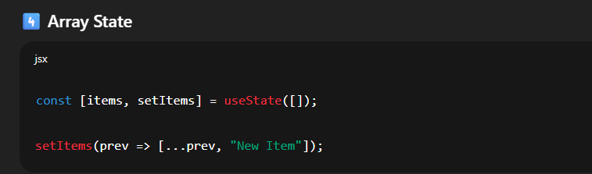
Using Different Types of State

Slide 5
Using Different Types of State
Feature | useState
Purpose | Manage local state in function components
Returns | [state, setState] array
Initial Value | Passed as an argument
Async Update | Updates are async
Causes Re-render | Yes, on every state change

Slide 6
useEffect Hook
The useEffect Hook allows us to perform side effects on the components.
Such as fetching data, directly updating the DOM and timers are some side effects.
It is called every time any state if the dependency array is modified or updated.
This hook runs on every render,but there is also a way of using a dependency array using which we can control the effect of rendering

Slide 7
useEffect Hook
How does it work?
You call useEffect with a callback function that contains the side effect logic.
By default, this function runs after every render of the component.
You can optionally provide a dependency array as the second argument.
The effect will only run again if any of the values in the dependency array change.
Importing useEffect hook
import { useEffect } from "react";
Structure of useEffect hook
The useEffect hook syntax accepts two arguments where the second argument is optional
useEffect(<FUNCTION>, <DEPENDECY>)
FUNCTION: contains the code to be executed when useEffect triggers.
DEPENDENCY: is an optional parameter, useEffect triggers when the given dependency is changed.

Slide 8
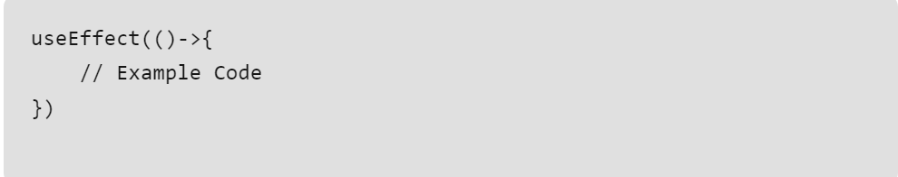
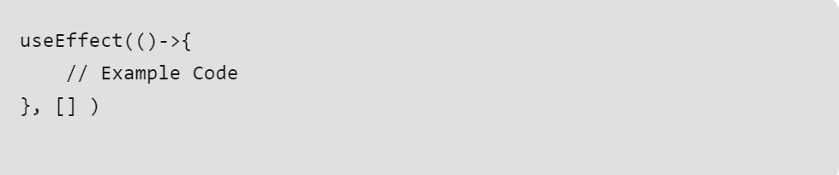
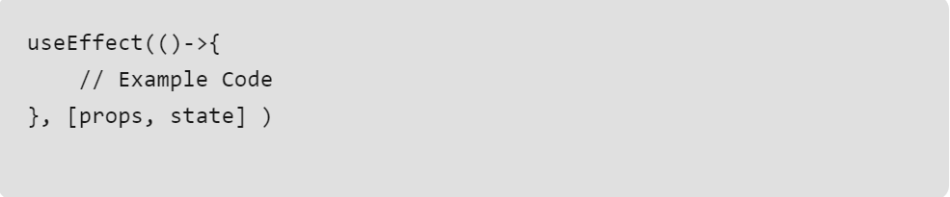
useEffect Hook(Cont..)
Controlling side effects in useEffect
1. To run useEffect on every render do not pass any dependency
2. To run useEffect only once on the first render pass any empty array in the dependency
3. To run useEffect on change of a particular value. Pass the state and props in the dependency array

Slide 9
React useContext Hooks
React Context is a way to manage state globally.
Context provides a way to pass data or state through the component tree without having to pass props down manually through each nested component.
useContext is a React Hook that allows you to share data between components without manually passing props down through every level (prop drilling).
📦 Why use it?
Without useContext:
If you have a theme, user info, or language settings, you would pass them through every child component manually → prop drilling.
With useContext:
Components can directly access the shared data from anywhere in the tree.
Syntax:
const value = useContext(mycontext);
MyContext → created using React.createContext()
value → the nearest provider's value

Slide 10
Purpose of useContext
Accessing Context Values:
With useContext, you can access values stored in a React context from any component within the same context provider.
Avoiding Prop Drilling:
It helps avoid “prop drilling” which is the process of passing props down through multiple levels of components just to reach a component that needs those values.
Simplified Data Sharing:
useContext simplifies the process of sharing data or functionality across many components in your application, especially when dealing with deeply nested components.

Slide 11
Key Points useContext
Feature | Description
Avoid Prop Drilling | Directly access data anywhere
Provider | Must wrap components that use the context
Multiple Contexts | Can use multiple useContext calls
Re-render | Context value changes cause re-renders in all consumers

Slide 12
React useRef
The useRef is a hook that allows to directly create a reference to the DOM element in the functional component.
The useRef Create a reference to a DOM element (like an input).
The useRef hook is a new addition in React 16.8.
Unlike useState if we change a value in useRef it will not re-render the webpage
Reasons to use useRef hook
The main use of useRef hook is to access the DOM elements in a more efficient way as compared to simple refs.
Since useRef hooks preserve value across various re-renders and do not cause re-renders whenever a value is changed.
they make the application faster and helps in caching and storing previous values

Slide 13
React useRef(Cont..)
Importing useRef hook
To import the useRef hook, write the following code at the top level of your component.
import { useRef } from 'react’
Structure of useRef hook
It accepts only one initial value
Syntax:
const refContainer = useRef(initialValue);
The useRef returns a mutable ref object. This object has a property called .current.
The .current property could be initialised to the passed argument initialValue
The object can persist a value for a full lifetime of the component.

Slide 14
React useReducer Hook
The useReducer hook is a state management hook in React that provides an alternative to the useState hook.
The useReducer Hook is the better alternative to the useState hook and is generally more preferred over the useState hook when you have complex state-building logic
The useReducer hook takes two arguments including reducer, initial state
Syntax:
const [state, dispatch] = useReducer(reducer, initialState);
reducer: The reducer is a function responsible for defining how the state transitions from one state to another based on dispatched actions. It takes two arguments: the current state and the action being dispatched.
initialSate: initialState is the initial state value for the state managed by the reducer. It can be of any data type: object, array, number, string, etc.
The function which contains all your state updates is called the reducer.
The method you call to perform the operations is the dispatch method.

