Slide 1
Exception Handling
Error: An error is a mistake done by the developer while writing business logic.
Errors are two types than can occur in an application.
Syntax errors[compile time errors]
Runtime errors[Exceptions]
Syntax errors: Occurs when compiling the program due to syntactical mistakes.[keywords misspelled, ; missing etc]
Compile time errors are detected by compilers.
Runtime errors: Occurs during program execution
Runtime errors are detected by Runtime System[CLR]
Runtime errors are called exceptions.

Slide 2
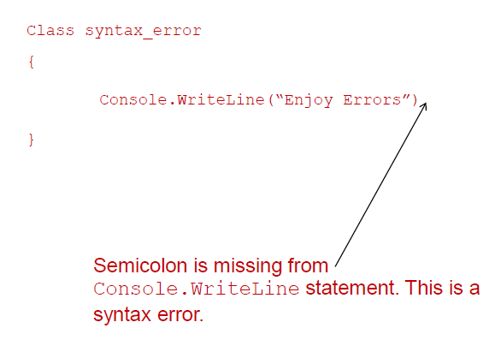
Exception Handling

Slide 3
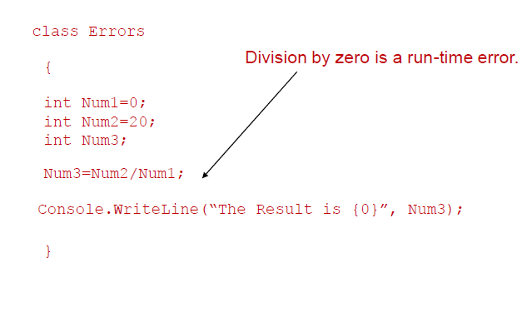
Exception Handling

Slide 4
Defining Exception
An exception is an abnormal condition that arises while running a program.
Examples:
Attempt to divide an integer by zero causes an exception to be thrown at run time.
Attempt to call a method using a reference that is null.
Attempting to access a file that does not exist on disk.
Note: When Exception occur at runtime, application terminates un successfully with error message.

Slide 5
Exception handling syntax
Handling exception that occur at runtime in our application is exception handling.
Syntax
try{
// code that may throw exception
}catch(Exception e){
// handler
}
finally{
//statements
}
A try block must either have a catch block or a finally block or both.

Slide 6
Exception Points
A try block is a block where error are expected to occur.
The errors are thrown in the form of System.Exception object in C#.
A catch block will have the code to handle the error. After the catch block executes control goes to the next statement after all the catch blocks in the same level.
A try block can have one or more catch block where each catch block can handle different types of exceptions. The type of exception that catch block specifies is called exception filter.
Only one catch block is executed for each exception that is thrown.

Slide 7
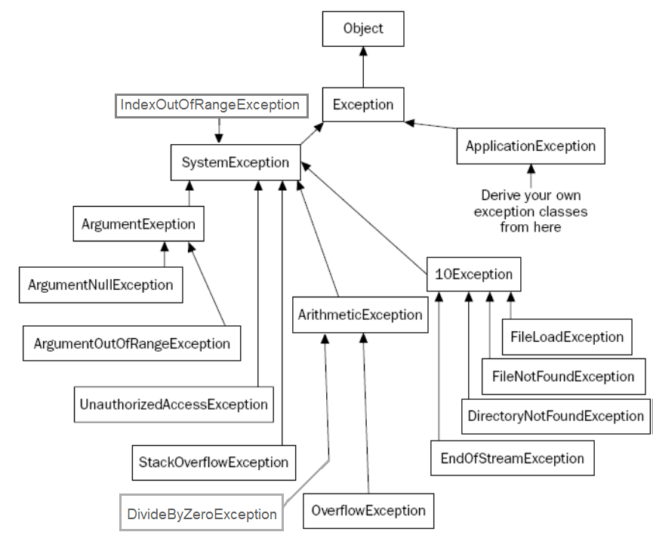
Exception Hierarchy
System namespace

Slide 8

Example: catch handler
using System;
class Div{
public static void Main(){
int k=10, j=0;
try{ k=k/j;
Console.WriteLine("hello");
}catch(DivideByZeroException e){
Console.WriteLine("you are attempting to divide by 0");
}}}

Slide 9
Multiple Exception
Multiple Exception can be handled by using multiple catch.
The subclass exceptions must be handled before the super class exception.
The code below handles 2 exceptions:
using System;
class Div{
public static void Main(string[] s){
try{
int k=Int32.Parse(Console.ReadLine());
j=j/k;
Console.WriteLine("j="+j);

Slide 10
}catch(DivideByZeroException d){
Console.WriteLine("Denominator is 0 " + d.Message); }
catch(FormatException d){
Console.WriteLine("String conversion into number failed "+d.Message);}}}
Execution Path 1:
Denominator is 0 Attempted to divide by zero.
Execution Path 2:
String conversion into number failed Input string was not in a correct format.
Execution Path 3:
i= 2: j=5

Slide 11
Catch-all Exception
All uncaught exception objects can be handled by a catch-all block which catches Exception object(the root class of all exception)
Example:
static void Main(string[] s){
try{
int k = Int32.Parse(Console.ReadLine());
j = j / k;
Console.WriteLine("j=" + j);
Console.WriteLine(s[1]);

Slide 12
}catch (DivideByZeroException d){
Console.WriteLine("Denominator is 0 " + d.Message);
} catch(FormatException d){
Console.WriteLine("String conversion into number failed "+d.Message);}
catch (Exception d){
Console.WriteLine("Some error occurred "+d);}
}
Execution Path:
With no command line argument 2:
j=5
Some error occurred Index was outside the bounds of the array.

Slide 13
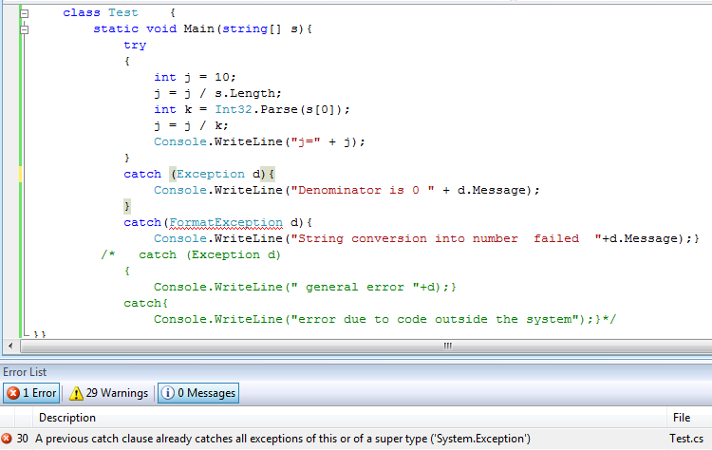
Unreachable exception error

Slide 14
Exception class members
Properties
Message
Gets a message that describes the current exception.
Source
Gets or sets the name of the application or the object that causes the error.
StackTrace
Gets a string representation of the frames on the call stack at the time the current exception was thrown
TargetSite
Gets the method that throws the current exception.
HelpLink
Gets or sets a link to the help file associated with this exception

Slide 15
finally
try block can have a finally block also apart from the catch block.
finally block will execute whether or not an exception occurs.
It is provided so that the clean up code could be written in all cases whether an error occurs or not, like closing of a file, database connection etc.
In C#, a try block must be followed by either a catch or finally block .
Syntax:
try{
//Code that may throw exception
}
[catch(SomeException_class1 e) {}
…
catch(SomeException_classN e) {} ]
[catch(…){}]
[finally{}]

Slide 16

Throwing an exception
It is possible to throw an exception explicitly from code.
This is done using throw keyword.
Syntax:
throw excepobject;
Example:
using System;
class Test {
static void Main(string[] s){
double d1=10,d2=s.Length;
if (d2 == 0) throw new DivideByZeroException();
d1 = d1 / d2; }}

Slide 17
Types of exception
Standard Exception
Exception thrown by the CLR
CLR throws objects of type SystemException
Application Exception
thrown by a user program rather than the runtime.
Inherits from ApplicationException
Exception
SystemException
ApplicationException

Slide 18
Application exception
using System;
class AgeException : ApplicationException{
string s;
public AgeException(string str) {
s=str +" is invalid age. Should be between 1 and 100";
}
public override string ToString(){
return s;
}
}

Slide 19

class Test{
public static void Main() {
try {
Console.WriteLine("enter age");
string s=Console.ReadLine();
int num = Int32.Parse(s);
if(num<1 || num>100)
throw new AgeException(s);
}
catch(AgeException e) {
Console.WriteLine (e);
}
}
}
What will happen if you enter an alphabets instead of number for age?

Slide 20
List of popular exceptions
Exceptions that we have already seen
SystemException, NullReferenceException, DivideByZeroException, TypeInitializationException, ArgumentException, FormatException, IndexOutOfRangeException, InvalidCastException
Other popular exceptions
ArithmeticException: exceptions that occur during arithmetic operations, base class for DivideByZeroException and OverflowException
OverflowException: Thrown when an arithmetic operation in a checked context overflows.
byte b = 255; checked { b++; }

Slide 21
Test your understanding
Will the set of code listed below throw any exception? If so what exception will be thrown. Which line will throw the exception?
1. class A { }
class B : A { }
class C :A{ }
class Test{
static void Main(string[] s) {
A a = new B();
C c = (C)a;
}
}
2. using System;
class Test{
static void Main(string[] s) {
Console.Write(s[0]);
Console.Write(s.Length); }}

Slide 22
3. using System;
class Test{
static Test(){
throw new Exception();
}
static void Main(string[] s) { }
}
4. using System;
class Test{
static void Main(string[] s) {
int b = 1000000000;
b = b * b;
Console.Write(b);
}
}

Slide 23
5. using System;
class Test{
static string str;
static void Main(string[] s) {
Console.Write(str.Length);
}
}
6. class Test{
static void Main() {
for (; ; ) Main();
}
}
7. class Test{
static void Main() {
string[] s = { "abc", "acc", "dd" };
object[] k = (object[])s;
k[0] = 1;
}}

