Slide 1
LINQ
LINQ stands for Language Integrated Query
LINQ is a new technology introduced in .NET 3.5 with Visual Studio 2008 or later versions.
LINQ can be used with C# or Visual Basic.
LINQ is a Object –oriented query language
LINQ (Language Integrated Query) is uniform query syntax used to retrieve data from different data sources like an Object Collection, DB tables, XML etc.
LINQ always works with objects so you can use the same basic coding patterns to query and transform data in XML documents, SQL databases, ADO.NET Datasets, .NET collections, and any other format for which a LINQ provider is available.
Linq uses System.Linq namespace it includes the necessary classes & interfaces for LINQ.

Slide 2
Advantages of LINQ
Familiar language: Developers don’t have to learn a new query language for each type of data source or data format.
Less coding: It reduces the amount of code to be written as compared with a more traditional approach.
Readable code: LINQ makes the code more readable so other developers can easily understand and maintain it.
Standardized way of querying multiple data sources: The same LINQ syntax can be used to query multiple data sources.
Compile time safety of queries: It provides type checking of objects at compile time.
IntelliSense Support: LINQ provides IntelliSense for generic collections.
Shaping data: You can retrieve data in different shapes.

Slide 3
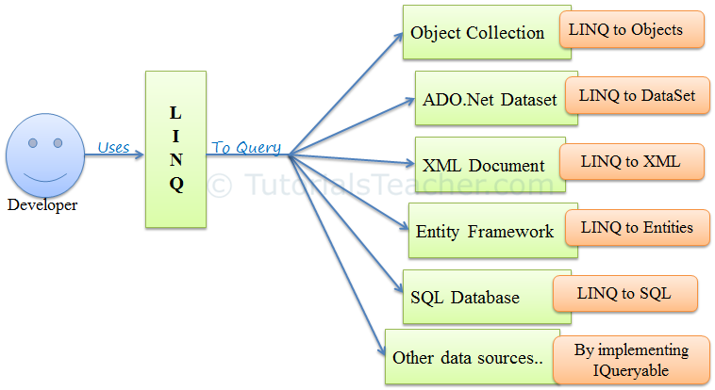
LINQ

Slide 4
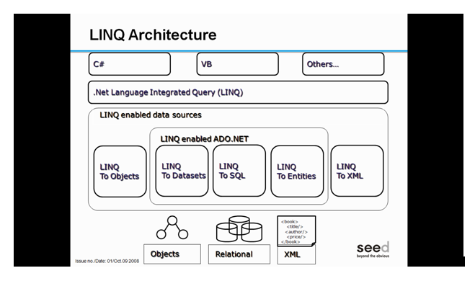

Slide 5
Core Assemblies in LINQ
The core assemblies in LINQ are:
using System.Linq
Provides Classes & Interface to support LINQ Queries
using System.Collections.Generic
Allows the user to create Strongly Typed collections that provide type safety and performance (LINQ to Objects)
using System.Data.Linq
Provides the functionality to access relational databases (LINQ to SQL)
using System.Xml.Linq
Provides the functionality for accessing XML documents using LINQ (LINQ to XML)
using System.Data.Entity
Provides the functionality to access relational databases (Entity Framework)

Slide 6
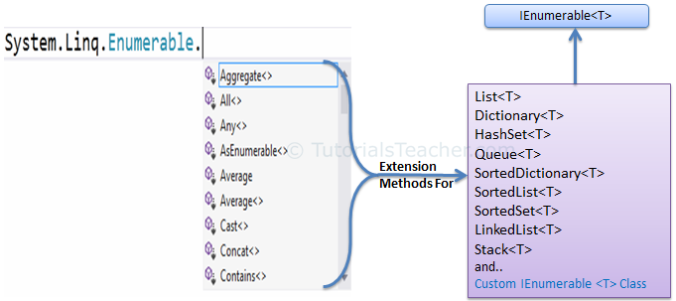
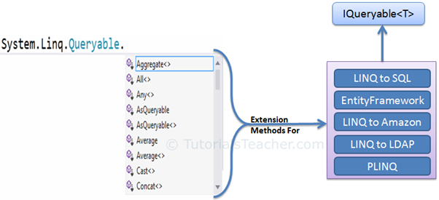
LINQ

Slide 7
LINQ Query Syntax
There are two basic ways to write a LINQ query to IEnumerable collection or IQueryable data sources.
Query Syntax or Query Expression Syntax
Method Syntax or Method extension syntax
Query Syntax:
Query syntax is similar to SQL (Structured Query Language) for the database. It is defined within the C# or VB code.
from <range variable> in <IEnumerable<T> or IQueryable<T> Collection>
<Standard Query Operators>
<select or groupBy operator> <result formation>

Slide 8
LINQ Query Syntax
Declarative query syntax :
var x= from item in data_source
where condition
select item
The query variable x only stores the query commands
The actual execution happens only when some operation is requested like iteration. This is refereed to as deferred execution.
While the syntax allows usage of “var” keyword, what the query really returns is a IEnumerable object.
Hence foreach can be used with the result of LINQ.
Note that LINQ query is case sensitive.

Slide 9
Standard Query Operators
There are over 50 standard query operators available in LINQ that provide different functionalities like filtering, sorting, grouping, aggregation, concatenation, etc.

Slide 10
Classification | Standard Query Operators
Filtering | Where, OfType
Sorting | OrderBy, OrderByDescending, ThenBy, ThenByDescending, Reverse
Grouping | GroupBy, ToLookup
Join | GroupJoin, Join
Projection | Select, SelectMany
Aggregation | Aggregate, Average, Count, LongCount, Max, Min, Sum
Quantifiers | All, Any, Contains
Elements | ElementAt, ElementAtOrDefault, First, FirstOrDefault, Last, LastOrDefault, Single, SingleOrDefault
Set | Distinct, Except, Intersect, Union
Partitioning | Skip, SkipWhile, Take, TakeWhile
Concatenation | Concat
Equality | SequenceEqual
Generation | DefaultEmpty, Empty, Range, Repeat
Conversion | AsEnumerable, AsQueryable, Cast, ToArray, ToDictionary, ToList

Slide 11
LINQ with Objects
The term "LINQ to Objects" refers to the use of LINQ queries Objects that implement IEnumerable , meaning all collection classes like List, Dictionary as well as arrays and string can use LINQ.
The collection name become the data source.
var x= from item in data_source
where condition
select item
The from clause similar to the for-each statement.
An identifier is used to refer to individual item in the collection. The where clause uses this identifier name to filter the collection.
This is a very powerful tool since a collection can be filtered using multiple where conditions. Where clause can use any C# condition that evaluated to a boolean value.
The query returns IEnumerable object.

Slide 12
Query Methods
Query methods provide a short cut way of writing queries.
These methods can be used on any enumerable object.
System.Linq.Enumerable methods have query methods and these extend the functionality of IEnumerable<T>
Methods:
Select
Where
OrderBy, OrderByDescending
Join
GroupBy
Example: var l= FlowerList.Select(e => e.Name);

Slide 13
Other LINQ Methods
All()
Any()
Contains()
Uses the Equals() method of the class to determine if the element specified is in the collection.
First()
Last()

Slide 14
Aggregate methods
Count()
Sum()
Min()
Max()
Average()
These LINQ methods produce single (non-sequential) result. So in such cases, immediate execution takes place.

