Slide 1
React JSX
JSX stands for JavaScript XML.
JSX, or JavaScript XML, is a syntax extension for JavaScript often used with React.
It allows you to write HTML elements and components in a syntax that looks similar to XML or HTML within your JavaScript code.
JSX allows us to write HTML elements in JavaScript and place them in the DOM.
JSX makes it easier and more instinctive to describe the structure of React components.
JSX is an extension of the JavaScript language based on ES6, and is translated into regular JavaScript at runtime.
JSX converts HTML tags into react elements.

Slide 2
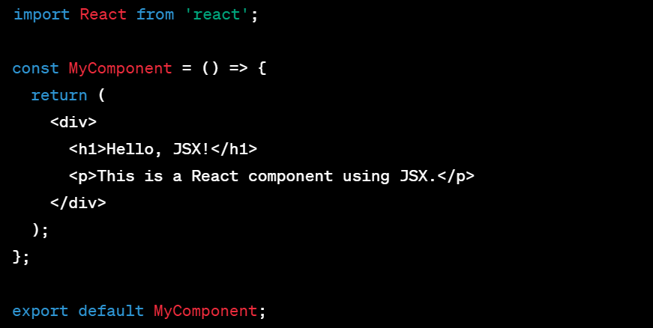
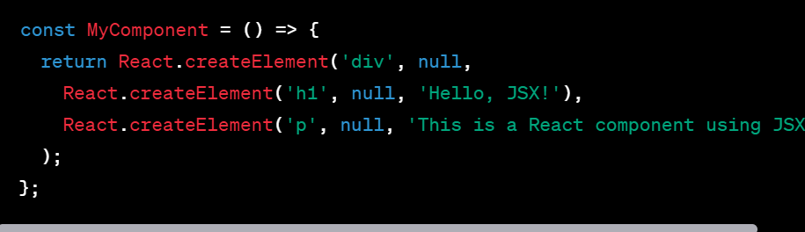
JSX Syntax/JSX for React Components
In the above example:
The return statement contains JSX code.
HTML-like tags (<div>, <h1>, <p>) are used to define the structure of the component.
JavaScript expressions can be embedded within curly braces ({}) to include dynamic content.
JSX gets transformed into JavaScript code before it's rendered by the browser. The example above would be transformed into something
like the following using React.createElement:

Slide 3
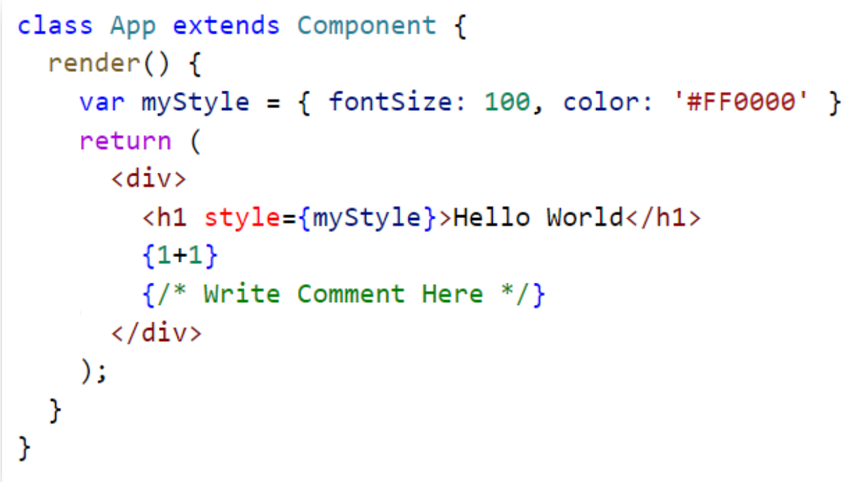
JSX Syntax/JSX for React Components

Slide 4
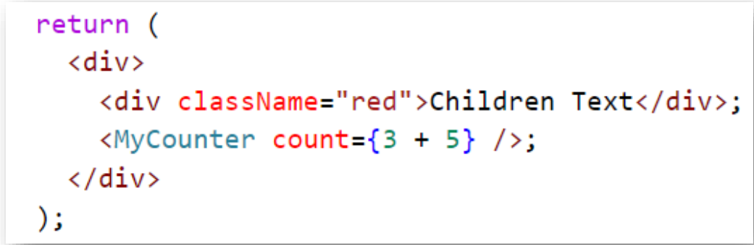
JSX Attributes
JSX tags have a tag name, attributes and children.
If an attribute value is enclosed in quotes then the value is string.
If we wrap the value in curly braces then the value is the enclosed JavaScript expression

Slide 5
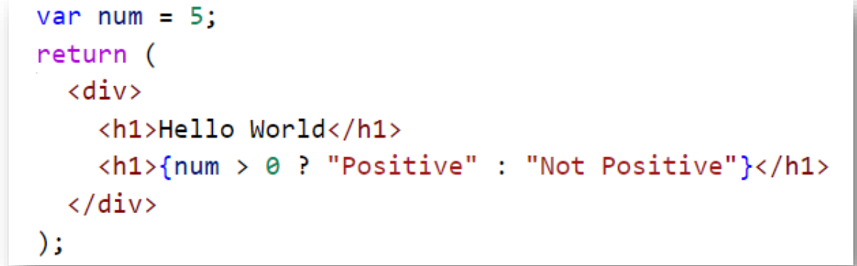
JSX Expressions
JSX expressions needs to wrap within curly brackets { }.
JSX expressions doesn’t encapsulate conditional constructs.
We can use ternary(conditional) expressions for making decisions.

Slide 6
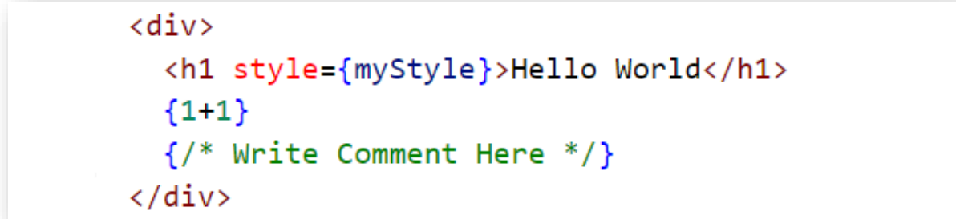
JSX Styling
React allows inline styles.
While using inline styles, We need to use camelCase syntax.

Slide 7
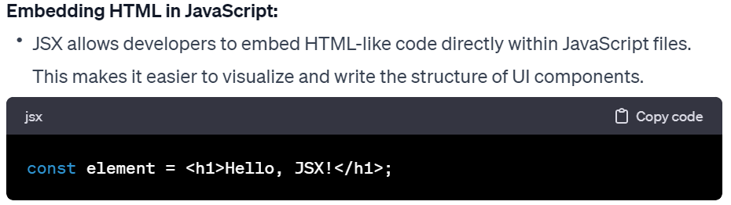
Key points about JSX
Readability: JSX makes the code more readable and resembles the HTML structure of the rendered components.
Expressiveness: JSX allows you to express the intended UI structure and hierarchy more naturally.
JavaScript Expressions: You can embed JavaScript expressions within curly braces ‘{ }’ to include dynamic content, variables, or execute functions.
Babel Transformation: JSX is not directly understood by browsers, so it needs to be transformed into JavaScript using tools like Babel as part of the build process.

Slide 8
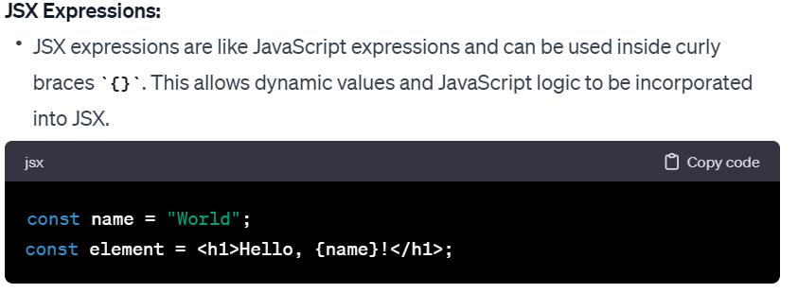
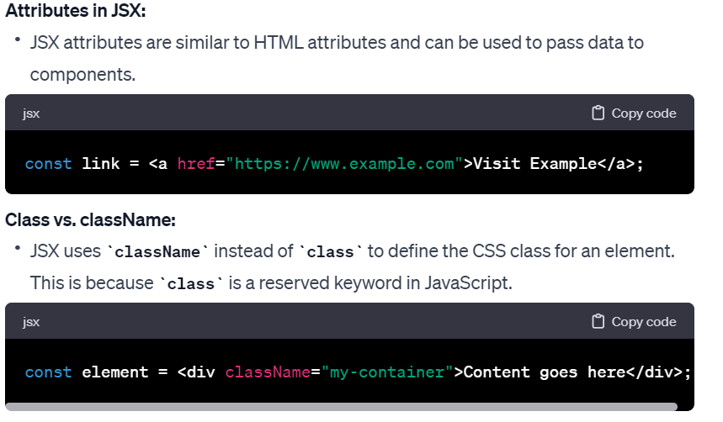
Key points about JSX

Slide 9
Key points about JSX
JSX is not Required:
While JSX is a common and recommended syntax for writing React components, it is not mandatory. React can also be written using pure JavaScript without JSX. However, JSX is widely adopted due to its readability and expressiveness.
Using JSX in React is a convenient way to write UI components, and it is a core part of the React development experience. The Babel transpiler is commonly used to convert JSX code into JavaScript that browsers can understand.

