Slide 1
Unit Testing for React Apps
Unit Testing is a testing method that tests an individual unit of software in isolation.
Unit testing for React Apps means testing an individual React Component.
Unit Testing is important for React Apps, as it helps in testing the individual functionality of React components. Moreover, any error in code can be identified at the beginning itself, saving time to rectify it at later stages.
Unit testing is the easiest way to improve the quality of your React applications since it helps in finding bugs and defects in your code.
Moreover, the early discovery of code bugs in the SDLC reduces the overall cost of development because less time is spent on bug fixing in the later stage of the project.
This leads to overall customer satisfaction and helps in gaining more trustworthy clients.

Slide 2
Benefits of Unit Testing
Process Becomes Agile: Agile Testing process is the main advantage of unit testing. When you add more features to the software, it might affect the older designs and you might need to make changes to the old design and code later. This can be expensive and require extra effort. But if you do unit testing, the whole process becomes much faster and easier.
Quality of code: Unit testing significantly improves the quality of the code. It helps developers to identify the smallest defects that can be present in the units before they go for the integration testing.
Facilitates change: Refactoring the code or updating the system library becomes much easier when you test each component of the app individually.
Smooth Debugging: The debugging process is very simplified by doing unit testing. If a certain test fails, then only the latest changes that have been made to the code need to be debugged.
Reduction in cost: When bugs are detected at an early stage, through unit testing, they can be fixed at almost no cost as compared to a later stage, let’s say during production, which can be really expensive.

Slide 3
Unit testing of React Apps using JEST?
Jest is a JavaScript testing framework that allows developers to run tests on JavaScript and TypeScript code and can be easily integrated with React JS.
Jest is an open-source test framework created by Facebook that has a great integration with React.js.
In React, the most often used test runner is Jest. We can run Jest in watch mode, which can run our tests every time we save the file.
Jest is a test runner that runs all our test suites and test cases.
It includes a command line tool for test execution similar to what Jasmine and Mocha offer.
It also allows us to create mock functions with almost zero configuration and provides a really nice set of matchers that makes assertions easier to read.
it offers a really nice feature called “snapshot testing,” which helps us check and verify the component rendering result.

Slide 4
Unit testing of React Apps using JEST
Any test in React, no matter how complicated, follows this structure:
Render the component
Get an element from the component and simulate any user interactions
Write an assertion.

Slide 5
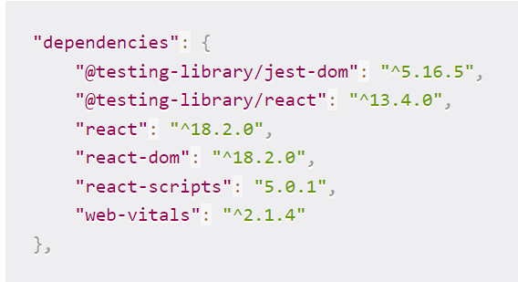
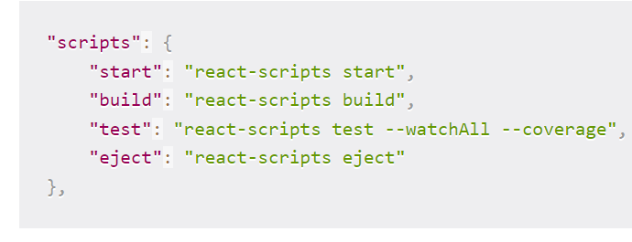
How to Set Up Our Project
We’ll be using Jest and React Testing Library.
Both of them come pre - installed with create-react-app
Also, make sure you have the following lines in your setupTests.js file.
import '@testing-library/jest-dom';
import '@testing-library/jest-dom/extend-expect’;
Also, in your package.json file, modify your scripts like this:

Slide 6
Code Coverage using Jest
Code Coverage means determining how much code has been executed while running the test.
Generating a code coverage with jest is quite simple. If you are using npm, run the below code to get the code coverage
npm test – –coverage

Slide 7
Best practices for testing React Apps with JEST
Avoid unnecessary tests: Consider a test where you expect some element to be defined and then expect it to have some property on it. Now the latter one becomes unnecessary, because what is the point if the element was not defined at all.
Don’t test implementation details: If your test does something that your user doesn’t, chances are that you are testing implementation details. For example, you may be exposing a private function just to test your component. This is a code smell — don’t do it. A refactor can easily break your test.
Push business logic into pure functions rather than UI components: Consider, having a Shopping Cart UI component that should not compute the cart total. This should be pushed to a pure function because it is easier to test.

