Slide 1
Welcome to
React JS (Demo Session)
By
MindMajix

Slide 2
Welcome To MindMajix
Mindmajix is a leading global online training platform, holding 8+ years of experience in all IT courses.
Achievements of MindMajix so far:
We believe in delivering Qualitative Training and have got more than 400 IT Courses to our library.
Successful in training more than 400k students and professionals around the globe.
Experienced trainers with more than 10 years of domain expertise.
We are corporate favourite training partner to the firms who are market leaders in delivering services

Slide 3
Trainer Profile
Name : Mr. Santhosh
Experience : Having total 14yrs of exp,
Presently working for MindMajix.

Slide 4
Course Curriculum
Course Contents:

Slide 5
Today’s Agenda
What is React JS?
Why is React used for building User Interfaces?
Getting Started with React JS Framework
Introduction to React Building Blocks
JSX, Transpiler, Virtual DOM,
Components, Props, States, Events.
Component Lifecycle, Router, Forms, Refs
List of React Developer Tools
React Components Page View
Kind of Applications you can build with "React Approach“
How to Build First React Application
Career and Job rising opportunities for React developers

Slide 6

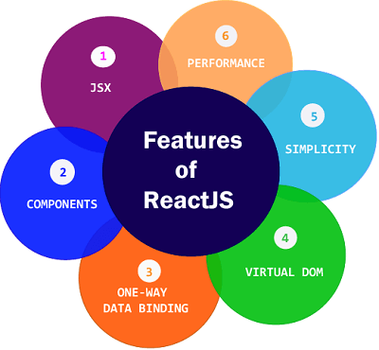
What is React JS
ReactJS is a JavaScript library for building ‘User Interfaces’. It is maintained by 'Facebook and a community of individual developers and companies’. React can be used as a base in the 'development of Single Page or Mobile Applications’
JavaScript libraries are collections of pre-written JavaScript code that can be used for common JS tasks, allowing you to bypass the time intensive (and unnecessary) process of coding by hand.

Slide 7
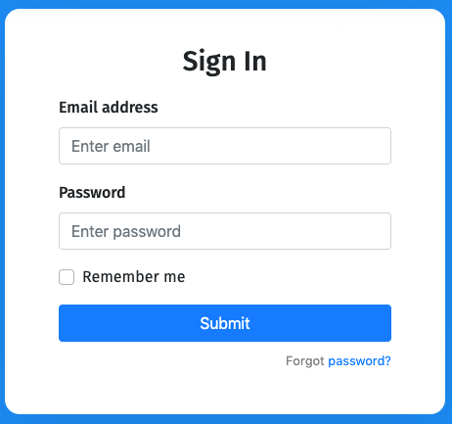
Why is ReactJS used for building User Interfaces?
What is User Interfaces?
ReactJs or React is a declarative, efficient, and a flexible JavaScript library for building user interfaces. It lets you compose complex UI’s from small and isolated pieces of code called components.” - ReactJs. ReactJs allows to fragment website into several individual components.

Slide 8
Getting started with ReactJS Framework
React JS is not a framework. We know that React is really good at handling the view. React allows you to recycle components multiple times in a single web application.
React is a library for building composable user interfaces. It encourages the creation of reusable UI components which present data that changes over time.
The key difference between a library and a framework is "Inversion of Control". When you call a method from a library, you are in control. But with a framework, the control is inverted: the framework calls you. A library is just a collection of class definitions

Slide 9
Introduction to React JS Building Blocks
React Js as a library for developing front end web applications is composed of various building blocks, which when interweave with each other, leads to the development of full fledged front end web applications.
JSX : Before starting to discussing any concept of React, we must always remember that everything in react is JS (JavaScript) even if doesn't look like it!
var jsxelement = <h1>hi!</h1>;
Transpiler : Transpilers, or source-to-source compilers, are tools that read source code written in one programming language, and produce the equivalent code in another language.
Virtual DOM : Like the actual DOM, the Virtual DOM is a node tree that lists elements and their attributes and content as objects and properties. React's render() method creates a node tree from React components and updates this tree in response to mutations in the data model, caused by actions

Slide 10
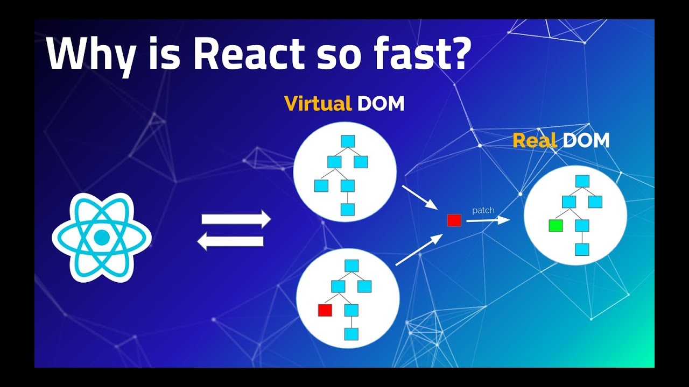
Introduction to React JS Building Blocks
.

Slide 11
Introduction to React JS Building Blocks
Components : Components are the building blocks of any React app and a typical React app will have many of these. Simply put, a component is a JavaScript class or function that optionally accepts inputs i.e. properties(props) and returns a React element that describes how a section of the UI (User Interface) should appear.
Props : Props are simply the attributes used on a JSX node. Ex., <FirstComponent exampleProp="this is a string given as a prop’s value" />
States : State in React components is essential to manage and communicate data in your application. It is represented as a JavaScript object and has component level scope, it can be thought of as the private data of your component.

Slide 12




List of ReactJS Developer Tools
Here you have a list of the powerful react developer tools that empower developers to boost their productivity by
Bit
React Sight
React Developers Tools
Create React App
Storybook
Storybook
React Bootstrap
React Styleguideist
Proton Native
React-Proto
info@mindmajix.com
India: +91 9246333245, USA: +1 917 456 8403

Slide 13
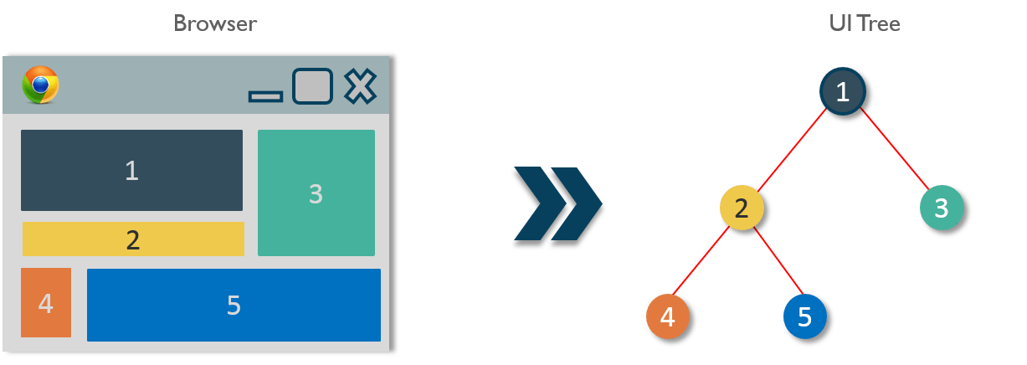
ReactJS Components Page View
Here a look at the sample page design & develop with components page view
info@mindmajix.com
India: +91 9246333245, USA: +1 917 456 8403

Slide 14
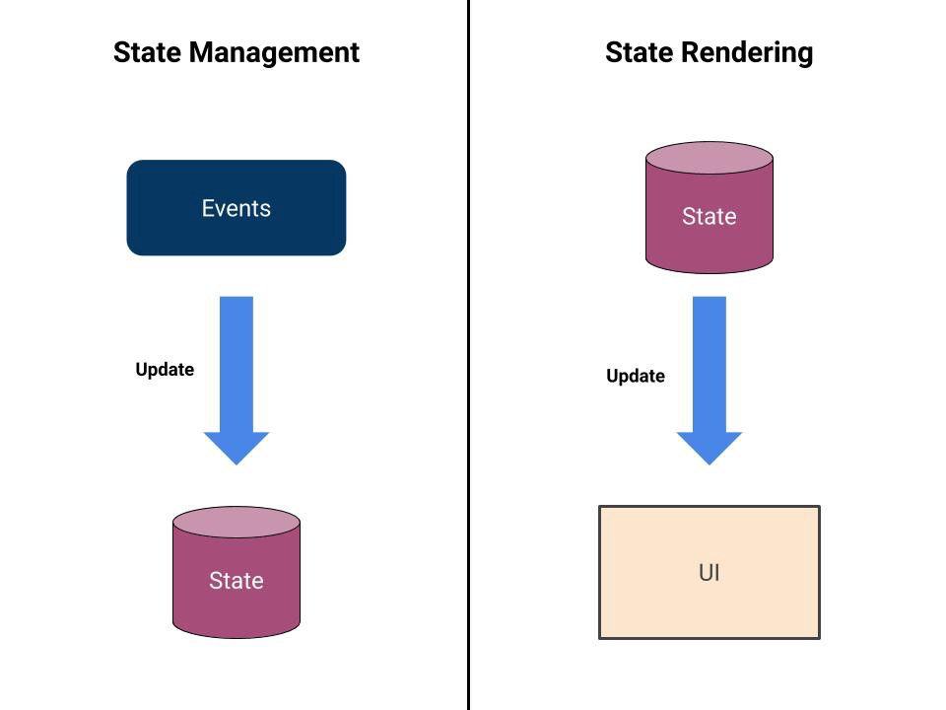
ReactJS Approach
You should split the task in at-least these two pieces: State Management and State Rendering.
info@mindmajix.com
India: +91 9246333245, USA: +1 917 456 8403

Slide 15
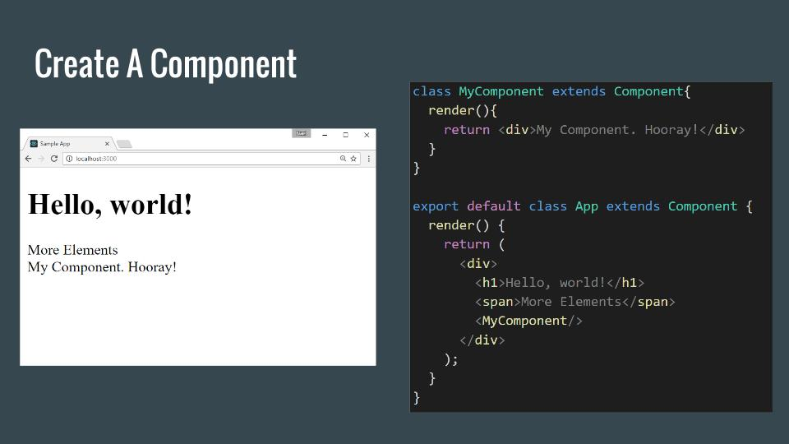
How to build ReactJS First Application
Here a look at the sample code design & develop with react first application
info@mindmajix.com
India: +91 9246333245, USA: +1 917 456 8403

Slide 16
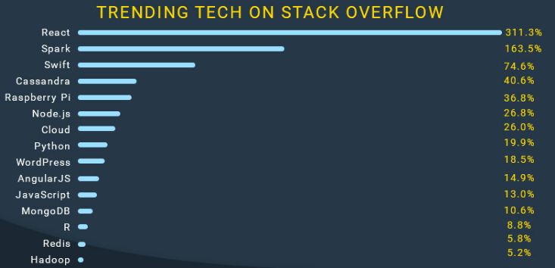
Career and Job opportunities for ReactJS Developers
REACTJS-THE BEST BET FOR DEVELOPER JOBS:- Yes it is currently most in demand because of one of the reason most of us are running after either Data Science or Python because of the hype around it. So very few people are opting for it. So huge demand but no much supply.

Slide 17
Career and Job opportunities for ReactJS Developers
Other good things:
Only Front End.
No need to learn SQL, any other skill.
One language only-JavaScript.
Very much doable.
Focus on only one thing.
Salary as good as full stack developer

Slide 18
Certifications Available
Mindmajix ReactJS Training covers all the essentials of ReactJS including JSX, components, frameworks, architecture, and more. This course will help you to become familiar with the fundamental processes and the skills you need to become a certified ReactJS developer.
You’ll also explore advanced concepts like API, Hooks, performance optimization, testing and deploying ReactJS applications with real-time examples and projects. Our React online course follows the industry’s best practices for modern React development

Slide 19
Projects we will Demonstrate
Project - One
Description of the project.
System requirements.
Project execution.
Project - Two
Description of the project.
System requirements.
Project execution.

Slide 20
Lab Setup
We will assist you to install in your laptop. Learner can use it life time.

Slide 21
Additional Course Resources
Session videos
Documentations
Useful references
Sample resumes
Resume preparation guidance

Slide 22
Course Demo Questionnaire
Any doubts regarding the subject is discussed here.
Any questions regarding course timings, resource allocation can be discussed with MindMajix.

Slide 23
We value your feedback
Thank YOU..!!
**We appreciate your feedback and this will help us improve in delivering qualitative trainings further.

